Slide 1
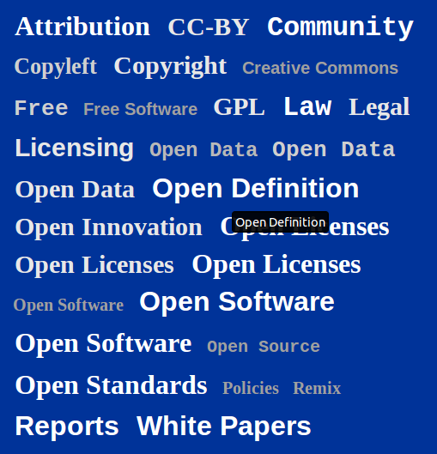
Morus
Legal and practical advise on openness

Slide 2
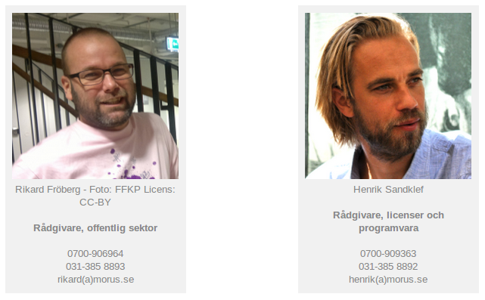

Team
Rikard - full time advisor
Henrik - Founder, CEO and part time advisor
Jonas - Founder and Chairman
Victor - Accounting and financials

Slide 3
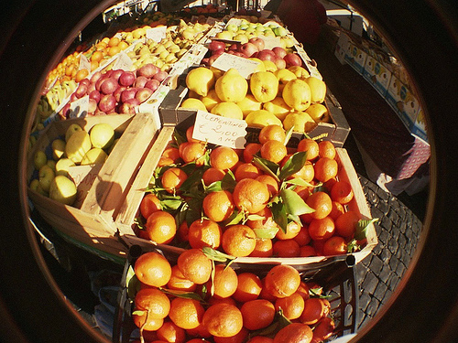
Market
Public sector
  Municipalities (Open Data)
  Authorities and PSBs (Open Data, licensing)
NGOs (Licensing, legal)
Projects (Licensing, best practices)
Private sector (Open business models, licensing)

Slide 4

Opportunities
Much ado about open data
Much confusion and insecurity around o.d.
Open Software gaining acceptance
License issues around FOSS very complex
Open Licensing gaining acceptance
Much confusion around open licenses
We offer mentorship, advise and analysis

Slide 5
Business concept
We provide
  Neutral advice around openness
  Expertise and long experience from FOSS
  Expertise and long experience from open licenses
We aim to
  Promote and support openness
  Safeguard that openness is implemented correctly and in line with overall goals of our customers

Slide 6
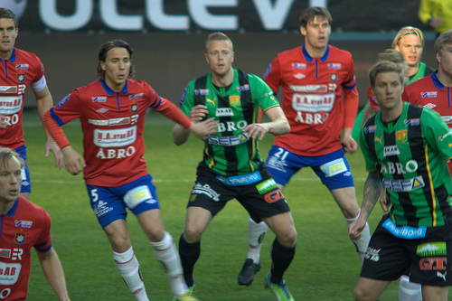
Competition
No direct competition within primary focus
Most indirect competition comes from vendors
Some competition from NGO:s
We work together with said NGO:s

Slide 7
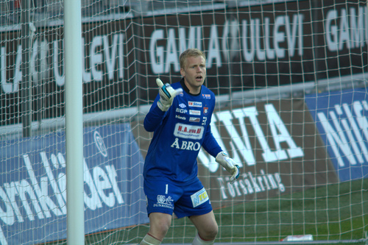
Goals
Organic growth
Become the de facto authority within our field
Have fun at work
Work with fun stuff
Contribute to openness on a professional level

Slide 8
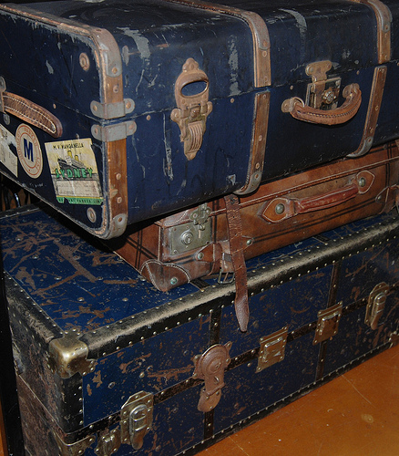
Cases
Gov. funded project helping municipalities with open data
Mentorship in municipality open data project
Expertise and evaluation for major gov. body open data project
License inventory and evaluation for EU funded open source project
FOSS expertise in Italian e-service project

Slide 9
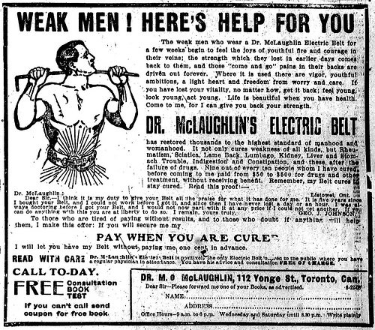
PR
Yes, we should do that, only... we're busy ;-)
We rely heavily on our networks
  Academic context
  Creative Commons
  FSFE, FSF, GNU, legal network
  Municipalities, Kivos etc
  Industry and previous projects

Slide 10
Images
Patentkork by blondinrikard CC-BY http://creativecommons.org/licenses/by/2.0/deed.en http://www.flickr.com/photos/blondinrikard/8833668852/
Market Day by James & Vilija CC-BY-SA http://creativecommons.org/licenses/by-sa/2.0/ http://www.flickr.com/photos/jmanners/428413630/
Punctuation marks made of puzzle pieces by Horia Varlan CC-BY http://creativecommons.org/licenses/by/2.0/deed.en http://www.flickr.com/photos/horiavarlan/4273913966/
ÖIS-GAIS by blondinrikard CC-BY http://creativecommons.org/licenses/by/2.0/deed.en http://www.flickr.com/photos/blondinrikard/8727903785/in/set-72157633454868399
Ring mig sen! by blondinrikard CC-BY http://creativecommons.org/licenses/by/2.0/deed.en http://www.flickr.com/photos/blondinrikard/8729023942/in/set-72157633454868399
Cases of yesteryear by kiwinz CC-BY http://creativecommons.org/licenses/by/2.0/deed.en http://www.flickr.com/photos/kiwinz/3792754955/
Vintage Ad #621: Weak Men! Here's Help For You by Jamie (Source: The Toronto World, September 20, 1908) CC-BY http://creativecommons.org/licenses/by/2.0/deed.en http://www.flickr.com/photos/jbcurio/2903834836/

