Slide 1
Introduction in Information Technology
Unit 2
Updated by Omar Issa

Slide 2
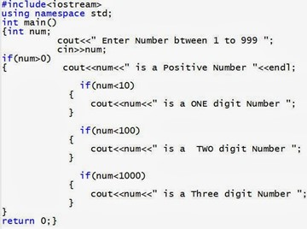
Problem Solving using programs
You can solve problems using a computer by building a program.
A program is a sequence of instructions to control the operation of a computer.
For the computer to execute a program, it must be written in a language that the computer can understand, in other words a programming language.

Slide 3
Steps to building a program (Problem Solving Steps)
Investigation and Analysis: starts with understanding the problem and then analyzing the requirements of the program
Design: stating the logical steps for solving the problem, these steps can be written as an Algorithm or drawn as a Flowchart
Implementation: building the program using a programing language
Testing and Maintenance: thoroughly checking the program and validating the output of the program against different inputs, then fixing any errors and continuously updating the program

Slide 4
Algorithms
Before writing a program using a programing language, it is important to form a clear vision of the steps that will constitute the program, and the logical sequence of those steps, these logical steps are known as an Algorithm.
An algorithm can be presented via two methods:
Pseudocode
Flowchart

Slide 5
Pseudocode
Pseudocode is using simple English language to write algorithms, when writing a Pseudocode there is no need to follow the syntax of a specific programming language.

Slide 6
Pseudocode & Algorithm
Example - Pseudocode
Write an algorithm to determine a student’s average grade and indicate whether it is passing or failing. The final grade is calculated as the average of his marks in courses.

Slide 7
Pseudocode & Algorithm
Pseudocode:
Input a set of marks for the courses
Calculate their average
Print the Average of the marks
if average is above or equal 50
Print “Pass”
else
Print “Fail”

Slide 8
Introduction to Flowcharts
A flowchart is a graphical representation of the sequence of operations in a program.
Flowcharts are similar to Pseudocode in their function.

Slide 9
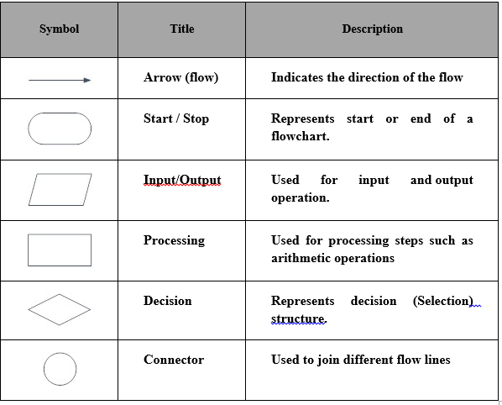
Flowchart Symbols

Slide 10
Types of logic structures
Sequential logic structure.
Selection (decision) logic structure.
Repetition (loop) logic structure.

Slide 11
1-Sequenence Structure
Executing instructions one after another in a sequence.

Slide 12
Example – Sequence Structure Flowchart
Draw a flowchart for a program that that calculates the Area of a Rectangle by asking the user to input the values of the Length and the Width of a rectangle, and then it calculates the Area of the rectangle
(Area = Length * Width),
and displays the result on the computer screen.

Slide 13
Example – Sequence Structure Flowchart
Draw a flowchart for a program that that calculates the Area of a Rectangle by asking the user to input the values of the Length and the Width of a rectangle, and then it calculates the Area of the rectangle
(Area = Length * Width),
and displays the result on the computer screen.

Slide 14
2- Selection (Decision) Structure
This Structure is composed of two sets of instructions, one of which will be executed, while the other will be skipped.
The decision shape is used, it has one input, and two outputs.
Only one of the two outputs will be selected, the selection decision is based on the result of evaluating the condition; the result can be either True or False.

Slide 15
Example - Selection Structure
Draw a flowchart of a program that receives as inputs two different numbers, then determines the which one is the largest value and prints the largest value on the computer screen.

Slide 16
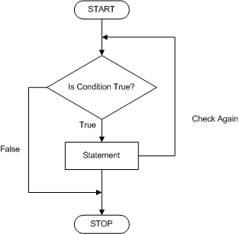
3- Repetition (Loop) Structure
In this structure, instructions are executed repeatedly as long as the result of the condition remains True. It will stop the repetition when the result of the condition becomes False.

Slide 17
What is the output of this flowchart?
Answer: 2 3

Slide 18
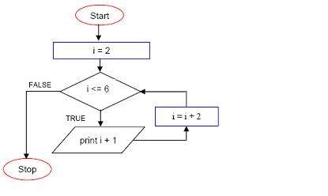
What is the output of this flowchart?
Answer: 3 5 7

Slide 19
References
1] J. Glenn Brookshear; Dennis Brylow (2015). Computer Science: An Overview, 12th Edition. ISBN 13: 978-1-292-06116-0.
[2] Ralph M. Stair & George W. Reynolds (2017). Principles of Information Systems , 13th Edition, Cengage Learning

