Slide 1
WELCOME

Slide 2
E-COMMERCE SITE

Slide 3
GROUP MEMBERS
Md. Akbar Hossain 17182103358
Md. Shahria Alam 17182103247
Md. Safayetur Rahman Jim 17182103237
Sadia Islam Sharna 17182103266
UNDER THE SUPERVISION OF
MD. Mijanur Rahman
Assistant Professor
Department of CSE
BUBT

Slide 4
OBJECTIVES:
Primary Requirement
Easily show-able products with category.
Shopping cart available for select required product.
Customer can confirm order for buy product.
Payment process via online.
Product review system for customer.
Product rating system will be added.
There also be added question, comment and reply system.
Secondary Requirement
Add tracking system

Slide 5
USED SERVER, LANGUAGE, FRAME WORK & DATABASE:
Server
XAMPP
Language
PYTHON
Frame Work
DJANGO
Designing Languages
HTML
CSS
JQUERY
Database Management
My SQL

Slide 6
OUTCOMES:
An online shop full of various products with different category.
These results a dynamic and easily browse-able site.
Customers easily justify the product quality.
Opportunity for customers to message the seller and get reply.
A good way to express their satisfaction through the product rating system and comment.

Slide 7
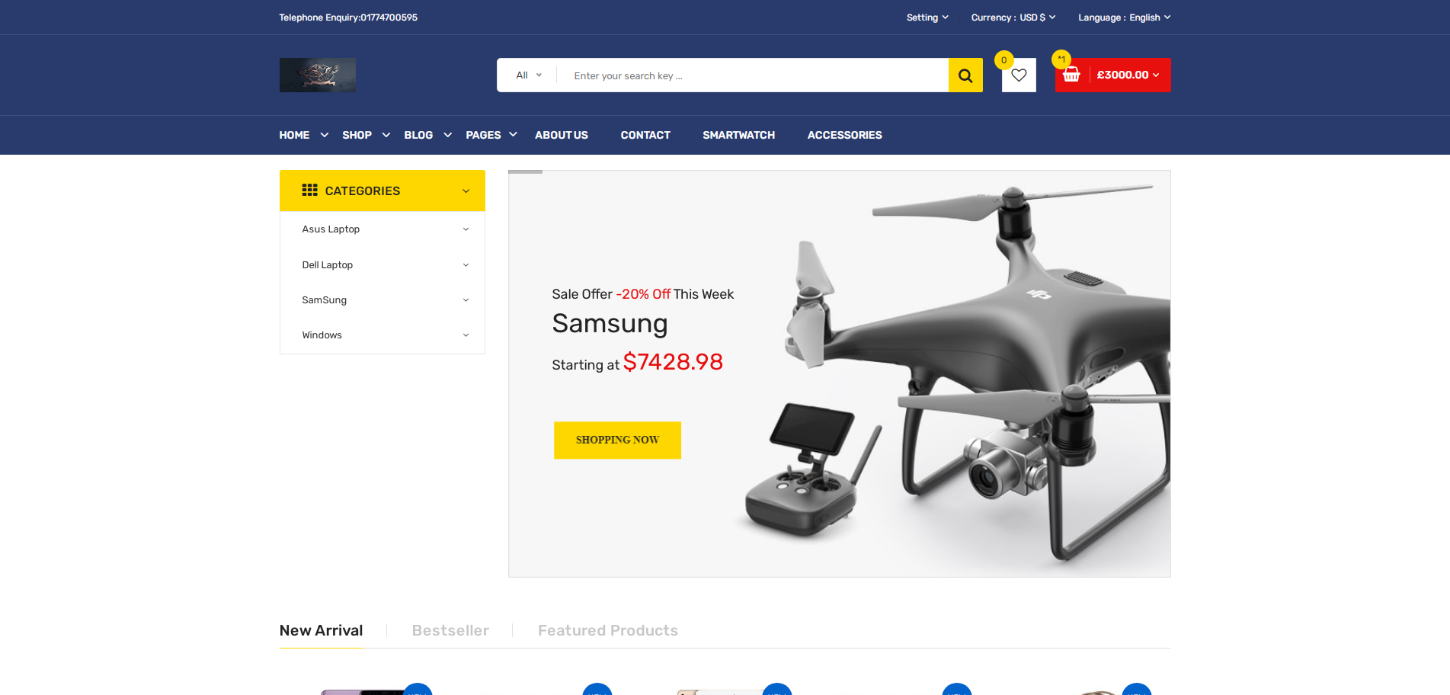
About Our Project

Slide 8
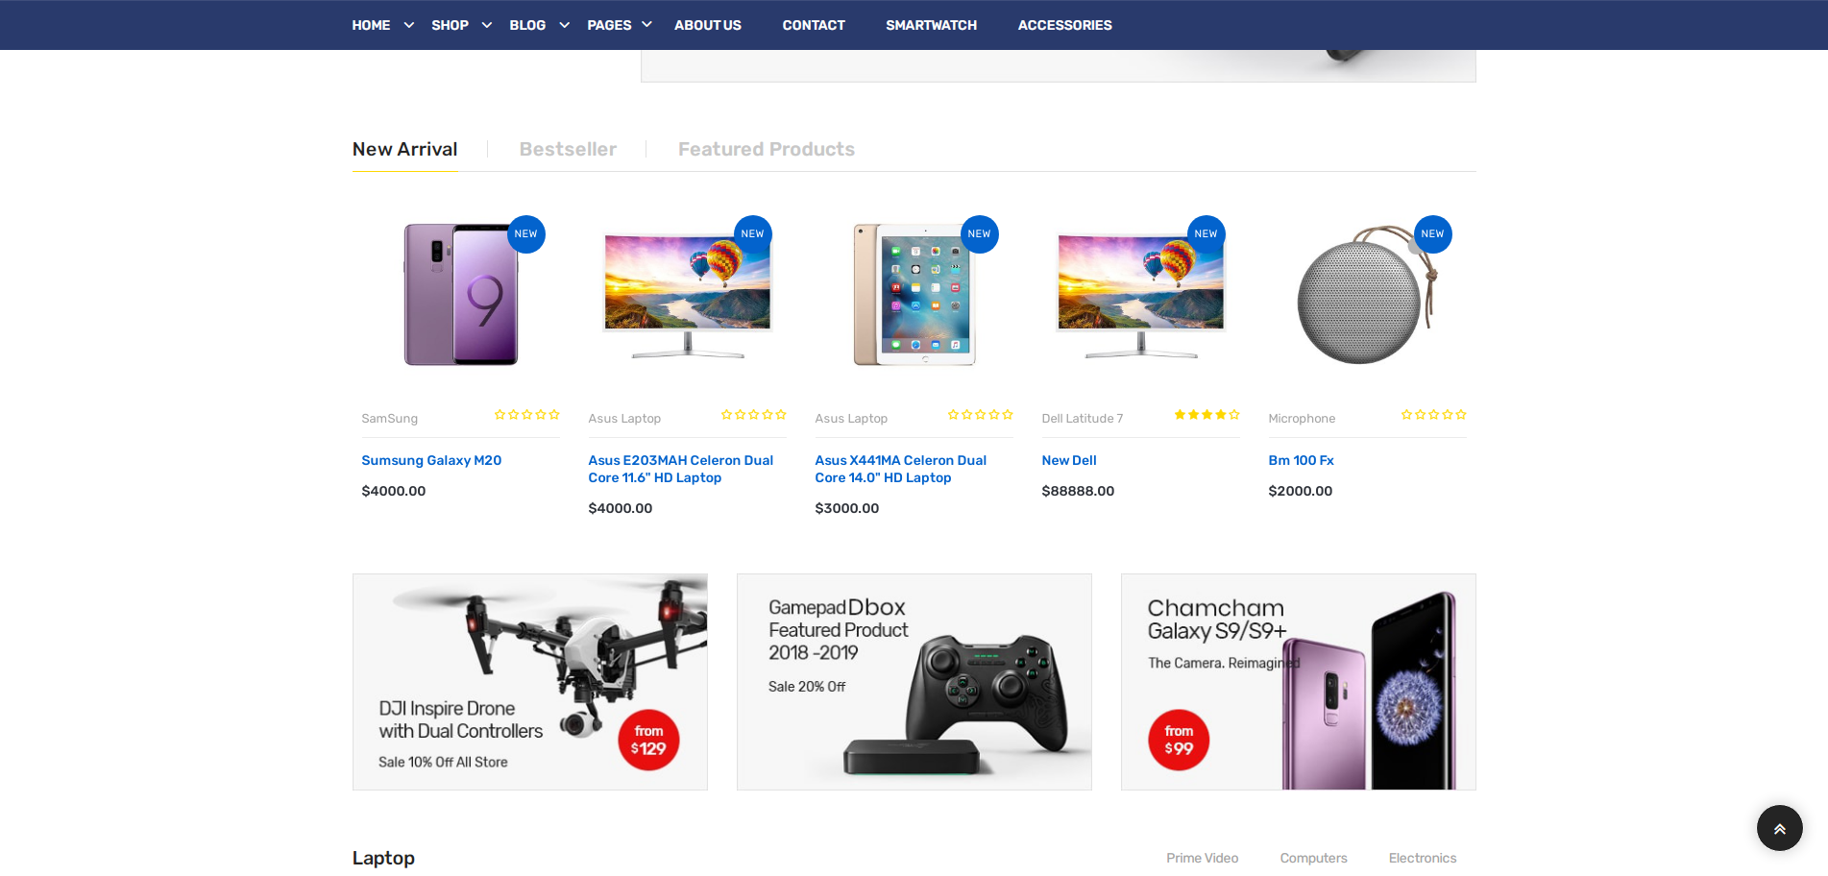

Slide 9
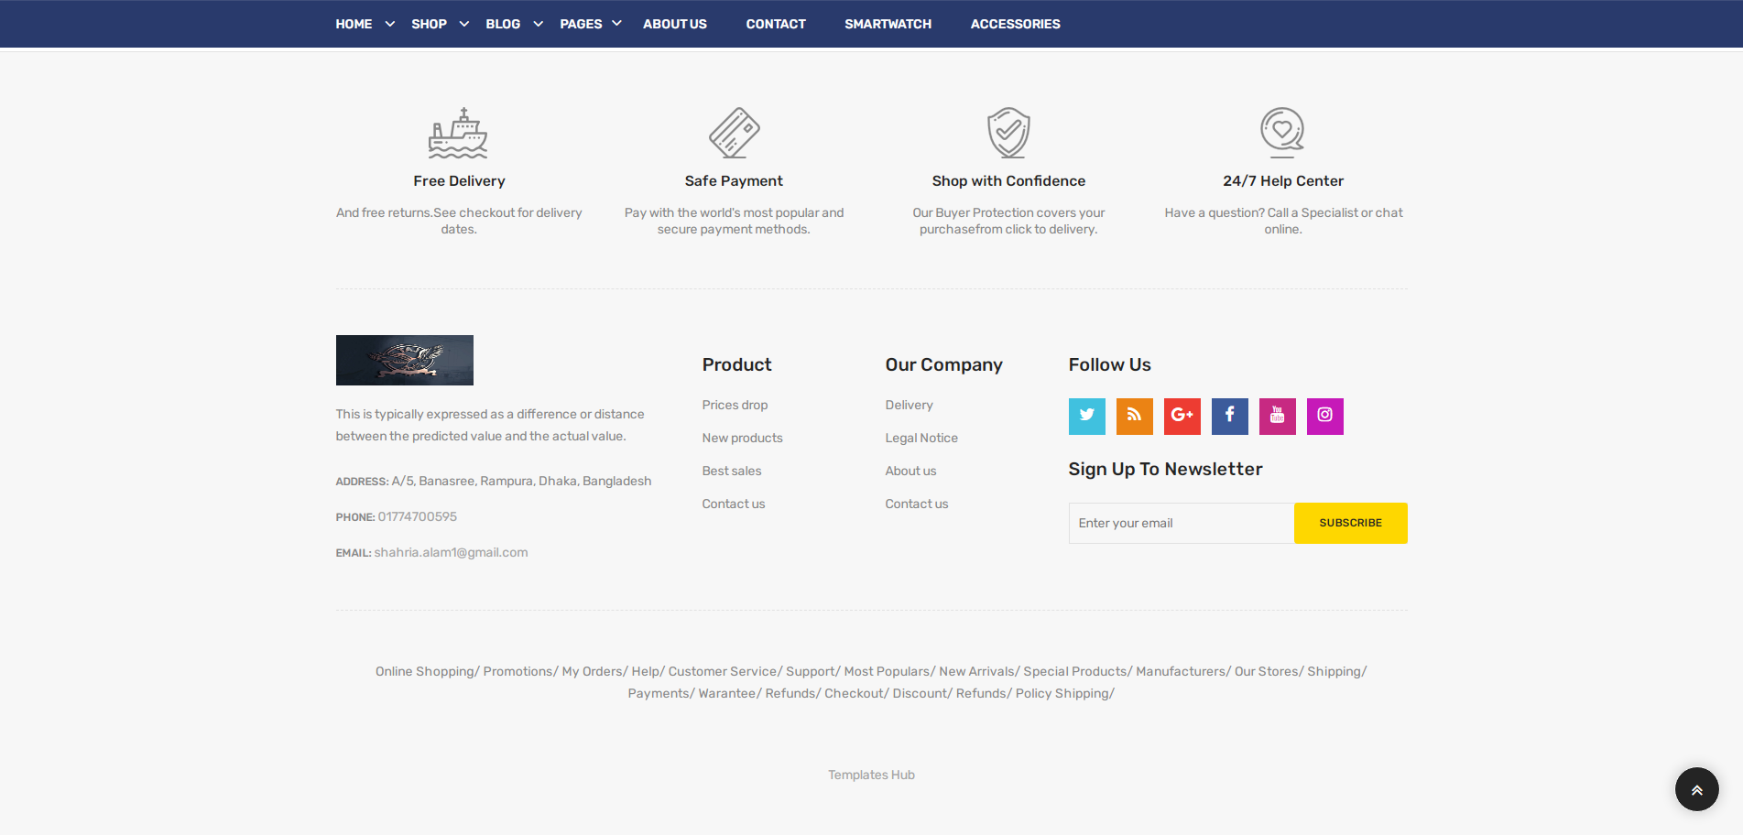

Slide 10
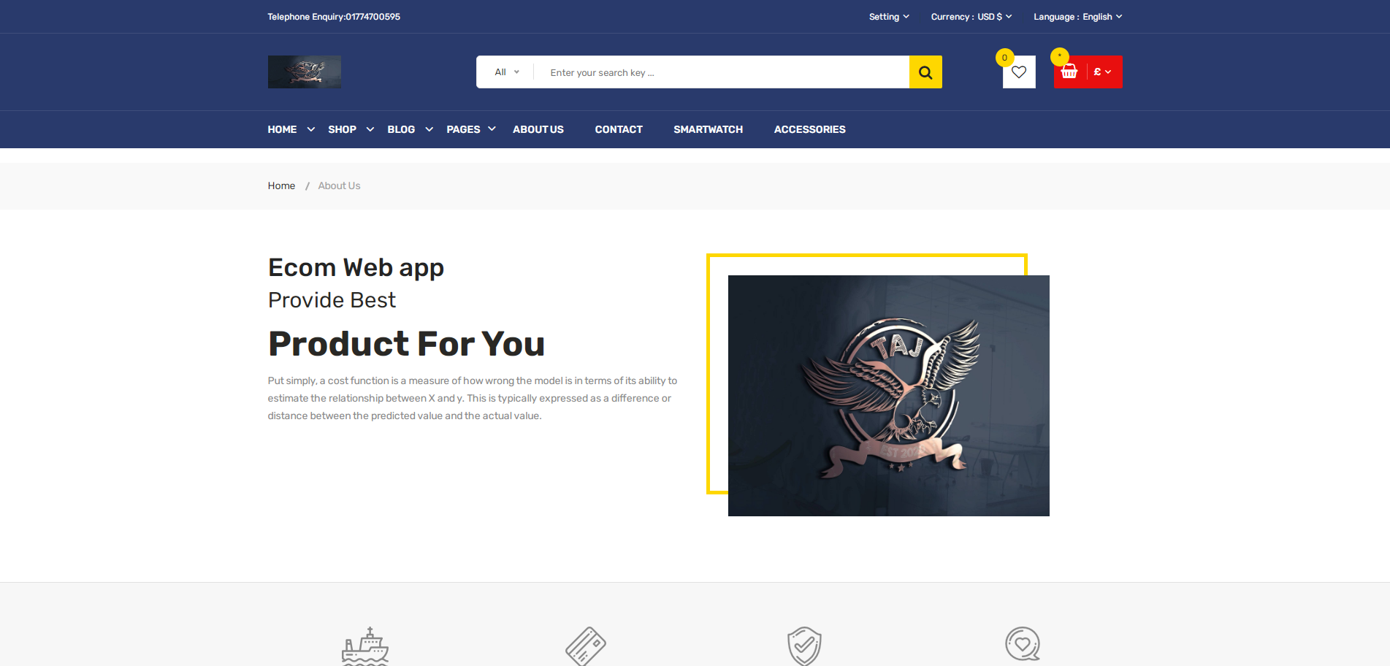

Slide 11
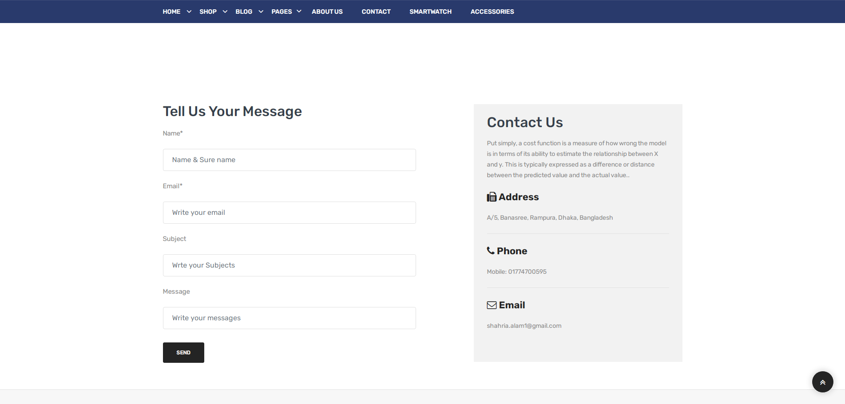

Slide 12
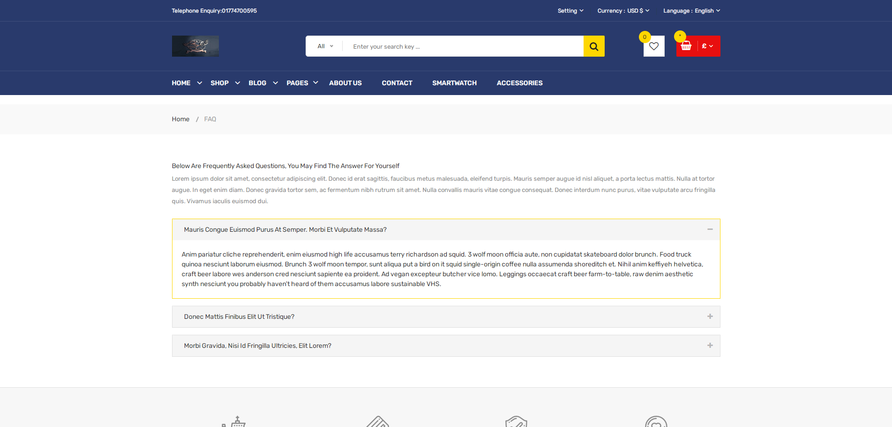

Slide 13
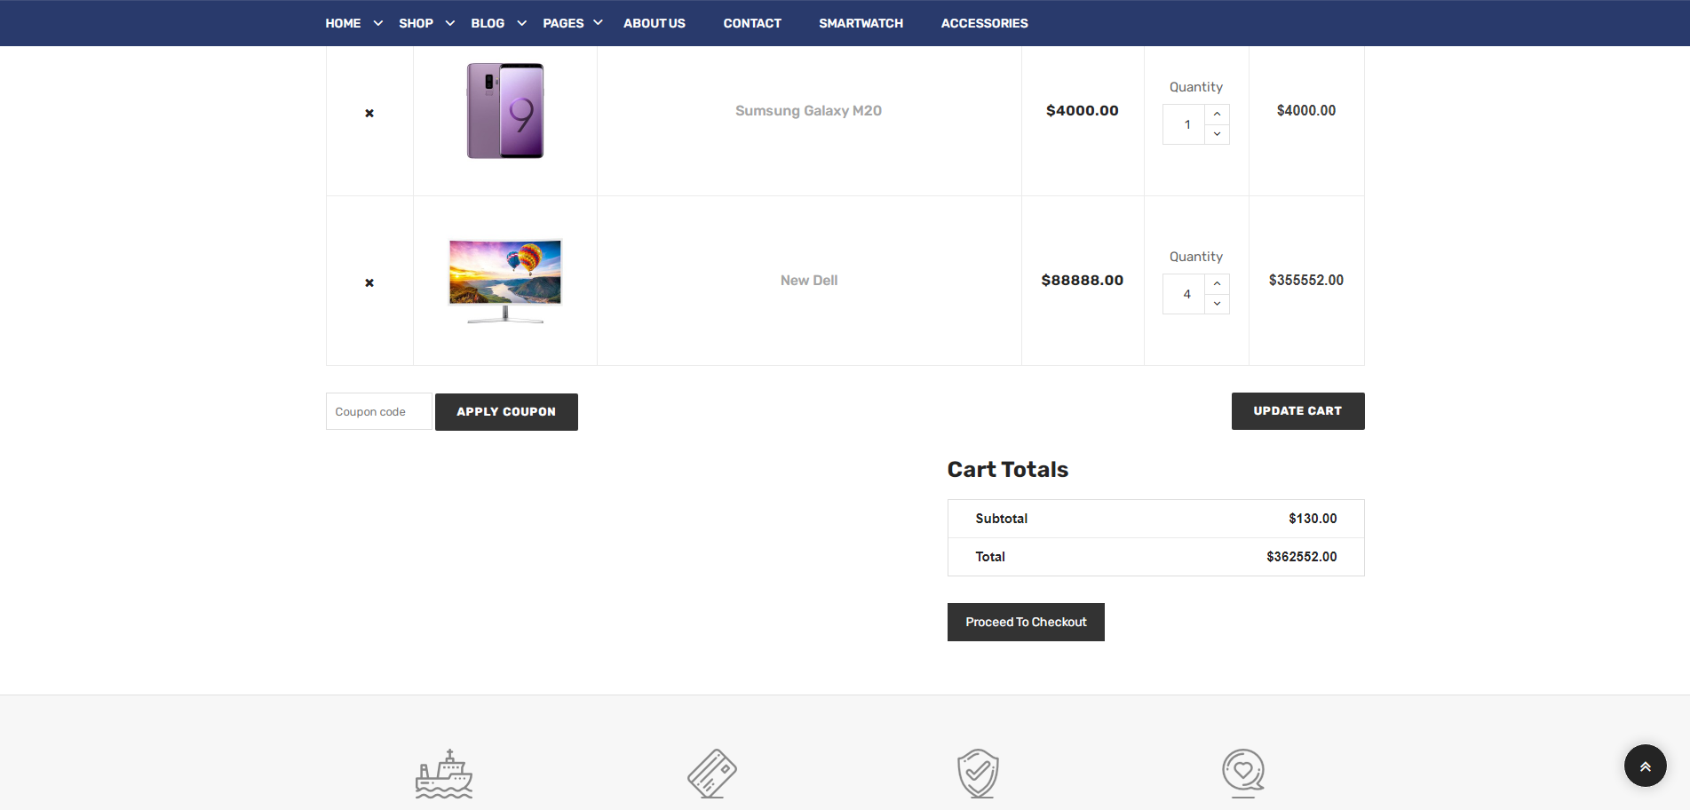

Slide 14
CURRENT LIMITATIONS:
Complicated to searching details of products.
No question and answer system.
No product review and rating system.

Slide 15


