Slide 1

Connected Cars
Mosaab Muhammed
Al-Azhar University

Slide 2
Scenario
From Cars to Cloud then to HDFS

Slide 3
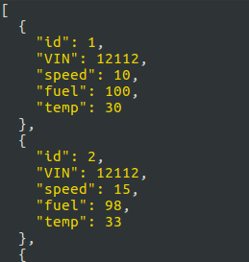
Car Simulators
First, I build a car simulator for 10 cars writing in
python.
Each simulator takes the information of the
car (VIN, Fuel, Temperature, Speed) from
(car1.json).
The following image shows a sample of
how this data looks like in the file.
The Code of the simulator for each car,
you can see it in CarSim Folder.

Slide 4
Spring Cloud Data Flow
Then after each car sends data to Spring CDF, Spring tries to
save it to HDFS (Hadoop).
The following code shows how I accomplished this methodology in
Spring CDF, by creating a stream and defining to take HTTP request
from the simulator then save it to HDFS (hadoop).

Slide 5
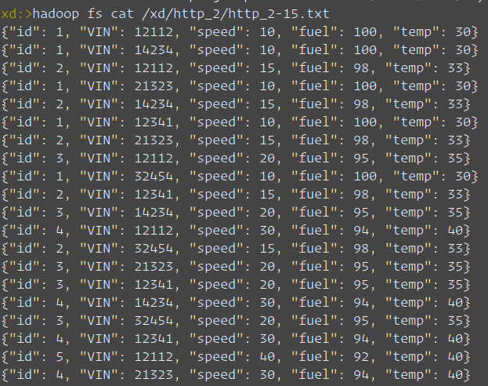
Hadoop
After Spring CDF takes the data of
the cars, then save it to Hadoop.
The following image shows the
Result after the simulator finished
sending data from the cars and save
to Hadoop like this.

Slide 6
THANK YOU!

