Slide 1
Exercises – biological signals
Exercise 11 - SS 2014 – Michel Kana

Slide 2
What will we do today?
Introduction to Fourier Transform
Heart rate variability with Fast Fourier Transform
Introduction to Wavelet Transform
Heart rate variability with Wavelet Transform
Summary

Slide 3
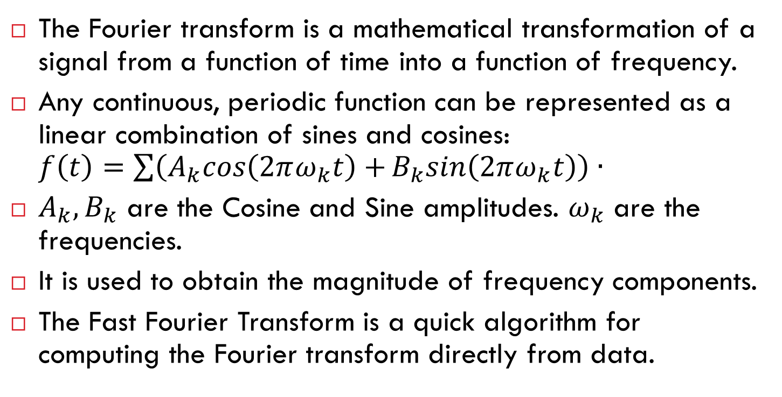
The Fourier Transform
The Fourier transform is a mathematical transformation of a signal from a function of time into a function of frequency.
Any continuous, periodic function can be represented as a linear combination of sines and cosines: $f\left(t\right)=\sum{\left(A_{k}cos\left(2πω_{k}t\right)+B_{k}sin\left(2πω_{k}t\right)\right)}∙$
$A_{k},B_{k}$ are the Cosine and Sine amplitudes. $ω_{k}$ are the frequencies.
It is used to obtain the magnitude of frequency components.
The Fast Fourier Transform is a quick algorithm for computing the Fourier transform directly from data.

Slide 4
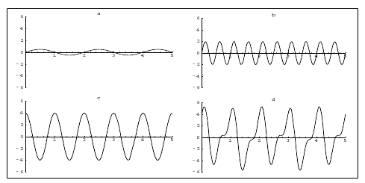

The Fourier Transform

Slide 5
The Fourier Transform in Matlab
Consider the following data x with two component frequencies components and noise
Sample frequency (Hz)
10 sec sample
fs = 100; t = 0:1/fs:10-1/fs; x = (1.3)*sin(2*pi*15*t) + (1.7)*sin(2*pi*40*(t-2)) + 2.5*gallery('normaldata',size(t),4);
15 Hz component
40 Hz component
Gaussian noise

Slide 6
The Fourier Transform in Matlab
Use fft to compute the discrete Fourier Transform and its power.
Window length
Transform length
m = length(x); n = pow2(nextpow2(m)); y = fft(x,n); f = (0:n-1)*(fs/n); power = y.*conj(y)/n;
Discrete Fourier Transform
Frequency range
Power of the DFT
nextpow2 finds the exponent of the next power of two greater than or equal to the window length (ceil(log2(m)))
pow2 computes the power. Using a power of two for the transform length optimizes the FFT algorithm

Slide 7
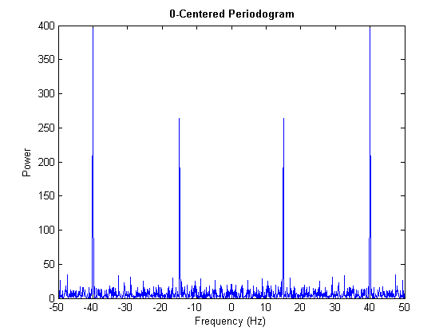
The Fourier Transform in Matlab
A plot of power versus frequency is called a periodogram
Rearrange y values
0-centered frequency range
y0 = fftshift(y); f0 = (-n/2:n/2-1)*(fs/n); power0 = y0.*conj(y0)/n; plot(f0,power0) xlabel('Frequency (Hz)') ylabel('Power') title('{\bf Periodogram}')
0-centered frequency range

Slide 8
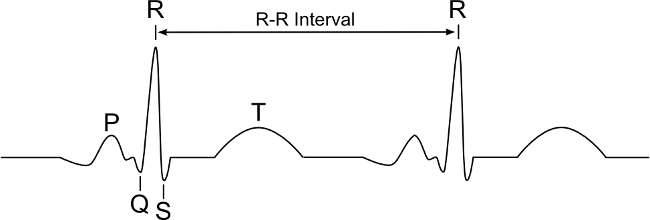
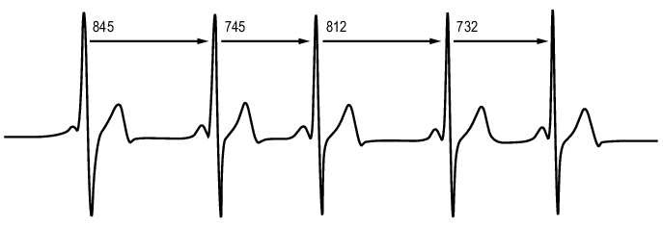
Heart Rate Variability
There are physiological rhythms in the beat-to-beat heart rate signal (series of intervals between adjacent QRS complexes).
845 | 745 | 812 | 732

Slide 9
Exercice 1: RR Interval measurement with BIOPAC
Biopac MP35 measurement system
ECG is recorded using Biopac SS2L wires plugged in the first channel.
Biopac Student Lab PRO software
The acquisition is set up at a sampling rate of 200 Hz.
Analog Channel CH1 should have the preset ECG (.5 - 35 Hz).
Calculation Channel C1 should have the preset ECG – RR Interval

Slide 10
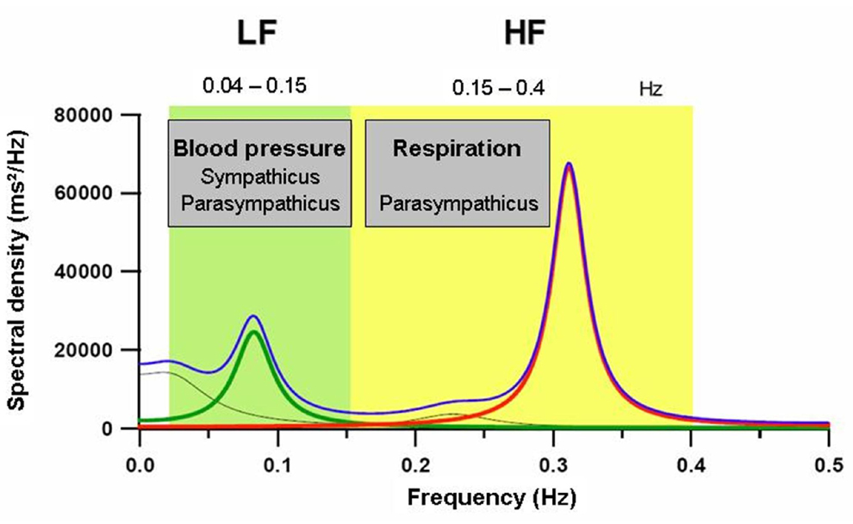
Heart Rate Variability
Analysis of HRV is usually studied in frequency domain by converting RR intervals signal to frequency components using Fast Fourier Transform.
The spectral values for HRV can be calculated for frequency bands:
very low (VLF: 0-0.04 Hz)
low (LF: 0.04–0.15 Hz)
high (HF: 0.15–0.4 Hz).

Slide 11
Heart Rate Variability
Low frequency oscillations are considered to be mediated by combined sympathetic and parasympathetic activity at rest while there is a predominance of sympathetic activity during stressful conditions
High frequency heart rate oscillations are associated with respiratory sinus arrhythmia and reflect parasympathetic activity
Very low frequencies are considered to be linked to the renin-angiotensin system, endothelial factors and thermoregulation.

Slide 12
Heart Rate Variability with Matlab
Importing RR intervals from Biopac into Matlab
File -> Save as text
Window length
Transform length
fs = 4; x = resample (RR, 4, 200) m = length(x); n = pow2(nextpow2(m)); y = fft(x,n); f = (0:n-1)*(fs/n); power = y.*conj(y)/n;
Discrete Fourier Transform
Frequency range
Power of the DFT

Slide 13
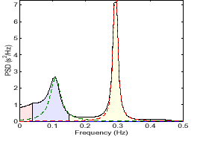
Heart Rate Variability with Matlab
y0 = fftshift(y); f0 = (-n/2:n/2-1)*(fs/n); power0 = y0.*conj(y0)/n; start = round((0.04*length(y0))/fs); end = round((0.5*length(y0))/fs); plot(f0(start:end),power0(start:end)) xlabel('Frequency (Hz)') ylabel('Power') title('{\bf Periodogram}')

Slide 14
Exercice 2: HRV during deep breathe test
Procedure
Subject is instrumented for ECG measurement with Biopac.
Perform a 1 min recording under resting conditions.
Perform another 1 min recording while the subject breathes at a rate of 6 respiration cycles per minute: 5 seconds for each inhalation and 5 seconds for each exhalation.
Evaluation
Estimate the total power of each frequency band (VLF, LF and HF) using the Integral measurement tool.
Calculate the percentage change in the power of HF component before and during the test
Find the subject with the greatest change in parasympathetic activity

Slide 15

Exercice 3: HRV during physical exercise
Procedure
Subject is instrumented for ECG measurement with Biopac.
Perform a 1 min recording in a lying position.
Perform another 3 min recording while the subject is performing a pedaling exercise. Both legs are suspended in the air and pedaling movements are executed.
Evaluation
Estimate the total power of each frequency band (VLF, LF and HF) using the Integral measurement tool.
Calculate the percentage change in the power of LF component before and during the test
Find the subject with the greatest change in sympathetic activity

Slide 16
Team Projects
Project 1: Cardiovascular Signal Analyzer
Digital filtering of a raw PPG signal
Extraction of PH (pulse height) and PP (peak-to-peak) values from a filtered PPG signal
MAP estimation using PH
Fourier transform of PP intervals and estimation of HF and LF
Implementation in Matlab, if possible with an interactive GUI
User should be able to import the raw signal import from a Biopac text export
User should be able to enter the sampling frequency, signal type (ECG or PPG or both) and channel numbers
User should be able to filter the raw signal
User should be able to execute PP, PH, MAP, LF, HF computation
User should be able to display plots of the raw signal for a given start and end timestamp
User should be able to display plots of PP, PH, MAP over the time for a given start and end timestamp and display the value of LF and HF

Slide 17
Team Projects
Project 2: Nervous Activity Analyzer
Digital filtering of a raw EEG signal
Extraction of alpha, beta, theta, delta waves from a filtered EEG signal
Computation of STD, AVG and CC
Implementation in Matlab, if possible with an interactive GUI
User should be able to import the raw signal import from a Biopac text export
User should be able to enter the sampling frequency
User should be able to filter the raw signal
User should be able to execute alpha, beta wave, theta, delta wave computation using Fourier or Wavelet transform or digital filtering
User should be able to execute STD, AVG, CC computation
User should be able to display plots of the raw signal for a given start and end timestamp
User should be able to display plots of alpha, beta wave, theta, delta waves over the time for a given start and end timestamp and display the values for STD, AVG and CC

Slide 18
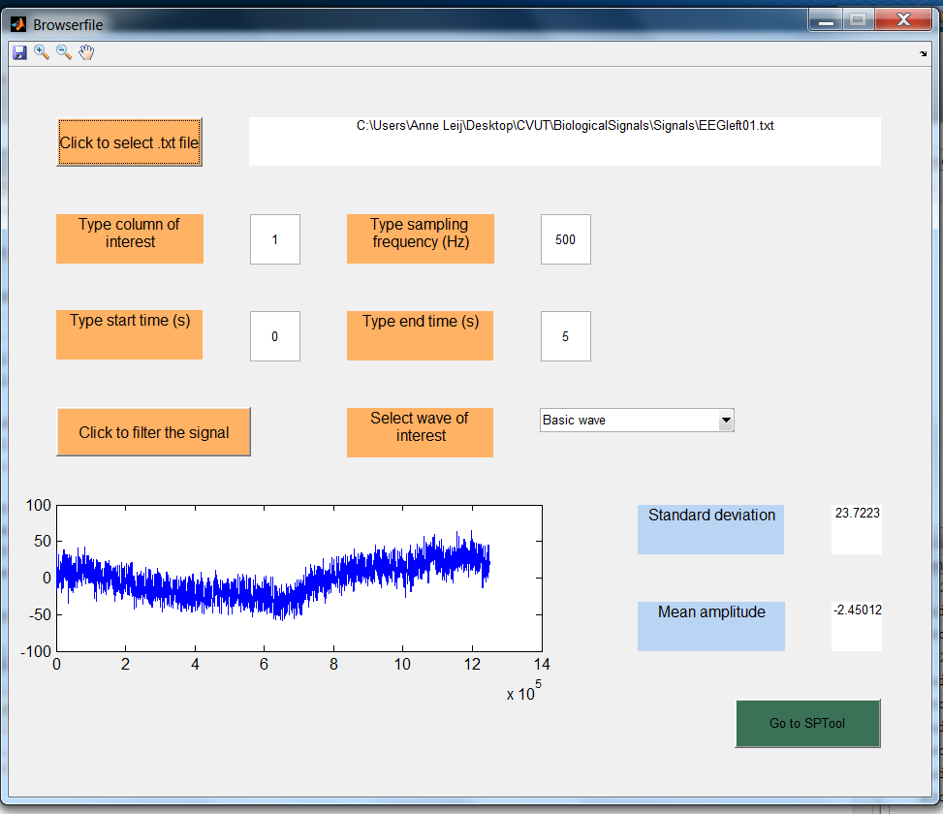

Slide 19
Team Projects
Project 3: Muscle Activity Analyzer
Digital filtering of a raw EMG signal
Computation of rectified EMG from a filtered EMG signal
Computation of the spectrum of the filtered EMG signal using Fourier transform
Computation of RMS, ARV
Implementation in Matlab, if possible with an interactive GUI
User should be able to import the raw signal import from a Biopac text export
User should be able to enter the sampling frequency
User should be able to filter the raw signal
User should be able to execute rectified EMG computation
User should be able to execute Fourier transform of the rectified EMG for a given start and end timestamp
User should be able to execute RMS, ARV computation for a given start and end timestamp
User should be able to display plots of the raw EMG, rectified EMG, EMG Fourier transform for a given start and end timestamp
User should be able to display the values for RMS, ARV for a given start and end timestamp

Slide 20
