Slide 1
Exercises – biological signals
Exercise 3 - SS 2014 – Michel Kana

Slide 2
What will we do today?
The physiology behind GSR
Structure of the GSR Signal
GSR measurement with BIOPAC
Summary

Slide 3
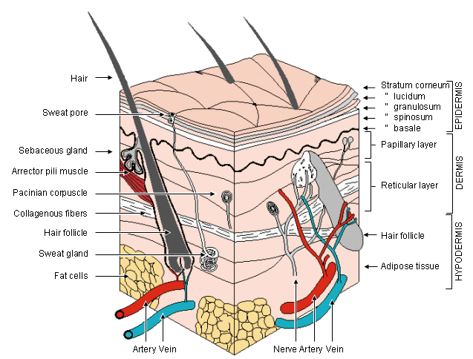
The physiology behind GSR
The skin is a three-layered (epidermis, dermis, subdermis) adaptive organ.
Human skin is a good conductor of electricity.
Change in conductance occurs when sweat glands fill or empty sweat.
The glands respond to sympathetic nervous stimulation.
When a weak electrical current is delivered to the skin, changes in the skin’s conduction can be measured: the Galvanic Skin Response.
GSR is expressed in units called microSiemens (μS or μMho).
Ref.: http://www.bem.fi/book/27/27.htm

Slide 4
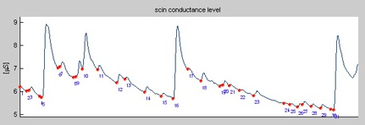
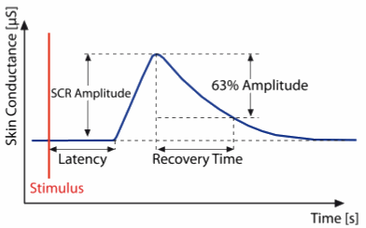
Structure of the GSR Signal
Waves in the GSR signal
SCL: Skin Conductance Level. It is the baseline level and provides a measure of overall psycho-physical activiation.
ca. 2-50 μS with a frequency range of 0 – 0.05 Hz
NSF: Non-specific Spontaneous Fluctuations. They are not event related and are useful for calculating overall emotional state.
ca. 1 or 3 per min
SCR: Skin Conductance Response. It reflects discrete environmental stimuli or events.
frequency range of 0.05 – 1.5 Hz
Parameters in the GSR signal
SCL: baseline level of skin conductance (e.g. 7,5 μS)
SCR Amplitude: amplitude of skin conductance response (e.g. 2,1 μS)
Latency: time delay between the event and the response (less than 3 sec)
Rise Time: duration between the onset of the response and its peak (1 to 3 sec)
Half-Recovery Time: duration between the peak and the half or 63% of the peak (2 to 10 sec)
Ref.: 1. ANSLAB – 2. ETH Zurich, Wearable Computing Laboratory

Slide 5
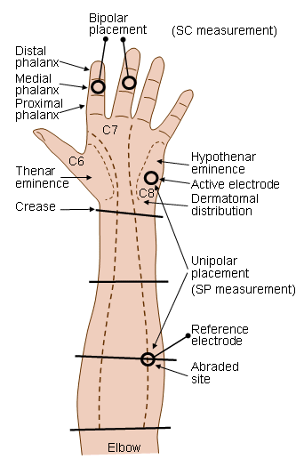
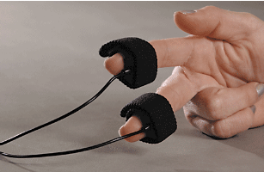
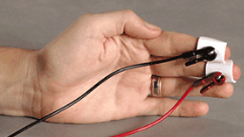
GSR Measurement
Operational configuration
A galvanic skin amplifier applies a constant low voltage to the skin through electrodes and measures the current flow.
Using Ohm’s low the resistance of the underlying conductor can be obtained.
The inverse of the resistance is the skin conductance.
Noise sources
Baseline drift
Variation in temperature
Power line interference
Ref.: http://www.bem.fi/book/27/27.htm

Slide 6
Exercice 1: GSR measurement with BIOPAC
Biopac MP35 measurement system
GSR is recorded using Biopac SS3LA transducer with built-in Ag/AgCl electrodes or SS57L wires with extra bipolar electrodes plugged in the second channel.
Electrodes can be attached to the right hand, on the index and major finger (medial phalanx).
Biopac Student Lab PRO software
The acquisition is set up for a sampling rate of 200 Hz.
Analog Channel CH1 should have the following settings
DC coupling
Hardware-based filter 0.05 Hz High Pass, 35 Hz Low Pass
Total gain 2000
Calibration needed for absolute measurements with SS3LA transducer: 0 mV = 0 microMho, 1 mV = 10 microMho.
MP menu > Set up Channels > View/Change Parameters > Scaling
Calculation Channel C1 is setup for smoothing the raw GSR signal
GSR parameters calculation
Estimate the average SCL
Select a skin conductance response and calculate SCR Amplitude, Latency, Rise Time and Half-Recovery Time
Identify Non-specific Spontaneous Fluctuations and estimate the number of NSF per minute.

Slide 7

Exercice 2: Response to neutral questions
Procedure
Subject is instrumented for GSR measurement with Biopac by the examiner.
The examiner records the GSR signal until no skin conductance response is noticed.
The examiner asks a question.
Subject answers. A SCR should appear on the GSR signal.
The examiner waits for the subject’s skin conductance level to return close to the baseline level before asking the next question
Evaluation
Identify the SCRs for each question
Calculate the Rise Time and SCR Amplitude for each question
Calculate the mean rise time and amplitude for all questions

Slide 8
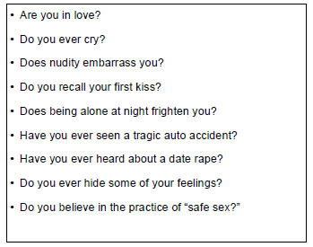
Exercice 3: Response to emotional questions
Procedure
Subject is instrumented for GSR measurement with Biopac by the examiner.
The examiner records the GSR signal until no skin conductance response is noticed.
The examiner asks a question.
Subject answers. A SCR should appear on the GSR signal.
The examiner waits for the subject’s skin conductance level to return close to the baseline level before asking the next question
Evaluation
Identify the SCRs for each question
Calculate the Rise Time and SCR Amplitude for each question
Calculate the mean rise time and amplitude for all questions

Slide 9
Exercice 4: Response to stress
Procedure
Subject is instrumented for GSR measurement with Biopac by the examiner. Fingers should be clean and dry.
The examiner records the GSR signal until no skin conductance response is noticed.
The examiner chooses a random number between 500 and 1000 and asks the subject to subtract 17 from that number, then 17 from the result and so on, as fast as possible with each calculation lasting max 5 seconds.
Subject answers. Several SCR should appear on the GSR signal.
The examiner stops the subject after 2 minutes.
Evaluation
Estimate and compare SCL before and during the test
Determine and compare the number of NSF before and during the test

Slide 10
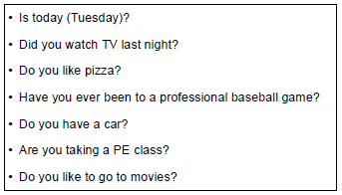
Exercice 5: Lie detection test
Procedure
Subject writes down correct answers to the questions and hide them from the examiner.
Subject is instrumented for ECG and GSR measurement with Biopac by the examiner. ECG is measured in Channel 2 with preset ECG (.5 - 35 Hz). The calculation channel C2 is configured with the preset Heart Rate.
The examiner records the GSR signal until no skin conductance response is noticed.
The examiner asks a question.
Subject answers (lie is allowed). Changes might appear on the signals.
The examiner evaluates the answer as true or false based on his observations. Examiner writes down subject’s answer and the evaluation.
Evaluation
Subject reveals the correct answers after the test.
Correct answers, subject answers and examiner’s evaluation are compared.
Compare mean heart rate, SCL, SCR amplitude, SCR rise time for true positives with the mean for false positives.

Slide 11
Summary
[What did we learn today]
Physiology behind the galvanic skin response.
Structure of the GSR signals.
Measurements and signal analysis.
[Plan for the next week]
PPG

