Slide 1
Exercises – biological signals
Exercise 4 - SS 2014 – Michel Kana

Slide 2
What will we do today?
The physiology behind PPG
Structure of the PPG Signal
PPG measurement with BIOPAC
Summary

Slide 3
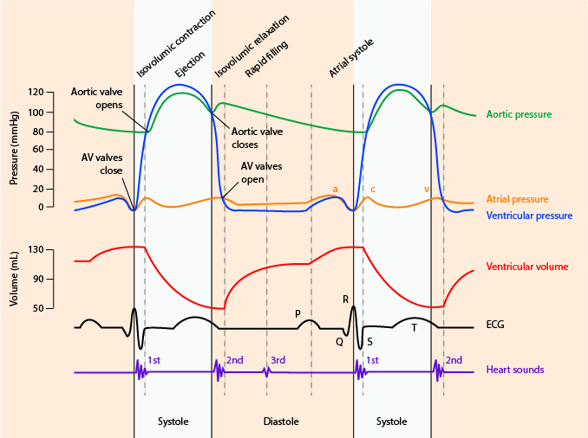
The physiology behind PPG
Photoplethysmography (PPG) is an optical measurement technique that can be used to detect blood volume changes in the microvascular bed of tissue
A photodetector can be placed on a tissue’s surface alongside the light-emitting diode and record the light that returns back
Light intensity is attenuated by oxygenated and deoxygenated hemoglobin (in blood cells), myoglobin (in muscle), and cytochromes, as well as melatonin (in skin)
Reductions in light intensity indicate relative increases in blood volume and vice versa
Wiggers diagram

Slide 4
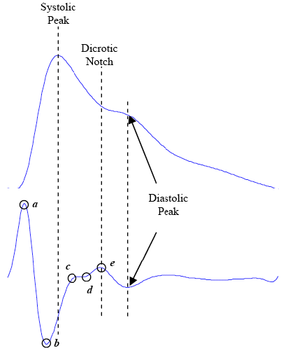
Structure of the PPG Signal
Waves in the PPG
The photoplethysmogram waveform consists of one systolic wave and one diastolic wave.
The second derivative photoplethysmogram waveform consists of four systolic waves (a, b, c, and d waves) and one diastolic wave (e wave).
PPG
2nd derivative of
PPG
Ref.: M. Elgendi “Standard Terminologies for Photoplethysmogram Signals”

Slide 5
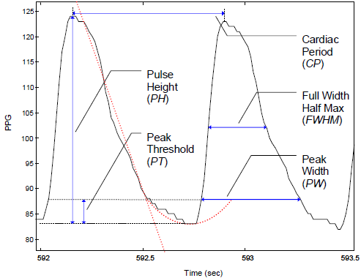
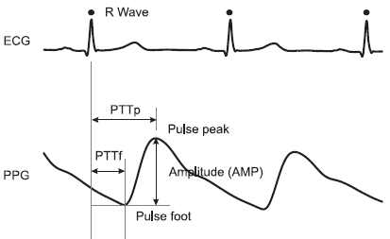
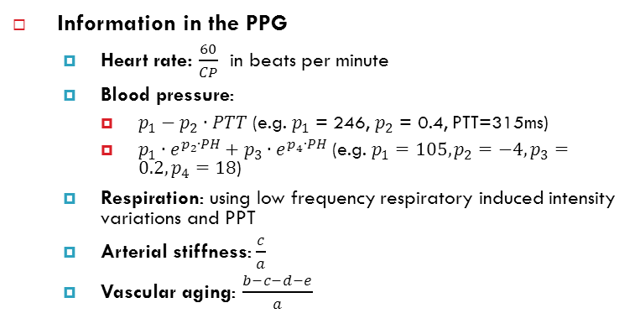
Structure of the PPG Signal
Parameters in the PPG signal
PH: pulse height or pulse amplitude
CP: cardiac period
FWHM: full width half max
PW: peak width
PT: peak threshold
PPT: pulse travelling time

Slide 6
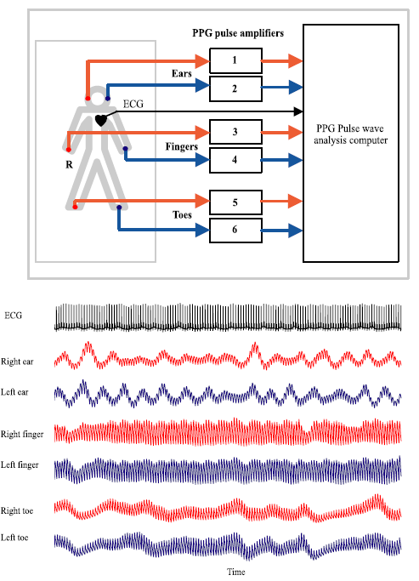
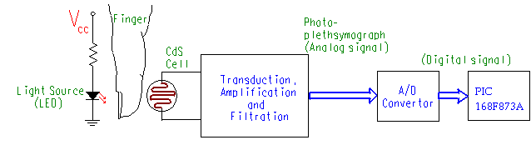

PPG Measurement
Ref.: http://www.engin.swarthmore.edu/~dluong1/E72/FinalProject/heart.htm
Operational configuration
Side-by-side mode
Transmission mode
Noise sources
Movement artefacts
Ambient light interference
Variation in temperature
power line interference

Slide 7
Exercice 1: PPG measurement with BIOPAC
Biopac MP35 measurement system
PPG is recorded using Biopac SS4LA plethysmograph transducer plugged in the first channel.
Tranducer should be attached to the left hand, index finger.
Biopac Student Lab PRO software
The acquisition is set up for Recording and Append into Memory at a sampling rate of 200 Hz. The total acquisition length can be set to 1 hour.
In the Setup Channels menu, the check boxes Acquire Data, Plot on Screen, Enable Value Display are enabled for the first channel.
Analog Channel CH1 should have the following settings
AC coupling 0.5 Hz High Pass, 1K Low Pass
Hardware-based filter 60 Hz Low Pass
Total gain 5000
Calculation Channel C1 should calculate the Difference of the channel CH1 in order to estimate the first derivative of the PPG waveform. Channel C1 should not be visible.
Calculation Channel C2 should calculate the Difference of the channel C1 in order to estimate the second derivative of the PPG waveform
PPG parameters calculation
Select two consecutive cardiac cycles
Read the values for PH, CP, FWHM, PW, PT
Estimate the heart rate
Estimate arterial stiffness and vascular aging

Slide 8
Exercice 2: ECG & PPG measurement with BIOPAC
Biopac MP35 measurement system
PPG is recorded using Biopac SS4LA plethysmograph transducer plugged in the first channel.
3 leads ECG is recorded using Biopac SS2L connecting wires plugged in the 2nd channel.
Biopac Student Lab PRO software
Analog Channel CH2 should have the following settings
AC coupling 0.5 Hz High Pass, 1K Low Pass
Hardware-based filter 35 Hz Low Pass
Total gain 2000
Calculation Channel C3 should calculate the heart rate from the PPG signal
Calculation Channel C4 should calculate the heart rate from the ECG signal
Calculation Channel C5 should estimate the mean arterial pressure from the pulse amplitude in the PPG signal
Pulse travel time calculation
Select one cardiac cycle
Use the measurement window and calculate the PPT
Estimate the mean arterial blood pressure using the PPT and the pulse amplitude
Suggest a method for calculating and displaying the PPT during realtime measurement
Heart rate comparison
Select a sufficiently long time period
Calculate and compare the mean, min and max heart rates obtained from ECG and PPG

Slide 9
Exercise 3: active standing test
Active Change of Posture Test
Subject is instrumented for PPG measurement with Biopac by the examiner.
The examiner records the PPG signal for 120 seconds.
The examiner gives a vocal signal to the subject to stand.
Subject stands up.
The examiner records the PPG signal for 120 seconds.
Evaluation
Identify significant phases in the heart rate and blood pressure waves
Compare the mean values between phases

Slide 10
Summary
[What did we learn today]
Physiology behind the photoplethysmogram.
Structure of the PPG signals.
Measurements and signal analysis.
[Plan for the next week]
Respiration measurement & analysis

