Slide 1
Exercises – biological signals
Exercise 6 - SS 2014 – Michel Kana

Slide 2
What will we do today?
The physiology behind EMG
Structure of the EMG Signal
EMG measurement with BIOPAC
Summary

Slide 3
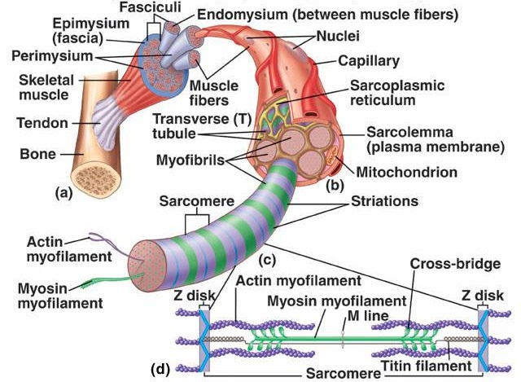
The physiology behind EMG
Three types of muscles in the human body: sceletal muscles, cardiac muscles and smooth muscles.
Most sceletal muscles are attached to bones and control body movement.
Sceletal muscles constitute about 40% of the body weight.
A sceletal muscle is a collection of muscle fibers (grouped into fascicles), nerves, blood vessels and connective tissues.
One muscle fiber or myocyte is a cell that contains a thousand of myofibrils built of proteins: myosin, actin, tropomyosin, troponin, titin, nebulin.
A sarcomere is a repeating pattern of alternating myosin (thick) and actin (thin) filaments.
Muscle contraction results from the sliding of the thin actin filament along the fixed myosin thick filament within a sarcomere.
Myosin heads repeadly bind and release actin molecules, pushing the thin filament toward the center of the sarcomere.
The elasticity of the huge titin protein (over 25000 amino acids) returns the stretched muscle to its resting length.
Ref.: D. Unglaub Human Physiology

Slide 4
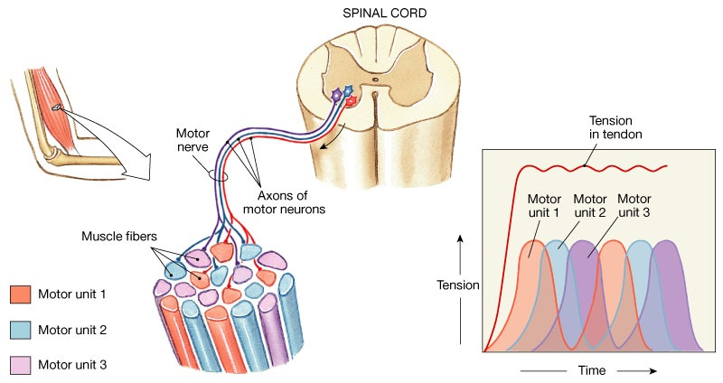
The physiology behind EMG
Ref.: D. Unglaub, Human Physiology
Sceletal muscles contract only in response to signals from somatic motor neurons.
A motor unit is a group of muscle fibers controlled by a single somatic motor neuron.

Slide 5
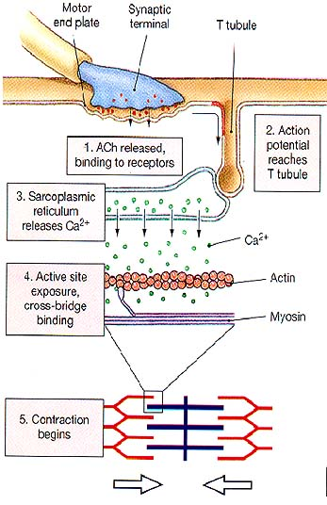
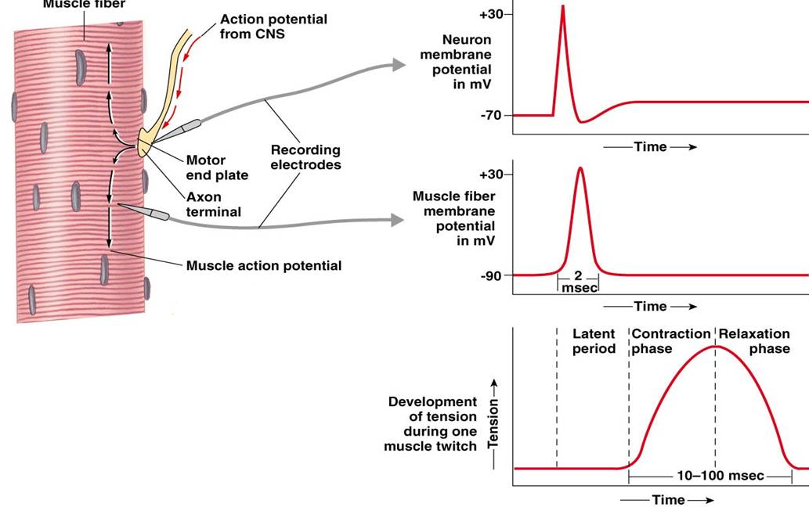
The physiology behind EMG
When a somatic motor neuron fires, Acetylcholine (ACh) is released on muscle fibers.
ACh initiates an action potential in the fiber, what triggers muscle contraction.
Electrical activity in a motor unit consists of a rhythmic series of action potentials.
The combination of the muscle fiber action potentials from all the muscle fibers of a single motor unit is the motor unit action potential (MUAP).
A surface electrical recording of the spiking activity derived from one or more motor units is called an electromyogram (EMG).
Ref.: D. Unglaub, Human Physiology

Slide 6
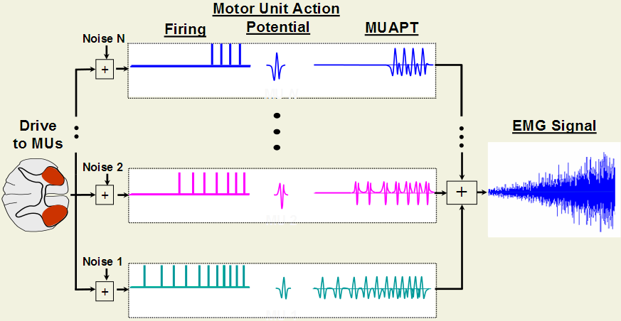
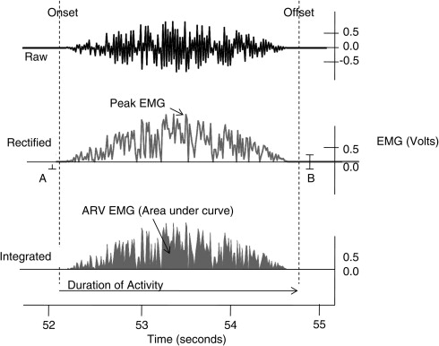
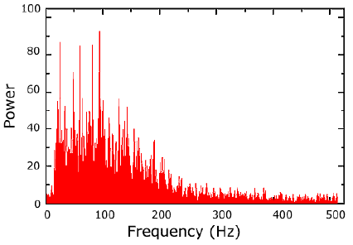
Structure of the EMG Signal
Parameters in the EMG signal
RMS: root mean square of the raw EMG signal as a measure of the power
ARV: average rectified value is the mean absolute value of the rectified EMG signal: It is also called Mean Amplitude Value.
PSD: power spectral density, i.e. amount of power per unit of frequency
MPF: median power frequency of the power spectral density is an index of muscle fatigue

Slide 7
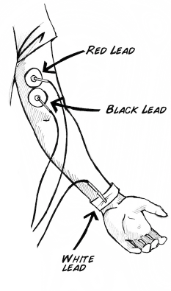
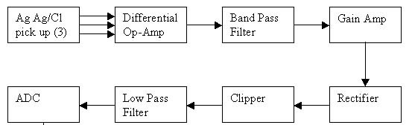
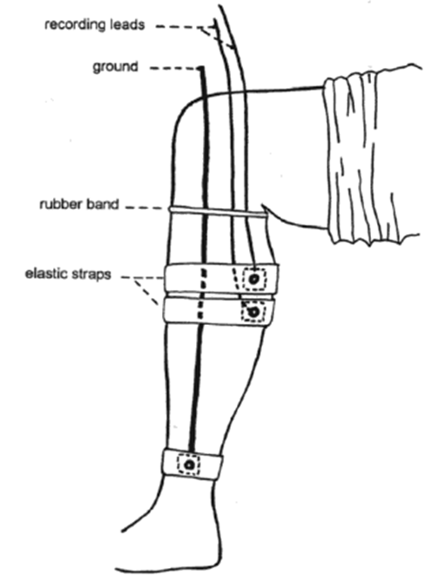
EMG Measurement
Operational configuration
Surface EMG with electrodes applied to the skin.
Fine wired EMG with needles introduced in the muscle.
Noise sources
Inherent noise in electronics components (0 to thousands Hz)
Ambient noise from electromagnetic radiation (0 to thousands Hz)
Motion artifact from electrode movements (0 to 20 Hz)
Power line interference (60 or 50 Hz)
Inherent instability of signal due to noisy activity of motor units (0 to 20 Hz)

Slide 8
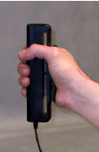
Exercice 1: EMG measurement with BIOPAC
Biopac MP35 measurement system
EMG is recorded using Biopac SS2L wires plugged in the third channel.
Electrodes can be attached to the dominant arm (biceps).
The grip force is measured using a Biopac SS25LA hand dynamometer plugged in the fourth channel
EMG is listen using Biopac OUT1 headphones connected to the Analog out port
Biopac Student Lab PRO software
The acquisition is set up at a sampling rate of 500 Hz.
Analog Channel CH3 should have the following settings
AC coupling 0.5 Hz High Pass, 1 kHz Low Pass, Total gain 1000
Hardware-based filter 30 Hz High Pass, 250 Hz Low Pass, 60 Hz Band Stop (Notch)
Choose MP35 Menu → Output Control → CH# to output and select Channel 3
Analog Channel CH4 should have the following settings
Preset Clench Force
Calibration needed (3.5 mV per Kg), MP menu > Set up Channels > View/Change Parameters > Scaling
Calculation Channel C3 should calculate the integrated EMG signal using Rectify
Calculation Channel C4 should calculate the integrated EMG signal using mean root squares and removing baseline
Calculation Channel C5 should calculate the amplitude of the EMG signal using Peak-to-peak Rate function
EMG parameters calculation
Estimate the mean ARV and mean RMS parameters from channels C3, C4
Estimate the MPF using Fast Fourier Transform (Menu Transform → FTT)

Slide 9


Exercice 2: EMG Biofeedback
Procedure
Subject is instrumented for EMG measurement with Biopac. Electrodes are placed on a leg and subject uses the headphones.
The subject should be seated with legs fully relaxed and eyes closed.
The subject should make a very slight effort to weakly and constantly contract the gastrocnemius.
The subject listens for a rhythmic series of ticking sounds of constant intensity. Each tick results from an action potential in a single motor unit.
Evaluation
Subject should use bio-feedback to consciously and precisely increase (or decrease) the frequency of these ticks in accordance with his/her efforts to slightly change the strength of gastrocnemius contraction.

Slide 10
Exercice 3: EMG Force Competition
Procedure
Subject is instrumented for PPG (1st channel), GSR (2nd channel) and EMG (3rd channel) measurement with Biopac. EMG Electrodes are placed on the biceps of the dominant arm. The hand dynamometer is hold by the hand on the same arm. PPG and GSR electrodes are place on the other arm.
The subject should press the hand dynamometer with the maximal possible effort and maintain the pressure for 10 seconds.
The subject should repeat the pressure five times with 5 seconds pause between cycles.
Evaluation
Calculate the average of the following parameters over all 5 cycles and derive their percentage of change compare to values before the exercise:
RMS from the EMG signal.
Heart rate from the PPG signal.
SCR Amplitude from the GSR signal
Force from the dynamometer signal.
Compare the results between subjects
The subject with the highest RMS increase, with lowest heart rate increase, lowest SCR increase and greatest force achievment wins the contest.

Slide 11
Summary
[What did we learn today]
Physiology behind the electromyogram.
Structure of the EMG signals.
Measurements and signal analysis.
[Plan for the next week]
EEG

