Slide 1
Exercises – biological signals
Exercise 7 - SS 2014 – Michel Kana

Slide 2
What will we do today?
The physiology behind EEG
Structure of the EEG Signal
EEG measurement with BIOPAC
Summary

Slide 3
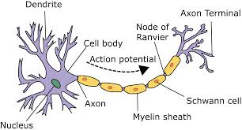
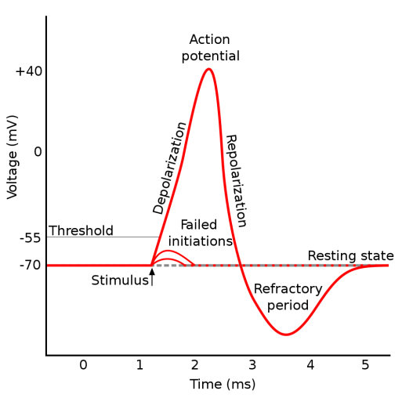
The physiology behind EEG
The nervous system is composed of neurons and glial cells
Neurons are excitable cells that generate and carry electrical signals that are called action potentials
The electrical activity spreading through the head and reaches the scalp
The resulting voltage differences can be recorded as the electroencephalogram (EEG)
EEG reflects the summation of synchronous activity of many neurons with similar spatial orientations
EEG offers a good millisecond temporal resolution, however with limited spatial resolution

Slide 4
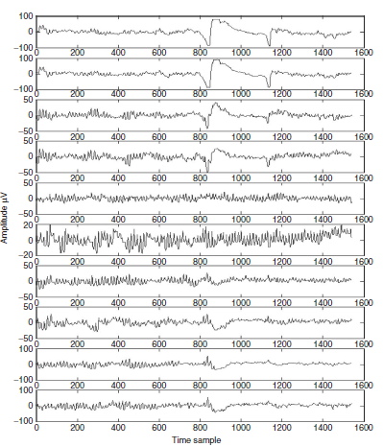
Structure of the EEG Signal
Characteristics of the EEG signal
Frequency components up to 300 Hz.
Amplitude in order to µvolts.

Slide 5
Structure of the EEG Signal
Characteristics of the EEG signal
Frequency components up to 300 Hz.
Amplitude in order to µvolts.
Waves in the EEG signal
Delta wave: high amplitude neural oscillations in the frequency range of 0.5 – 4 Hz. They are primarily associated with deep sleep.
Theta wave: neural oscillations in the frequency range of 4 – 8 Hz. They have been associated with access to unconsciousness, creative inspiration and deep meditation.
Alpha wave: neural oscillations in the frequency range of 8 – 13 Hz. They are associated to a relaxed awareness without any attention or concentration. They should be reduced or eliminated by opening the eyes, by hearing unfamiliar sounds, by anxiety, mental concentration or attention.
Beta wave: neural oscillations in the frequency range of 13 – 30 Hz. They are associated with active thinking, active attention, focus on the outside world, or solving concrete problems.
Gamma wave: neural oscillations in the frequency range of 30 – 90 Hz. They are suggested to be related to consciousness.

Slide 6
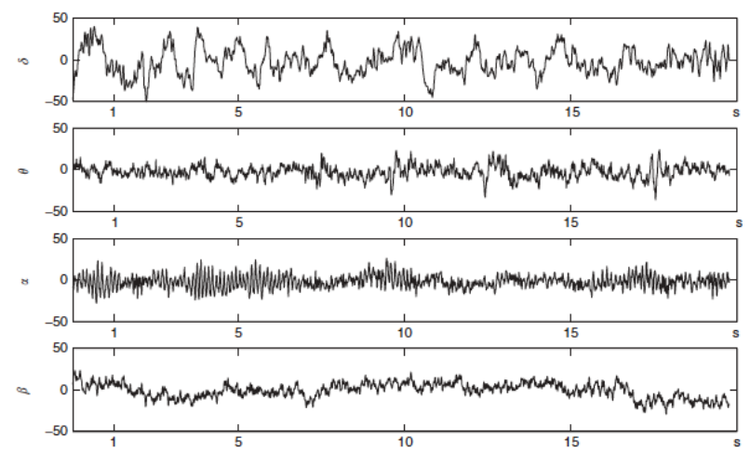
Structure of the EEG Signal
Parameters in the EEG signal
Standard deviation (STD): measure of activity in the brain wave
Average Value (AVG): measure of mean amplitude
Cycle Count (CC): measure of central frequency

Slide 7
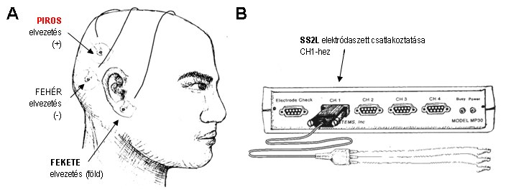
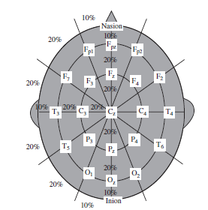
EEG Measurement
Operational configuration
Multichannel recording with an electrodes cap using 10 to 20 Ag–AgCl disks.
For example, C3 and C4 can be used to record the right and left finger movement related signals
1-Channel recording.
Differential or referential electrodes setup.
Noise sources
Muscle movement artifact (0 to 1000 Hz)
Motion artifact from electrode movements (0 to 20 Hz)
Power line interference (60 or 50 Hz)

Slide 8
Exercice 1: EEG measurement with BIOPAC
Biopac MP35 measurement system
EEG is recorded using Biopac SS2L wires plugged in the third channel.
Electrodes are attached as depicted, avoiding hair between scalp and electrodes.
Biopac Student Lab PRO software
The acquisition is set up at a sampling rate of 500 Hz.
Analog Channel CH1 should have the preset Electroencephalogram EEG (.5-100Hz)
Calculation Channel C1 should have the preset EEG alpha (8-13Hz)
Calculation Channel C2 should have the preset EEG beta (13-30Hz)
Calculation Channel C3 should have the preset EEG delta (0.5-4Hz)
Calculation Channel C4 should have the preset EEG theta (4-8Hz)
Calculation Channel C5 should have the preset EEG gamma (30-90Hz)
EEG parameters calculation
Estimate the STD, AVG and CC of each of the five brain waves

Slide 9
Exercice 2: Relaxed with eyes open without blinking
Procedure
Subject is instrumented for EEG measurement with Biopac.
The subject should be seated with legs fully relaxed and keep eyes open, staring at the computer screen without blinking during min 10 seconds.
Evaluation
Estimate the STD of the all brain waves

Slide 10
Exercice 3: Relaxed with eyes closed
Procedure
Subject is instrumented for EEG measurement with Biopac.
The subject should be seated with legs fully relaxed and eyes closed during 120 seconds.
Evaluation
Estimate the STD, AVG and CC of the alpha wave
Verify the following assertions:
Females tend to have higher mean frequency of alpha waves
Alpha amplitude tend to be higher in outgoing subjects

Slide 11
Exercice 4: Mental math with eyes closed
Procedure
Subject is instrumented for EEG measurement with Biopac.
The subject should be seated with legs fully relaxed and eyes closed.
After 60 seconds of baseline measurement at rest, the subject should mentally find the reminder of 12345 divided by 12 during another 60 seconds.
Evaluation
Estimate the STD, AVG and CC of the alpha and beta waves
By how much did the amplitude of alpha waves changed?
Are there changes in the beta waves?

Slide 12
Exercice 5: Hyperventilation with eyes closed
Procedure
Subject is instrumented for EEG and PPG measurement with Biopac.
The subject should be seated with legs fully relaxed and eyes closed.
The subject should increase breathing rate to 60 cycles per minute while breathing deeply during 120 seconds.
Evaluation
Estimate the STD, AVG and CC of the alpha wave
It is expected that carbon dioxide levels fall, pH increases, blood pressure decreases, overall brain activity increases, alpha rhythms increase. Can you verify?

Slide 13
Team Projects
Project 1: Cardiovascular Signal Analyzer
Digital filtering of a raw PPG signal
Extraction of PH (pulse height) and PP (peak-to-peak) values from a filtered PPG signal
MAP estimation using PH
Fourier transform of PP intervals and estimation of HF and LF
Implementation in Matlab, if possible with an interactive GUI
User should be able to import the raw signal import from a Biopac text export
User should be able to enter the sampling frequency, signal type (ECG or PPG or both) and channel numbers
User should be able to filter the raw signal
User should be able to execute PP, PH, MAP, LF, HF computation
User should be able to display plots of the raw signal for a given start and end timestamp
User should be able to display plots of PP, PH, MAP over the time for a given start and end timestamp and display the value of LF and HF

Slide 14
Team Projects
Project 2: Nervous Activity Analyzer
Digital filtering of a raw EEG signal
Extraction of alpha, beta, theta, delta waves from a filtered EEG signal
Computation of STD, AVG and CC
Implementation in Matlab, if possible with an interactive GUI
User should be able to import the raw signal import from a Biopac text export
User should be able to enter the sampling frequency
User should be able to filter the raw signal
User should be able to execute alpha, beta wave, theta, delta wave computation using Fourier or Wavelet transform or digital filtering
User should be able to execute STD, AVG, CC computation
User should be able to display plots of the raw signal for a given start and end timestamp
User should be able to display plots of alpha, beta wave, theta, delta waves over the time for a given start and end timestamp and display the values for STD, AVG and CC

Slide 15
Team Projects
Project 3: Muscle Activity Analyzer
Digital filtering of a raw EMG signal
Computation of rectified EMG from a filtered EMG signal
Computation of the spectrum of the filtered EMG signal using Fourier transform
Computation of RMS, ARV
Implementation in Matlab, if possible with an interactive GUI
User should be able to import the raw signal import from a Biopac text export
User should be able to enter the sampling frequency
User should be able to filter the raw signal
User should be able to execute rectified EMG computation
User should be able to execute Fourier transform of the rectified EMG for a given start and end timestamp
User should be able to execute RMS, ARV computation for a given start and end timestamp
User should be able to display plots of the raw EMG, rectified EMG, EMG Fourier transform for a given start and end timestamp
User should be able to display the values for RMS, ARV for a given start and end timestamp

