Slide 1
Exercises – biological signals
Exercise 8 - SS 2014 – Michel Kana

Slide 2
What will we do today?
The physiology of EOG
Structure of the EOG Signal
EOG measurement with BIOPAC
Semester Plan
Summary

Slide 3
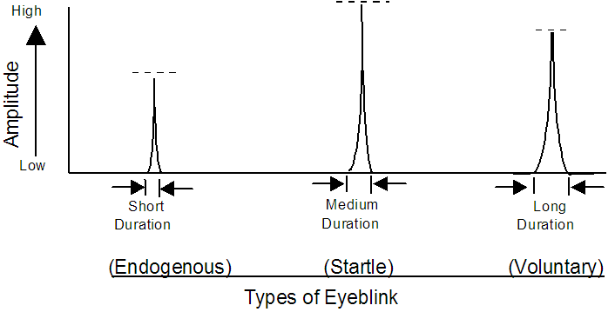
The physiology of EOG
Eye blinks and eye movements are behaviors.
There are three types of eye blinks:
reflex blinks as instinctive response to something invading the eye or startle response to loud noises.
voluntary blinks as a result of a decision to blink.
endogenous blinks due to perception and information processing. They reflect changes of attention and changes in thought processes.
Eye movements are controlled by the brain in conjunction with cranial nerves and extra-ocular muscles
Three pairs of muscles work together to control each eyeball.
The two eyeballs operate together in tandem although they are not connected mechanically.
The superior and inferior rectus control the up-and-down movement.
The lateral and medial rectus control side-to-side movement.
Saccadic movements describe quick jumps of the eye from one fixation point to another.
Smooth movements are slow, broad rotations of the eye that enable it to maintain fixation on an object moving with respect to the head.

Slide 4
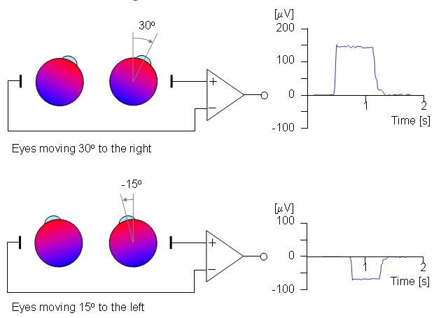
Structure of the EOG Signal
The rear of the eyeball is negative relative to the front of the eyeball, setting up an electrical dipole.
The measurement of the potential difference (0.1-1.0 mV) in the dipole is called electrooculography (EOG).

Slide 5
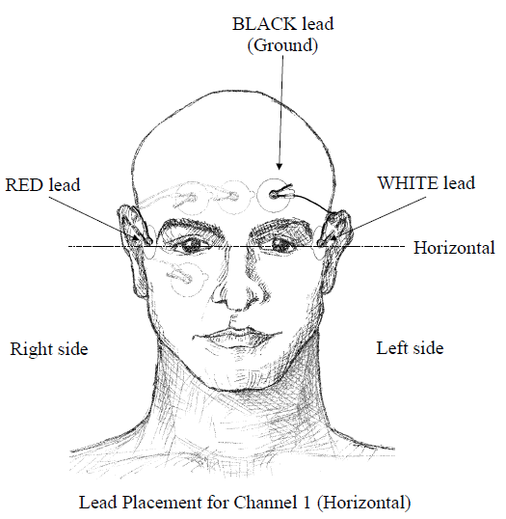
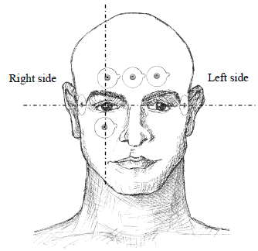
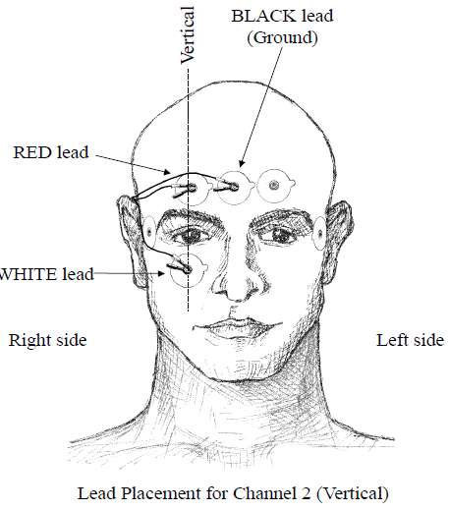
EOG Measurement
Operational configuration
2 channels for vertical and horizontal movements.
Noise sources
Muscle movement artifact (0 to 1000 Hz)
Motion artifact from electrode movements (0 to 20 Hz)
Power line interference (60 or 50 Hz)

Slide 6
Exercice 1: EOG measurement with BIOPAC
Biopac MP35 measurement system
EOG is recorded using 2 Biopac SS2L wires plugged in the first and second channel.
The first electrode lead set is attached for horizontal movement.
The second electrode lead set is attached for vertical movement.
Head movement should be avoided.
Biopac Student Lab PRO software
The acquisition is set up at a sampling rate of 200 Hz.
Analog Channel CH1 should have the preset Electrooculogram EOG (.5-35 Hz)
EOG parameters calculation
Identify eye blinks, moves to the left, right, up or down

Slide 7
Exercice 2: Detection of eye directions
Procedure
Subject is instrumented for EOG measurement with Biopac.
Subject adjust to a vertical seating position.
Experimenter should hold a pen about 10 cm in front of Subject’s eyes in the center of his visual field.
Subject should pick a focal point on the pen so that his eyes remain horizontal.
Experimenter should briskly moves the pen 10 cm to the right and back to center in about 3 seconds.
Subject should fixate on the pen, track it, and try not to blink.
The experiment should be repeated while moving the pen 10 cm to the left, then back to center; 10 cm up, then back to center; 10 cm down then back to center; 10 cm far, then back to the center.
Evaluation
Identify relationship between pen direction and what you see on the computer

Slide 8
Exercice 3: Detection of eyes blinks and reading
Procedure
Subject is instrumented for EOG measurement with Biopac.
The subject should read a text with several lines during 60 sec.
The subject should repeat the experiment with different types of reading materials (blank paper, easy text, hard text)
Evaluation
Identify the time when the subject changed the line.
Identify and count eye blinks.
Identify the relationship between reading attention and eye blinks.

