Slide 1
Exercises – biological signals
Exercise 9 - SS 2014 – Michel Kana

Slide 2
Team Projects
Project 1: Cardiovascular Signal Analyzer
Digital filtering of a raw PPG signal
Extraction of PH (pulse height) and PP (peak-to-peak) values from a filtered PPG signal
MAP estimation using PH
Fourier transform of PP intervals and estimation of HF and LF
Implementation in Matlab, if possible with an interactive GUI
User should be able to import the raw signal import from a Biopac text export
User should be able to enter the sampling frequency, signal type (ECG or PPG or both) and channel numbers
User should be able to filter the raw signal
User should be able to execute PP, PH, MAP, LF, HF computation
User should be able to display plots of the raw signal for a given start and end timestamp
User should be able to display plots of PP, PH, MAP over the time for a given start and end timestamp and display the value of LF and HF

Slide 3
Team Projects
Project 2: Nervous Activity Analyzer
Digital filtering of a raw EEG signal
Extraction of alpha, beta, theta, delta waves from a filtered EEG signal
Computation of STD, AVG and CC
Implementation in Matlab, if possible with an interactive GUI
User should be able to import the raw signal import from a Biopac text export
User should be able to enter the sampling frequency
User should be able to filter the raw signal
User should be able to execute alpha, beta wave, theta, delta wave computation using Fourier or Wavelet transform or digital filtering
User should be able to execute STD, AVG, CC computation
User should be able to display plots of the raw signal for a given start and end timestamp
User should be able to display plots of alpha, beta wave, theta, delta waves over the time for a given start and end timestamp and display the values for STD, AVG and CC

Slide 4
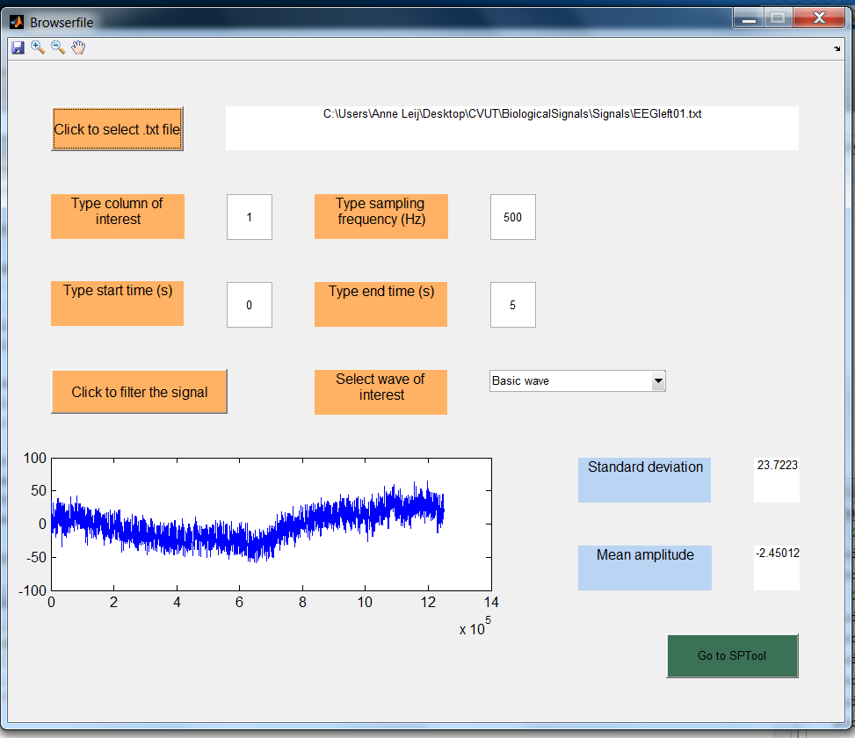

Slide 5
Team Projects
Project 3: Muscle Activity Analyzer
Digital filtering of a raw EMG signal
Computation of rectified EMG from a filtered EMG signal
Computation of the spectrum of the filtered EMG signal using Fourier transform
Computation of RMS, ARV
Implementation in Matlab, if possible with an interactive GUI
User should be able to import the raw signal import from a Biopac text export
User should be able to enter the sampling frequency
User should be able to filter the raw signal
User should be able to execute rectified EMG computation
User should be able to execute Fourier transform of the rectified EMG for a given start and end timestamp
User should be able to execute RMS, ARV computation for a given start and end timestamp
User should be able to display plots of the raw EMG, rectified EMG, EMG Fourier transform for a given start and end timestamp
User should be able to display the values for RMS, ARV for a given start and end timestamp

Slide 6
