Slide 1

Optimization Properties of Deep Networks
Awni Hannun and Peng Qi
Multilayer neural networks notoriously hard to train.
Used frequently in practice, but no consensus as to best optimization algorithm or strategy.
Not much theoretical or empirical analysis to support selection of optimization algorithm.
Goal: What online algorithm to use to train the typical multilayer network and why?
CS229T: Course Project

Slide 2


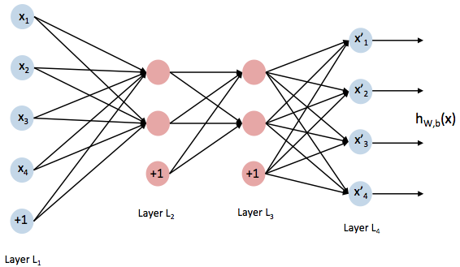
Models
Classification (Cross-entropy loss)
Autoencoder (Squared loss)
CS229T: Course Project

Slide 3


Optimization Algorithms
Accelerated Gradient
Intuition : Encourage persistent directions in gradient.
Adaptive Gradient
Intuition : Encourage rare features.
CS229T: Course Project

Slide 4
Analysis
CS229T: Course Project

Slide 5
Analysis
CS229T: Course Project

Slide 6
Results
Classification (Cross-entropy loss)
4 hidden layers, 150k params
Autoencoder (Squared loss)
7 hidden layers, 2.6 M params
CS229T: Course Project

