Slide 1


Slide 2
Man-in-the-middle attack
Group :9
Name:Lia,Earun Nesa
ID:16-32062-2
Name:Fatema,Kaniz
ID:16-32033-2
Name:Mosaddeq,Shadman
ID:15-30748-3
Name:Ghosh,Rajesh
ID:15-30471-3

Slide 3
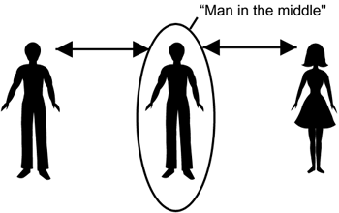
What is Man in the middle attack(MITM)?
The attacker makes independent connections with the victims and modify messages in transit without detection.
Able to intercept and cut off the communications.
Active eavesdropping.

Slide 4
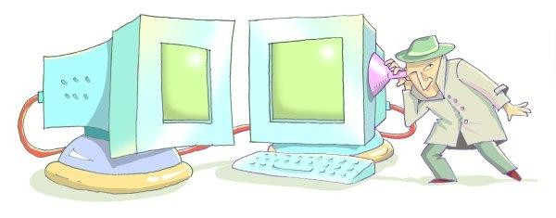
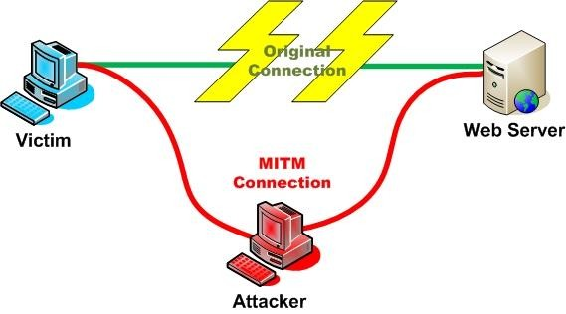
Types of MITM attack
Passive MITM
Attackers ‘tap’ the communication, capturing information in transit without changing it
Active MI TM
Attackers access sensitive information by intercepting and altering communications between the user of a public network and any requested website.

Slide 5
Evolved versions of MITM attack
MITC
MTTB
MITMO
MITA
MIT-IOT

Slide 6
Ways to modify a message
There are (at least) two ways to modify a message:
Modify it on the fly (ex. in Wi-Fi LANs)
Can capture, modify, and replay the message (known as store and forward) (ex. in wired networks)

Slide 7
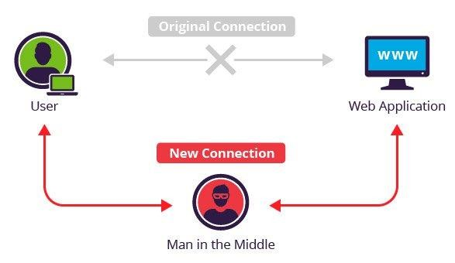
MITM in different networks: store & forward (LANs)
Man-in-the-middle modification attack.
An attacker cuts the wire, receives all the data without consent.
Possible at every forwarding router in the Internet, which is one reason the Internet is treated as totally insecure.

Slide 8
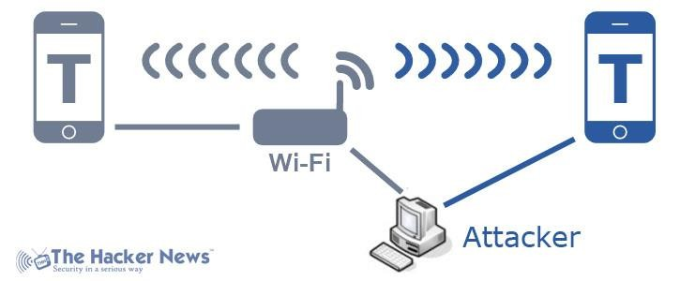
MITM in different networks: store & forward (Wi-Fi LANs)
More difficult because there is no wire to cut.
Must stop the receiver from getting the message on the initial transmission so he can then forward it after exercising his evil intent.
To become a man-in-the-middle between mobile device (Mob) and the access point (AP), the enemy must do the following steps:

Slide 9
Steps of MITM attack in Wi-Fi LANs
Listen to a massage
Transmit a sudden burst
Forge an acknowledgment massage
Recalculates the correct check word
Wait for an acknowledge message

Slide 10
Prevention of MITM attack in Wi-Fi
Mutual authentication between the corporate user and the access point and providing protection against replay attacks.
The security methods for Wi-Fi called Wireless Protected Access (WPA) and Robust Security Network (RSN/WPA2) do this.

Slide 11
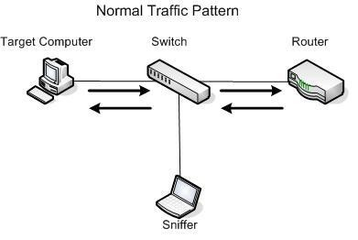
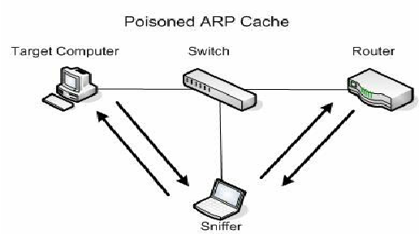
Ways MITM attacks
ARP cache poisoning: a form of attack in which an attacker changes the Media Access Control (MAC) address and attacks an Ethernet LAN by changing the target computer's ARP cache with a forged ARP request and reply packets

Slide 12
Ways MITM attacks(cont.)
HTTP session hijacking: A security attack on a user session over a protected network
passing the hash: An expoit in which an attacker steals a hashed user credential and, without cracking it, reuses it to trick an authentication system into creating a new authenticated session on the same network.

Slide 13
Ways MITM attacks(cont.)
IP address spoofing: creation of Internet Protocol (IP) packets with a false source IP address, for the purpose of impersonating another computing system.
DNS spoofing: an attack in which altered DNS records are used to redirect online traffic to a fraudulent website that resembles its intended destination.

Slide 14
Tools used for MITM
Cain and Abel
Wireshark
Kali Linux
Ettercap
USB Wi-Fi Adapter

Slide 15
Prevent MITM attack
Strong WEP/WAP Encryption on Access Points
Virtual Private Network
Force HTTPS
Public Key Pair Based Authentication

Slide 16
Conclusion
It’s unfortunate that cyber-attacks are becoming so much sophisticated. So, we have to take action against the cyber attack and secure our online communication. Remember, Cyber security is important to everyone, So every person that secures communications make an impact on internet users as a whole.

Slide 17
Any question?
Thank you so much

