Slide 1

Business Rule Validation Across The Stack
Validating User Submitted Data with FluentValidation
Stefan Vantchev
Software Architect, Mosaix Software
Pittsburgh, PA
svantchev@mosaixsoftware.com

Slide 2
Goals
Unobtrusive - reduce clutter in controller code
Testable - increase code coverage and allow for fully dedicated validation testing
Extensible - provide for pain-free development of add-on functionality and high degree of customization
Injectable - DI ready, allow for custom integration scenarios
Easy to read and understand

Slide 3
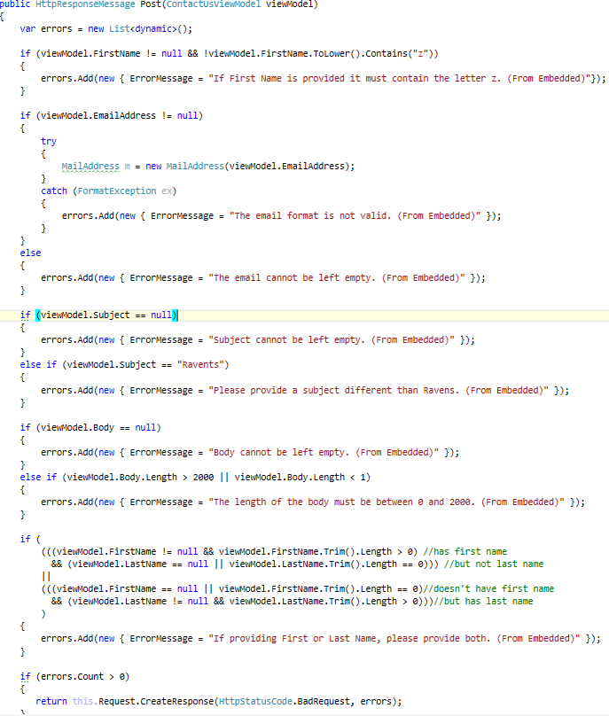
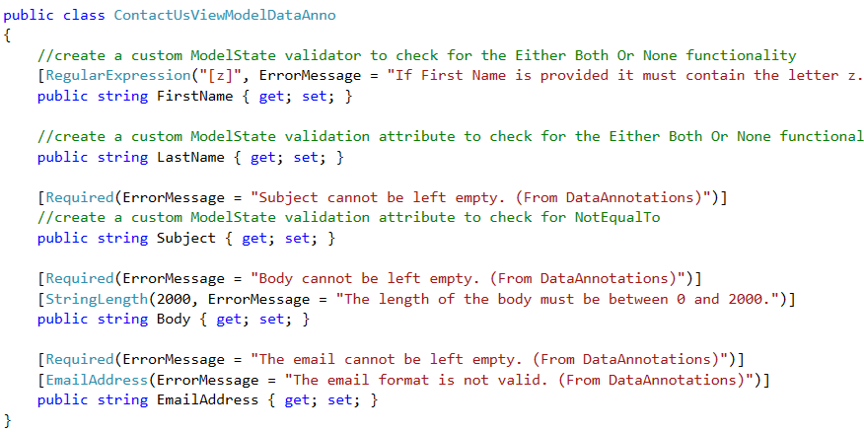
Unobtrusive
Controller Action Embedded Validation Logic
Data Model Embedded Validation Logic

Slide 4
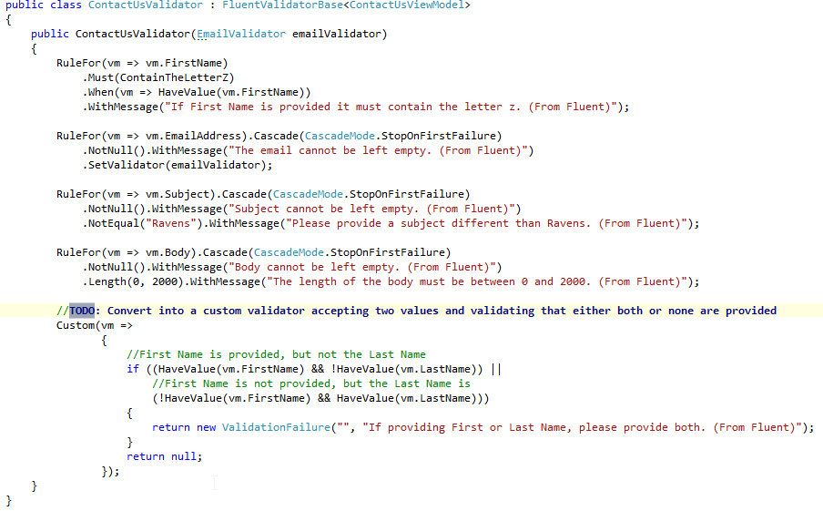
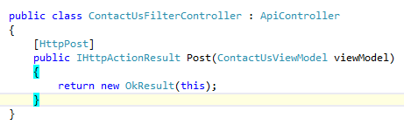
Unobtrusive
Fluent Validator
Controller After Validation Moved to Fluent IValidator<T>
By encapsulating the validation logic in its own class, we have achieved clean controller code and reusable validation object.
The messages are here for consistency purposes.

Slide 5
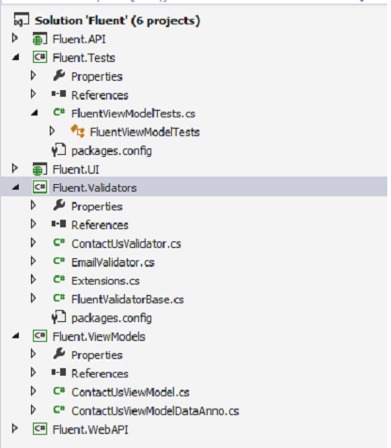
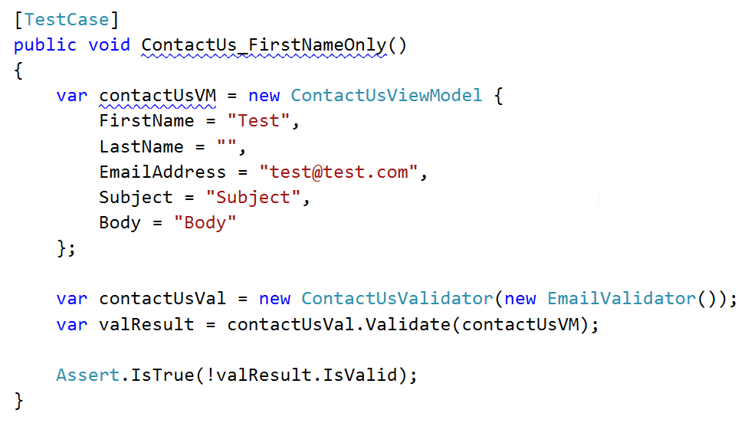
Testable
Proper Project Structure Allows For Ease of Testing
Unit Testing Example

Slide 6
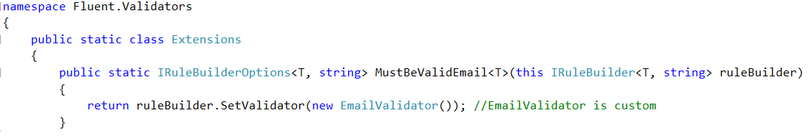
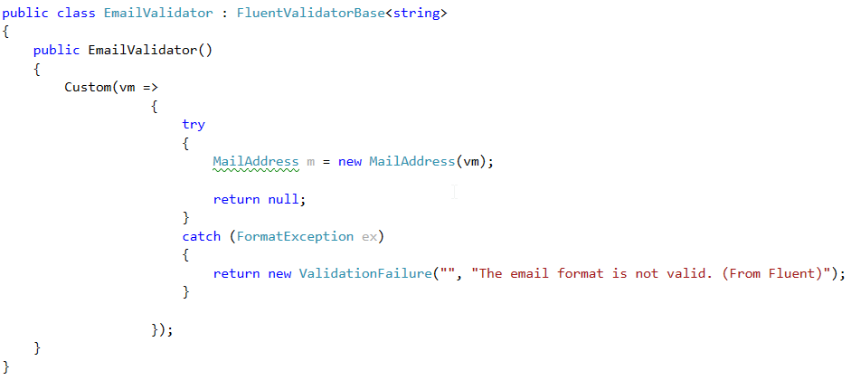
Extensible
Fluent Validation Extensions
Fluent Validation Custom Validators

Slide 7
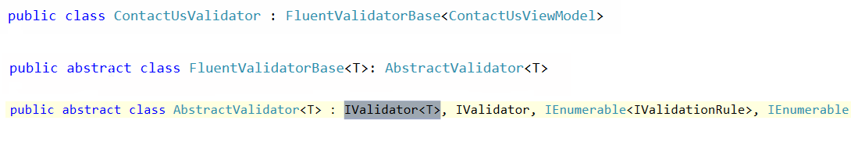
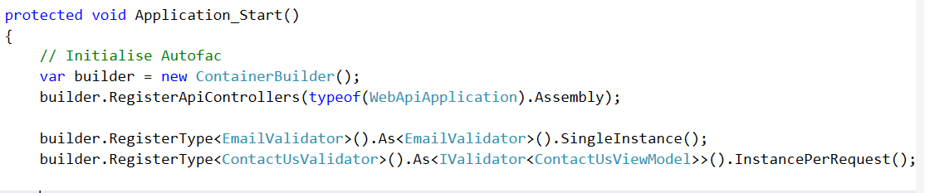
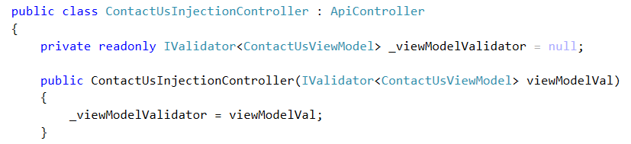
Injectable
Validator Extended Signature
Autofac Dependency Injection Container Setup
Controller Constructor Injection

Slide 8
Possibilities
Convert the FluentValidationActionFilter to a DelegateHandler to allow for integration of in a delegate pipelines for purposes route execution optimization
early execution of validation logic prevents unnecessary instantiation of the rest of the HttpMessage lifecycle players. Refer to Appendix A
Develop functionality for dynamic validation based on configuration parameters - an injectable validation configurator
via DI we can already inject database driven error messages, regular expression strings; a custom validator could possibly be devised to accept field validation definitions to allow for customized validation experience
Associate data validity with the version of the validator used at the time of validation
with some clever engineering, it is possible to associate data at time of creation with the validation version which was applied at that time
Validation-only routes
most of data validation is done on data submission; why not provide validation-only routes for pre-submission

Slide 9
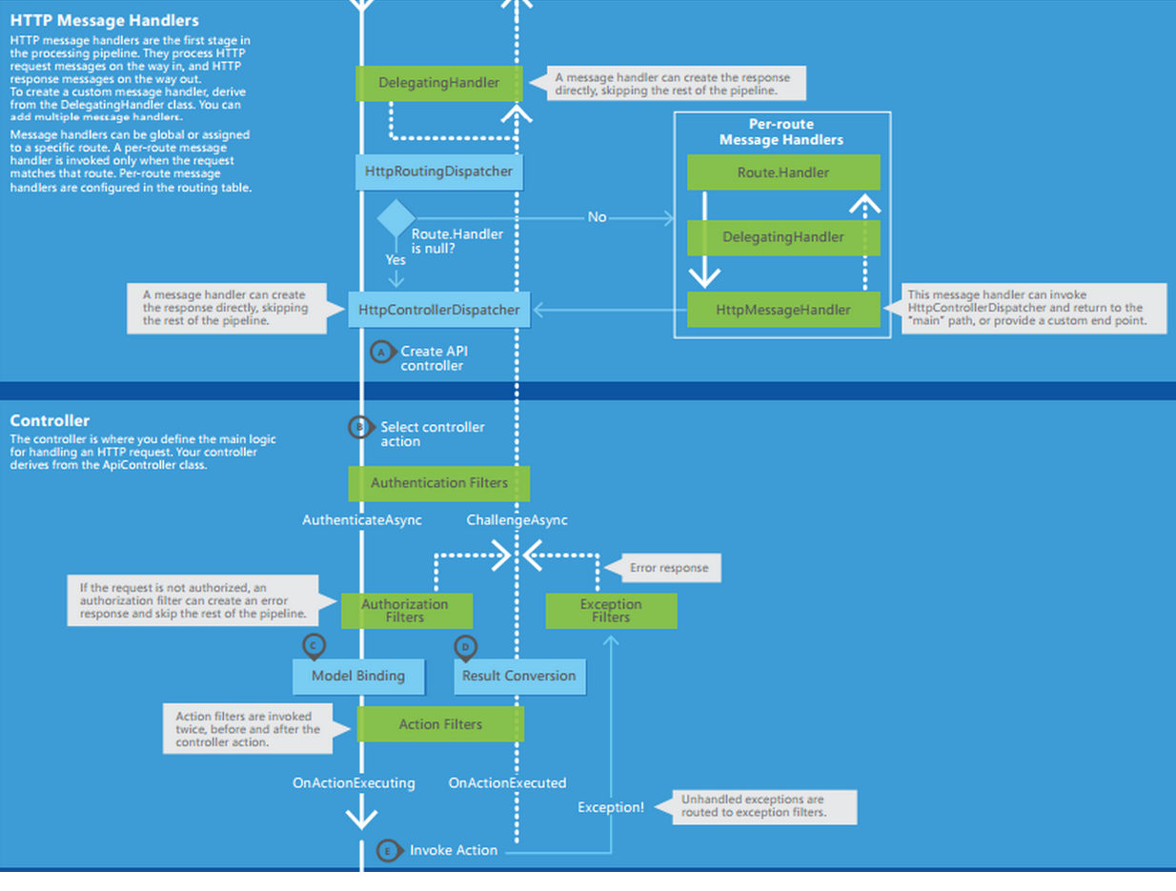
Appendix A
New Execution Stage for FluentValidationDelegateHandler
Current Execution Stage of FluentValidationActionFilter

Slide 10
Appendix B
Resources
FluentValidation
https://github.com/JeremySkinner/FluentValidation/
FluentValidation Action Filter
https://github.com/richardlawley/WebApi-FluentValidation/tree/master/src/RichardLawley.WebApi.FluentValidation
WebAPI HTTP Message Lifecycle
http://download.microsoft.com/download/9/C/3/9C31B8B7-6E13-4A69-B378-9A04C80616EF/Web%20API%20Poster.zip
Complete Guide To Validation In MVC
http://www.devtrends.co.uk/blog/the-complete-guide-to-validation-in-asp.net-mvc-3-part-2

Slide 11
The Only Thing That Is Constant Is Change
Heraclitus
Stefan Vantchev
Software Architect, Mosaix Software
Pittsburgh, PA
svantchev@mosaixsoftware.com

