Slide 1
Oxfords e lesson 1 T3
Grade : Basic 6
Subject : Mathematics
Topic : Length And
Pythagoras Theorem

Slide 2
Salient point
Pythagoras Theorem
Pythagoras theorem states that in a right angled triangle, the square of the hypotenuse is equal to the sum of the squares of the other two sides.

Slide 3






Let us use the triangle below to illustrate this information.

Slide 4
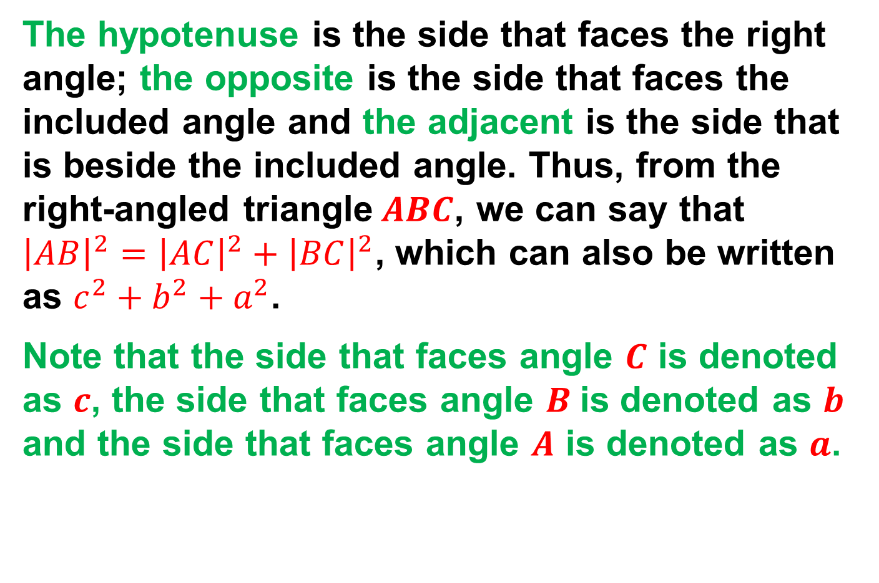
The hypotenuse is the side that faces the right angle; the opposite is the side that faces the included angle and the adjacent is the side that is beside the included angle. Thus, from the right-angled triangle$ABC$, we can say that ${\left|AB\right|}^{2}={\left|AC\right|}^{2}+{\left|BC\right|}^{2}$, which can also be written as $c^{2}+b^{2}+a^{2}$.
Note that the side that faces angle $C$ is denoted as $c$, the side that faces angle $B$is denoted as $b$ and the side that faces angle $A$ is denoted as $a$.

Slide 5
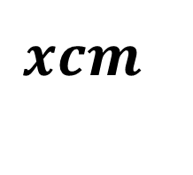
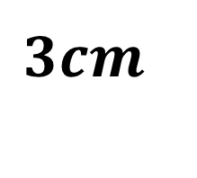
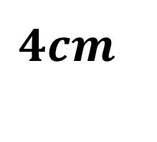

Question 1
Find the length of the unknown side $x,$ in the figure below.

Slide 6


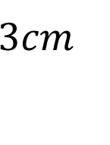


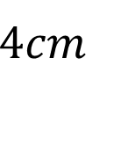
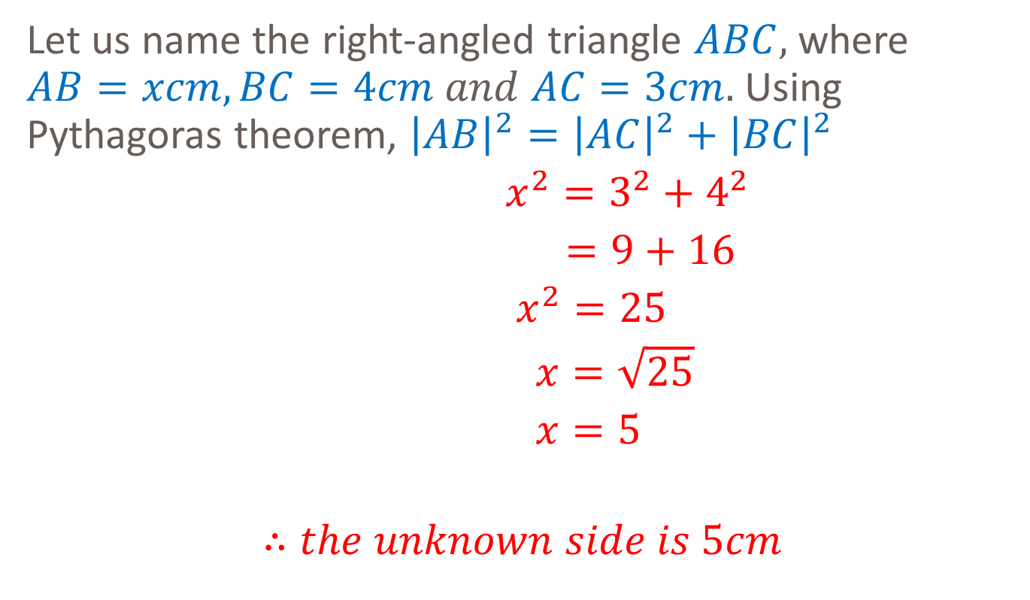
solution
Let us name the right-angled triangle $ABC,$ where $AB=xcm, BC=4cm and AC=3cm.$ Using Pythagoras theorem, ${\left|AB\right|}^{2}={\left|AC\right|}^{2}+{\left|BC\right|}^{2}$
$x^{2}=3^{2}+4^{2}$
$=9+16$
$x^{2}=25$
$x=\sqrt{25}$
$x=5$
$$∴the unknown side is 5cm$$

Slide 7

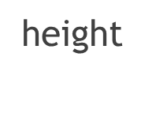



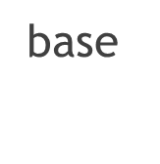
Area of triangle

Slide 8
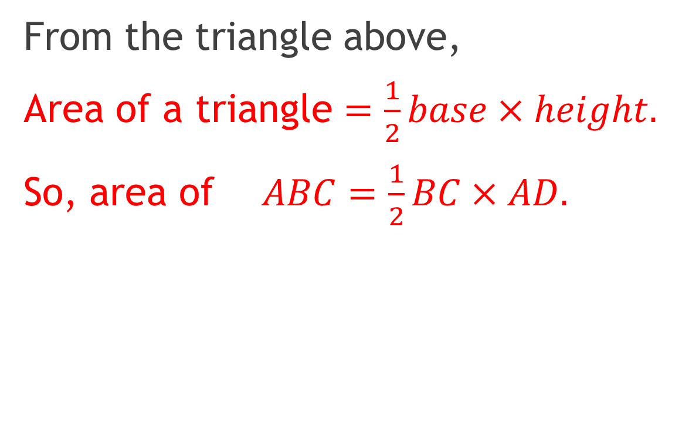
From the triangle above,
Area of a triangle $=\frac{1}{2}base×height.$
So, area of $ABC=\frac{1}{2}BC×AD.$

Slide 9

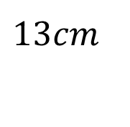
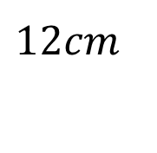
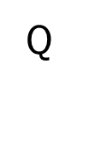


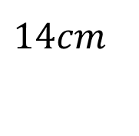

Question 2
Find the area of $∆PQR$.

Slide 10
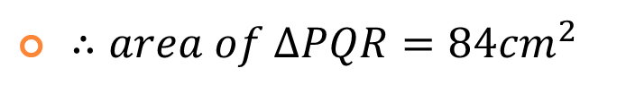
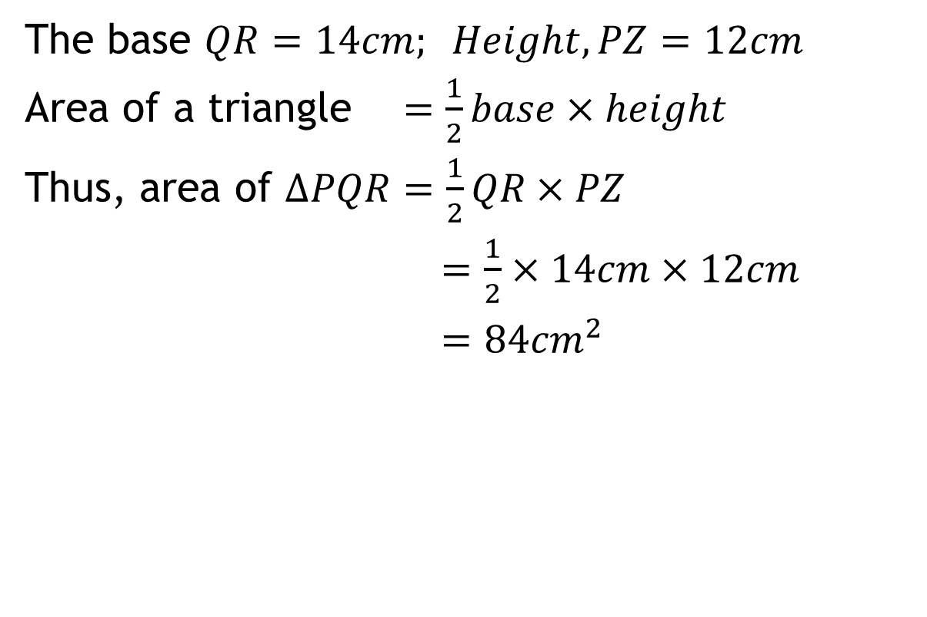
Solution
The base $QR=14cm; Height, PZ=12cm$
Area of a triangle $=\frac{1}{2}base×height$
Thus, area of $∆PQR=\frac{1}{2}QR×PZ$
$=\frac{1}{2}×14cm×12cm$
$=84{cm}^{2}$

Slide 11


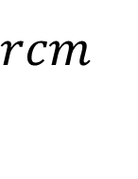
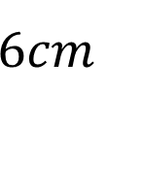




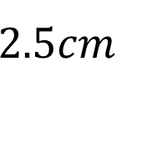
assignment
1. Find the lengths of the unknown sides.
(a) (b)

Slide 12
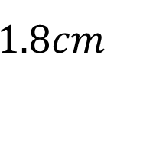
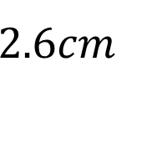
2. Find the area of the triangle below.

Slide 13
Additional studies
Read and study on the area of plane shapes.

