Slide 1
Oxfords E-lesson 2,T3
Grade : Basic 8
Subject : Basic science
Topic : Work, Energy and
Power
Breakdown : i) explain work.
ii) explain when work is to be done.
iii) calculate work done on an object

Slide 2
Learning Outcome
i). Explain work.
ii). When is work said to be
done?
iii). Calculate work done on a
object.

Slide 3
Salient Points
Work
Work is a product of force and distance moved in a given direction. The quantity of work done is always equal to the quantity of energy put in.
In science, work is said to be done when a force can produce movement in a measured direction.
ie work = force (f) X distance (d) moved in the direction of the force
[ w = f X d ]

Slide 4
Work can simply be defined as the product of distance moved and the force applied in the direction of the movement.
Generally, for any work done, there must be energy input since energy is the capacity of any system or body to do work. Both work and energy are measured in unit called joules named after the scientist P. Joules who carried out early studies on energy.

Slide 5
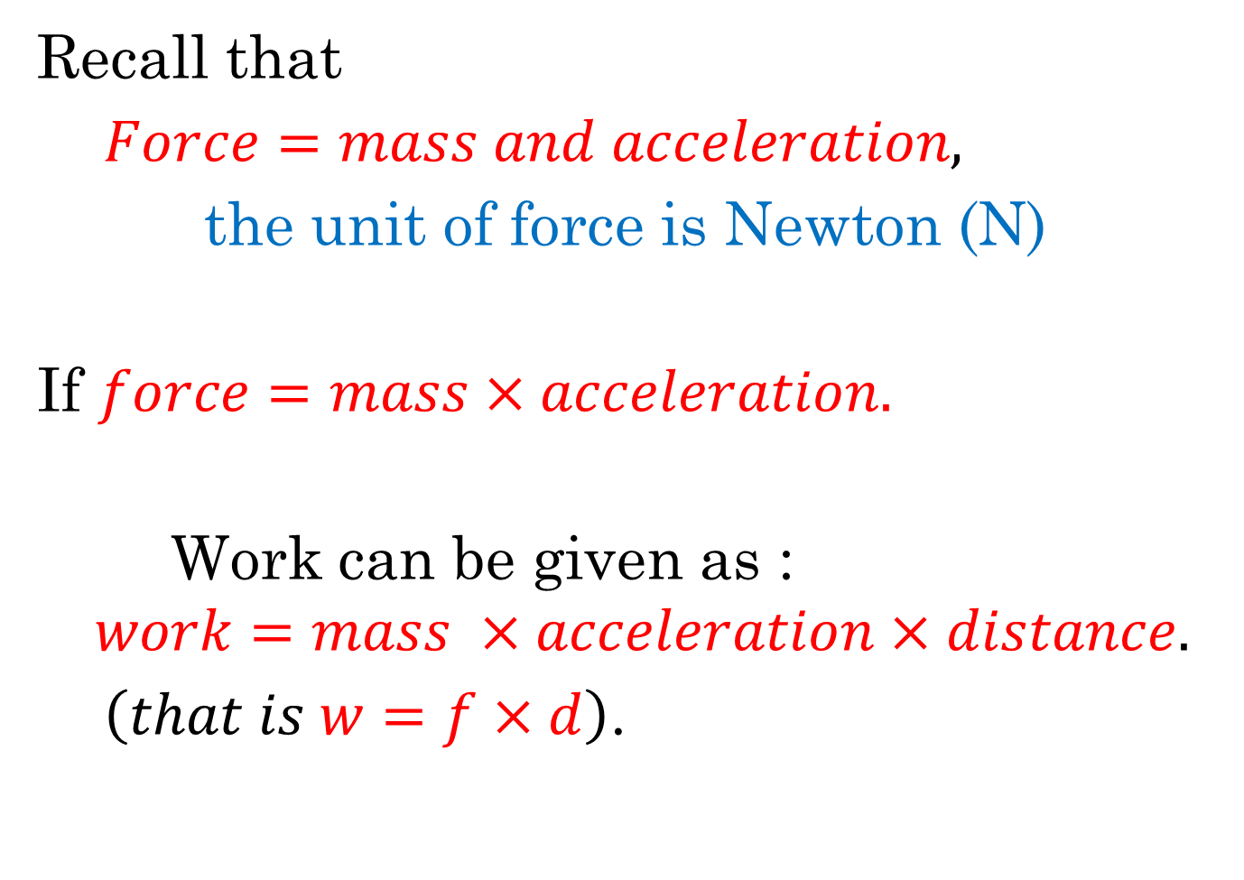
Recall that
$Force=mass and acceleration,$
the unit of force is Newton (N)
If $force=mass×acceleration.$
Work can be given as :
$$work=mass ×acceleration×distance.$$
$\left(that is w=f×d\right)$.

Slide 6
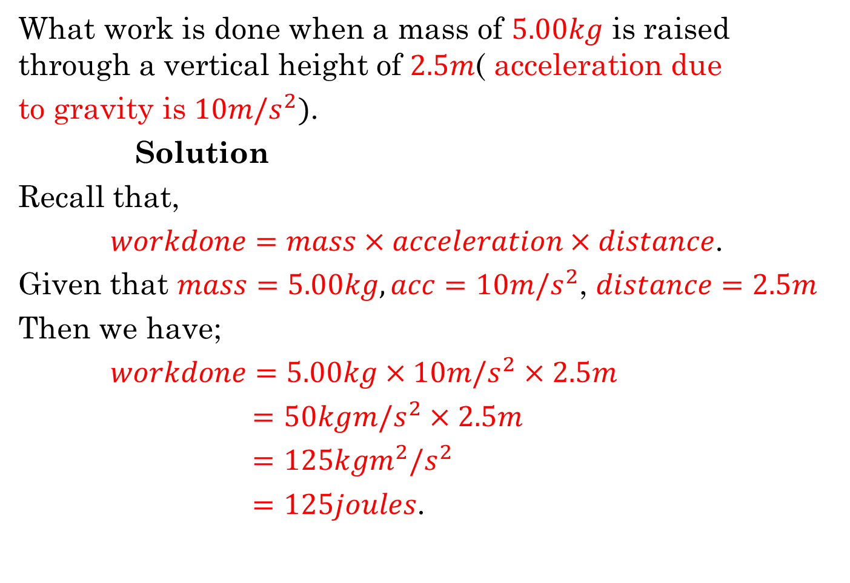
Example
What work is done when a mass of $5.00kg$ is raised through a vertical height of $2.5m$( acceleration due
to gravity is $10m/s^{2})$.
Solution
Recall that,
$workdone=mass×acceleration×distance$.
Given that $mass=5.00kg, acc=10m/s^{2}$, $distance=2.5m$
Then we have;
$workdone=5.00kg×10m/s^{2}×2.5m$
$=50kgm/s^{2}×2.5m$
$=125kgm^{2}/s^{2}$
$=125joules$.

Slide 7
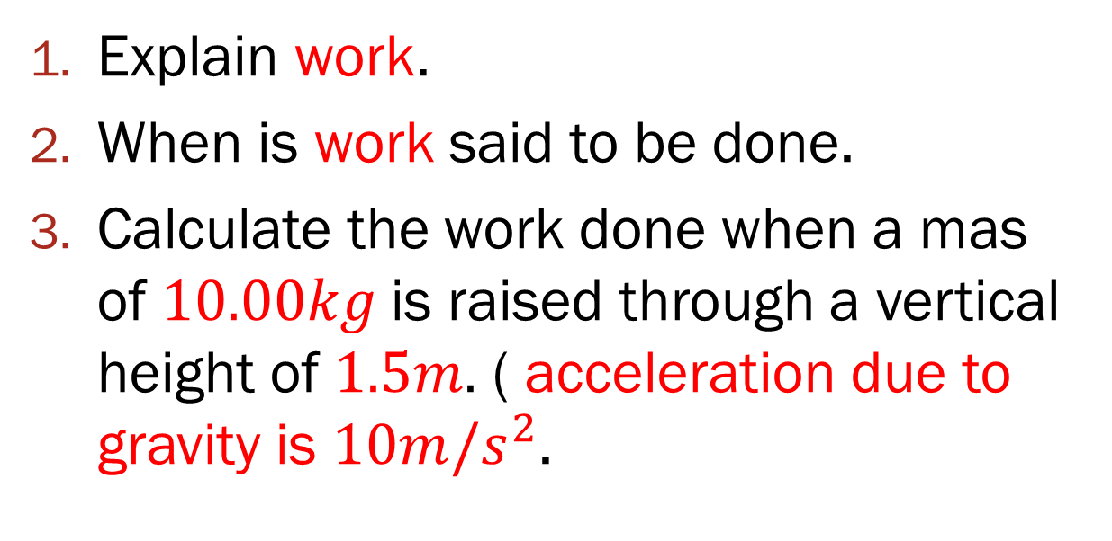
Assignment
Explain work.
When is work said to be done.
Calculate the work done when a mas of $10.00kg$is raised through a vertical height of $1.5m.$ ( acceleration due to gravity is $10m/s^{2}$.

Slide 8
Additional Studies
Study extensively on ‘Power’ and its calculations

