Slide 1
Oxfords E-lesson 1, t3
Grade : Basic 9
Subject : Basic Science
Topic : You and Energy
Breakdown : i) Magnetism.
ii) Electrical Energy

Slide 2
Salient point
Magnet(Definition):
A magnet is a metallic object that
attracts other metallic objects towards
it. Elements which are attracted by
magnets are called magnetic materials.
They include iron, steel, nickel etc.

Slide 3
Substances that can be attracted by
magnets are said to be magnetic
substances and the ability of a magnet
to attract magnetic substances is called Magnetism.

Slide 4
Laws of Magnetism
When a bar of magnet is put in a
plate of iron fillings, the iron fillings will
move closer or cling or are attracted to
the magnet and cluster at the ends of the
magnet.

Slide 5
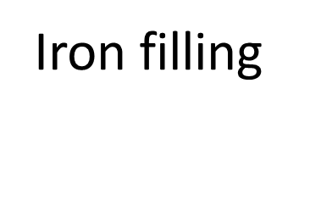


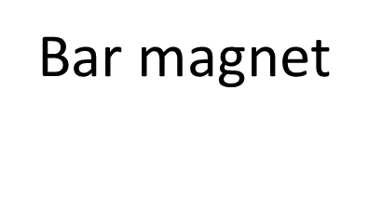

Slide 6
The magnet is a stone load that occurs
naturally under the earth crust. A magnet
can attract pieces of metals. The pole of
a magnet is a portion of the magnet
where its magnetic properties appears to
be strongest.

Slide 7
The end that points to the northward direction is called North Pole while the end that points to the southward direction is known as South Pole.

Slide 8
According to Coulomb’s first law, the
force between two magnetic poles is
directly proportional to the product of
their pole strength and inversely
proportional to the distance between
them.

Slide 9
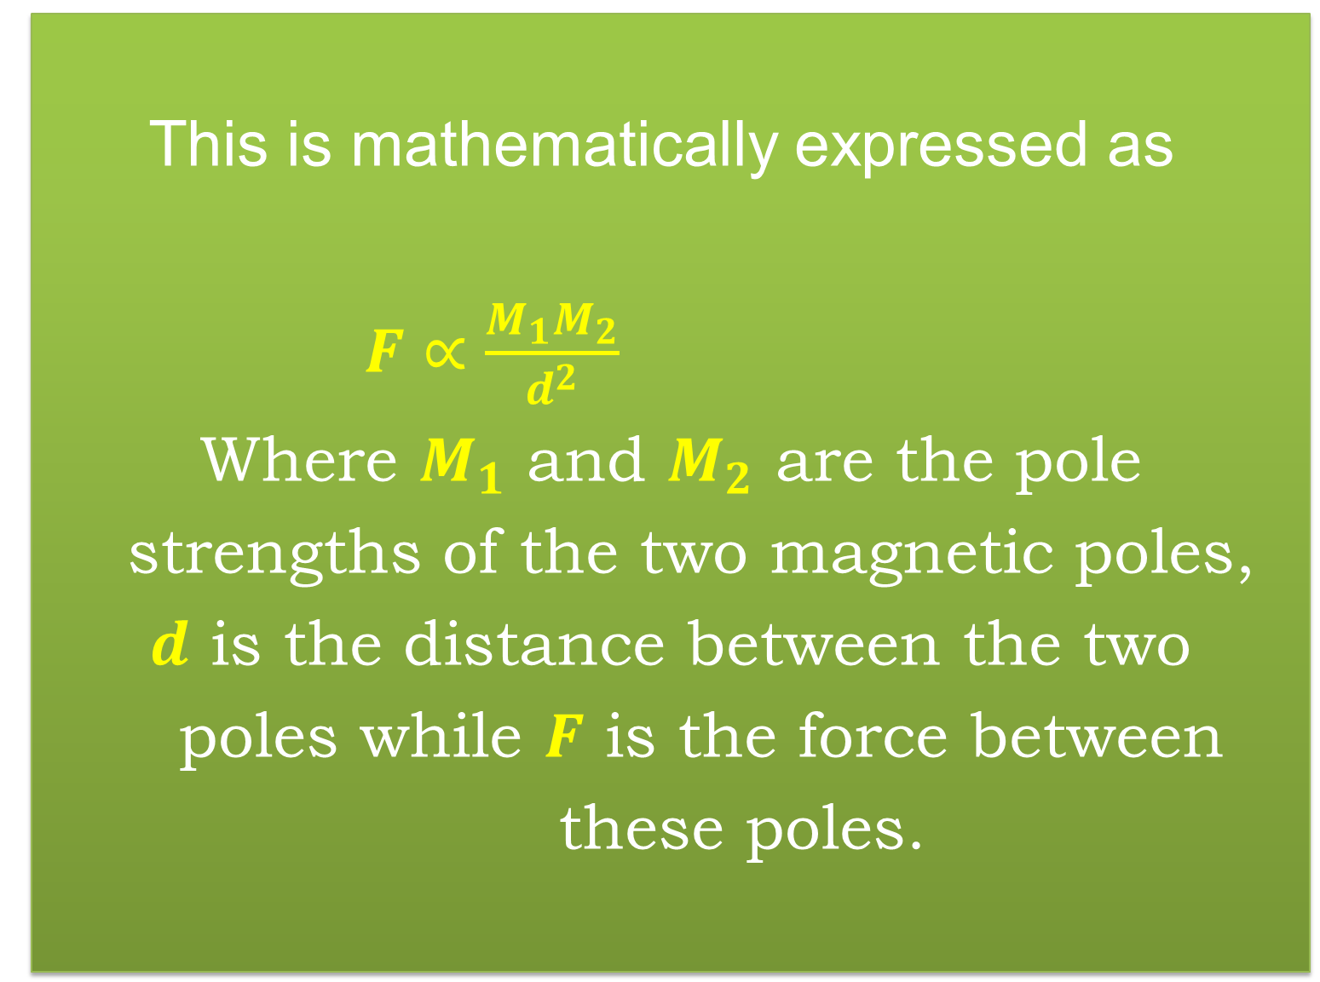
This is mathematically expressed as
$F∝\frac{M_{1}M_{2}}{d^{2}}$
Where $M_{1}$ and $M_{2}$ are the pole
strengths of the two magnetic poles,
$d$ is the distance between the two
poles while $F$ is the force between
these poles.

Slide 10


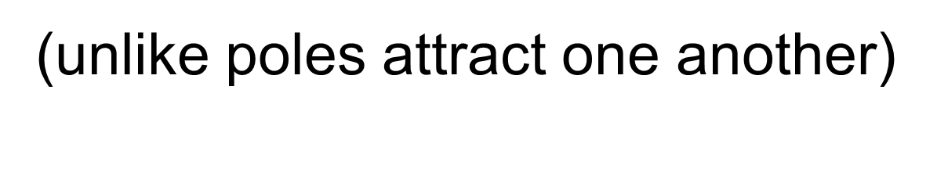

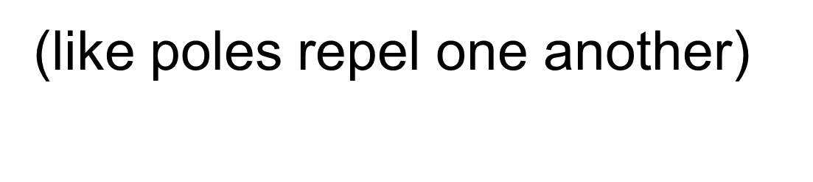
Attraction and repulsive poles

Slide 11
Magnetic field
The region or space around a
magnet in which the influence of the
magnet can be felt or detected is called a magnetic field.

Slide 12
This space can be mapped out using a
magnetic needle which swings around
and settles in a definite direction when
placed in a magnetic field. The swinging
of the needle shows that it has been
subjected to a force. This force is known
as the magnetic force. Thus magnetic field
is a force field.

Slide 13
Care for magnet
The simple ways of taking care of a
magnet includes:
1). Magnets should be handled and stored with
care so that it will not loose its magnetic
properties.
2). Magnets should be knocked or hit with
objects.
3). A non-magnetic object should be placed
between magnets.
4). Two magnets must be placed in opposite directions
to avoid repulsion.

Slide 14
Assignment
1). Explain the term ‘Magnet’.
2). State the Coulomb’s Law of Magnetism.
3). What is a magnetic field?
4). a). Explain the poles of a magnet.
b). Use a bar magnet to show the
difference between the poles.
5). Mention two ways of taking care of
magnets.

Slide 15
Additional studies
Read and study extensively on:
1) (a). Electrical energy.
(b). Flow of electrons.
(c). Electric circuit: (i). Parallel
(ii). Series
2). Fuses and Circuit breaker.
3). Electric meter reading and billing.

