Slide 1
Oxfords E- Lesson 1, T3.
Grade: JSS3
Subject: Mathematics
Topic: Household and
commercial Arithmetic.

Slide 2
Breakdown: Ratios and Proportion, Household
Arithmetic, Commercial Arithmetic.
Learning Outcome
1. Solve simple problems involving Ratios and proportion.
2. Solve problems involving savings and instalmental
payments.
3. Solve problems on profit and loss.

Slide 3
Salient Points
Ratios and Proportions:
A ratio is the relationship which one quantity has
with another quantity
of the same kind, with respect to magnitude,
while proportion is the equality of ratios.
Let us consider the following problem:

Slide 4
Question 1
A car uses 40 liters of petrol for a journey of
500km.
What quality of fuel is required for a journey of
360km?

Slide 5
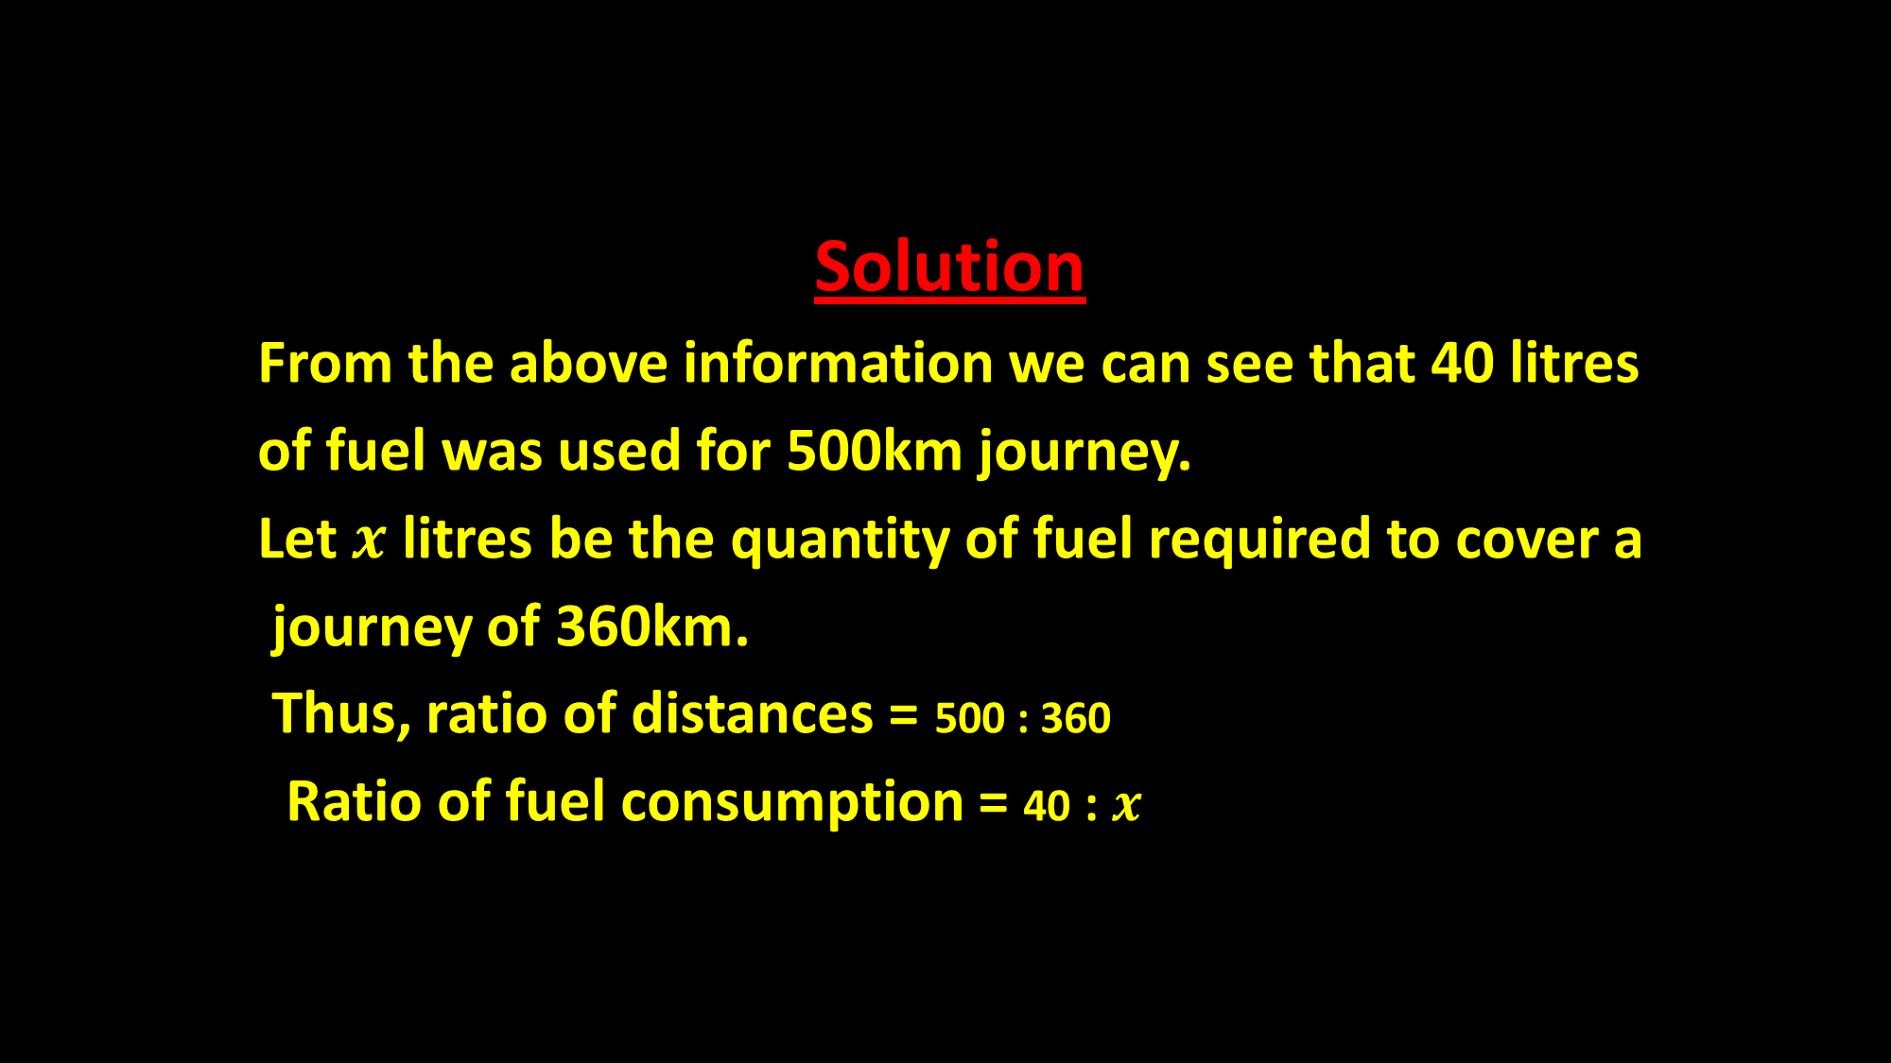
Solution
From the above information we can see that 40 litres
of fuel was used for 500km journey.
Let $x$ litres be the quantity of fuel required to cover a
journey of 360km.
Thus, ratio of distances = 500 : 360
Ratio of fuel consumption = 40 : $x$

Slide 6
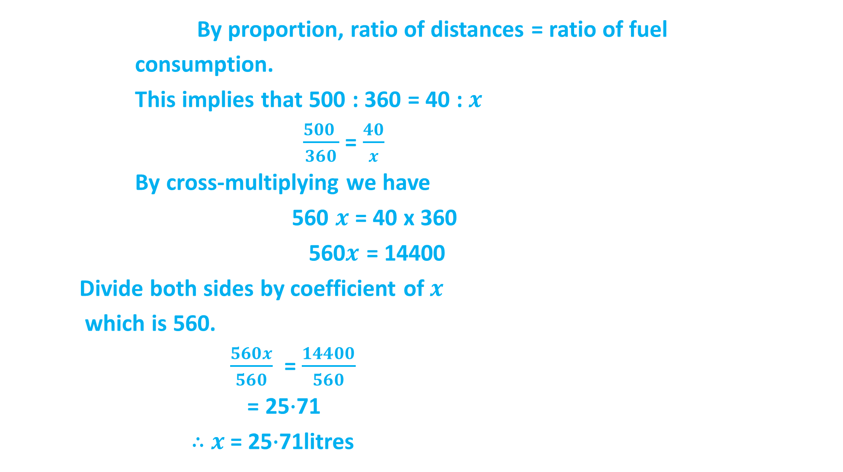
By proportion, ratio of distances = ratio of fuel
consumption.
This implies that 500 : 360 = 40 : $x$
$\frac{500 }{360}$ = $\frac{40}{x}$
By cross-multiplying we have
560 $x$ = 40 x 360
560$x$ = 14400
Divide both sides by coefficient of$x$
which is 560.
$\frac{560x}{560}$ = $\frac{14400}{560}$
= 25$∙$71
$∴$ $x$= 25$∙$71litres

Slide 7
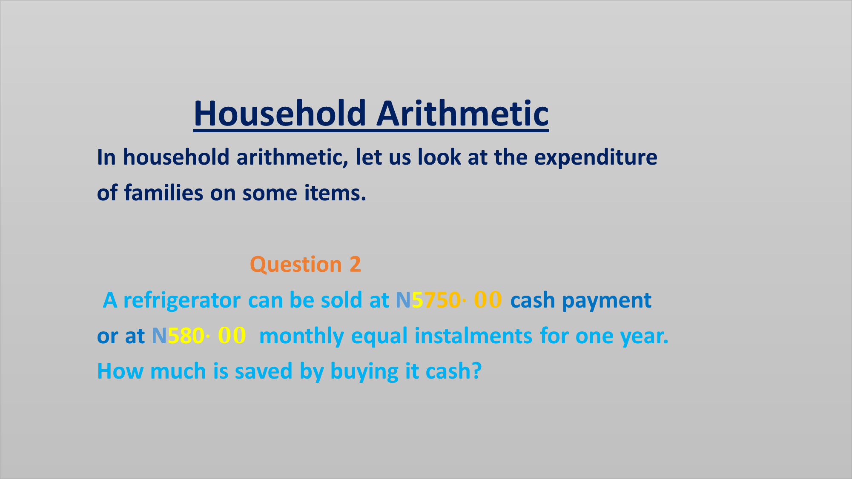
Household Arithmetic
In household arithmetic, let us look at the expenditure
of families on some items.
Question 2
A refrigerator can be sold at N5750$∙00$ cash payment
or at N580$∙00$ monthly equal instalments for one year.
How much is saved by buying it cash?

Slide 8
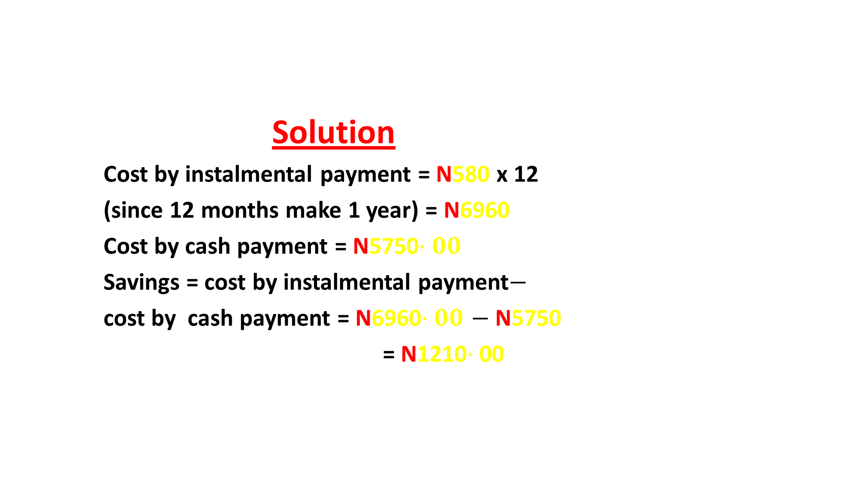
Solution
Cost by instalmental payment = N580 x 12
(since 12 months make 1 year) = N6960
Cost by cash payment = N5750$∙00$
Savings = cost by instalmental payment$−$
cost by cash payment = N6960$∙00$ $−$ N5750
= N1210$∙$00

Slide 9
Commercial Arithmetic
Here we want to consider the aspect of commercial
arithmetic that involves profit and loss
Question 3
A trader incurred a loss of 5% by selling a book
for N150. How much does he sell to make a gain of 5%?

Slide 10
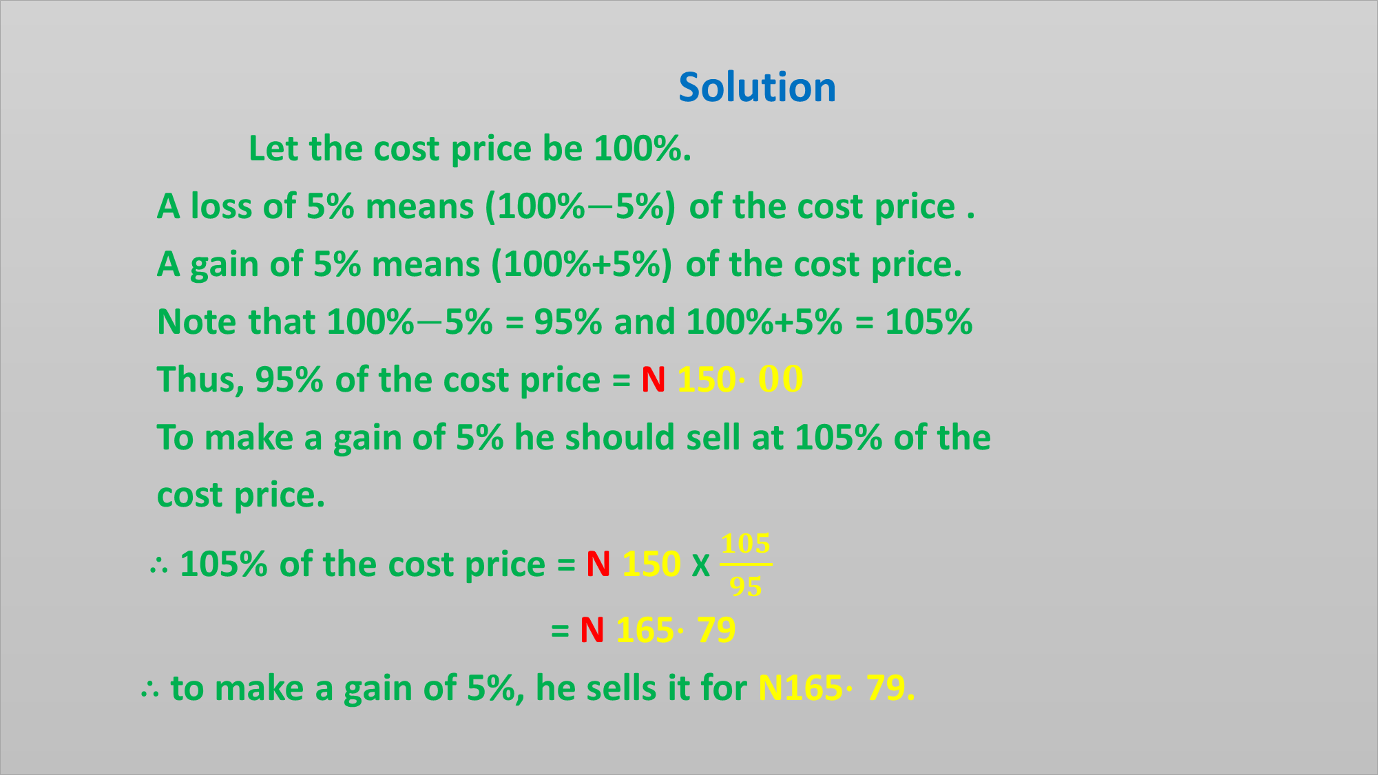
Solution
Let the cost price be 100%.
A loss of 5% means (100%$−$5%) of the cost price .
A gain of 5% means (100%+5%) of the cost price.
Note that 100%$−$5% = 95% and 100%+5% = 105%
Thus, 95% of the cost price = N 150$∙00$
To make a gain of 5% he should sell at 105% of the
cost price.
$∴$ 105% of the cost price = N 150 X $\frac{105}{95}$
= N 165$∙$ 79
$∴$ to make a gain of 5%, he sells it for N165$∙$ 79.

Slide 11
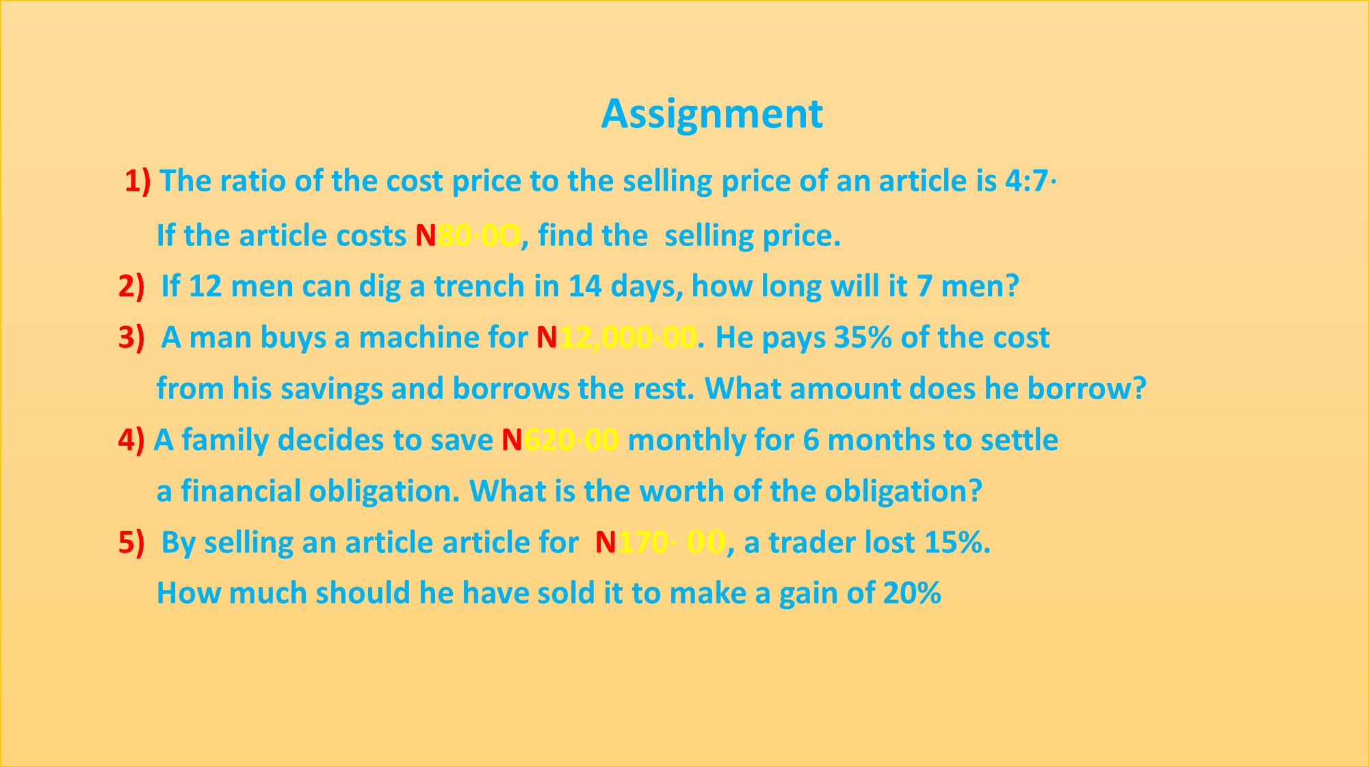
Assignment
1) The ratio of the cost price to the selling price of an article is 4:7$∙$
If the article costs N80$∙$0O, find the selling price.
2) If 12 men can dig a trench in 14 days, how long will it 7 men?
3) A man buys a machine for N12,000$∙$00. He pays 35% of the cost
from his savings and borrows the rest. What amount does he borrow?
4) A family decides to save N620$∙$00 monthly for 6 months to settle
a financial obligation. What is the worth of the obligation?
5) By selling an article article for N170$∙00$, a trader lost 15%.
How much should he have sold it to make a gain of 20%
$$∙$$

Slide 12
ADDITIONAL STUDIES
Read and study fractions and percentages.

