Slide 1
Oxfords E-lesson 1
Grade : SS3
Subject : Chemistry（Revision）
Topic : Rules for Writing Electronic Configuration

Slide 2
Salient Points
Filling Orbitals
Filling orbitals method is known as Aufbau order of filling sublevels. In this method, the orbitals are selected based on the direction of the arrow.

Slide 3
The orbital 1s is selected before 2s and so on.
1s
2s 2p
3s 3p 3d
4s 4p 4d 4f
5s 5p 5d
6s 6p
7s

Slide 4
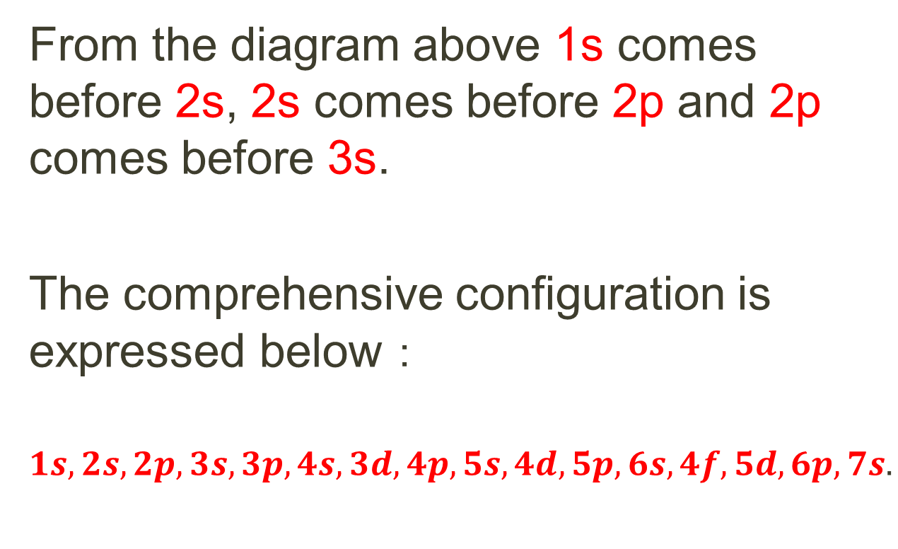
From the diagram above 1s comes before 2s, 2s comes before 2p and 2p comes before 3s.
The comprehensive configuration is expressed below：
$$1s,2s,2p,3s,3p,4s,3d,4p,5s,4d,5p,6s,4f,5d,6p,7s.$$

Slide 5
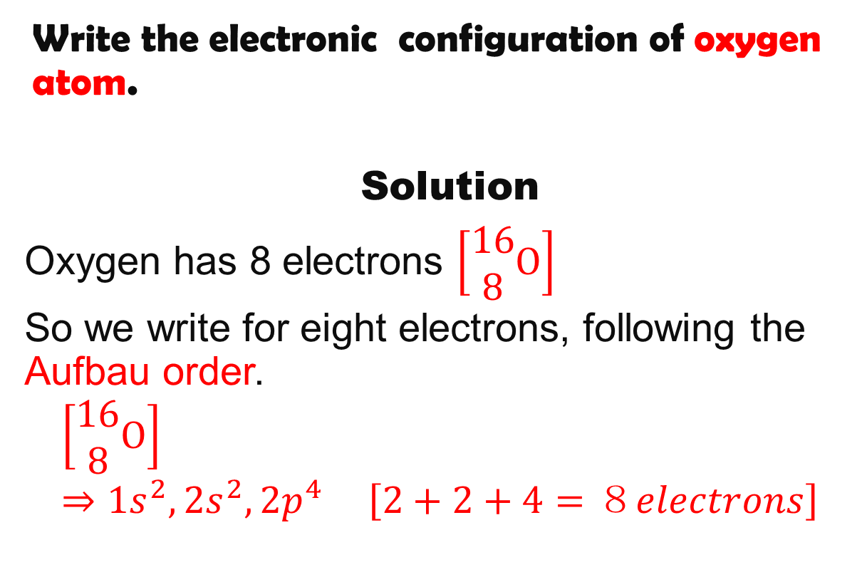
Example 1
Write the electronic configuration of oxygen atom.
Solution
Oxygen has 8 electrons $\left[\begin{aligned}16 \\ 8\end{aligned}O\right]$
So we write for eight electrons, following the Aufbau order.
$$\left[\begin{aligned}16 \\ 8\end{aligned}O\right]⇒1s^{2},2s^{2},2p^{4} \left[2+2+4=８electrons\right]$$

Slide 6
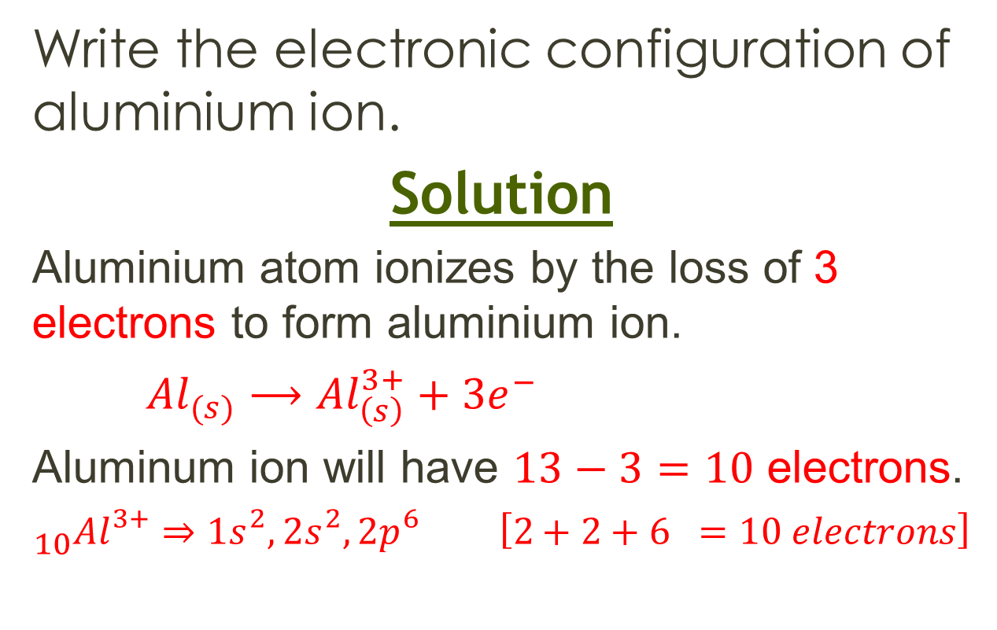
Example 2
Write the electronic configuration of aluminium ion.
Solution
Aluminium atom ionizes by the loss of 3 electrons to form aluminium ion.
${Al}_{(s)}⟶{Al}_{\left(s\right)}^{3+}+{3e}^{−}$
Aluminum ion will have $13−3=10$ electrons.
$${}_{10}^{}{{Al}^{3+}⇒{1s}^{2},{2s}^{2},{2p}^{6}} \left[2+2+6 =10 electrons\right]$$

Slide 7
Assignment
Write the electronic configurations of the following:
Nitrogen atom.
Sodium ion.
Calcium atom.
Chloride ion.
Chromium atom.

Slide 8
Additional Studies
Study valency and oxidation number of elements.

