Slide 1
Oxfords E-Lesson 1
GRADE : SS3 (SSCE REVISION)
SUBJECT : MATHEMATICS
TOPIC : NUMBER BASES
BREAKDOWN : COMPUTATIONS INVOLVING NON-DECIMAL BASES. EQUATIONS INVOLVING BASES.

Slide 2
Learning Outcome
Solve problems involving non-decimal bases.
Solve equations involving bases.

Slide 3
Salient Points
Computations Involving Non-decimal
Bases
When we talk of non-decimal bases,
we mean other bases apart from base
10. Whenever you are solving any
problem involving a non-decimal base,
the digits that are allowed to exist are
those that are not up to the base
involved.

Slide 4
Suppose you add or multiply numbers in bases other than ten and your
result is up to or more than the base involved you should carry out the necessary conversion to that base.

Slide 5
For example in operations of numbers
in base 8, the only digits that can exist
are 0, 1, 2, 3, 4, 5, 6, and 7

Slide 6
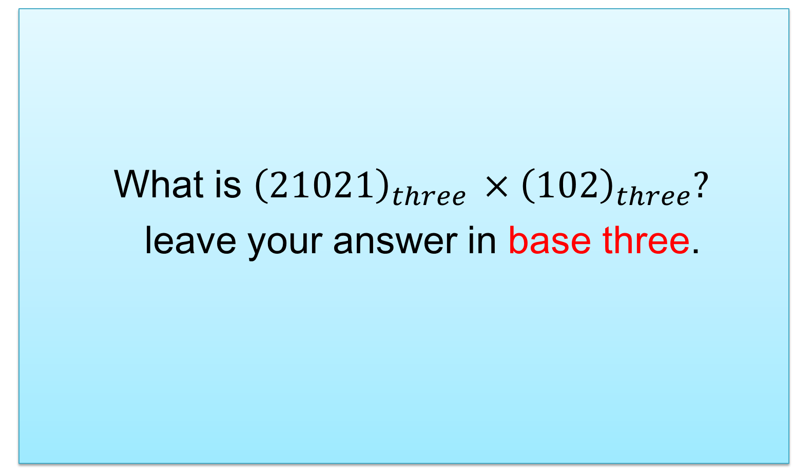
Question 1
What is ${\left(21021\right)}_{three }×{\left(102\right)}_{three}?$
leave your answer in base three.

Slide 7
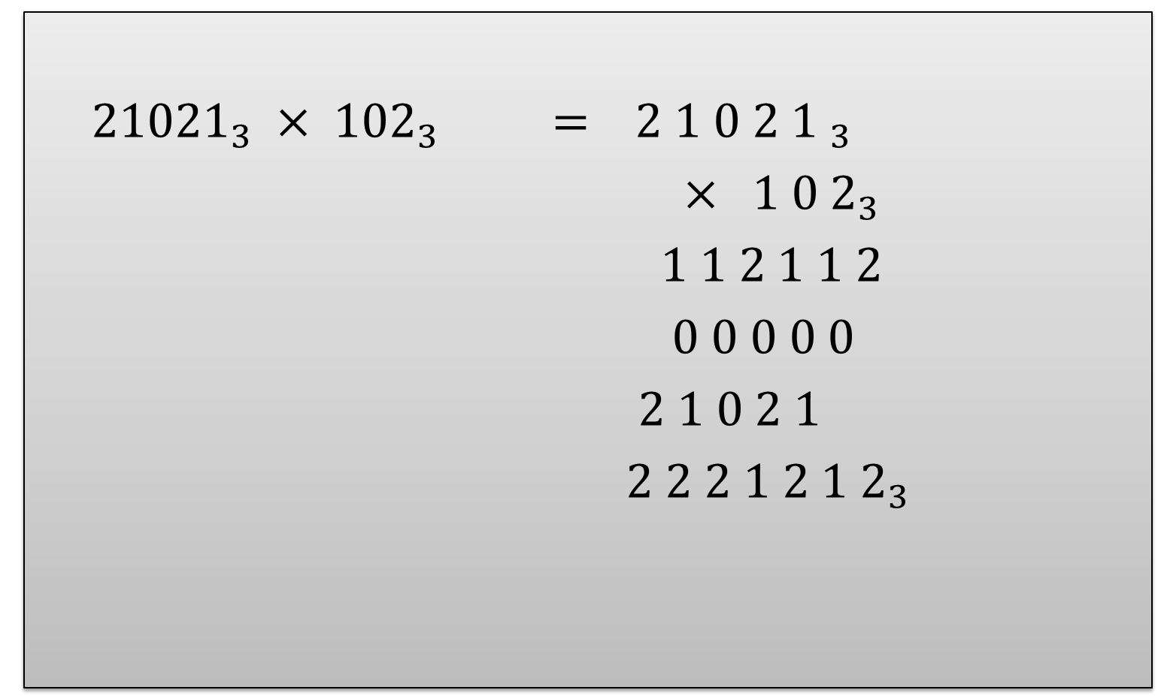
Solution
${21021}_{3} × {102}_{3} =$ ${2 1 0 2 1 }_{3}$
$× { 1 0 2}_{3}$
$1 1 2 1 1 2$
$0 0 0 0 0$
$2 1 0 2 1$
${2 2 2 1 2 1 2}_{3}$

Slide 8
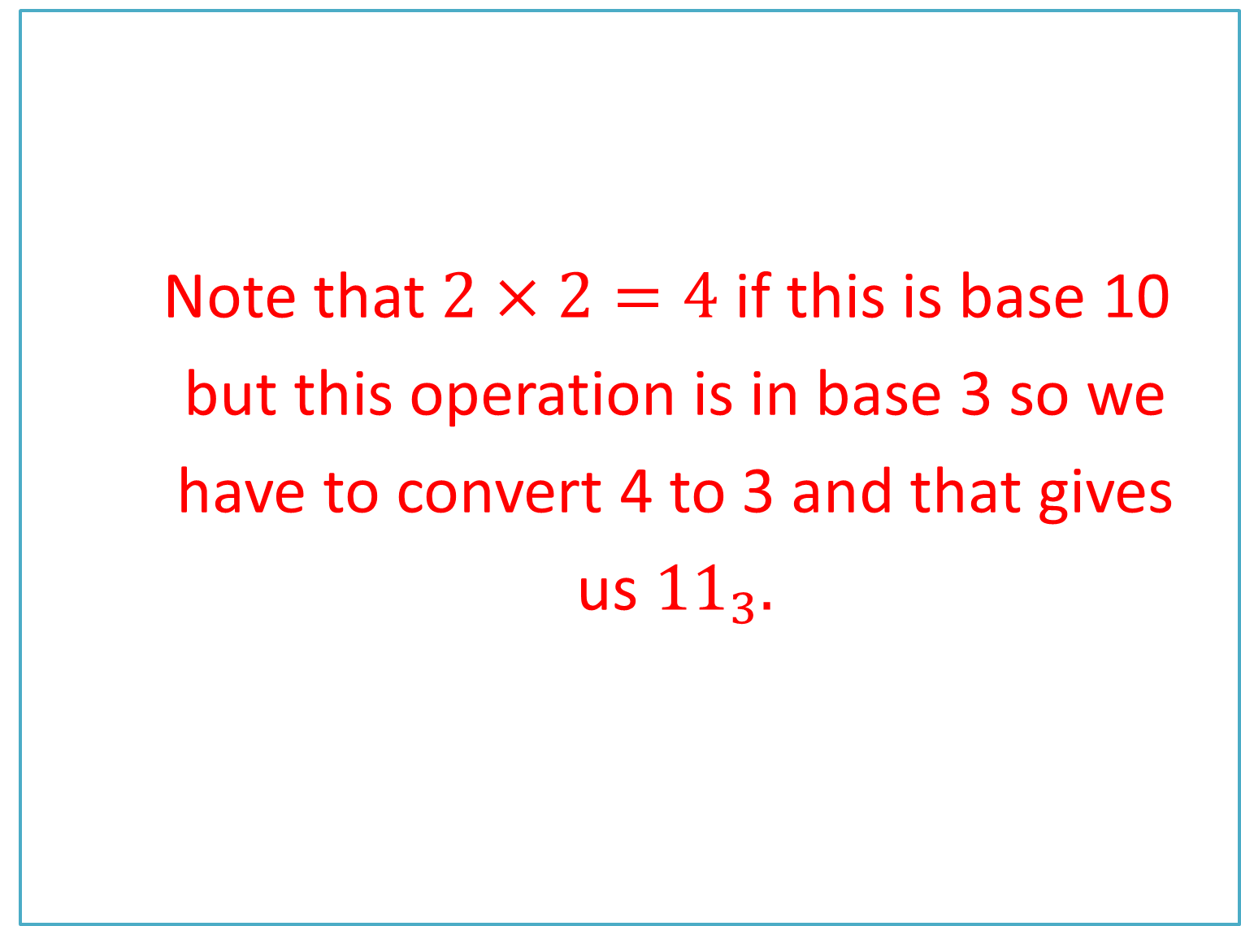
Note that $2×2=4$ if this is base 10
but this operation is in base 3 so we
have to convert 4 to 3 and that gives
us ${11}_{3}.$

Slide 9
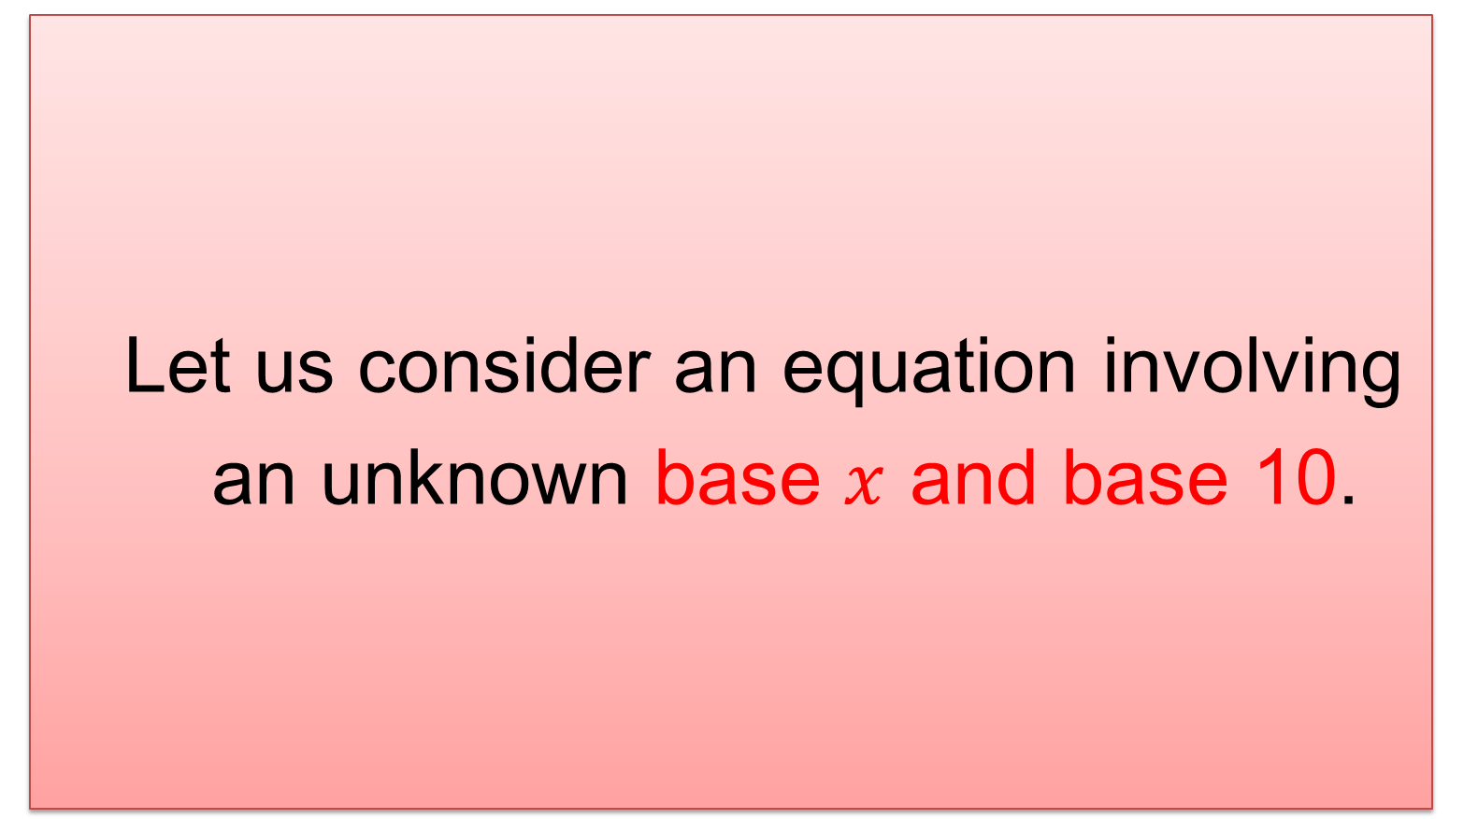
Equations Involving Bases
Let us consider an equation involving
an unknown base $x$ and base 10.

Slide 10
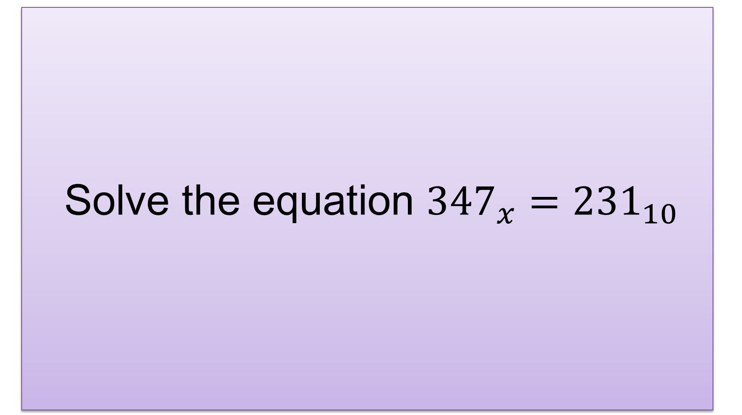
QUESTION 2
Solve the equation ${347}_{x}={231}_{10}$

Slide 11
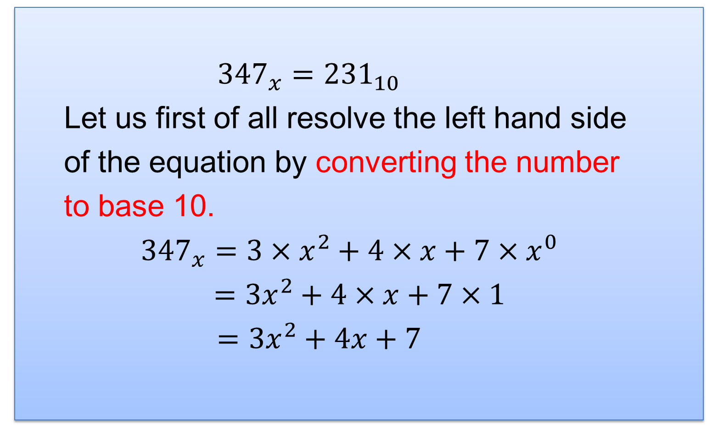
Solution
${347}_{x}={231}_{10}$
Let us first of all resolve the left hand side
of the equation by converting the number
to base 10.
${347}_{x}=3×x^{2}+4×x+7×x^{0}$
$=3x^{2}+4×x+7×1$
$=3x^{2}+4x+7$

Slide 12
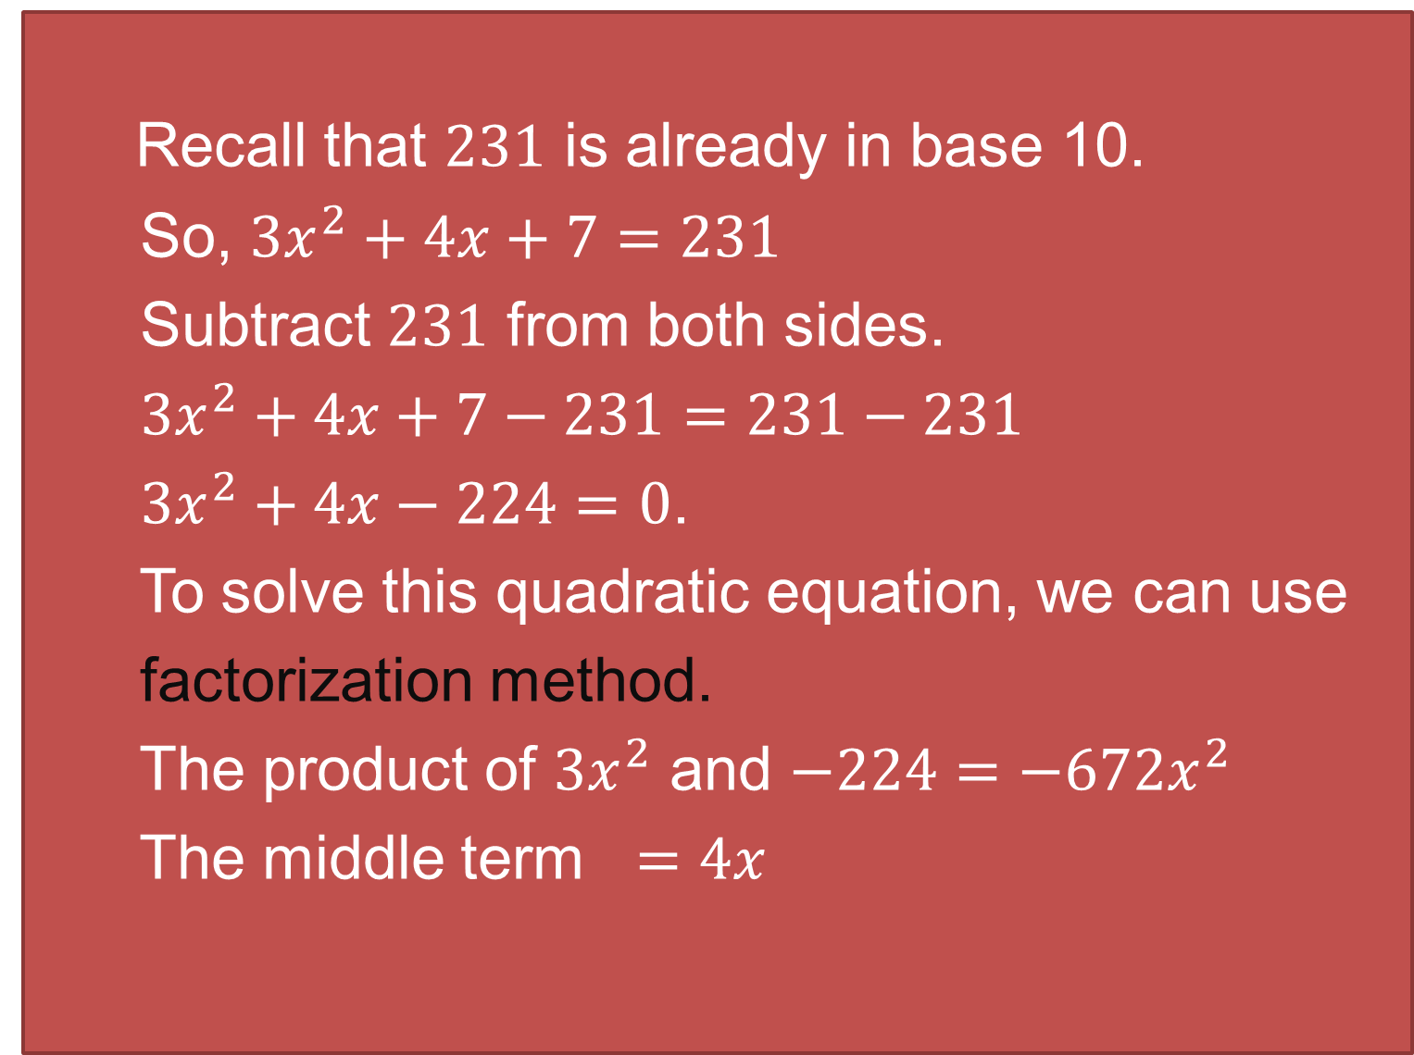
Recall that $231$ is already in base 10.
So, $3x^{2}+4x+7=231$
Subtract $231$ from both sides.
$3x^{2}+4x+7−231=231−231$
$3x^{2}+4x−224=0$.
To solve this quadratic equation, we can use
factorization method.
The product of $3x^{2}$ and $−224=−672x^{2}$
The middle term $=4x$

Slide 13
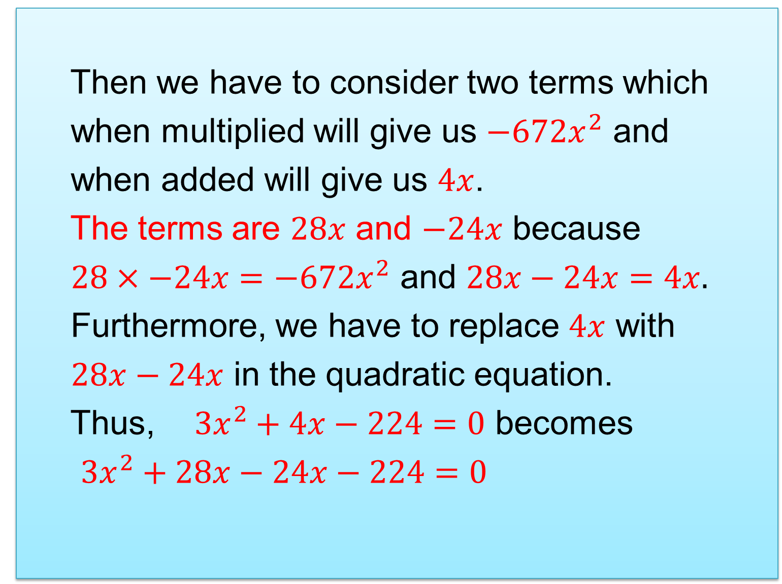
Then we have to consider two terms which
when multiplied will give us $−672x^{2}$ and
when added will give us $4x$.
The terms are $28x$ and $−24x$ because
$28×−24x=−672x^{2}$ and $28x−24x=4x.$
Furthermore, we have to replace $4x$ with
$28x−24x$ in the quadratic equation.
Thus, $3x^{2}+4x−224=0$ becomes
$3x^{2}+28x−24x−224=0$

Slide 14
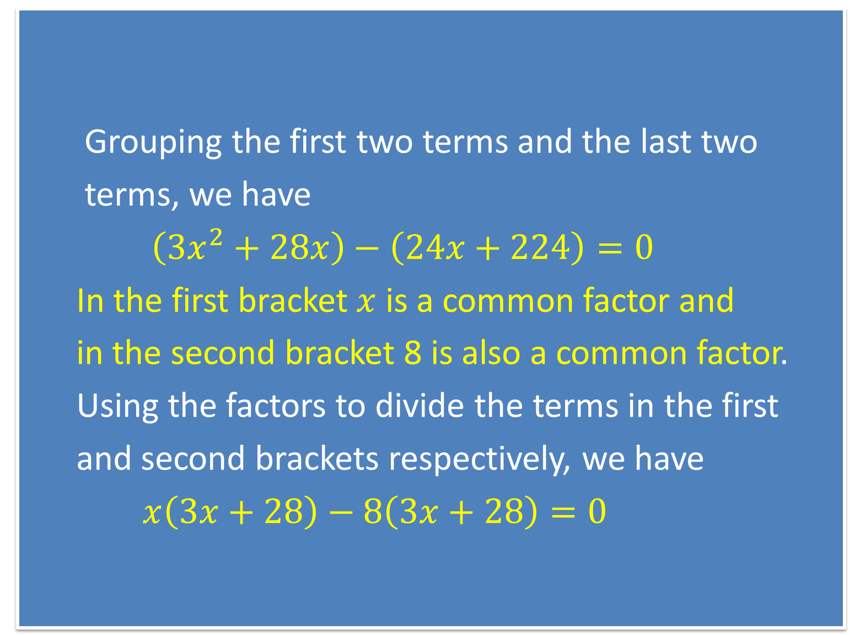
Grouping the first two terms and the last two
terms, we have
$\left(3x^{2}+28x\right)−\left(24x+224\right)=0$
In the first bracket $x$ is a common factor and
in the second bracket 8 is also a common factor.
Using the factors to divide the terms in the first
and second brackets respectively, we have
$x\left(3x+28\right)−8\left(3x+28\right)=0$

Slide 15
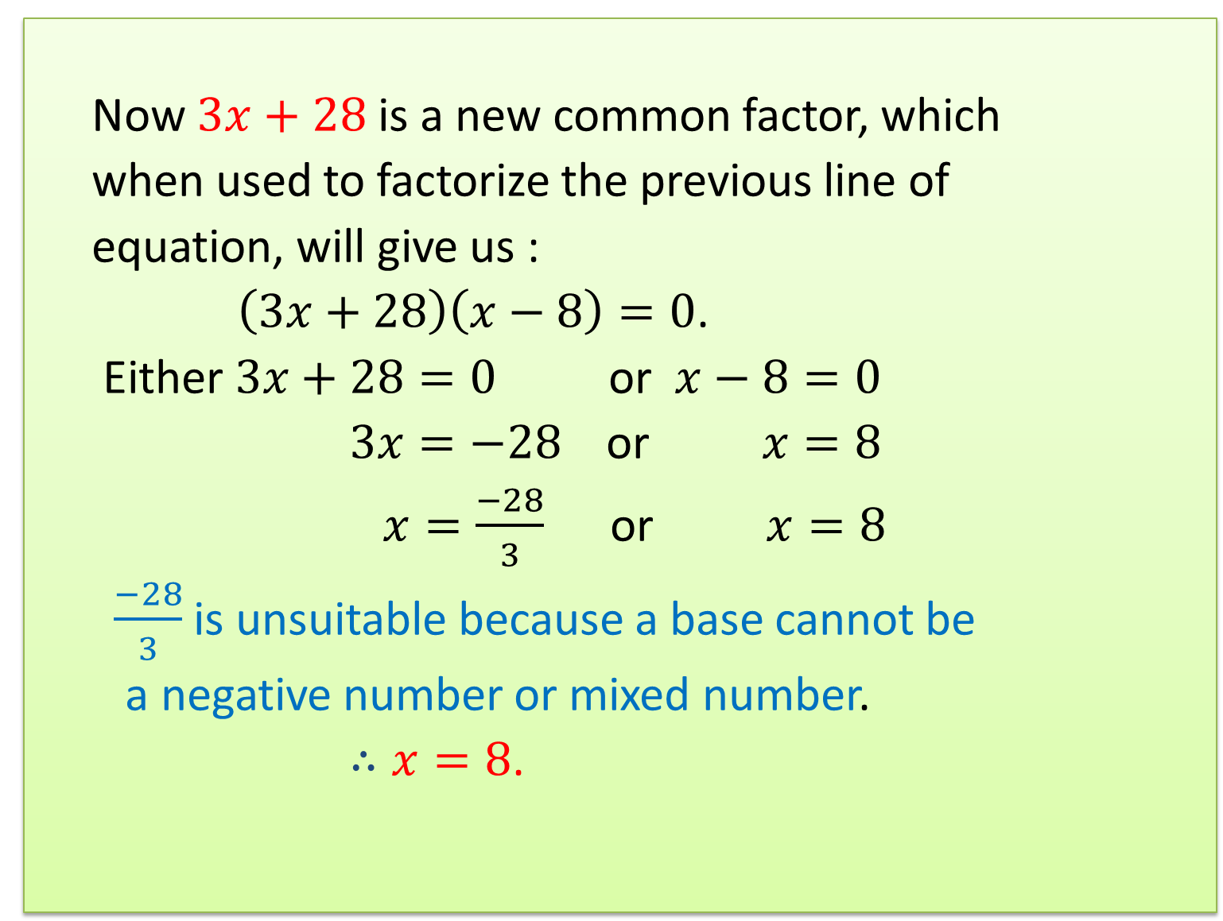
Now $3x+28$ is a new common factor, which
when used to factorize the previous line of
equation, will give us :
$\left(3x+28\right)\left(x−8\right)=0$.
Either $3x+28=0$ or $x−8=0$
$3x=−28$ or $x=8$
$x=\frac{−28}{3}$ or $x=8$
$\frac{−28}{3}$ is unsuitable because a base cannot be
a negative number or mixed number.
$∴x=8$.

Slide 16
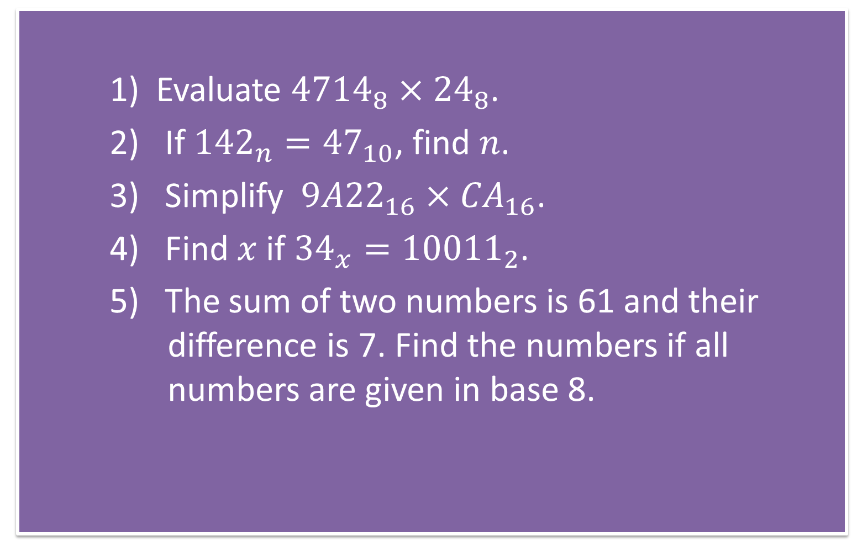
Assignment
1) Evaluate ${4714}_{8}×{24}_{8}$.
2) If ${142}_{n}={47}_{10}$, find $n$.
3) Simplify ${9A22}_{16}×{CA}_{16}$.
4) Find $x$ if ${34}_{x}={10011}_{2}$.
5) The sum of two numbers is 61 and their difference is 7. Find the numbers if all numbers are given in base 8.

Slide 17
Additional Studies
Study division of numbers in non-decimal bases.

