Slide 1
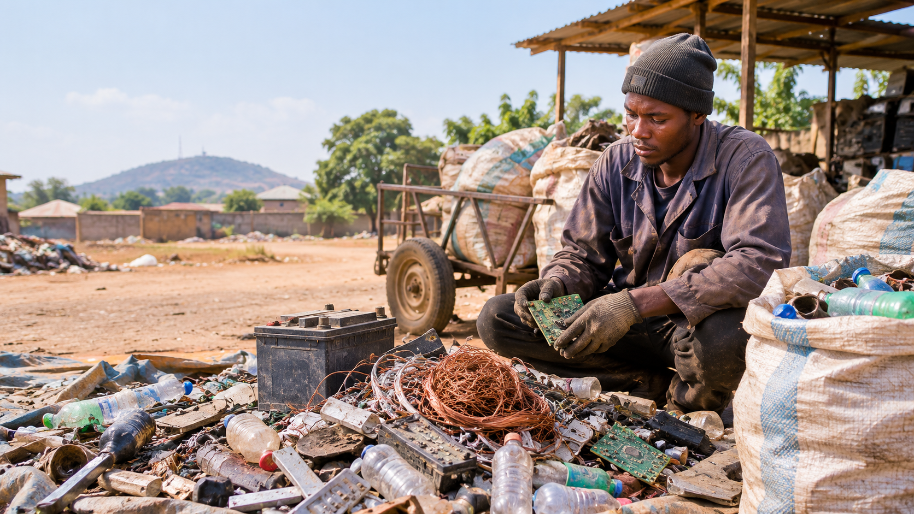
InteliScrap AI
MTN PACHIPANDA CHALLENGE 2026
Know what it is. Know what it's worth. Stay safe.
An offline, voice-guided safety and pricing assistant for Nigeria's scrap collectors.
Built by Team-Nexus
Illustration
Notes:
Open with the promise, not the tech. One sentence: InteliScrap AI helps people who collect scrap in Nigeria know what they are holding, how dangerous it is, and what it is worth, even with no internet. The background picture is an AI-generated illustration and is labelled that way. Then go straight to the problem.

Slide 2
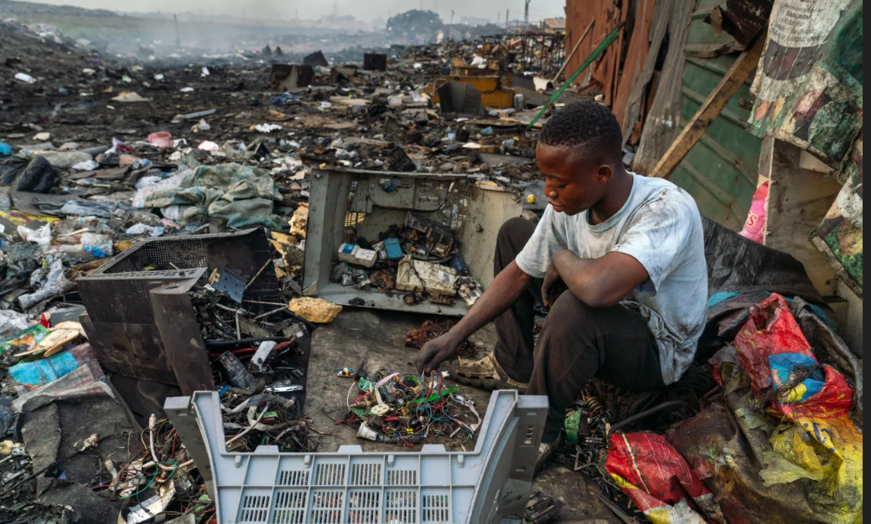


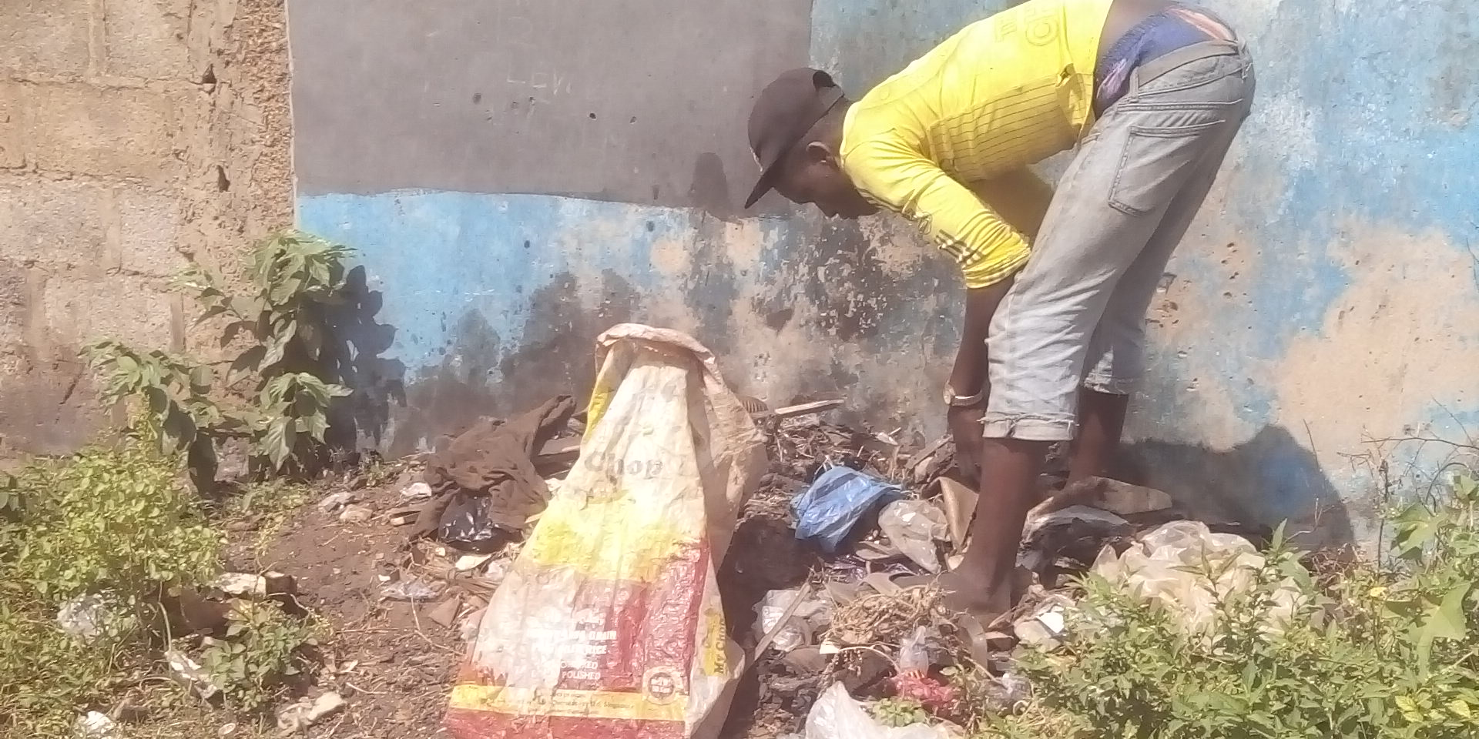

Collectors work blind
01 · THE PROBLEM
Hidden danger
Batteries and e-waste can hold lead, acid and mercury. Many collectors learn the risk too late.
Unfair prices
Photo: sorting electronic waste by hand
There is no public price list. Buyers set the price and collectors cannot check it.
Wasted effort
Scrap sits in nearby homes and offices, unseen. Collectors walk far and much is dumped.
Most apps also need data, English and a smartphone.
Photo: a collector searching roadside waste
InteliScrap AI · MTN PachiPanda Challenge 2026
2
Notes:
Tell it as a short story: a collector picks up an old car battery. He does not know it holds lead and acid. He does not know it is worth more than the buyer will offer. And he does not know a house two streets away has more. Three gaps: safety, price, access. Then the last line: most apps assume data, English and a smartphone, so they do not reach him. Both pictures are photos and need a confirmed source and permission before the pitch. The top one is a press-style photo that may not be from Nigeria, so the caption names no place. Do not say where it was taken unless you can confirm it. Replace both with your own photos if you can. TODO: add one or two sourced statistics (for example the number of informal collectors in Nigeria, or injury data). Do not use a number you cannot cite.

Slide 3
Snap a photo. Get the answer.
02 · OUR SOLUTION
1
2
3
4
Snap
Identify
Know
Hear
Take a photo with a basic Android phone. No sign-in needed to start.
AI on the phone names the material, even with no internet.
See the hazards and a fair price per kilo in Naira.
The phone reads the safety advice aloud in Hausa or Nigerian Pidgin.
One scan means a safer collector and a fairer price.
InteliScrap AI · MTN PachiPanda Challenge 2026
3
Notes:
Walk the four steps in the order a collector lives them. Key point: the voice step removes the reading barrier, so the app works for people who cannot read English well. Hazard types covered include corrosive acid, lead poisoning and mercury exposure (15 hazard types in total). Live demo idea: scan one item on stage.

Slide 4
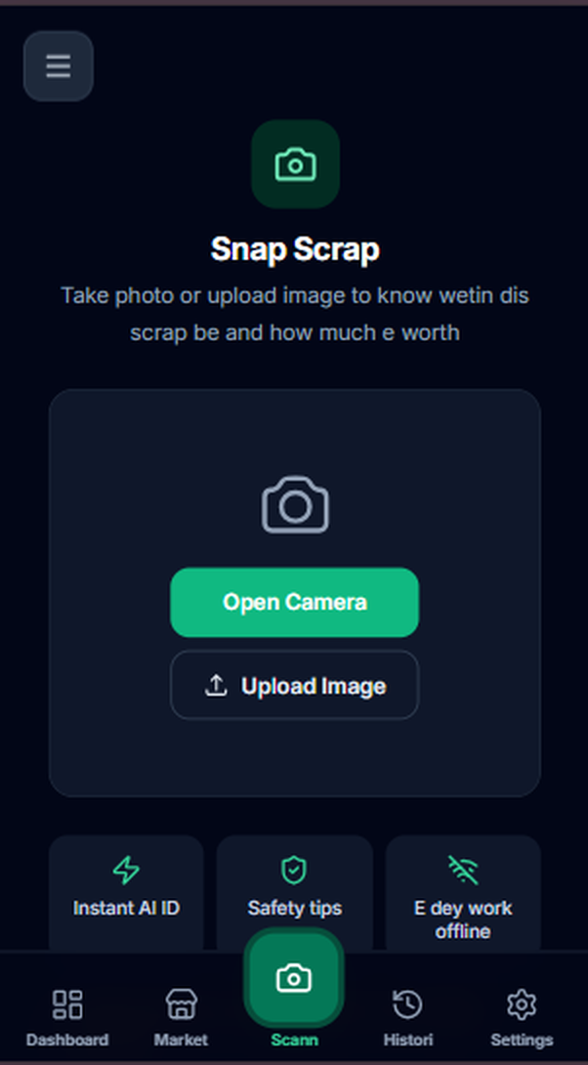
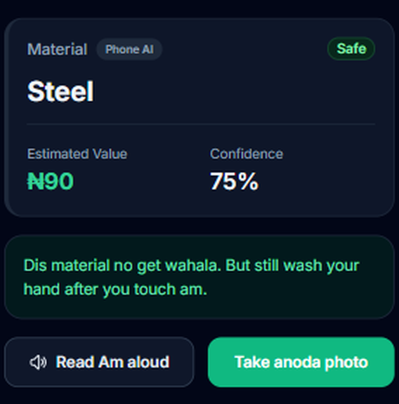
See it work
03 · THE PRODUCT
Snap or upload
One tap opens the camera. The screen speaks Pidgin and says it works offline.
Material, value, confidence
The result shows an estimated value and a confidence score. The Phone AI badge shows it was made on the phone.
Safety advice, read aloud
A clear Safe or hazard badge, plain advice in Pidgin, and one tap to hear it.
2 · Know
1 · Snap
InteliScrap AI · MTN PachiPanda Challenge 2026
4
Notes:
This is the live app, not a mock-up. Walk left to right: snap, then know. Point at the Phone AI badge: it proves the answer came from the phone with no internet. Point at the confidence score and the Safe badge. The advice is written in Nigerian Pidgin and the button reads it aloud. Before any live demo or recording, fix the result screen: the lower part of the screen still shows raw text labels (confirm_listing, listing_confirm_desc, list_scrap) instead of translated words. They are cropped out of this slide. Also avoid screenshots that show a real phone number.

Slide 5

Works offline. Never guesses.
04 · HOW IT WORKS
STEP 1
STEP 2
STEP 3
STEP 4
On the phone
Server model
Backup model
Manual pick
A built-in AI model reads the photo. No internet needed.
If online, a larger vision model checks the photo.
A second on-phone model, used only when it is sure.
If no AI is sure, the collector picks the material.
Every result shows its source: on-device, server or manual. A collector can always tell a real AI result from a manual pick.
InteliScrap AI · MTN PachiPanda Challenge 2026
5
Notes:
This is the trust slide. The app tries four routes in order and stops at the first one that works. If none can, it asks the collector to choose, and it never invents a result. For safety work, an honest "I am not sure" is worth more than a confident wrong answer. Every result carries a source label and a confidence score. Be ready to say how accurate the on-device model is once it is trained on local scrap photos.

Slide 6


Every phone, every collector
05 · WHO IT REACHES
Smartphone
Feature phone
An installable web app with photo scan, voice guide and saved scans. It syncs when the internet returns.
Sign up by USSD code. Get pickup alerts by SMS. Accept a job by USSD or a voice call.
Nearby matching
A household lists scrap. We find the closest collectors on a hexagon map and alert them. The first to accept gets the job.
InteliScrap AI · MTN PachiPanda Challenge 2026
6
Notes:
Two doors into one system. Smartphone users get the full app. Feature-phone users, who are many among informal collectors, register with a USSD code and work through SMS and voice. We already have six preset hubs in Zaria on the USSD menu (Samaru, Sabon Gari, Kongo, Bomo, Hanwa, Dutsen Abba). Matching uses the same hexagon grid idea that ride-hailing apps use, so we do not scan every collector in the database.

Slide 7
Built for the street, not the office
06 · WHY WE ARE DIFFERENT
What matters | Typical scrap app | InteliScrap AI
Internet | Required | Core scan runs on the phone
Language | English text | Hausa and Pidgin voice
Hazard warnings | Rare | 15 hazard types, read aloud
Fair price | Seller must know | Price per kilo in Naira
Feature phones | Not supported | USSD, SMS and voice
Every row is a real street limit: no data, low literacy, basic phones.
InteliScrap AI · MTN PachiPanda Challenge 2026
7
Notes:
Keep this slide quick. The point: every row is a real street constraint (no data, low literacy, basic phones) and we designed around each one. "Typical scrap app" means a standard marketplace or price-listing app. Before pitching, name one or two real competitors you checked, so the comparison is specific. Yoruba and Igbo voice are planned, not live. Do not claim them as live.

Slide 8
A working prototype, not a slide idea
07 · WHAT WE HAVE BUILT
8
15
62
6
scrap classes the on-device model supports
hazard types with Hausa and Pidgin warnings
automated tests covering the backend
Zaria hubs on the USSD sign-up menu
Working today: offline app, photo scan, hazards and prices, voice guide, pickup matching, USSD and SMS, hub dashboards.
Next: train the on-device model on real local scrap photos.
InteliScrap AI · MTN PachiPanda Challenge 2026
8
Notes:
All four numbers come from the project README: 8 scrap classes (copper, aluminium, PET plastic, lead battery, brass, steel, e-waste, glass), 15 hazard types in the Hausa and Pidgin dictionaries, 62 backend tests, and 6 preset Zaria hubs on USSD. Be honest about stage: the full product loop is built, and the next step is to train the classifier on real scrap photos for field accuracy. Judges trust a team that names its next step. TODO: add a screenshot or short demo clip if there is room.

Slide 9



Free for collectors. Businesses pay.
08 · BUSINESS MODEL, PHASE 1
Hub subscriptions
Pickup fee
Estate fee
Recycling hubs pay a monthly fee to post daily buy requests and track live progress.
A small platform fee on every completed pickup, settled in the app.
Gated estates and offices pay a flat fee, planned at ₦2,000 to ₦5,000, for vetted and safe pickup.
Households list scrap for free. Collectors use the app for free. Cash on the spot keeps adoption easy.
InteliScrap AI · MTN PachiPanda Challenge 2026
9
Notes:
Principle: the people with the least money pay nothing, so adoption is easy. Money comes from the businesses that gain from a clean, traceable supply: hubs (monthly subscription, our main recurring B2B income), a small fee per completed pickup, and estates or offices that want guaranteed safe collection. Prices shown are planned and will be tested in the pilot. Later idea from the first draft, not on the slide: buying in bulk at hubs and selling to industrial plants for a 15 to 20 percent margin. It needs cash and storage, so it belongs after the pilot.

Slide 10
Compliance and safety for big buyers
09 · BUSINESS MODEL, PHASE 2
Cleaners in labs, banks, hospitals and schools face the same hidden risks. Manufacturers must also prove where their waste goes.
Offering | Who pays | What they get | Planned price
Compliance dashboard | Manufacturers under NESREA rules | Auditable record of every collection | Annual fee
E-Bangle wristband | Banks, schools, hospitals | Sensor alerts for cleaning staff | $40 to $60 each
E-Bangle software | Same buyers | Safety dashboard and live alerts | ₦10,000 per device a month
InteliScrap AI · MTN PachiPanda Challenge 2026
10
Notes:
Phase 2 turns our collection data into a product. Extended Producer Responsibility (EPR) rules push manufacturers to show that their waste is collected and recycled. Our app already creates an auditable export of every settled collection: collector, material, weight, value and originating hub. The E-Bangle is a future wearable for deskless cleaning staff, and it needs a mobile connection to sync to the company dashboard. All prices are planned assumptions from the first draft (the $40 to $60 price was estimated to give about a 40 percent margin) and need pilot testing. Make clear that the E-Bangle is future work, not built.

Slide 11



Every collector is a future MTN customer
10 · WHY THIS FITS MTN
MoMo payouts
New data users
USSD, SMS and IoT
Collectors are paid in cash today. We plan a small bonus for MoMo payouts, moving cash workers onto MoMo wallets.
Voice guidance gives low-literacy workers a clear reason to use a smartphone and buy data.
Feature phones join through USSD and SMS. Future E-Bangles would sync over MTN business IoT SIMs.
Each collector we reach is a possible SIM, data user and MoMo wallet.
InteliScrap AI · MTN PachiPanda Challenge 2026
11
Notes:
This slide answers "why you, why MTN, why now". Three links: money (MoMo), customers (smartphone and data users who start with a survival reason to go online) and network (USSD and SMS today, IoT SIMs later). Our USSD and SMS flow runs through Africa's Talking in the prototype, and in a pilot we would want to move it onto an MTN shortcode. The MoMo bonus is a planned idea, not built. Say so if asked.

Slide 12
From prototype to pilot to scale
11 · ROADMAP
Now · Oct 2026
Next · by mid-2027
Later · 2027 to 2028
Working prototype
Hausa and Pidgin voice
USSD sign-up in Zaria
Train on local scrap photos
Add Yoruba and Igbo voice
Pilot with collectors and hubs
Test MoMo payouts
Compliance dashboard for manufacturers
More cities across the north
E-Bangle for cleaning staff
InteliScrap AI · MTN PachiPanda Challenge 2026
12
Notes:
Three stages, each unlocking the next. Now: the product loop works end to end. Next: the pilot proves accuracy, adoption and willingness to pay, and this is where the PachiPanda support matters most. Later: the bigger revenue lines (compliance and the E-Bangle) once we have real collection data. The dates are target dates for now. Confirm them with the team before pitching.

Slide 13
Three builders, one working product
12 · TEAM NEXUS
Backend and database
Frontend and voice
Edge AI, QA and DevOps
APIs, pickup matching, USSD and SMS.
Offline app, camera, dashboards and the Hausa and Pidgin voice guide.
The on-device scrap classifier, tests, sync and deployment.
[Name]
[Name]
[Name]
We built the whole loop ourselves: app, AI, voice, backend and tests.
InteliScrap AI · MTN PachiPanda Challenge 2026
13
Notes:
Replace each [Name] with the builder's name and add a photo if you like. The team is three builders. In the project README the work is split across five roles, so here the roles are grouped: Edge AI is joined with QA and DevOps, and the frontend is joined with the voice and accessibility work. Say one line about why this team: you built the whole loop yourselves (app, AI, voice, backend, tests), and mention that the team is local to the users' region if that is true.

Slide 14
13 · OUR ASK
What we need to run the pilot
Funding
MTN access
Mentorship
₦5,000,000 to collect scrap photos, train the model and run a three-month pilot.
Help with a USSD shortcode, SMS and MoMo payouts.
Guidance on field pilots and on working with recycling hubs.
Every kilogram of scrap, fairly valued.
Safer collectors. Fairer prices. A cleaner Nigeria.
team.nexus@example.com · +234 800 000 0000 · github.com/Moses2411/inteliscrap-AI
14
Notes:
Be specific. Fill in the funding amount and what it buys (for example: photo collection, model training, pilot costs for a set number of collectors and hubs). Ask for MTN help that only MTN can give: a USSD shortcode, SMS delivery and MoMo payouts. End on the closing line and stop talking. The funding amount, email and phone number on the slide are sample values. Replace them with the real ones before pitching.

