Slide 1

Diversity and Inclusion in the VA Workforce
Presented by
Georgia Coffey, Deputy Assistant Secretary
Office of Diversity and Inclusion
U.S. Department of Veterans Affairs

Slide 2


Objectives of this Training
To provide a clear understanding of what diversity is and what it isn't.
To raise a greater awareness and sensitivity to Diversity issues that go well beyond the assumed categories.
To recommend behavioral tools for fostering a more cohesive workplace.

Slide 3


Diversity Defined
Diversity is the mosaic of people who bring a variety of backgrounds, styles, perspectives, values and beliefs as assets to the groups and organizations with which they interact.

Slide 4

Distinction Between EEO, Affirmative Action and Diversity & Inclusion
Equal Employment Opportunity | Affirmative Action | Diversity & Inclusion
The enforcement of statutes to prevent employment discrimination | The effort to achieve parity in the workforce through outreach and eliminating barriers in hiring | Leveraging differences in the workforce to achieve better results
Notes:
Generally speaking, EEO and affirmative action programs are considered legislated employment equity risk management programs.
EEO and Affirmative Action programs generally cover those groups protected by title 7 of the 1964 Civil Rights act, whereas Diversity is a more inclusive concept. AA programs contain goals and timetables designed to bring the level of representation for minority groups and women into parity with relevant labor force statistics.
Diversity is a voluntary approach that does not utilize artificial programs, standards, or barriers.

Slide 5
Primary and Secondary
Dimensions of Diversity
Geographic
Location
Military
Experience
Education
Work
Experience
Age
Gender
Work/thinking
Style
Sexual
Orientation
Disability
Socioeconomic
status
Family
Status
Ethnic
Heritage
Race
Religion
First
Language
Communication
Style
Organizational
Role and Level
Notes:
This model illustrates both the primary and secondary dimensions of diversity that exert an impact on each of us at home, work and in society. While each dimension adds a layer of complexity to individual identity, it is the dynamic interaction among all the dimensions that influences self-image, values, opportunities and expectations. Together, the primary and secondary dimensions of diversity give definition and meaning to our lives by contributing to a synergistic, integrated whole -- the diverse person.

Slide 6


All Communication is Filtered Through Your Cultural Perspective
Age
National origin
Race
Sexual orientation
Religion
Disability
Gender
Education
Work role/experience
Personality
Customs
Geographic location
Functional discipline
Languages used
Values
Communication style
Work Style
Learning style
Economic status
Family situation
Military experience
Philosophical perspective

Slide 7

A New Metaphor for American Culture
The “melting pot” theory of American society has evolved, instead consider a vegetable soup metaphor.
You can easily identify and taste
the unique flavors of the
individual parts.
Members of various cultural groups
may not want to be assimilated, they
want their tastes, looks and texture
to remain whole.
To reap the business benefits of diversity, you must employ inclusive work strategies.
Notes:
Soup—has an overall flavor, but can easily see and taste individual parts.
The parts exist together, contributing to the success of the soup, yet each part is still very different.

Slide 8

VA’s Diversity & Inclusion Goals:
Making Full Use of the Unique Skill Sets of Each Employee
Food for Thought:
Do I bring my “full self” to work?
My ideas | My personality
My opinions | My uniqueness
My background

Slide 9
Benefits of Workforce Diversity & Inclusion
Improved understanding of those you work for, with, and around.
Creates a work environment that allows everyone to reach their full potential.
Provides multiple perspectives on problem solving.
Better performance outcomes.
Increases employee productivity.
Increased retention rates.
Boosts employee morale.
Improved customer relations.
Reduces complaints and grievances.
It’s the right thing to do!
Notes:
Diversity is about business, driven by the changing nature of the workforce
Protect the merit principle: attract, retain, motivate, and develop the best and brightest.
Focus on the product, not how the product is done.

Slide 10
The Business Imperative:
What does the research show?
Workforce diversity is positively associated with higher business performance outcome measures.
Racial diversity is positively associated with higher performance in organizations that integrate and leverage diverse perspectives as resources for product delivery.
Gender diversity is positively associated with more effective group processes and performance in organizations with people-oriented performance cultures.
Diverse teams are more creative and perform better in problem solving than homogeneous teams.*
The effects of diversity on group processes and performance are highly dependent on the presence of facilitating or inhibiting conditions in the organization; absent facilitating conditions, the aforementioned outcomes are reversed.
Conclusion: Diversity enhances performance but requires attention.
The Effects of Diversity on Business Performance: Report of the Diversity Research Network, November 2002: Five year longitudinal study on workforce diversity and performance measures in Fortune 500 companies.
*Work Team Dynamics and Productivity in the Context of Diversity Conference, Center for Creative Leadership, N.Y.U, A.P.A, ,October, 1994

Slide 11
The Economic Imperative:
What does the research show?
Racial and gender diversity are positively associated with higher establishment productivity, product quality, and economic benefits.
Demographic shifts in population portend shifts in purchasing power and consumer trends. Workforce diversity reflecting consumer/ market diversity results in:
  New product development
  Consumer confidence
  Increased product/service marketability
  Significant revenue growth (e.g., McDonalds, Pepsi-Cola, IBM – 3000% growth form 1998 -2001 attributed to diversity market)*
Discrimination and poor diversity management pose a human and economic cost:
  The average EEO complaint costs the organization approximately $250,000
  25-40% of workforce attrition rate and 5-20% in lost productivity can be attributed to poor diversity management; turnover costs 75-150% of the replaced employee’s salary.
Achieving and maintaining workforce diversity requires investment., but the return on the investment, in terms of both economic and “good will branding” capital, outweighs the cost.
Conclusion: Diversity should be strategically aligned with business goals; diversity requires investment, but pays dividends.
Workforce Diversity and Productivity: An Analysis of Employer-Employee Matched Data, Linda Barrington, The Conference Board, and Kenneth R. Troske, University of Missouri-Columbia, April 18, 2001: Analysis of workforce diversity and economic performance of establishments in manufacturing, retail trade, and services sectors.
*The New Diversity, Carol Hymotiz, Wall Street Journal, November 14, 2005.

Slide 12
The Human Imperative:
What are the lessons learned?
Notwithstanding the economic costs, the human costs of intolerance to diversity is incalculable.
Defining diversity solely as race and gender can have a detrimental effect; “understanding the multidimensional nature of identity is important in defining diversity in work teams.”*
A framework for diversity in work groups should include:**
  personal demographics
  knowledge, skills, and abilities
  values, beliefs, and attitudes
  personality and cognitive and behavioral style
  organizational demographics
When defining diversity in multidimensional terms, including DIVERSITY OF THOUGHT, it naturally brings in aspects grounded in race, gender, and ethnicity.
*Nkomo, S. M. (in press). Identity and the complexity of diversity.
**McGrath, J., Berdahl, J., & Arrow, H. (in press). Traits, expectations, culture and clout: The dynamics of diversity in work groups. In S. E. Jackson & M. N. Ruderman (Eds.), Work team diversity: Paradigms and perspectives. Washington, DC: American Psychological Association.

Slide 13

The Human Imperative:
What are the lessons learned?
Case in Point: Intelligence Community
Obstacles leading to intelligence failures included:
  Hardened attitudes against change
  Insular organizations
  Resistance to external recommendations
  Insistence on preserving the status quo
Recommendations for improvements in performance culture include:
  Agencies should encourage dissent, not smother it.
  Move away from tradition of searching for consensus in favor of open debate and more diverse spectrum of views.
Dissent on Intelligence is Critical, by Walter Pincus and Peter Baker, Washington Post, March 30, 2005;
Panel Warns on Headstrong Agencies, by Dana Priest, Washington Post, April 1, 2005, on findings of Commission on the Intelligence Capabilities Regarding Weapons of Mass Destruction, February 2004.

Slide 14

The Human Imperative:
What are the lessons learned?
Case in Point: NASA
“ Organizational culture refers to the values, norms, beliefs, and practices that characterize the functioning of a particular institution.”*
Causes that contributed to the Columbia accident included:
  An organizational culture that squelched dissent
  A performance culture that stifled differences of opinion
  Resistance to external criticism and doubt
  Imposition of the “party line vision… (which) led to flawed decision-making, self-deception, introversion, and diminished curiosity”
  Organizational barriers that prevented open, effective communication
  NASA has since implemented one of the strongest diversity management programs in Federal government
*Report of the Columbia Accident Investigation Board, March 2003.

Slide 15
Take-Aways
What does this mean for the Federal workforce?
Workforce diversity enhances performance and productivity; it is a business, economic, and social imperative in the 21st century.
To be a high performing organization, diversity should be broadly defined by traditional EEO demographics, social, cognitive, and behavioral perspectives.
To be effective, diversity management must be strategically implemented and aligned with business goals; Diversity requires investment and attention in order to be effective.
Intolerance and insensitivity to diversity breeds disastrous and costly results; agencies must empower employees and guarantee their EEO rights.
Diversity principles must be incorporated in all aspects of an organization’s performance culture, including:
    - Leadership communications - Group work processes
    - Recruitment and retention strategies - Succession planning
    - Rewards and developmental systems - Strategic planning

Slide 16
Organizational Culture
The expression of an organization’s collective values, beliefs, and behaviors.
Key Questions
Do staff, volunteers, or program participants“check their individual identities at the door?”
What’s wrong with just being “color-blind” or “gender-blind” or whatever-kind of blind?
Does the “way we’ve always done it” close out thinking as well as staff, volunteers, program participants and community partners?
Is there some way you “ought to be” in order to fit in the association and its programs?

Slide 17
Organizational Inclusion
Extent to which the organization provides fair and equitable treatment to all employees and groups
Equity of Practices
Extent to which culture avoids assimilationist strategies and is open to learning from different and non-traditional sources
Organizational Culture
Extent to which the organization draws upon diverse sources of knowledge and experience for planning and operations
Voice & Participation

Slide 18
Cultural Competence
Cultural Competence is the ability to respond effectively and appropriately to different cultural/generational contexts in the workplace.
Acknowledge and accept differences in cognitive, behavioral, philosophical, social, and communicative styles that arise from different cultural generational contexts.
Seek to understand; ask for clarification or reasons for the behavior
Communicate policies, procedures clearly to employees if you are a manager

Slide 19
Cultural/Generational Differences
Individual vs. team work orientation
Visual vs. oral learning style
Expressive vs. introverted behavior
Physical vs. non-physical
Emotive vs. reserved personality
Assertive vs. acquiescent behavior
Gregarious vs. solitary social style
Work vs. family focus
Divergent vs. convergent thinking
Long term vs. short term career planning

Slide 20
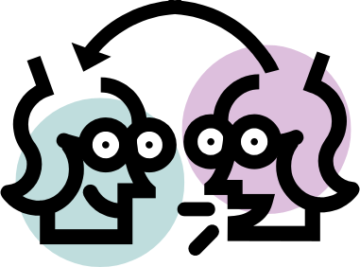

Cultural Competence
Respect others’ opinions.
Acknowledge cultural/ generational differences and historical injustices without becoming defensive.
Be open to learning about other cultures and ideas.
Give others the benefit of
the doubt in a dispute.
Seek first to understand others’
point of views; then to be understood.
Don’t stereotype.
Don’t judge others by your own cultural standards.
Don’t assume your culture’s way is the only way.
Don’t talk down to anyone; communicate effectively.

Slide 21
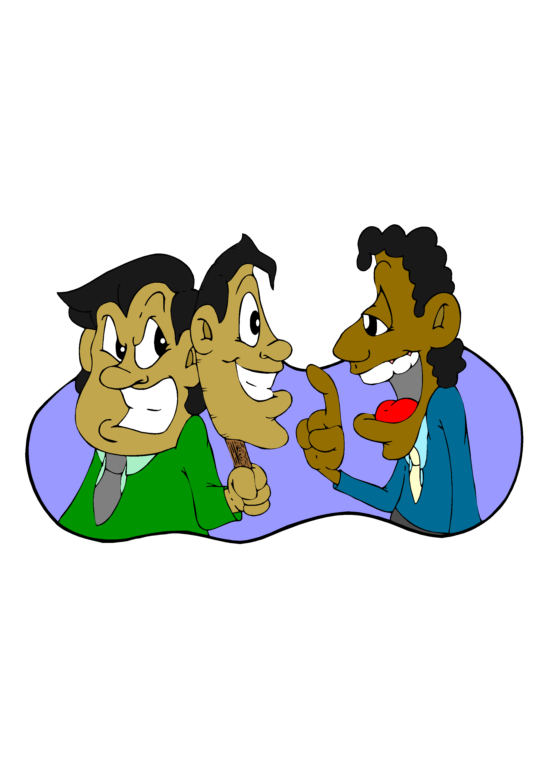
Impediments to Cross-Cultural
Communication
Irrational Assumptions
Misunderstanding
Prejudice
Fear
Notes:
Introduces the next four slides

Slide 22
Irrational Assumptions
An irrational assumption is a belief that is founded on baseless supposition, often skewed by bias. One of the best examples of irrational assumptions are the stereotypes we formulate about people based on their association or membership with cultural or ethnic groups.
“If we all worked on the assumption
that what is accepted as true is really true,
there would be little hope of advance.”
--Orville Wright

Slide 23
Misunderstanding
Misunderstandings are a normal part of communication either because we unintentionally or intentionally use the wrong words or because we don’t understand what is being said to us. To prevent misunderstanding know who you’re talking to, be respectful, and be sure of what you want to say.
“Listen, I’m going to talk to the Indians.
It’s probably a misunderstanding.”
--General Custer

Slide 24
Prejudice
By definition, prejudice is either a bias in favor of or against something. Such biases can of course be benign, however, those preferences having to do with people can be hurtful and cause problems especially in the workplace.
“Just as a child is born without fear,
so it is born without prejudice.
Prejudice, like fear, is acquired.”
Marie Killea
Notes:
Prejudice
By definition, prejudice is either a bias in favor of or against something. Such biases can of course be benign, however, those preferences having to do with people can be hurtful and cause problems especially in the workplace.

Slide 25
Fear
Fear of change in the workplace is counterproductive, especially fear of ideas and people who are different from us.
“I think we have to own the fears that we have of each other,
and then, in some practical way, some daily way,
figure out how to see people differently
than the way we were brought up to.”
--Alice Walker

Slide 26

Number 1 Rule for Diversity, Inclusion, and Constructive Conflict Management
Dialogue! In order to understand the other’s point of view, seek first to understand.
Dialogue! In order to communicate your own position.
Dialogue! In order to arrive at a mutually beneficial agreement that serves common goals.

Slide 27
How Can Managers Promote Diversity & Inclusion?
Lead employees by example; respect people and differences in the workplace.
Create a welcoming, inclusive environment in
which to conduct business.
Incorporate diversity in policies, strategic plans, operational procedures.
Learn and practice early conflict resolution strategies.
Practice regular, effective, and open communication; empower your employees; requires trust.
Demonstrate executive commitment to diversity on an ongoing and regular basis.
Walk the talk.
Notes:
This does not mean that a less qualified woman/minority/person with a disability should get a promotion or be hired over a more qualified white candidate.

Slide 28

Diversity Best Practices
Leadership commitment.
Effective communication and transparency.
Equitable employment practices.
Recruitment outreach.
Continuous learning and career development.
Coaching and mentoring.
Early conflict resolution.
Flexible work culture.
Notes:
Introduces next four slides
The goal of diversity best practices is to create an environment that will be attractive to high quality people
--fully utilize talents and skills
-retention (where the best people stay and flourish)

Slide 29
Leadership Commitment
Communicate and practice commitment to diversity and inclusion often.
Reinforce diverse work and employment practices, including diversity of thought.
Practice constructive conflict management.
Educate the workforce on the business value of diversity and inclusion.
Mentor and coach diverse employees.

Slide 30


Career Development
Definition: aligning the needs of the organization with the professional development of its employees.
Diversity & Inclusion should be incorporated in career development, especially in the following areas:
  Succession planning
  Internal mobility systems
  Training and development opportunities
  Performance management--ensure evaluations don’t include subtle biases against diverse groups of people
Notes:
Internal mobility systems: Selections and promotions
Performance management—use standard criteria

Slide 31


Recruitment Outreach
Cast the net wide: Recruitment outreach efforts should target a wide variety of academic, professional and community organizations for the most talented and qualified persons in diverse groups.

Slide 32
How Can Employees Promote Diversity?
Practice positive, constructive work habits in the workplace; work cooperatively towards a common goal.
Live up to the social contract; contribute to your fullest potential; strive for excellence.
Recognize and respect others and their individuality.
Think before you speak and be sensitive to others.
Talk about your differences and ask tactful questions about how people want to be treated.
Eliminate stereotypes and generalizations.

Slide 33
Diversity is only FAIR
Feedback/communication promotes understanding, reduces conflict; and enhances productivity.
Assist others to become culturally competent; support one another – we are all in this together!
Inclusion should be practiced; empower employees to fully perform and participate in pursuit of the organization’s mission.
Respect is non-negotiable; honor the social contract.
Notes:
With regard to the acronym F.A.I.R., the F. for “feedback” is intended to denote the idea that it is just as important to hear or listen to others as it is to be heard. Actually, this is a hallmark of what communication does at its best, namely, allows all parties to be heard. The A. for “assistance” is simply intended to convey the idea that it is vital that a workplace imbue a disposition toward helping or serving, not just its customers, but its own employees as well. The I. for “inclusion” emphasizes the idea that to make the workplace function optimally, it is imperative that every employee feel a genuine sense of belonging in an organization. Finally, the R. is for “respect” which as a subjective term requires that each individual’s perception of what it means to be respectful be taken into account.

Slide 34

Small Group Case Study Discussions

Slide 35
Case Study #1
An employee of a U.S. company was sent to Costa Rica to learn the operations in its satellite company for a month. When she arrived she was scheduled to meet with the Project Managers at 9:00 a.m. the next day, however had to wait a half hour for them to show up. The Costa Rican employees did not apologize or think anything of being late, which upset her so much that after the meeting she went to the head of operations in Costa Rica to complain about the incident but found him unresponsive to her concerns. She regarded tardiness as a sign of disrespect and could not understand why no one was sympathetic to the matter. What should she do? Is this a cultural issue?
Notes:
This case study features culturally based differences which concern the perception of time. There are at least two factors worth considering here namely that the U.S.’s employee is a guest in a foreign country, and the satellite company still belongs to a U.S. conglomerate. Keep in mind that if the employee confronts the Costa Ricans she might be jeopardizing their relationship. On the other hand if she doesn’t confront them on the matter, they may do the same thing to a company customer who may become as irked as the employee

Slide 36
Case Study #2
An employee who works for a division that is very diverse is troubled by the fact that many of the employees who are of the same cultural background tend to socialize with each other almost exclusively, even though most of the employees regardless of their culture seem to work well together. The employee believes that if everyone socialized more cross culturally this might help improve the work environment. Should the employee take it upon himself to try and promote more cross cultural socializing during lunch or after work? Is he right in his assumption?
Notes:
This case study features a manger who believes that more enculturation can only be a good thing and should be encouraged. This approach to promoting diversity however eliminates one of its most important elements namely, that a person should come around to supporting diversity through their personal edification and not by being coerced by management into doing so.

Slide 37
Case Study #3
A first rate employee who has been with his company for ten years and has never had a single complaint lodged against him makes a controversial statement about a coworker’s sexual orientation when he is asked a point blank question by another coworker. His remark causes nearly every employee in his division to complain about him to management and demand an apology. The employee who made the remark admits to having made the statement but refuses to apologize because he believes that he is entitled to his own opinion, especially since he was pressed on the matter. Should the employee in question be disciplined? Is he entitled to his own opinion in the workplace?
Notes:
This case study features an employee who makes an inappropriate comment because he is coerced into doing so by another employee who bates him. The employee who is bated speaks his mind, but to the chagrin of the office. As the supervisor if you discipline this employee you are setting the precedent that no one ought speak their mind. On the other hand, if you don’t discipline the employee you may also be setting the precedent for a tolerance for that sort of commentary. Rather than disciplining anyone what might be most effective in dealing with this situation would probably be some type of informal or formal mediation session, either facilitated by a trained mediator and/or the supervisor.

Slide 38

Last Words To Ponder
“When we feel a sense of belonging it is not because we are the same as everyone else, but because we have been accepted as we are.”

