Slide 1
Data Management for Data Science Homework 1 – 2
Teachers: Prof. Lembo Domenico
Prof. Rosati Riccardo
Providers: MousaAlreza dastmard 1852433
Melika Sadat Parpinchi 1880156

Slide 2
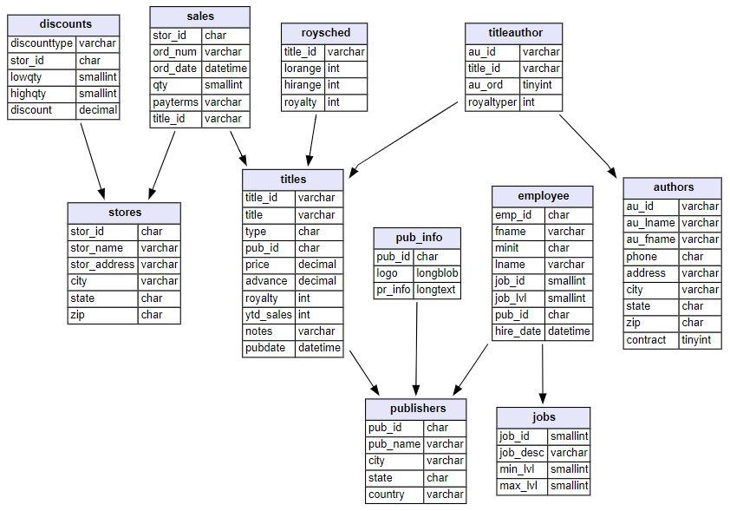
Pubs dataset https://relational.fit.cvut.cz/dataset/Pubs

Slide 3
Dataset details:
Table details:
Associated task:
Regression
Domain:
Retail
Data types:
Numeric
String
LOB
Temporal
Size:
400 KB
Count of tables:
11
Count of rows:
255
Count of columns:
64
Missing values:
Yes
Compound keys:
No
Loops:
No
Type:
Synthetic
Instance count:
18
Target table:
Titles
Target column:
Ytd_sales
Target_ID:
Title_ID
Target timestamp:
pubdate
Tables:
Titles
Authors
Titleauthor
Sales
Stores
discounts
Publishers
Pub_info
Employee
Jobs
Roysched
Primary Keys:
Title_id
Au_id
Au_id + title_id
Title_id + stor_id + ord_num
Stor_id
Stor_id
Pub_id
Pub_id
Emp_id
Job_id
Title_id

Slide 4
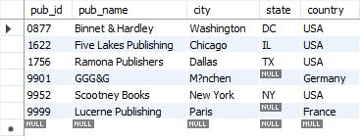

Q1-1, Q2-1-1, Q2-1-2: List of publishers that don't have business book
HW1: nested queries, queries with negated subqueries
HW2: rewriting, indexing, adding views
Code result:
Using “not exists”:
select * from publishers where not exists (select * from titles where titles.pub_id = publishers.pub_id and type = 'business');
Optimizing (Using View and index):
create index i_type on titles(type);
create view business_pub_ids as select pub_id from titles where type = 'business';
Using “not in”:
select * from publishers where pub_id not in (select * from business_pub_ids );
View result:
Our analyze:
There 4 publishers located in the USA and two in Germany and France.

Slide 5
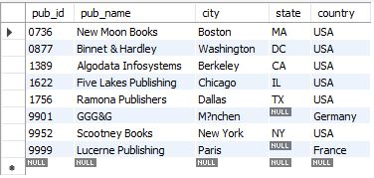
Q1-2: List of publishers that have published books that have mod in their type
HW1: nested queries
Code result:
Using “exists”, “Like”:
select * from publishers where exists (select * from titles where type like '%mod%');
Our analyze:
Mostly the publishers have books of type %mod% are located in the USA

Slide 6
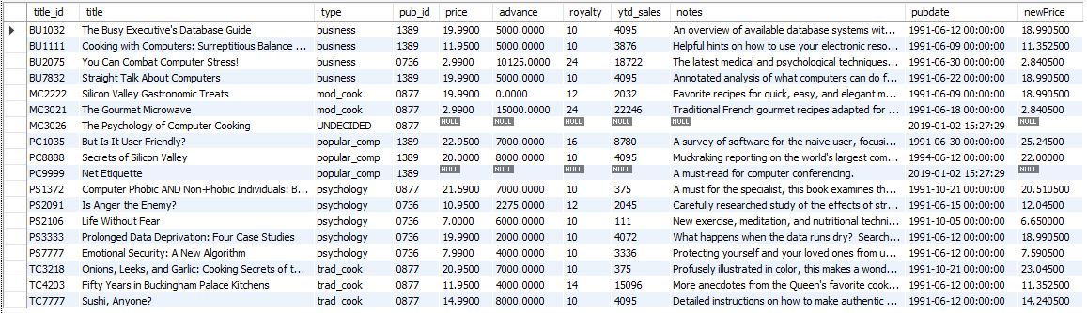
Q3: Raising the price by 10% for those books have total sale more than 500 Else decreasing by 5%
HW1: joins, aggregations, nested queries
Using “case when”, “group by”, “having” :
select * ,
case when
title_id in (select titles.title_id from titles inner join sales on sales.title_id = titles.title_id group by titles.title_id having sum(qty*price) > 500)
then price * 1.1
else price * .95
end as newPricefrom titles ;
Our analyze:
Comparing the columns price and newPrice we can see that mostly the new calculated price is less than previous price.

Slide 7
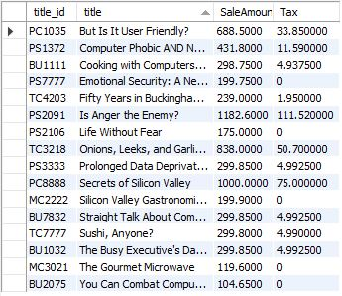
Q4: TAX calculation for each book based on total sale If total sale is less than 200 then TAX = 0 If total sale is less than 500 then TAX = (Total sale - 200)*5% If total sale is less than 800 then TAX = 15 + (Total sale - 500)*10% If total sale is less than 1000 then TAX = 45 + (Total sale - 800)*15% else TAX = 75 + (Total sale - 1000)*20%
HW1: joins, aggregations, nested queries
Code result:
Using “case when”, “drived query”, “group by”
select * , case when SaleAmount < 200 then 0
when SaleAmount < 500 then 0+(SaleAmount - 200) * .05
when SaleAmount < 800 then 0 + 15 +(SaleAmount - 500) * .10
when SaleAmount < 1000 then 0 + 15 + 30 +(SaleAmount - 800) * .15
else 0 + 15 + 30 + 30 + (SaleAmount - 1000) * .20
end as Tax
from (select titles.title_id , title , sum(qty*price) as SaleAmount from sales inner join titles
on titles.title_id = sales.title_id
group by titles.title_id , title) as d ;
Our analyze:
Rarely we can find publishers that have to pay TAX more than 100$ based on TAX scenario defined above. And there exist publishers have not to pay TAX.

Slide 8
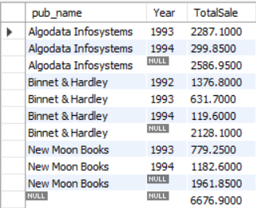
Q5: Total Sale of publishers in diffrent years and in overall.
HW1: joins, aggregations, nested queries
Using “group by”, “rollup”, “YEAR”, “sum”:
select pub_name , YEAR(ord_date) as Year , sum(qty * price ) as TotalSale
from sales inner join
titles on titles.title_id = sales.title_id inner join publishers on publishers.pub_id = titles.pub_id
group by pub_name , YEAR(ord_date)
with rollup;
Code result:
The ROLLUP generates the subtotal row every time the product line changes and the grand total at the end of the result.
Our analyze:
There are only 3 publishers that have sold books listed in titles table The results shows that each publishers almost sold same amount of books And the total sold per year is decreasing

Slide 9
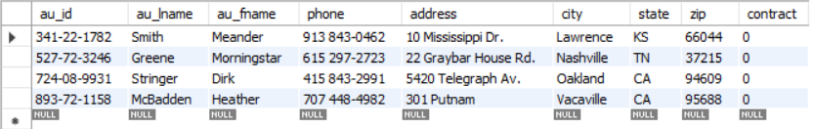
Q6: List of authors that don't have books
HW1: queries with negated subqueries, joins
HW2: rewriting queries
Using “is null” :
select *
from authors
left join titleauthor on titleauthor.au_id = authors.au_id
where title_id is null;
Optimizing (Subquery instead of join):
Using “not in” :
select *
from authors
where au_id not in
(select au_id
from titleauthor);
Our analyze:
There are 4 autors that haven't published any book yet
Code result:

