Slide 1
Data Management for Data Science Homework 1 – 2
Teachers: Prof. Lembo Domenico
Prof. Rosati Riccardo
Providers: Melika Sadat Parpinchi 1880156
MousaAlreza dastmard 1852433

Slide 2
Summary: Dataset: PUBS, 11 tables # of Queries: 23 (Including DUPLICATEs) # of UNIQUE Queries: 13

Slide 3
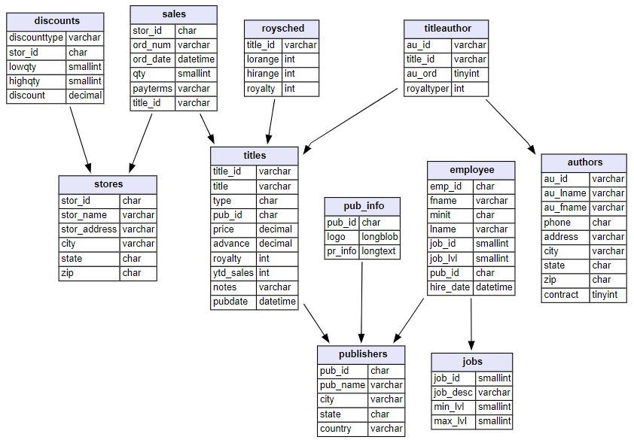
Pubs dataset https://relational.fit.cvut.cz/dataset/Pubs

Slide 4
Dataset details:
Table details:
Data types:
Numeric
String
Size:
400 KB
Count of tables:
11
Count of rows:
255
Count of columns:
64
Missing values:
Yes
Target table:
Titles
Target column:
Ytd_sales
Target_ID:
Title_ID
Target timestamp:
pubdate
Tables:
Titles
Authors
Titleauthor
Sales
Stores
discounts
Publishers
Pub_info
Employee
Jobs
Roysched
Primary Keys:
Title_id
Au_id
Au_id + title_id
Title_id + stor_id + ord_num
Stor_id
Stor_id
Pub_id
Pub_id
Emp_id
Job_id
Title_id

Slide 5
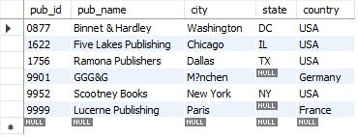

Q1-1, Q2-1-1, Q2-1-2: List of publishers that don't have business book
HW1: nested queries, queries with negated subqueries
HW2: rewriting, indexing, adding views
Code result:
Using “not exists”:
select * from publishers where not exists (select * from titles where titles.pub_id = publishers.pub_id and type = 'business');
Optimizing (Using View and index):
create index i_type on titles(type);
create view business_pub_ids as select pub_id from titles where type = 'business';
Using “not in”:
select * from publishers where pub_id not in (select * from business_pub_ids );
View result:
Our analyze:
There 4 publishers located in the USA and two in Germany and France.

Slide 6
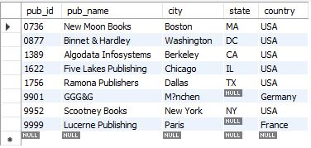
Q1-2: List of publishers that have published books that have mod in their type
HW1: nested queries
Code result:
Using “exists”, “Like”:
select * from publishers where exists (select * from titles where type like '%mod%');
Our analyze:
Mostly the publishers have books of type %mod% are located in the USA

Slide 7
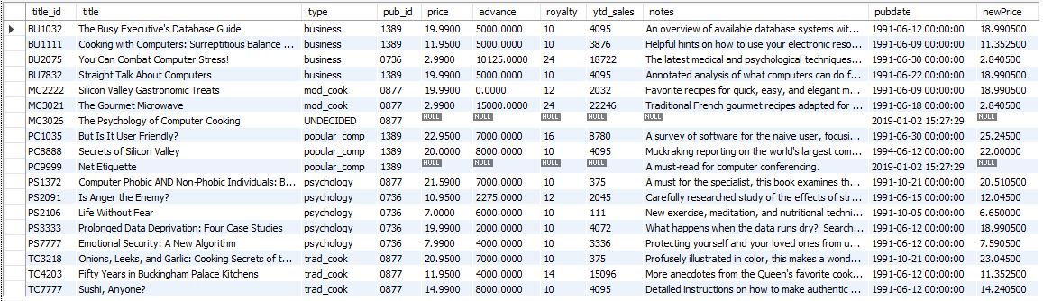
Q1-3: Raising the price by 10% for those books have total sale more than 500 Else decreasing by 5%
HW1: joins, aggregations, nested queries
Using “case when”, “group by”, “having” :
select * ,
case when
title_id in (select titles.title_id from titles inner join sales on sales.title_id = titles.title_id group by titles.title_id having sum(qty*price) > 500)
then price * 1.1
else price * .95
end as newPricefrom titles ;
Our analyze:
Comparing the columns price and newPrice we can see that mostly the new calculated price is less than previous price.

Slide 8
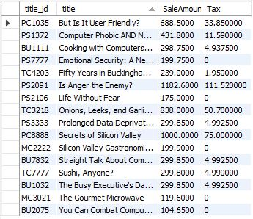
Q1-4: TAX calculation for each book based on total sale If total sale is less than 200 then TAX = 0 If total sale is less than 500 then TAX = (Total sale - 200)*5% If total sale is less than 800 then TAX = 15 + (Total sale - 500)*10% If total sale is less than 1000 then TAX = 45 + (Total sale - 800)*15% else TAX = 75 + (Total sale - 1000)*20%
HW1: joins, aggregations, nested queries
HW2: tables derived from the existing database tables
Code result:
Using “case when”, “drived query”, “group by”
select * , case when SaleAmount < 200 then 0
when SaleAmount < 500 then 0+(SaleAmount - 200) * .05
when SaleAmount < 800 then 0 + 15 +(SaleAmount - 500) * .10
when SaleAmount < 1000 then 0 + 15 + 30 +(SaleAmount - 800) * .15
else 0 + 15 + 30 + 30 + (SaleAmount - 1000) * .20
end as Tax
from (select titles.title_id , title , sum(qty*price) as SaleAmount from sales inner join titles
on titles.title_id = sales.title_id
group by titles.title_id , title) as d ;
Our analyze:
Rarely we can find publishers that have to pay TAX more than 100$ based on TAX scenario defined above. And there exist publishers have not to pay TAX.

Slide 9
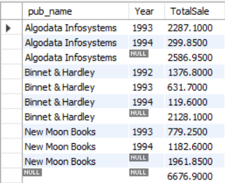
Q1-5: Total Sale of publishers in diffrent years and in overall.
HW1: joins, aggregations, nested queries
Using “group by”, “rollup”, “YEAR”, “sum”:
select pub_name , YEAR(ord_date) as Year , sum(qty * price ) as TotalSale
from sales inner join
titles on titles.title_id = sales.title_id inner join publishers on publishers.pub_id = titles.pub_id
group by pub_name , YEAR(ord_date)
with rollup;
Code result:
The ROLLUP generates the subtotal row every time the product line changes and the grand total at the end of the result.
Our analyze:
There are only 3 publishers that have sold books listed in titles table The results shows that each publishers almost sold same amount of books And the total sold per year is decreasing

Slide 10
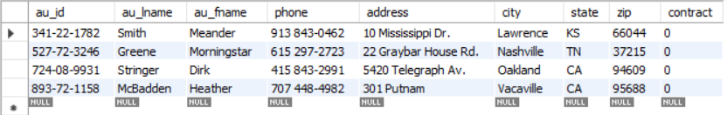
Q1-6-1, Q1-6-2: List of authors that don't have books
HW1: queries with negated subqueries, joins
HW2: rewriting queries
Using “is null” :
select *
from authors
left join titleauthor on titleauthor.au_id = authors.au_id
where title_id is null;
Optimizing (Subquery instead of join):
Using “not in” :
select *
from authors
where au_id not in
(select au_id
from titleauthor);
Our analyze:
There are 4 autors that haven't published any book yet
Code result:

Slide 11
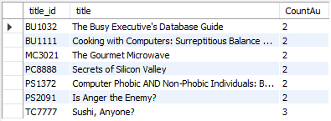
Q1-7: List of books that have at least 2 authors in ascend order
HW1: joins, aggregations, nested queries
Code result:
Using “Count”, “group by”, “having”, “order by”:
select titles.title_id , title , Count(au_id) as CountAu
from titles inner join
titleauthor on titleauthor.title_id = titles.title_id
group by titles.title_id , title
having Count(au_id) > 1
order by 3;
Our analyze:
Among those books have at least two co-authors, there is only one book with 3 authors and the remain books have only two co-authors

Slide 12
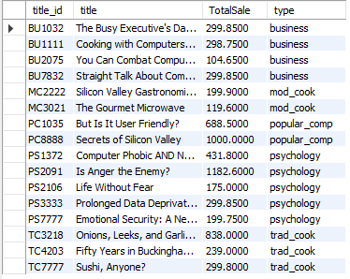

Q1-8-1, Q1-8-2, Q2-2-1, Q2-2-2: Total sale of business books
HW1: joins, aggregations, nested queries
HW2: rewriting queries, adding views
Using “where”, “group by”, “sum”:
select titles.title_id , title , sum(qty*price) as TotalSale
from titles inner join
sales on sales.title_id = titles.title_id
group by titles.title_id , title , type
having type = 'business';
Using “where”, “group by”, “sum”:
select titles.title_id , title , sum(qty*price) as TotalSale from titles inner join
sales on sales.title_id = titles.title_id where type = 'business'
group by titles.title_id , title;
View result:
Optimizing (Using View and index):
Create view title_sale_view as
select titles.title_id , title , sum(qty*price) as TotalSale, type
from titles inner join
sales on sales.title_id = titles.title_id
group by title_id , title;select * from title_sale_view;select title_id , title , TotalSale
from title_sale_view
where type = 'business';
Code result:

Slide 13
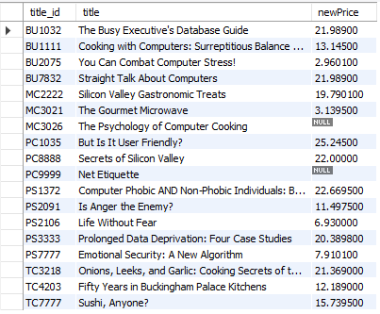
Q1-9, Q2-4-1, Q2-4-2: Pricing book based of various conditions: if publisher located in California then increase price by 10%if the book has more than 1 authors then increase price by 5%,if the book is sold more than 200$ then increase price by 2%,else decrease price by 1%
Code result:
HW1: joins, aggregations, nested queries
HW2: rewriting queries, adding views
Using “where”, “group by”, “sum”:
select title_id , title ,
case when pub_id in
(select pub_id from publishers where state = 'CA') then price * 1.1 else case when title_id in
(select title_id from titleauthor group by title_id having count(*) > 1) then price * 1.05
else case when title_id in
(select titles.title_id from titles inner join sales on sales.title_id = titles.title_id group by titles.title_id having sum(qty*price) > 200) then price * 1.02 else price * .99 end end end as newPricefrom titles ;
Next page

Slide 14

Using “where”:
select title_id , title ,
case when pub_id in
(select pub_id from publishers where state = 'CA') then price * 1.1 else case when title_id in
(select * from titleauthor_view) then price * 1.05 else case when title_id in
(select * from title_view) then price * 1.02 else price * .99 end end end as newPrice
from titles ;
Optimizing (Using view):
create view titleauthor_view as
select title_id from titleauthor
group by title_id
having count(*) > 1;
create view title_view as
select titles.title_id from titles inner join sales on sales.title_id = titles.title_id group by titles.title_id having sum(qty*price) > 200;
View result:

Slide 15
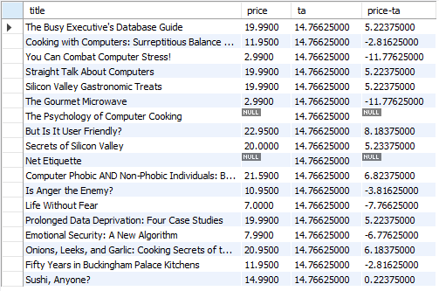
Q1-10, Q2-3-1, Q2-3-2: List of books, their price and average price and its diffrence
HW1: joins, aggregations, nested queries
HW2: rewriting queries, adding views, indexing
Using “view”:
Select title, price, (Select * from ave_price),
Price-(Select * from ave_price)
from titles;
Code result:
Using “avg”, “cross join”:
Select title, price, ta, price-ta
from titles Cross join
(Select avg(price) as ta from titles) k;
Optimizing (Using view and index):
create index i_price on titles(price);
create view ave_price as
Select avg (price) from titles;

Slide 16
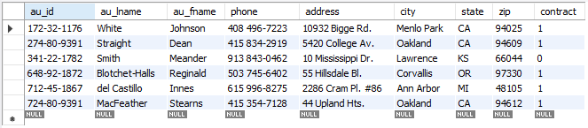
Q2-5: adding indices
HW2: adding indices to one or more tables
Using “where”,”Like”:
select * from authors
where au_lname like "%t%“
and
au_fname like "%n%";
Optimizing (indexing):
create index i_composite ON authors(au_fname, au_lname);
#drop index i_composite ON authors;
Code result:

Slide 17
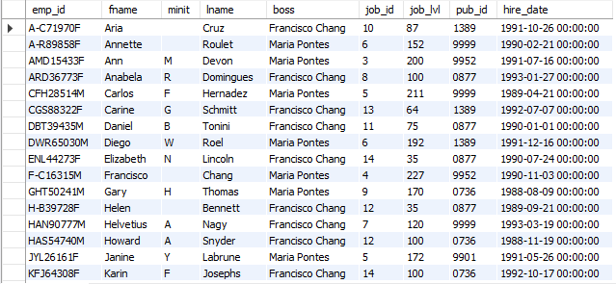
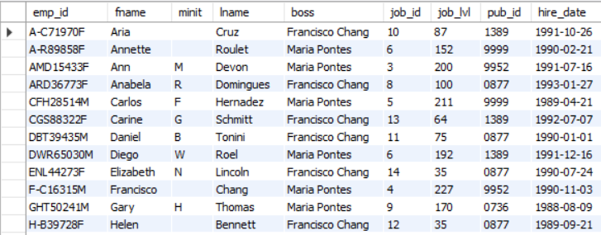
Q2-6: modifying the schema database, adding integrity constraints
HW2: modifying the schema of the database, adding integrity constraints to one or more tables
View result(not all):
Optimizing (Using View and index):
create view boss_view as
select emp_id, fname, minit, lname,
case when job_lvl > 150 then 'Maria Pontes' else 'Francisco Chang' end as boss,
job_id, job_lvl, pub_id, hire_date
from employee;
Modifying table employee:
alter table employee
ADD boss varchar(50)
AFTER lname;
update employee
SET boss = 'Maria Pontes‘
WHERE job_lvl > 150;
update employee
SET boss = 'Francisco Chang‘
WHERE job_lvl <= 150;
Code result:

Slide 18
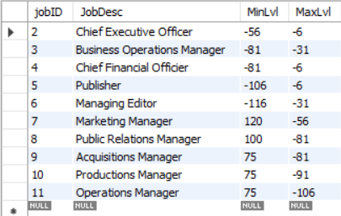
Q2-7: Migrating the jobs data into JobR which has integrity constraints and hope to make query faster from JobR
HW2: modifying the schema of the database, adding integrity constraints to one or more tables
Optimizing (Using Integrity Constrains):
create table JobR (jobID int Primary Key, JobDesc varchar(50) unique, MinLvl tinyint not null, MaxLvl tinyint not null);insert into JobR select * from jobs where max_lvl > 100;select * from JobR;
Code result:

Slide 19
Conclusion:
13 different queries in term of meaning are designed, for the seek of optimization some of queries are duplicated having the same meaning but different syntax, however the running time differences are not noticeable for the same queries since the queries run on local host with small number of records, but we hope that view creation, indexing, integrity constrain and, smart syntax would optimize the queries when it comes to a huge amount of data.

