Slide 1
Data Management for Data Science Homework 1 – 2
Teachers: Prof. Lembo Domenico
Prof. Rosati Riccardo
Providers: Melika Sadat Parpinchi 1880156
MousaAlreza dastmard 1852433

Slide 2
Summary: Dataset: PUBS, 11 tables # of Queries: 20 (Including DUPLICATEs) # of UNIQUE Queries: 11
Notes:
We prepared 13 queries for both HW1 and HW2. In total there are 23 queries, some of them have the same meaning, but different syntax in order to make comparison between optimized queries and lets say not-optimized queries.
The data set is about books have been sold. It has 11 tables.

Slide 3
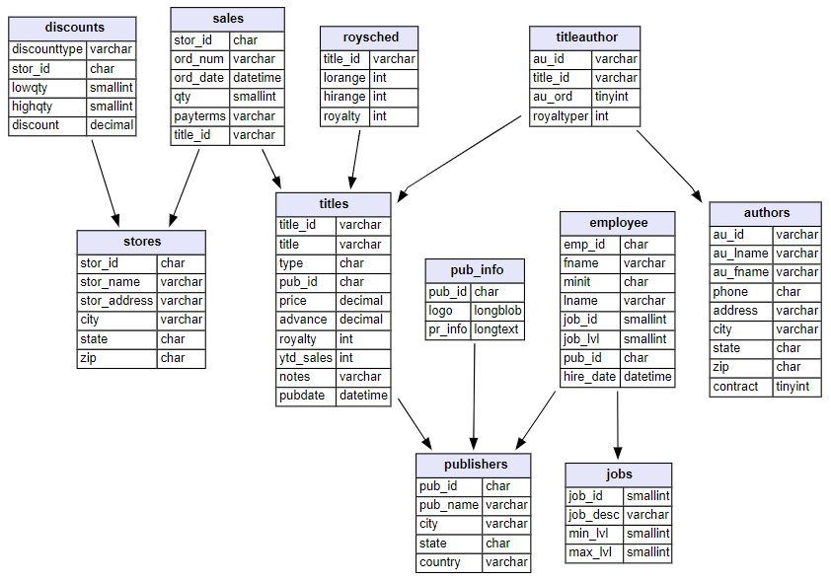
Pubs dataset https://relational.fit.cvut.cz/dataset/Pubs
Notes:
Titles is the target table, which store information about different books, which is connected to sales table directly and discounts and stores indirectly keep monetary information of the books sales. Books might have more than 1 authors that causes having titleauthor table which connects titles table and authors table. Also publisher, employee and jobs information are stored in separate tables interconnectedly.

Slide 4
Dataset details:
Table details:
Data types:
Numeric
String
Datetime
Size:
400 KB
Count of tables:
11
Count of rows:
255
Count of columns:
64
Missing values:
Yes
Target table:
Titles
Target column:
Ytd_sales
Target_ID:
Title_ID
Target timestamp:
pubdate
Tables:
Titles
Authors
Titleauthor
Sales
Stores
discounts
Publishers
Pub_info
Employee
Jobs
Roysched
Primary Keys:
Title_id
Au_id
Au_id + title_id
Title_id + stor_id + ord_num
Stor_id
Stor_id
Pub_id
Pub_id
Emp_id
Job_id
Title_id
Notes:
In total, there are 64 columns and 255 records wrapped up in 11 tables. Data types are numeric, string and datetime and missing values appear in some columns.

Slide 5
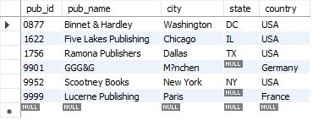

Q1-1, Q2-1-1, Q2-1-2: List of publishers that don't have business book
HW1: nested queries
HW2: rewriting, indexing, adding views
Code result:
Using “not exists”:
select * from publishers where not exists (select * from titles where titles.pub_id = publishers.pub_id and type = 'business');
Optimizing (Using View and index):
create index i_type on titles(type);
create view business_pub_ids as select pub_id from titles where type = 'business';
Using “not in”:
select * from publishers where pub_id not in (select * from business_pub_ids );
View result:
Our analyze:
There 4 publishers located in the USA and two in Germany and France.
Notes:
Lets start with the queries appears in both HW1 and 2 which has the same meaning
It leverages nested queries, negated subqueries and also view and indexing for enhancing the running time.
The query reports on list of publishers that don’t have business book. First we extract only those publishers that have published at least a book and then among them select ones that have never published business books.

Slide 6
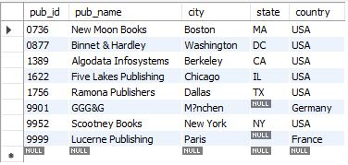
Q1-2: List of publishers that have published books that have mod in their type
HW1: nested queries
Code result:
Using “exists”, “Like”:
select * from publishers where exists (select * from titles where type like '%mod%');
Our analyze:
Mostly the publishers have books of type %mod% are located in the USA
Notes:
The query is about make a list of books which have the word “mod” in their type.
To do so, we use “exists” and “like” syntax combined with subquery to output the list. mostly the publisher in the USA have published books of type %mod%

Slide 7
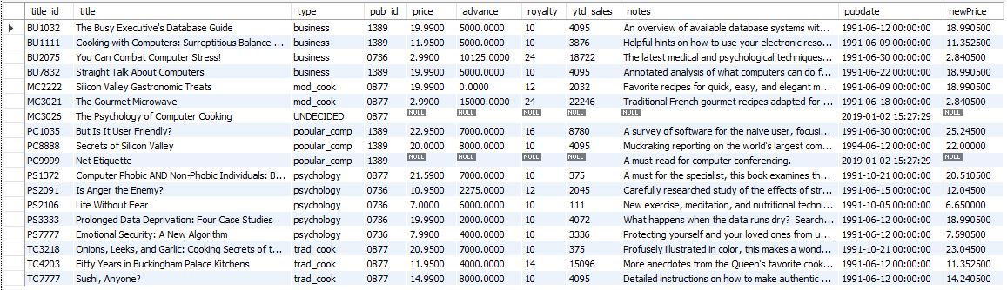
Q1-3: Raising the price by 10% for those books have total sale more than 500 Else decreasing by 5%
HW1: joins, aggregations, nested queries
Using “case when”, “group by”, “having” :
select * ,
case when
title_id in (select titles.title_id from titles inner join sales on sales.title_id = titles.title_id group by titles.title_id having sum(qty*price) > 500)
then price * 1.1
else price * .95
end as newPricefrom titles ;
Our analyze:
Comparing the columns price and newPrice we can see that mostly the new calculated price is less than previous price.
Notes:
Next query is applying pricing procedure in order to raise the price of more popular books and decrease the price of less popular.
“Case when” combined with a nested query that has “having” in used to put condition on total sale.

Slide 8
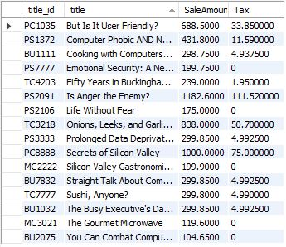
Q1-4: TAX calculation for each book based on total sale If total sale is less than 200 then TAX = 0 If total sale is less than 500 then TAX = (Total sale - 200)*5% If total sale is less than 800 then TAX = 15 + (Total sale - 500)*10% If total sale is less than 1000 then TAX = 45 + (Total sale - 800)*15% else TAX = 75 + (Total sale - 1000)*20%
HW1: joins, aggregations, nested queries
HW2: tables derived from the existing database tables
Code result:
Using “case when”, “drived query”, “group by”
select * , case when SaleAmount < 200 then 0
when SaleAmount < 500 then 0+(SaleAmount - 200) * .05
when SaleAmount < 800 then 0 + 15 +(SaleAmount - 500) * .10
when SaleAmount < 1000 then 0 + 15 + 30 +(SaleAmount - 800) * .15
else 0 + 15 + 30 + 30 + (SaleAmount - 1000) * .20
end as Tax
from (select titles.title_id , title , sum(qty*price) as SaleAmount from sales inner join titles
on titles.title_id = sales.title_id
group by titles.title_id , title) as d ;
Our analyze:
Rarely we can find publishers that have to pay TAX more than 100$ based on TAX scenario defined above. And there exist publishers have not to pay TAX.
Notes:
The aim of this query is to calculate the tax. We assume that those books with higher total sale have to pay tax with higher rate. To calculate the total sale of each book a drived query is implemented that will be deleted automatically after running this querry.

Slide 9
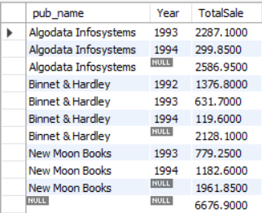
Q1-5: Total Sale of publishers in different years and in overall.
HW1: joins, aggregations, nested queries
Using “group by”, “rollup”, “YEAR”, “sum”:
select pub_name , YEAR(ord_date) as Year , sum(qty * price ) as TotalSale
from sales inner join
titles on titles.title_id = sales.title_id inner join publishers on publishers.pub_id = titles.pub_id
group by pub_name , YEAR(ord_date)
with rollup;
Code result:
The ROLLUP generates the subtotal row every time the product line changes and the grand total at the end of the result.
Our analyze:
There are only 3 publishers that have sold books listed in titles table The results shows that each publishers almost sold same amount of books And the total sold per year is decreasing
Notes:
The query is about annual sales of publishers in different years and in total. Not only group by pub_name and YEAR gives us the total sale for each publisher on different year, but also using rollup adds information on total sale for each publisher on whole years and total sale of all publishers. It can be witnessed that the total sale has a downward trend respect to the years.

Slide 10
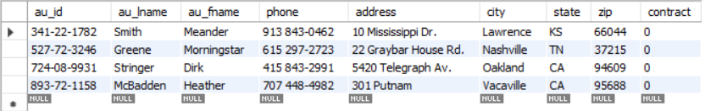
Q1-6-1, Q1-6-2: List of authors that don't have books
HW1: queries with negated subqueries, joins
HW2: rewriting queries
Using “is null” :
select *
from authors
left join titleauthor on titleauthor.au_id = authors.au_id
where title_id is null;
Optimizing (Subquery instead of join):
Using “not in” :
select *
from authors
where au_id not in
(select au_id
from titleauthor);
Our analyze:
There are 4 authors that haven't published any book yet
Code result:
Notes:
There are authors that exist in authors table, but have not published any book yet. The list of these authors can be achieved by this query.
To optimize the query we rewrite the query and instead of join we use subquery that should improve the running time.

Slide 11
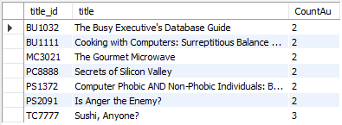
Q1-7: List of books that have at least 2 authors in ascend order
HW1: joins, aggregations, nested queries
Code result:
Using “Count”, “group by”, “having”, “order by”:
select titles.title_id , title , Count(au_id) as CountAu
from titles inner join
titleauthor on titleauthor.title_id = titles.title_id
group by titles.title_id , title
having Count(au_id) > 1
order by 3;
Our analyze:
Among those books have at least two co-authors, there is only one book with 3 authors and the remain books have only two co-authors
Notes:
The query gives information on number of authors that each book have. We filter those books with more than one author.

Slide 12
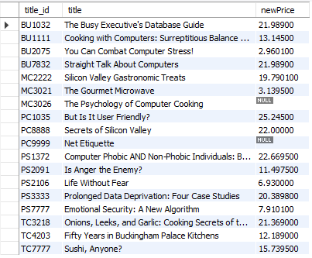
Q1-9, Q2-4-1, Q2-4-2: Pricing book based of various conditions: if publisher located in California then increase price by 10%if the book has more than 1 authors then increase price by 5%,if the book is sold more than 200$ then increase price by 2%,else decrease price by 1%
Code result:
HW1: joins, aggregations, nested queries
HW2: rewriting queries, adding views
Using “where”, “group by”, “sum”:
select title_id , title ,
case when pub_id in
(select pub_id from publishers where state = 'CA') then price * 1.1
else case when title_id in
(select title_id from titleauthor group by title_id having count(*) > 1) then price * 1.05
else case when title_id in
(select titles.title_id from titles inner join sales on sales.title_id = titles.title_id group by titles.title_id having sum(qty*price) > 200) then price * 1.02 else price * .99 end end end as newPricefrom titles ;
Next page
Notes:
The query changes the price based on several conditions like, state where the publisher is located, total sale, number of authors. Necessary information for different condition are obtained by nested queries. And the difference between this query and the other one (Tax) is that we used “else case when” so maybe some results in first subquery appear also in next ones but we want that to change only once with listed priority.

Slide 13

Using “where”:
select title_id , title ,
case when pub_id in
(select pub_id from publishers where state = 'CA') then price * 1.1 else case when title_id in
(select * from titleauthor_view) then price * 1.05 else case when title_id in
(select * from title_view) then price * 1.02 else price * .99 end end end as newPrice
from titles ;
Optimizing (Using view):
create view titleauthor_view as
select title_id from titleauthor
group by title_id
having count(*) > 1;
create view title_view as
select titles.title_id from titles inner join sales on sales.title_id = titles.title_id group by titles.title_id having sum(qty*price) > 200;
View result:
Notes:
Since there are several subqueries for each condition, we put the subqueries in different views to make the code neat and improve the performance.

Slide 14
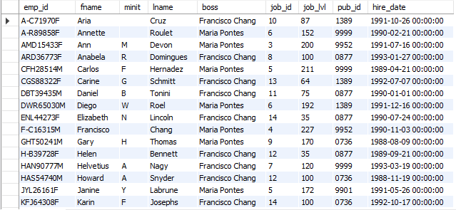
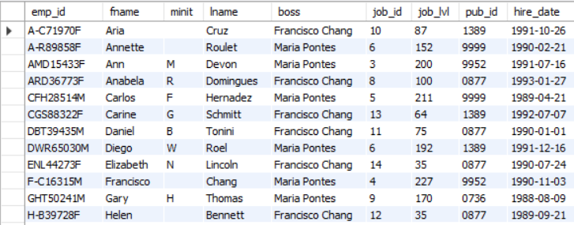
Q2-6: modifying the schema database, adding integrity constraints
HW2: modifying the schema of the database, adding integrity constraints to one or more tables
View result(not all):
Optimizing (Using View and index):
create view boss_view as
select emp_id, fname, minit, lname,
case when job_lvl > 150 then 'Maria Pontes' else 'Francisco Chang' end as boss,
job_id, job_lvl, pub_id, hire_date
from employee;
Modifying table employee and using check constraint:
alter table employee
ADD boss varchar(50) check (boss in ('Francisco Chang', 'Maria Pontes'))
AFTER lname;
update employee
SET boss = 'Maria Pontes‘
WHERE job_lvl > 150;
update employee
SET boss = 'Francisco Chang‘
WHERE job_lvl <= 150;
Code result:
Notes:
Assume that we frequently fetch queries that need the information about the direct manager of the employees (boss), So it’s better to keep this information in the employee table rather than running a query when it is needed. Also the values in column hire_date are more accurate than they must be. So we only keep the hire date and drop the hire time.

Slide 15
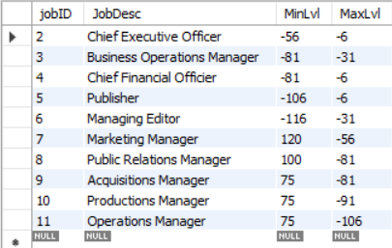
Q2-7: Migrating the jobs data into JobR which has integrity constraints and hope to make query faster from JobR
HW2: modifying the schema of the database, adding integrity constraints to one or more tables
Optimizing (Using Integrity Constrains):
create table JobR (jobID int Primary Key, JobDesc varchar(50) unique, MinLvl tinyint not null, MaxLvl tinyint not null);insert into JobR select * from jobs where max_lvl > 100;select * from JobR;
Code result:
Notes:
Lets suppose that jobs table is not well-disgned. We migrate the data in jobs table into JobR table and add constrain on values on creation of the table.

Slide 16
Conclusion:
11 different queries in term of meaning are designed, for the seek of optimization some of queries are duplicated having the same meaning but different syntax, however the execution time differences are not noticeable for the same queries since the queries run on local host with small number of records, but we hope that view creation, indexing, integrity constrain and, smart syntax would optimize the queries when it comes to a huge amount of data.

