Slide 1

Data Management for Data Science Homework 3
Teachers: Prof. Lembo Domenico
Prof. Rosati Riccardo
Providers: MousaAlreza dastmard 1852433
Melika Sadat Parpinchi 1880156

Slide 2
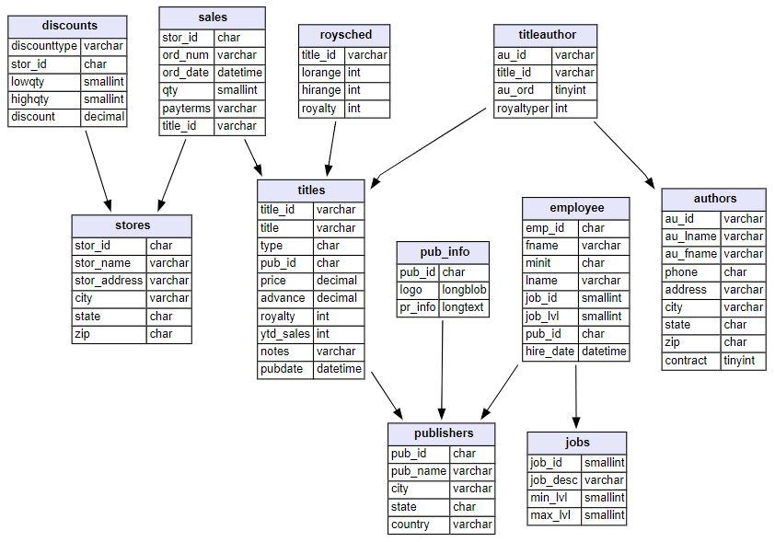
SQL(Mysql) vs. nosql(neo4j)
Dataset details:
Data types:
Numeric
String
Datetime
Size:
400 KB
Count of tables:
11
Count of rows:
255
Count of columns:
64
Missing values:
Yes
Target table:
Titles
Target column:
Ytd_sales
Target_ID:
Title_ID
Target timestamp:
pubdate

Slide 3
SQL(Mysql) vs. nosql(neo4j)
Relational databases:
rows and tables
primary key , foreign key
Joins are computed at query time (Compute-heavy and Memory-intensive)
many-to-many relationships => JOIN table
Ability to use views

Slide 4
SQL(Mysql) vs. nosql(neo4j)
Not only SQL:
Graph data model
No need to infer connections as foreign keys
Connected structures
Contains a list of relationship records
Similar to the real world
Graph-specific functionality

Slide 5
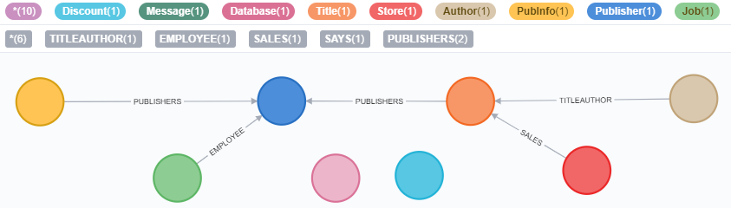
SQL(Mysql) vs. nosql(neo4j)
A graph database can store any kind of data using a few simple concepts:
Nodes - graph data records
Relationships - connect nodes
The real power of Neo4j is in connected data.
To associate any two nodes, we can add a Relationship which describes how the records are related.

Slide 6
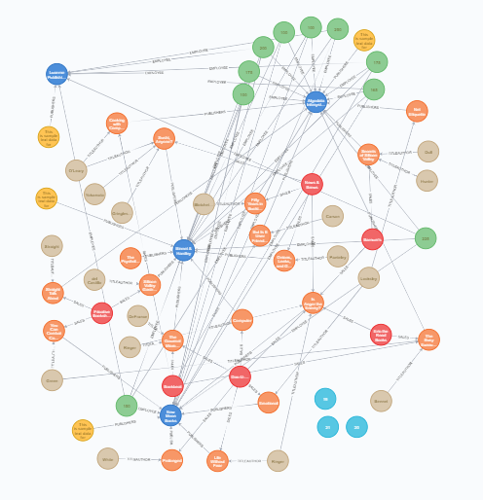
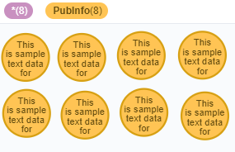

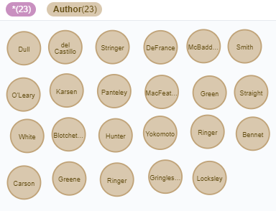
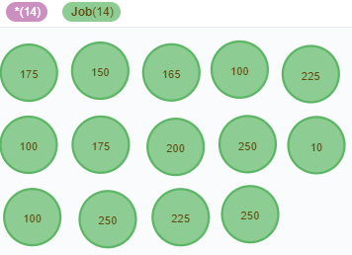
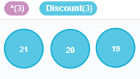
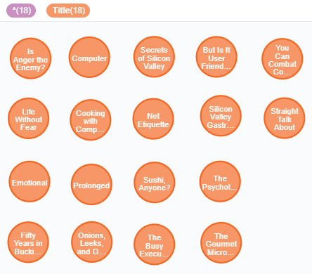

Our Graph

Slide 7
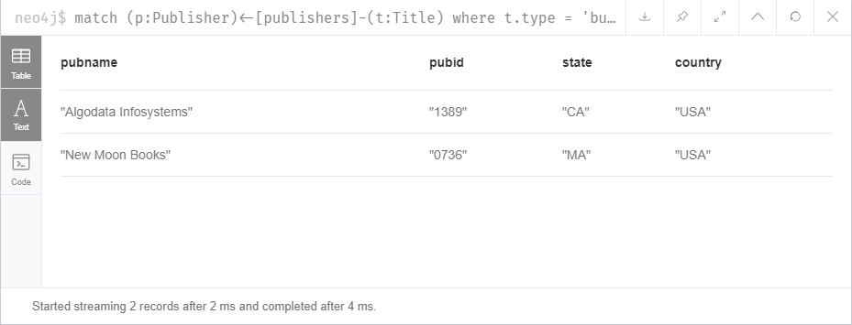

Q1. List of publishers that have business book
Nosql(Neo4j)
match (p:Publisher)<-[publishers]-(t:Title)
where t.type = 'business'
return distinct p.pubName as pubname, p.pubId as pubid, p.state as state, p.country as country
CREATE INDEX ON :Title(type)
Or CREATE INDEX FOR (t:Title) ON (t.type)
Drop INDEX ON :Title(type)
Sql(mysql)
select * from publishers
where exists
(select * from titles where titles.pub_id = publishers.pub_id and type = 'business');
create index i_type on titles(type);
drop index i_type on titles;

Slide 8
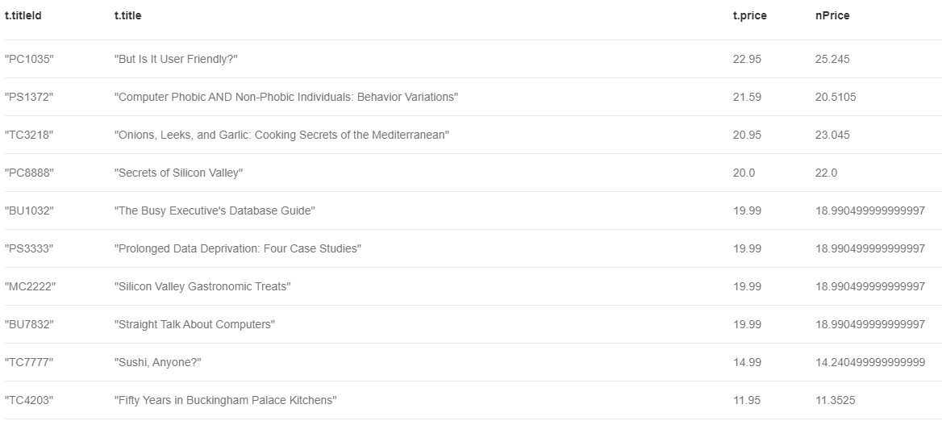
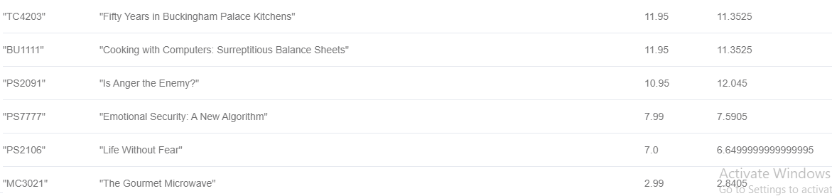
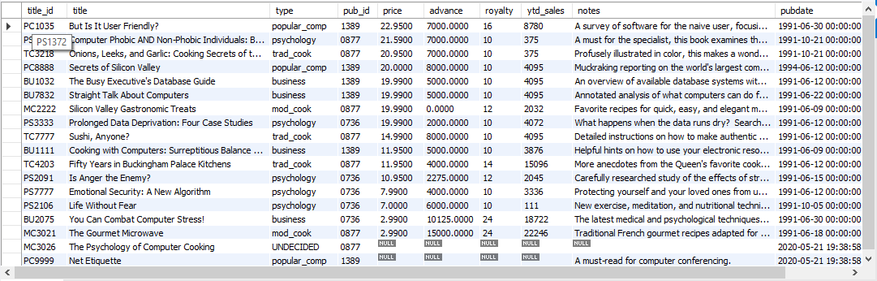
from titles ;
Q2. Rasing the price by 10% for those books have total sale more than 500 Else decreasing by 5%
Nosql(Neo4j)
match (s:Store)-[a:SALES]-(t:Title)
return t.titleId, t.title, t.price,
CASE
WHEN sum(a.qty*t.price) > 500 then t.price * 1.1
ELSE t.price * 0.95 END AS nPrice
order by t.price desc
Sql(mysql)
select * , case when title_id in (select titles.title_id
from titles inner join sales on sales.title_id = titles.title_id
group by titles.title_id
having sum(qty*price) > 500) then price * 1.1 else price * .95
end as newPrice
from titles
order by price desc;

Slide 9
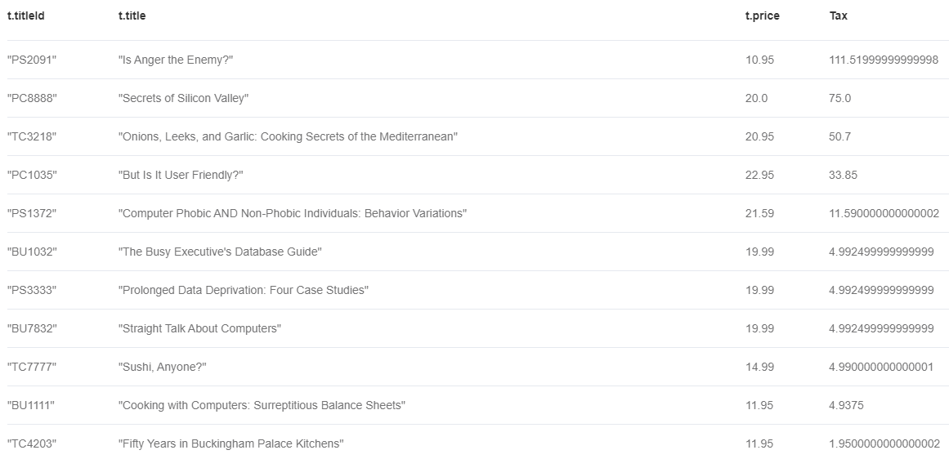
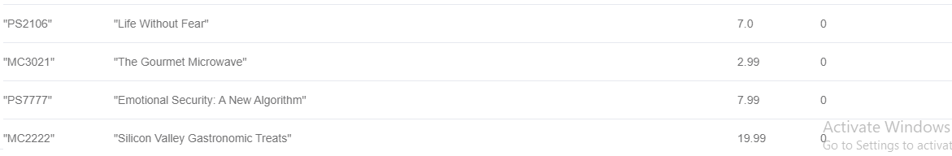
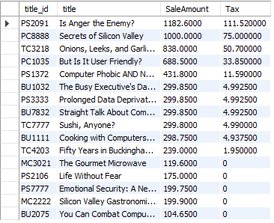
Limit 3
Q3. TAX calculation for each book based on total sale
Nosql(Neo4j)
match (s:Store)-[a:SALES]-(t:Title)
return t.titleId, t.title, t.price,
case
when sum(a.qty*t.price) < 200 then 0
when sum(a.qty*t.price) < 500 then 0 + (sum(a.qty*t.price) - 200) * .05
when sum(a.qty*t.price) < 800 then 0 + 15 + (sum(a.qty*t.price) - 500) * .10
when sum(a.qty*t.price) < 1000 then 0 + 15 + 30 + (sum(a.qty*t.price) - 800) * .15
else 0 + 15 + 30 + 30 + (sum(a.qty*t.price) - 1000) * .20
END AS Tax
order by Tax Desc
Sql(mysql)
select * , case
when SaleAmount < 200 then 0
when SaleAmount < 500 then 0 + (SaleAmount - 200) * .05
when SaleAmount < 800 then 0 + 15 + (SaleAmount - 500) * .10
when SaleAmount < 1000 then 0 + 15 + 30 + (SaleAmount - 800) * .15
else 0 + 15 + 30 + 30 + (SaleAmount - 1000) * .20
end as Tax
from (select titles.title_id , title , sum(qty*price) as SaleAmount from sales
inner join titles on titles.title_id = sales.title_id
group by titles.title_id , title) as d
order by Tax Desc
;

Slide 10
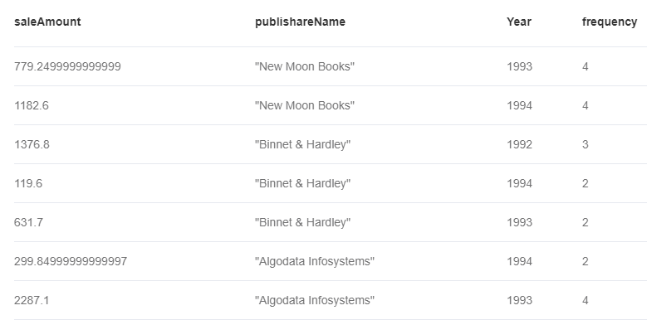
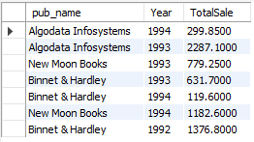
order by publishareName
Q4. Total Sale of publishers in diffrent years
Nosql(Neo4j)
Sql(mysql)
match (s:Store)-[a:SALES]-(t:Title)-[publishers]-(p:Publisher)
return sum(a.qty*t.price) as saleAmount, p.pubName as publishareName, a.ordDate.year as Year , size(collect(a.ordDate.year)) as frequency
select pub_name , YEAR(ord_date) as Year , sum(qty * price ) as TotalSale
from sales inner join titles on titles.title_id = sales.title_id
inner join publishers on publishers.pub_id = titles.pub_id group by pub_name , YEAR(ord_date);

Slide 11
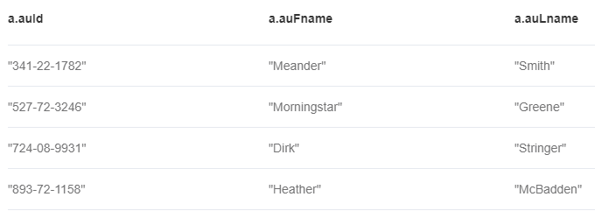

Q5. List of authors that don't have books
Nosql(Neo4j)
match (t:Title)
WITH collect(t) as ta
match (a:Author) WHERE all(t in ta WHERE NOT Exists( (a)--(t) ) )
return a.auId, a.auFname, a.auLname
Sql(mysql)
Join:
select * from authors
left join titleauthor on titleauthor.au_id = authors.au_id
where title_id is null;
Subquery:
select * from authors
where au_id not in (select au_id from titleauthor);

Slide 12
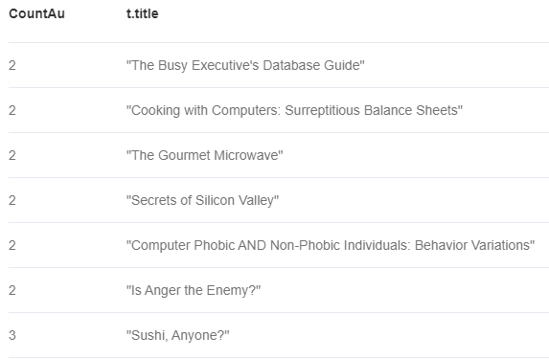
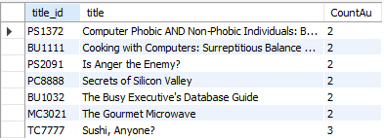
Q6. List of books that have at least 2 authors in ascend order
Nosql(Neo4j)
Sql(mysql)
match (t:Title)-[ta:TITLEAUTHOR]-(a:Author)
WITH t, collect(ta) as CoAu
WHERE size(CoAu) > 1
return size(CoAu) as CountAu, t.title
order by CountAu
select titles.title_id , title , Count(au_id) as CountAu
from titles
inner join titleauthor on titleauthor.title_id = titles.title_id
group by titles.title_id , title
having Count(au_id) > 1
order by 3;

