Slide 1

Data Management for Data Science Homework 3
Teachers: Prof. Lembo Domenico
Prof. Rosati Riccardo
Providers: MousaAlreza dastmard 1852433
Melika Sadat Parpinchi 1880156

Slide 2
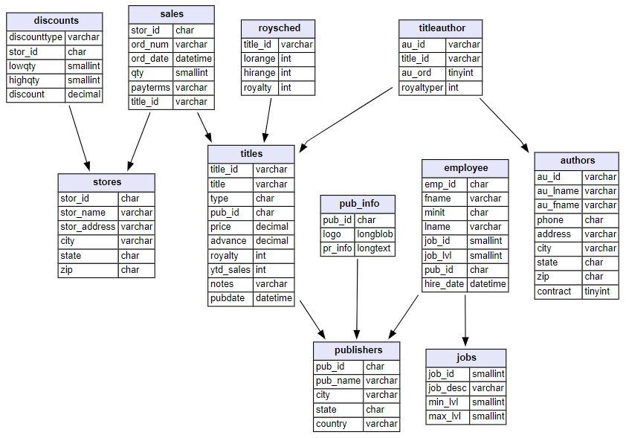
SQL(Mysql) vs. nosql(neo4j)
Dataset details:
Data types:
Numeric
String
Datetime
Size:
400 KB
Count of tables:
11
Count of rows:
255
Count of columns:
64
Missing values:
Yes
Target table:
Titles
Target column:
Ytd_sales
Target_ID:
Title_ID
Target timestamp:
pubdate

Slide 3
SQL(Mysql) vs. nosql(neo4j)
In relational databases, references to other rows and tables are indicated by referring to primary key attributes via foreign key columns. Joins are computed at query time by matching primary and foreign keys of all rows in the connected tables. These operations are compute-heavy and memory-intensive and have an exponential cost.
When many-to-many relationships occur in the model, you must introduce a JOIN table (or associative entity table) that holds foreign keys of both the participating tables, further increasing join operation costs.
This makes understanding the connections very cumbersome because you must know the person ID and department ID values (performing additional lookups to find them) in order to know which person connects to which departments. Those types of costly join operations are often addressed by denormalizing the data to reduce the number of joins necessary, therefore breaking the data integrity of a relational database.

Slide 4
SQL(Mysql) vs. nosql(neo4j)
Unlike other database management systems, relationships are of equal importance in the graph data model to the data itself. This means we are not required to infer connections between entities using special properties such as foreign keys or out-of-band processing like map-reduce.
By assembling nodes and relationships into connected structures, graph databases enable us to build simple and sophisticated models that map closely to our problem domain. The data stays remarkably similiar to the its form in the real world – small, normalized, yet richly connected entities. This allows us to query and view your data from any imaginable point of interest, supporting many different use cases.
Each node (entity or attribute) in the graph database model directly and physically contains a list of relationship records that represent the relationships to other nodes. Whenever we run the equivalent of a JOIN operation, the graph database uses this list, directly accessing the connected nodes and eliminating the need for expensive search-and-match computations.
This ability to pre-materialize relationships into the database structure allows Neo4j to provide performance of several orders of magnitude above others, especially for join-heavy queries, allowing users to leverage a minutes to milliseconds advantage.
The straightforward graph structure results in much simpler and more expressive data models than those produced using traditional relational databases.

Slide 5
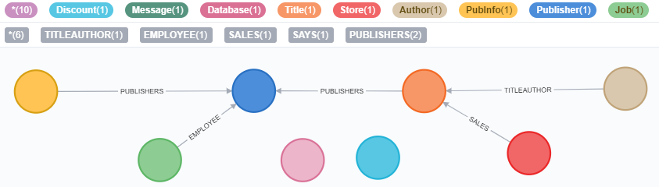
SQL(Mysql) vs. nosql(neo4j)
A graph database can store any kind of data using a few simple concepts:
Nodes - graph data records
Relationships - connect nodes
Properties - named data values
The real power of Neo4j is in connected data. To associate any two nodes, we can add a Relationship which describes how the records are related.
In a property graph, relationships are data records that can also contain properties

Slide 6
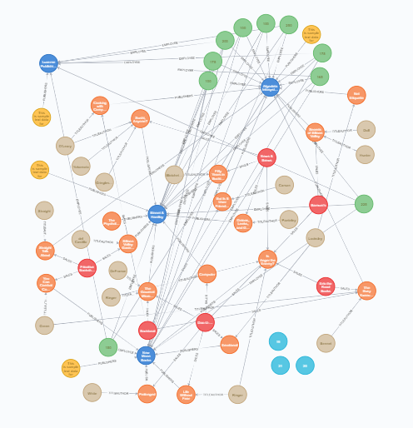
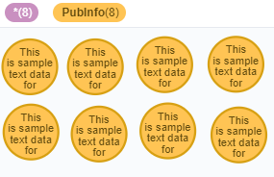
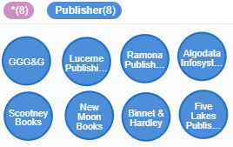
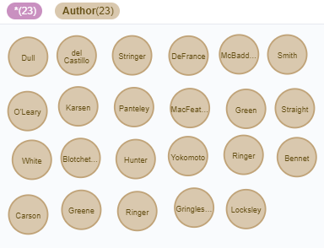
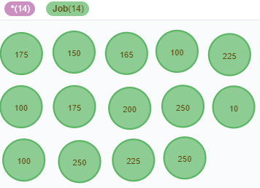
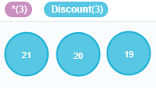
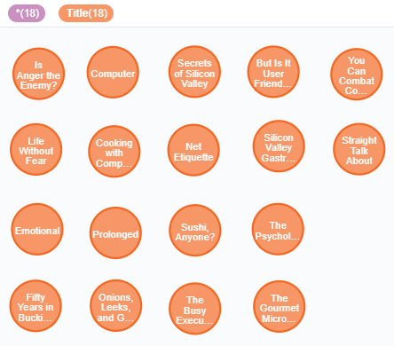

Our Graph

Slide 7
SQL(Mysql) vs. nosql(neo4j)
MySQL Server is intended for mission-critical, heavy-load production systems as well as for embedding into mass-deployed software. On the other hand, Neo4j stores data in nodes connected by directed, typed relationships with properties on both, also known as a Property Graph. It is a high performance graph store with all the features expected of a mature and robust database, like a friendly query language and ACID transactions.
Cypher, Neo4j’s declarative graph query language, is built on the basic concepts and clauses of SQL but has a lot of additional graph-specific functionality to make it easy to work with your graph model.
A view is the result set of a stored query on the data, which the database users can query just as they would in a persistent database collection object.
Neo4j doesn't host stored queries.

Slide 8
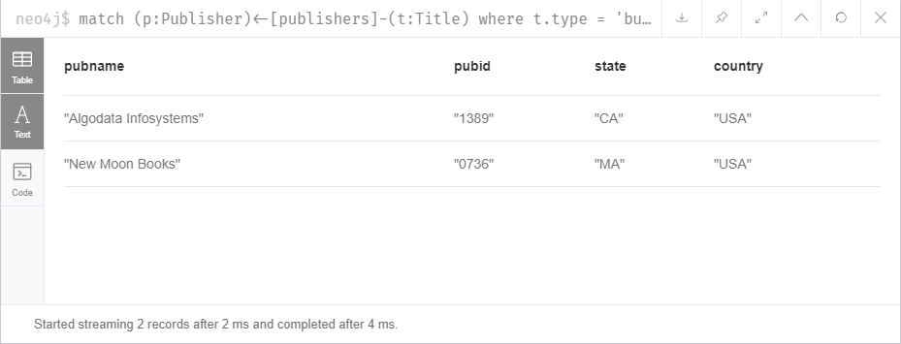

Q1. List of publishers that have business book
Nosql(Neo4j)
match (p:Publisher)<-[publishers]-(t:Title)
where t.type = 'business'
return distinct p.pubName as pubname, p.pubId as pubid, p.state as state, p.country as country
CREATE INDEX ON :Title(type)
Or CREATE INDEX FOR (t:Title) ON (t.type)
Drop INDEX ON :Title(type)
Sql(mysql)
select * from publishers
where exists
(select * from titles where titles.pub_id = publishers.pub_id and type = 'business');
create index i_type on titles(type);
drop index i_type on titles;

Slide 9
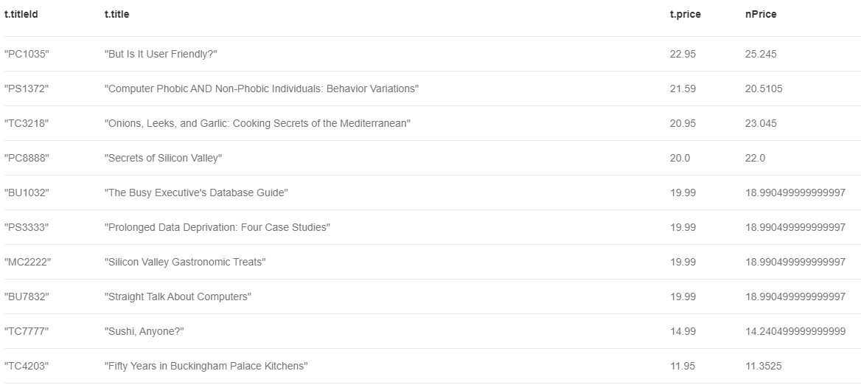
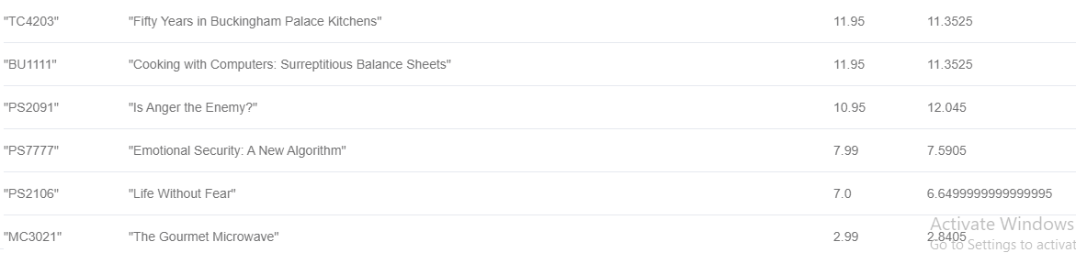
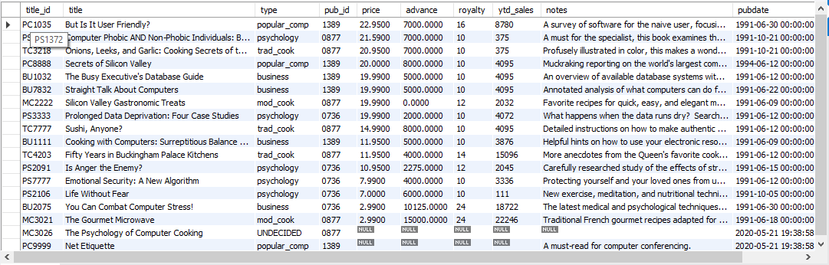
from titles ;
Q2. Rasing the price by 10% for those books have total sale more than 500 Else decreasing by 5%
Nosql(Neo4j)
match (s:Store)-[a:SALES]-(t:Title)
return t.titleId, t.title, t.price,
CASE
WHEN sum(a.qty*t.price) > 500 then t.price * 1.1
ELSE t.price * 0.95 END AS nPrice
order by t.price desc
Sql(mysql)
select * , case when title_id in (select titles.title_id
from titles inner join sales on sales.title_id = titles.title_id
group by titles.title_id
having sum(qty*price) > 500) then price * 1.1 else price * .95
end as newPrice
from titles
order by price desc;

Slide 10
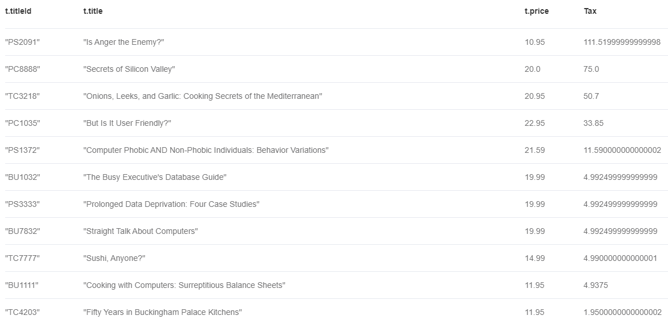
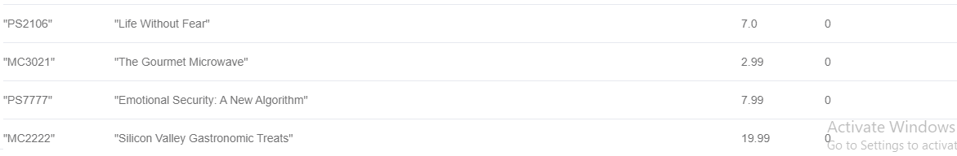
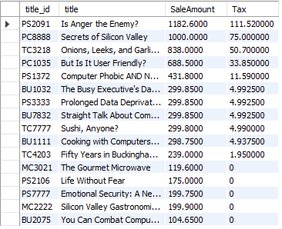
Limit 3
Q3. TAX calculation for each book based on total sale
Nosql(Neo4j)
match (s:Store)-[a:SALES]-(t:Title)
return t.titleId, t.title, t.price,
case
when sum(a.qty*t.price) < 200 then 0
when sum(a.qty*t.price) < 500 then 0 + (sum(a.qty*t.price) - 200) * .05
when sum(a.qty*t.price) < 800 then 0 + 15 + (sum(a.qty*t.price) - 500) * .10
when sum(a.qty*t.price) < 1000 then 0 + 15 + 30 + (sum(a.qty*t.price) - 800) * .15
else 0 + 15 + 30 + 30 + (sum(a.qty*t.price) - 1000) * .20
END AS Tax
order by Tax Desc
Sql(mysql)
select * , case
when SaleAmount < 200 then 0
when SaleAmount < 500 then 0 + (SaleAmount - 200) * .05
when SaleAmount < 800 then 0 + 15 + (SaleAmount - 500) * .10
when SaleAmount < 1000 then 0 + 15 + 30 + (SaleAmount - 800) * .15
else 0 + 15 + 30 + 30 + (SaleAmount - 1000) * .20
end as Tax
from (select titles.title_id , title , sum(qty*price) as SaleAmount from sales
inner join titles on titles.title_id = sales.title_id
group by titles.title_id , title) as d
order by Tax Desc
;

Slide 11
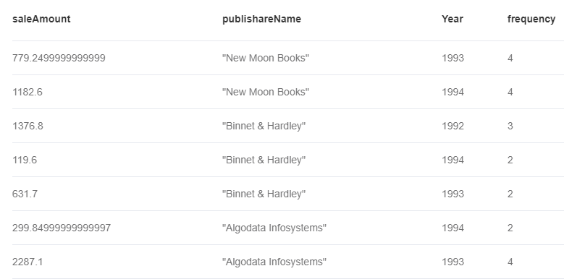
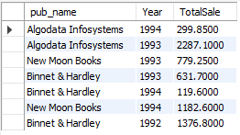
order by publishareName
Q4. Total Sale of publishers in diffrent years
Nosql(Neo4j)
Sql(mysql)
match (s:Store)-[a:SALES]-(t:Title)-[publishers]-(p:Publisher)
return sum(a.qty*t.price) as saleAmount, p.pubName as publishareName, a.ordDate.year as Year , size(collect(a.ordDate.year)) as frequency
select pub_name , YEAR(ord_date) as Year , sum(qty * price ) as TotalSale
from sales inner join titles on titles.title_id = sales.title_id
inner join publishers on publishers.pub_id = titles.pub_id group by pub_name , YEAR(ord_date);

Slide 12
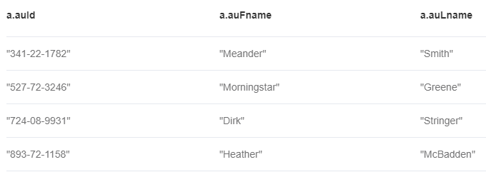

Q5. List of authors that don't have books
Nosql(Neo4j)
match (t:Title)
WITH collect(t) as ta
match (a:Author) WHERE all(t in ta WHERE NOT Exists( (a)--(t) ) )
return a.auId, a.auFname, a.auLname
Sql(mysql)
Join:
select * from authors
left join titleauthor on titleauthor.au_id = authors.au_id
where title_id is null;
Subquery:
select * from authors
where au_id not in (select au_id from titleauthor);

Slide 13
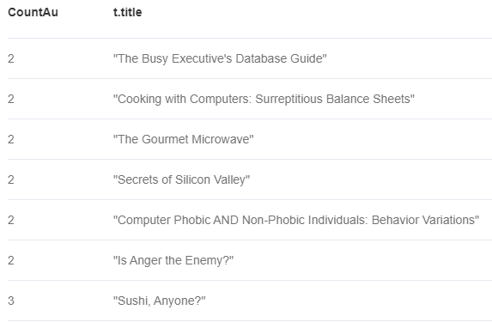
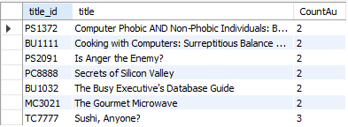
Q6. List of books that have at least 2 authors in ascend order
Nosql(Neo4j)
Sql(mysql)
match (t:Title)-[ta:TITLEAUTHOR]-(a:Author)
WITH t, collect(ta) as CoAu
WHERE size(CoAu) > 1
return size(CoAu) as CountAu, t.title
order by CountAu
select titles.title_id , title , Count(au_id) as CountAu
from titles
inner join titleauthor on titleauthor.title_id = titles.title_id
group by titles.title_id , title
having Count(au_id) > 1
order by 3;

