Slide 1

DevOps
Presented by - Moses J
ENG19CS0187
5th Sem ‘D’ Sec
Presented to - Prof.CVSN Reddy

Slide 2
Agenda
Introduction to Devops
Evolution of Develop
How DevOps works ?
Introduction MLOps
MLOps LifeCycle

Slide 3
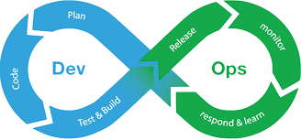
What is DevOps?
“Continuous collaboration communication”.
Software development method that stresses communication, collaboration and integration between software developers and information technology(IT) professionals.
DevOps supports automating and monitoring the process

Slide 4
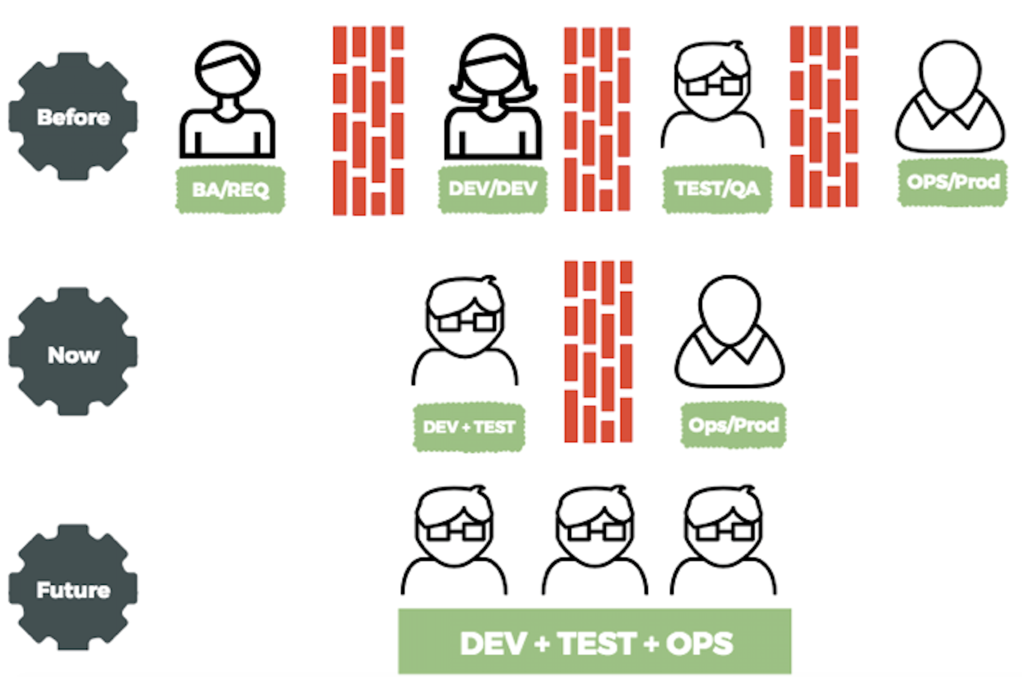
Evolution DevOps

Slide 5
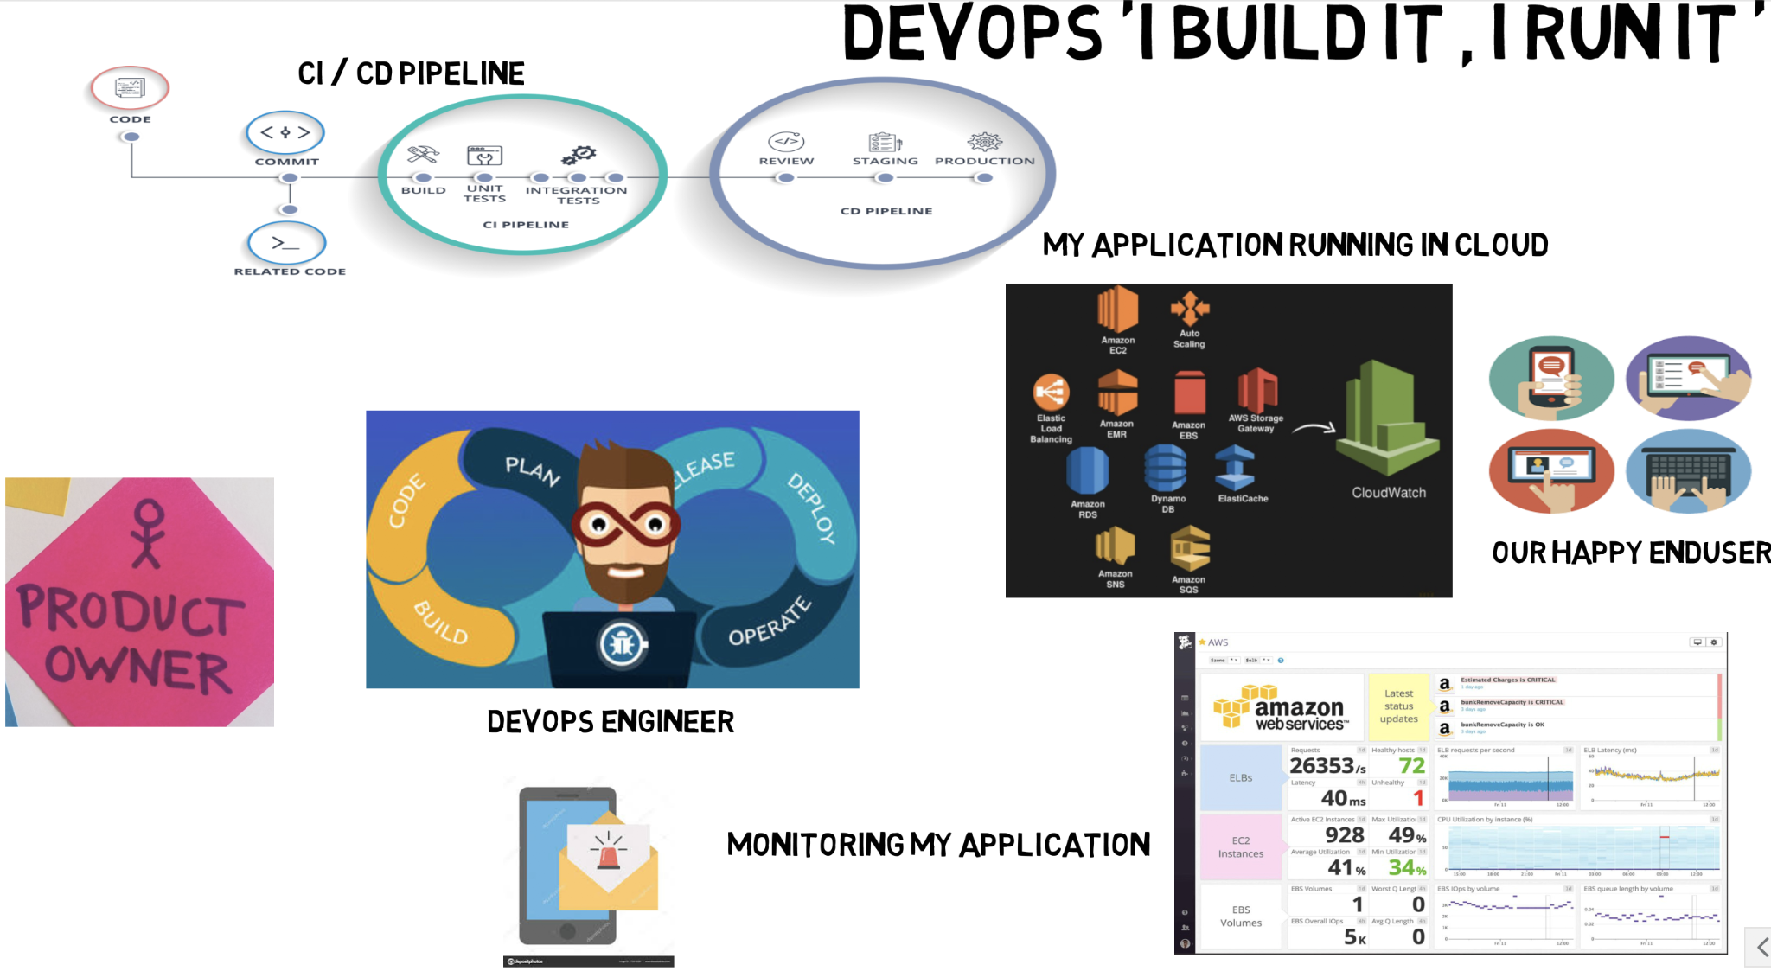
How DevOps works

Slide 6
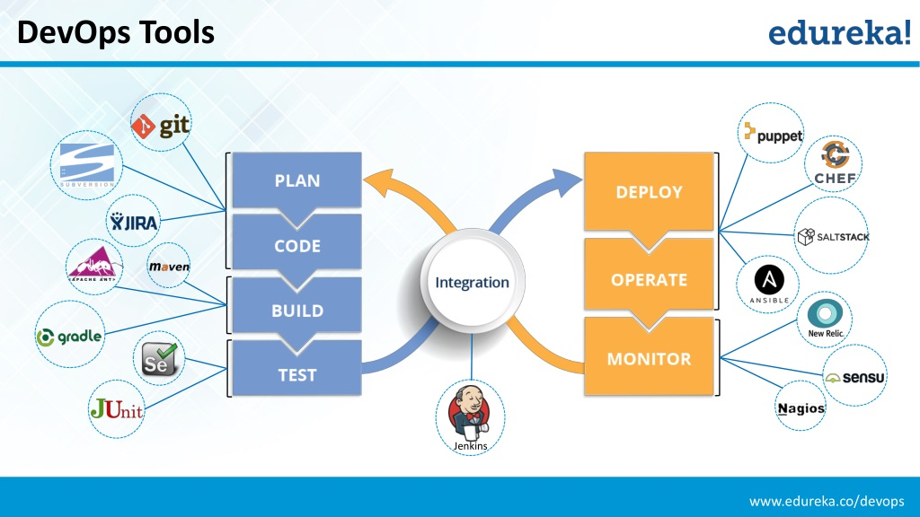

Slide 7
MLOps

Slide 8
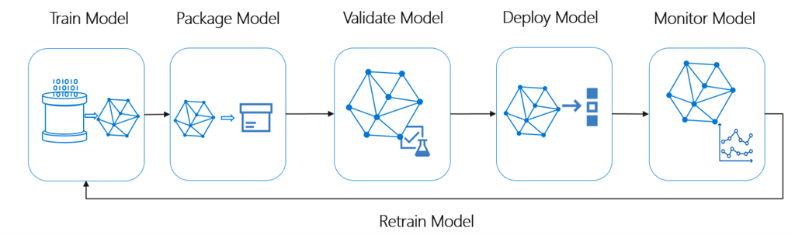
What does the Machine Learning Lifecycle look like?

Slide 9
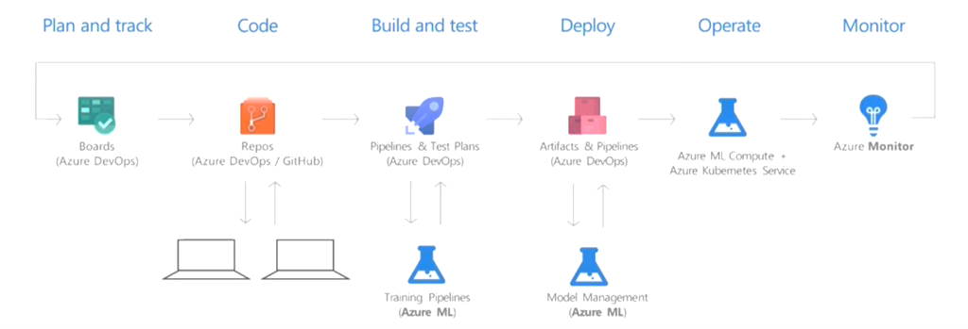

Slide 10



What is MLOps?
Bring together people process and platform to automate ml in fuse software delivery and provide continuous value to our users.
People
Blend together the work of individual engineers in a repository.
Each time you commit your work is automatically built and tested and bugs are detected faste.
Code, data models and training pipelines are shared to accelerate innovations
Process
Provide templates to bootstrap your infrastructure and model development environment, expressed as code.
Automate the entire process from code commit to production.
Data engineering is all about 24/7 reliability but data science is about in a loop agility.
Platform
safely deliver features to your customers as soon as they’re ready.
Monitor your pipeline ,infrastructure and products in production and know when they aren’t behaving as expected

Slide 11
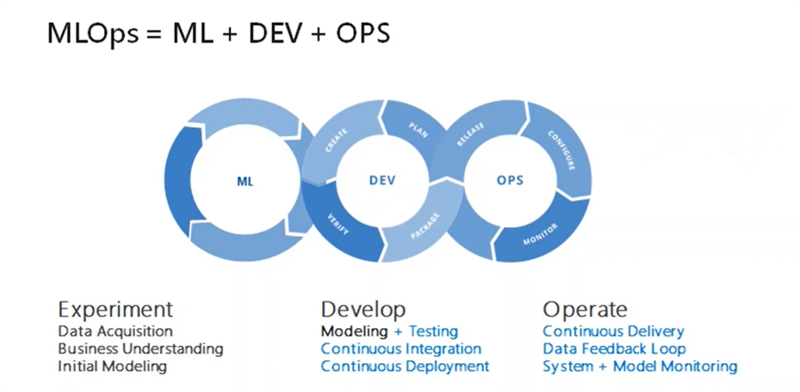

Slide 12
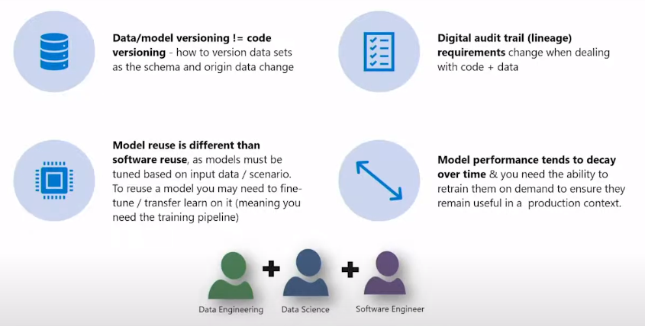
How is MLOps different from DevOps

Slide 13
How does the MLOps Life Cycle look like?

Slide 14
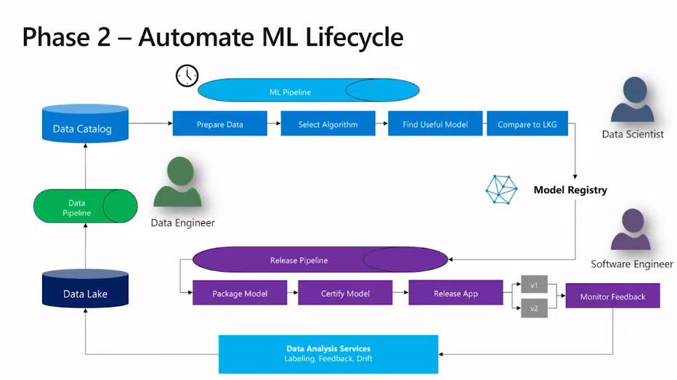

Slide 15
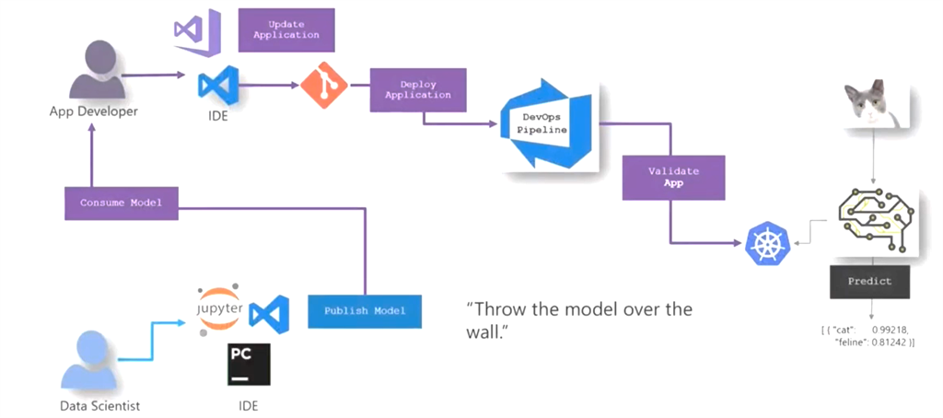

Slide 16
Mushroom Classification ML model
https://colab.research.google.com/drive/1yaFsADBNTnYtmehntd3eTQR4paI-4oMU?usp=sharing

Slide 17


