Slide 1
FERO Payment Science
CASE MEMO · AUGUST 2026
Stop fighting the same fires.
Build a product that fixes itself.
Three merchant problems. One root cause. One way out.
Moses Bargue Kortu Jr. · MSc, Business Analytics & Big Data · IE University
Notes:
Good morning, and thank you for the time. Before the detail — one framing thought. The three problems in the brief arrived as three separate fires, but they're the same fire wearing three outfits. In every case the team reacts after the fire starts, with nothing to catch the next one. My answer is the same each time: put out today's fire with evidence, then build the guardrail that stops it starting again. That shift is the whole memo. Let me show you.

Slide 2
FERO 01 · The way of working
Three problems. One root cause. One way out.
Every problem gets the same two moves — put out the fire this week, build the guardrail next sprint.
TRACK 1 · THIS WEEK
TRACK 2 · NEXT SPRINT
Put out the fire
Stop it coming back
Find the real cause with evidence, then ship the fix.
Build the guardrail that catches it early next time.
1
Check the math — not the design
1
Test every change safely first
2
Watch what merchants actually do
2
Score the risk automatically
3
Then ask the merchants directly
3
Give urgent work a set lane
THE SHIFT THAT MATTERS Stop counting activity. Move the numbers merchants feel.
Moses Bargue Kortu Jr. · TPO case · August 2026
02
Notes:
Every problem at a payments company shows up the same way — something breaks and the team scrambles. The trouble is the scramble is different every time and lives in one person's head, so the same fires keep coming back. My fix: run every problem through the same two moves. This week, put out the fire with a real diagnosis. Next sprint, build the guardrail. The payoff is the team stops re-fighting old fires, and FERO becomes a company merchants can rely on. One habit throughout: measure what merchants feel, not how busy the team looks.

Slide 3
FERO 02 · Problem 1 · Merchants leaving over wrong numbers
Merchants are leaving over wrong numbers.
If the numbers are wrong, no prettier screen will fix it. Start with the numbers.
THIS WEEK Find the real cause, in order
NEXT SPRINT Test every fee change safely
1
CHECK
MUST BE
IF IT FAILS
Check the math
Compare our ledger to the raw gateway records. Days 1–2.
Fee accuracy
within 0.15%
pull it
Exports work
99.5%+
pull + alert
2
Watch the behaviour
Portal clicks, failed exports, slow pages. Days 3–4.
Screen speed
under 0.9s
pull if it lasts
3
Merchant mood
no worse
hold + review
Ask the merchants
Short calls with those who left and nearly left. Day 5.
CHEAP TEST FIRST Hand-send the top 20 merchants a spreadsheet for two weeks before rebuilding anything. Saves a quarter of engineering.
Moses Bargue Kortu Jr. · TPO case · August 2026
03
Notes:
Bigger merchants left once their totals stopped matching their books. The tempting move — redesign the screen — is wrong, because a nicer screen just shows wrong numbers more clearly. So week one goes in order: check the math first, watch behaviour, then talk to merchants. Why a week and not a day? A day gives a hunch, not a proof. Then the guardrail: every fee change is tested quietly on real traffic and only ships if it passes four checks. And before rebuilding, the cheap test — hand-send 20 merchants a spreadsheet for two weeks. If complaints stop, it was the screen. If not, it was the numbers.

Slide 4
FERO 03 · Problem 2 · The plugin that keeps breaking
The plugin that keeps breaking.
Don't ask which file is broken. Let the data point at it.
NEW MERCHANTS STUCK
SETUP TIME
ERRORS
TOP 2 FILES
27%
18 hrs
4.2k
57%
give up during setup
should be under 4
per 1,000 sessions
of all the errors
THIS WEEK Where merchants get stuck
NEXT SPRINT Fix the riskiest files first
CheckoutObserver.php
P0
94
changed 18× · 1,200 errors
PaymentGatewayAdapter.php
P0
78
changed 11× · 890 errors
WebhookHandshake.php
P1
61
changed 6× · 340 errors
SettingsPersister.php
P2
28
changed 4× · 88 errors
THE REAL NUMBER Not bugs fixed per sprint. Time to a merchant's first sale — from 18 hours down to under 4.
Moses Bargue Kortu Jr. · TPO case · August 2026
04
Notes:
The plugin ships with bugs new merchants hit during setup, and every quick fix spawns two more. So don't guess — let the data point. The funnel shows only 27% reach go-live, and the biggest cliff is the connection step — technical, not design. The code ranking shows two files cause 57% of errors. The guardrail is a health score that refreshes nightly, so every Monday the riskiest files are already sorted. And the number we track isn't bugs fixed — it's time to a merchant's first sale, from 18 hours to under four.

Slide 5
FERO 04 · Problem 3 · The mid-sprint fire drill
The mid-sprint fire drill.
Protect the plan — but not blindly. Fifteen minutes decides, not the loudest voice.
→
→
STEP 1 · 5 MIN
STEP 2 · 5 MIN
STEP 3 · 5 MIN
Is the risk real?
How big is the fix?
Decide and tell them
Confirm it's genuinely a big account — not just an urgent tone.
Size it with the tech lead. Quick, or a real project?
Swap it in, or give a firm date. Put it in writing for the rep.
NEXT SPRINT A set lane for every request
LANE
WHEN
DEADLINE
GOES TO
P0
Platform down, money can't move
4 hours
everyone, now
P1
Big merchant blocked, over $50k
24 hours
the 15% buffer
P2
Has a workaround, mid-size
next sprint
planned in
P3
Nice-to-have or polish
later
the backlog
THE REAL NUMBER Did the sprint still finish, and how long did urgent work wait? Those tell you the handoff works. Ticket counts don't.
Moses Bargue Kortu Jr. · TPO case · August 2026
05
Notes:
This is the most political of the three. A rep bursts in mid-sprint — a merchant's about to leave. Whatever you decide sets the tone. So every urgent request runs the same 15-minute check: is the risk real, how big is the fix, then decide and tell the rep in writing. The guardrail: hold 15% of every sprint for urgent work, and sort every request into one of four lanes with a clear deadline. The lane decides, not who shouted loudest. The number that proves it: did the sprint still finish, and how long did urgent work wait.

Slide 6
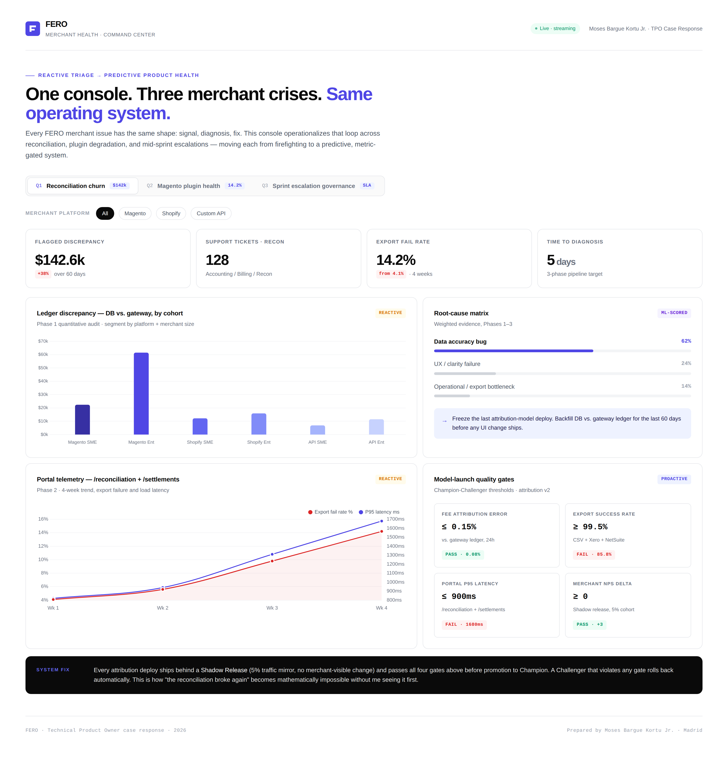
FERO 05 · The working dashboard
Don't take my word for it. Open it.
One file. No install. Opens in any browser, even offline. Three tabs, one per problem.
WHAT'S INSIDE
One tab per problem
Filter recalculates live
Cause breakdown
Safe-release checks
Risk-ranked files
Set lanes for requests
Works with no internet
Moses Bargue Kortu Jr. · Technical Product Owner case · August 2026
06
Notes:
Everything I've walked through is built into a dashboard you can open and click through — one file, no install, works offline. Three tabs, one per problem, filters recalculate live. If presenting live, open it and click one filter so they see the numbers move. I built it for two reasons: whoever does this job should show the tools they'd run, not just describe them; and the fastest way to make a way of working real is to hand people something they can see themselves in. So that's the plan — fix today's fire, build tomorrow's guardrail, measure what merchants feel. Thank you.

