Slide 1
Developing
a
Defensible
Claim
Literary Arguments

Slide 2
Claim
A statement that requires a defense with evidence from the text.
A synthesis (or combination) of smaller ideas into a larger, insightful idea that puts forth an original understanding of the deeper meaning of text.

Slide 3
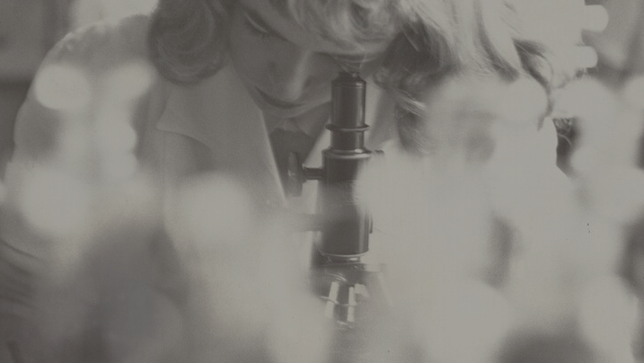
This begins with…
Important sentences
Key words
A whole paragraph that seems crucial
A symbol or object that repeats
Notes:
Forming a claim begins with what you notice as you are reading. A recognition of patterns or collection of sentences that feel heavy with meaning.
These pieces of evidence that you find then become connected to an idea. An important sentence can bring you an idea about a character. A key words can bring an idea of the tone of a paragraph. A paragraph could develop a conflict. Etc.
These small, individual ideas then get pieced together into a bigger idea about the deeper meaning in the story, the claim.

Slide 4
Evidence
Ideas
Claim
object that repeats
Planning:
Notes:
The idea here is going from small details to big ideas. Synthesizing information; piecing together details like a puzzle in order to form a insightful conclusion.
This form of piecing together seemingly mundane details into an original perspective and being able to draw conclusions from minute details is a skill that goes beyond English Literature. Business analysts that can look at a bunch of data/information and draft a logical course of action for a company; or doctors that picks up on heart murmurs or an imbalance in nutrient intake and form a diagnosis of their patients condition. In these situations we are noticing patterns, puzzle pieces that we must connect in order to create meaning.

Slide 5
Strong Claims
Strong claims are insightful; weak claims are vague
Put forth an original idea based on evidence
Respond to the prompt in an insightful way

Slide 6
Weak Claims
Just restate the prompt or rephrase it; lack an original idea
Are generic and superficial; they say nothing specific about the story.
The paragraph needs to be convincing
Provide a claim, but doesn’t respond to the prompt

Slide 7
Weak Claims
“The story has a twist ending because the husband comes back alive.”
Notes:
This is a claim for ‘The Story of an Hour’ by Kate Chopin.
This story can be used as an example for building a strong claim and argument as students are already familiar with it.
What makes this claim weak?

Slide 8
Evidence
Louise whispers: “free, free, free!” – shows her sudden realization of independence.
Narrator’s description: “Her pulses beat fast, and the coursing blood warmed and relaxed every inch of her body.” – physical transformation accompanying emotional liberation.
Louise envisions: “There would be no one to live for during those coming years; she would live for herself.” – direct assertion of autonomy.
“There would be no powerful will bending hers in that blind persistence with which men and women believe they have a right to impose a private will upon a fellow-creature.” – critique of domination in marriage.
The doctors’ interpretation: “When the doctors came they said she had died of heart disease—of the joy that kills.” – dramatic irony: the reader knows she died not from joy, but from the devastating loss of her newfound autonomy.
Notes:
For a stronger claim, start by looking at the evidence and forming a collection of ideas about the text.
Evidence:
Louise whispers: “free, free, free!” – shows her sudden realization of independence.
Narrator’s description: “Her pulses beat fast, and the coursing blood warmed and relaxed every inch of her body.” – physical transformation accompanying emotional liberation.
Louise envisions: “There would be no one to live for during those coming years; she would live for herself.” – direct assertion of autonomy.
“There would be no powerful will bending hers in that blind persistence with which men and women believe they have a right to impose a private will upon a fellow-creature.” – critique of domination in marriage.
The doctors’ interpretation: “When the doctors came they said she had died of heart disease—of the joy that kills.” – dramatic irony: the reader knows she died not from joy, but from the devastating loss of her newfound autonomy.

Slide 9
Strong Claims
“Chopin structures the plot around an ironic reversal: the supposed tragedy of Brently’s death becomes Louise’s moment of awakening and freedom, only to be undercut by his unexpected return. This sudden collapse of her imagined future highlights the fragility of autonomy for women within patriarchal marriage.”
Notes:
Ask students what makes this stronger?
It is arguable as it interprets the twist ending as more than a plot mechanism
It identifies literary technique like irony
It connects technique to meaning and larger context (i.e. Patriarchal Marriage)

Slide 10
Strong Claims
“Chopin structures the plot around an ironic reversal: the supposed tragedy of Brently’s death becomes Louise’s moment of awakening and freedom, only to be undercut by his unexpected return. This sudden collapse of her imagined future highlights the fragility of autonomy for women within patriarchal marriage.”
Notes:
Note that there are several parts to the claim that will need to be addressed in the paragraph: Her awakening to her new found autonomy and how fragile this autonomy is.
All parts of the claim should be addressed in the paragraph.

Slide 11
Forming a Paragraph
In The Story of an Hour, Kate Chopin structures the plot around an ironic reversal to expose the fragility of women’s autonomy within marriage. At first, the report of Brently Mallard’s death appears to be a tragedy, yet it quickly transforms into a moment of awakening for Louise as she whispers “free, free, free!” and imagines “a long procession of years to come that would belong to her absolutely.” Chopin builds this sense of liberation through Louise’s vision of spring and “patches of blue sky,” symbolic of renewal and possibility. However, the sudden reappearance of Brently shatters this imagined freedom, cutting short the life she had just begun to claim. This collapse is not simply a plot twist for shock value; rather, it demonstrates how easily patriarchal structures can revoke a woman’s independence, even when she believes she has secured it. By arranging the story around this ironic rise and fall, Chopin emphasizes that female autonomy in her society is not only fragile but often impossible to sustain within the confines of traditional marriage.

Slide 12
Forming a Paragraph
In The Story of an Hour, Kate Chopin structures the plot around an ironic reversal to expose the fragility of women’s autonomy within marriage. At first, the report of Brently Mallard’s death appears to be a tragedy, yet it quickly transforms into a moment of awakening for Louise as she whispers “free, free, free!” and imagines “a long procession of years to come that would belong to her absolutely.” Chopin builds this sense of liberation through Louise’s vision of spring and “patches of blue sky,” symbolic of renewal and possibility. However, the sudden reappearance of Brently shatters this imagined freedom, cutting short the life she had just begun to claim. This collapse is not simply a plot twist for shock value; rather, it demonstrates how easily patriarchal structures can revoke a woman’s independence, even when she believes she has secured it. By arranging the story around this ironic rise and fall, Chopin emphasizes that female autonomy in her society is not only fragile but often impossible to sustain within the confines of traditional marriage.
Notes:
Claim
Evidence
Insight/Commentary
Closing sentence
Note that it doesn’t have to be broken up like this. Students could provide some insight/commentary write after each piece of evidence or even within the same sentence that they provide evidence for. There are no strict rules for this. As long as the elements can be discerned in some way.

Slide 13
Claim
Ideas
Evidence
object that repeats
Writing:
Notes:
So, essentially the process of writing the actual analytical paragraph is the reverse of planning:
You present your claim
Break down the ideas presented in the claim (remember a claim is a synthesis of more than one idea)
Then you provide you evidence and insight to support and explain these ideas.

Slide 14
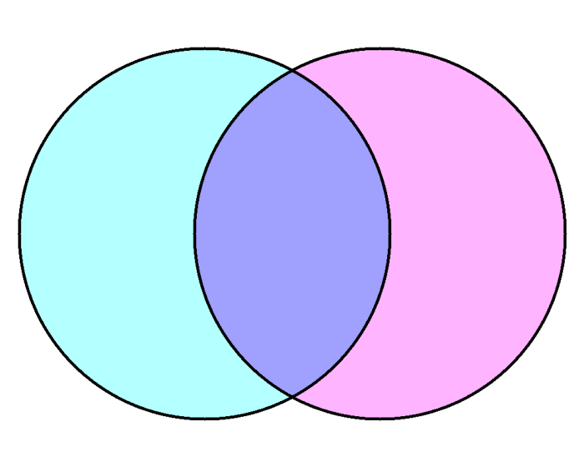
Grimm’s Snow White
Gaiman’s Snow, Glass, Apples
Perspective: Third-person omniscient, traditional fairy-tale narrator.
Plot: Classic structure — good vs. evil, innocence rewarded, villain punished.
Snow White is innocent, passive, and victimized.
The Queen is unequivocally evil, driven by jealousy.
Moral simplicity: virtue triumphs over wickedness.
Ending: Snow White lives “happily ever after” with the prince; Queen dies gruesomely.
Both use familiar fairy-tale motifs: mirrors, poisoned apples, huntsman, dwarfs/forest folk, apparent death and revival.
Themes of beauty, envy, power, and survival are central.
The Queen and Snow White remain locked in a battle for dominance and identity.
Both stories end with the Queen destroyed and Snow White alive.
Perspective: First-person narration by the Queen, an unreliable narrator.
Plot: Retelling inverts roles — the Queen is sympathetic, Snow White monstrous.
Snow White is depicted as vampiric, predatory, feeding on others’ blood and life.
The Queen frames her actions as necessary to protect her people.
Themes of truth vs. lies, unreliable memory, sexuality, and monstrosity.
Ending: The Queen is burned alive, claiming control of her own story
Notes:
Review the Venn Diagram of Snow, Glass, and Apples, then have them create an analytical paragraph about the use of narrative perspective in the story.
Show this after they have worked on it on their own first.
Grimm’s Snow White
Perspective: Third-person omniscient, traditional fairy-tale narrator.
Plot: Classic structure — good vs. evil, innocence rewarded, villain punished.
Snow White is innocent, passive, and victimized.
The Queen is unequivocally evil, driven by jealousy.
Moral simplicity: virtue triumphs over wickedness.
Ending: Snow White lives “happily ever after” with the prince; Queen dies gruesomely.
Purpose of structure:
Reinforces moral binaries (innocence vs. wickedness).
Builds suspense with repetition (three attempts by the Queen) before justice prevails.
Ends with closure — Snow White is rewarded, the Queen punished.
Meaning:
The plot affirms cultural values of virtue, beauty, and obedience.
Evil is externalized and defeated; goodness is preserved and celebrated.
Shared Elements
Both use familiar fairy-tale motifs: mirrors, poisoned apples, huntsman, dwarfs/forest folk, apparent death and revival.
Themes of beauty, envy, power, and survival are central.
The Queen and Snow White remain locked in a battle for dominance and identity.
Both stories end with the Queen destroyed and Snow White alive.
Linear, classic fairy-tale arc: exposition → conflict → climax → resolution. For the most part.
Snow White’s apparent death(s) and final revival lead to a clear moral outcome.
Gaiman’s Snow, Glass, Apples
Perspective: First-person narration by the Queen, an unreliable narrator.
Plot: Retelling inverts roles — the Queen is sympathetic, Snow White monstrous.
Snow White is depicted as vampiric, predatory, feeding on others’ blood and life.
The Queen frames her actions as necessary to protect her people.
Themes of truth vs. lies, unreliable memory, sexuality, and monstrosity.
Ending: The Queen is burned alive, claiming control of her own story.
Fragmented, confessional structure: told retrospectively in the Queen’s first-person voice.
Events unfold as memories, shifting between what the Queen saw, feared, or imagined
.
Purpose of structure:
Undermines the reliability of “truth” — we never know for sure what happened.
Shifts the moral center: the Queen frames herself as protector, Snow White as predator.
The climax (Snow White’s return and the Queen’s execution) reverses expectations — the “villain” is destroyed but the ending feels unjust.
Meaning:
Raises questions about who controls the story and how perspective shapes truth.
Highlights themes of sexuality, monstrosity, and survival.
Creates moral ambiguity — readers must decide whom to believe.
Interpretive Notes
Plot: Grimm’s tale reinforces moral binaries, while Gaiman destabilizes them, showing how narrative framing changes meaning.
Perspective: Grimm’s neutral, “all-seeing” narrator vs. Gaiman’s personal, confessional, unreliable narrator — demonstrating how shifting POV can completely reframe who is hero and who is monster.

Slide 15
Let’s Practice!
In literary works, authors often manipulate narrative perspective and point of view to shape how readers understand characters and themes. The choice of narrator not only determines what information is revealed or concealed but also colors the tone and meaning of the story.
In Neil Gaiman’s “Snow, Glass, Apples” (a retelling of Snow White), the familiar fairy tale is transformed through an unexpected narrator whose perspective radically alters the reader’s moral understanding of events.
Write an analytical paragraph in which you examine how Gaiman’s use of narrative perspective and point of view shapes the reader’s interpretation of the story.
Notes:
Practice Prompt: Write an analytical paragraph in which you examine how Gaiman’s use of narrative perspective and point of view shapes the reader’s interpretation of the story.

Slide 16
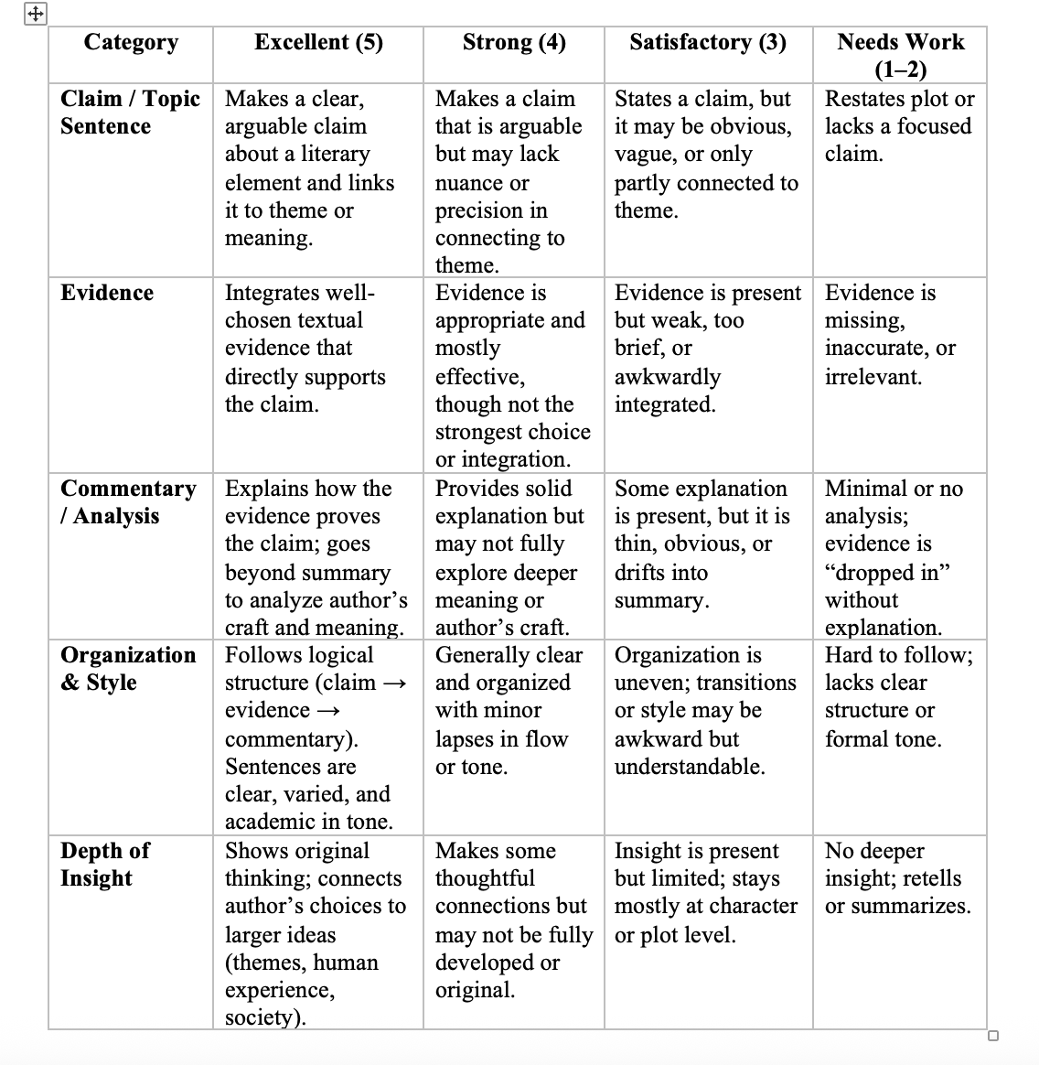
Notes:
Rubric for if you want students to Peer Review the paragraph they write for Snow, Glass, Apples.
Also located in the drive.

Slide 17
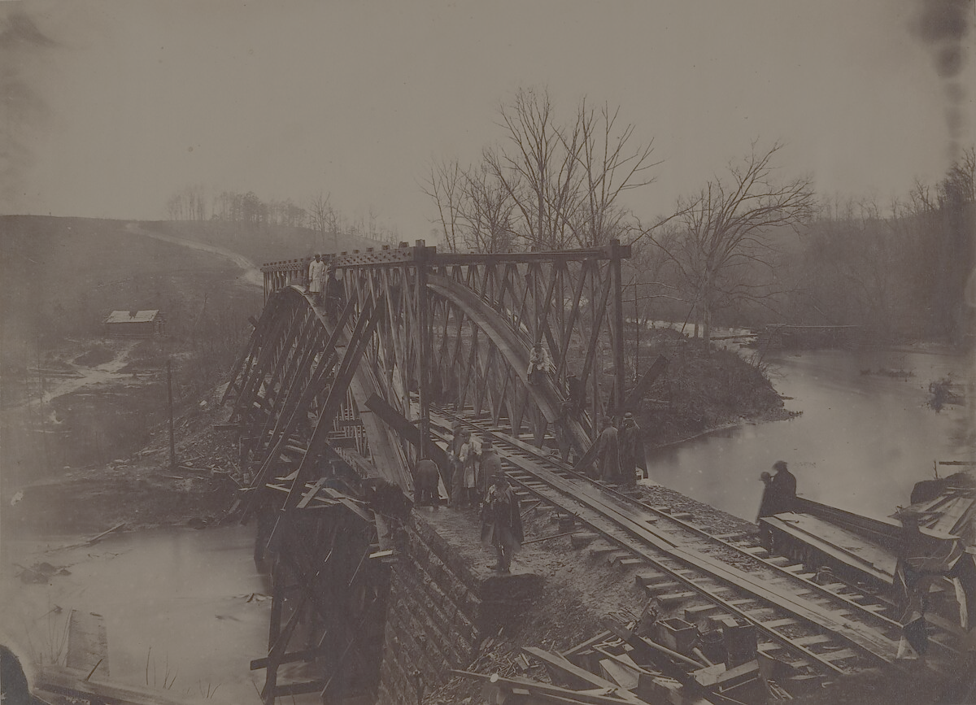
An Occurrence at Owl Creek Bridge (1890)
A short story written by writer and American Civil War veteran Ambrose Bierce.
described as "one of the most famous and frequently anthologized stories in American literature"
Bierce's abandonment of strict linear narration in favor of the internal mind of the protagonist is an early example of the stream-of-consciousness narrative mode.
It was adapted into a short film that went on to win the Academy Award for Best Short Film and was later picked up as an episode in The Twilight Zone.
Notes:
Stream of consciousness is a style or technique of writing that tries to capture the natural flow of a character's extended thought process, often by incorporating sensory impressions, incomplete ideas, unusual syntax, and rough grammar.
The Twilight Zone is a fantasy, sci-fi, horror anthology series about ordinary people in extraordinary situations involving futuristic societies, space travel, aliens invasions, telepathy, dreams, death and the afterlife, time travel, and cautionary tales of dystopian societies and conformity.

Slide 18
Analytical Paragraph Prompt
In the Twilight Zone adaptation of An Occurrence at Owl Creek Bridge, the filmmakers use cinematic techniques to align the audience with the condemned man’s perspective, only to later shift that perspective in the story’s conclusion. Write an analytical paragraph in which you explain how the episode’s use of narrative perspective shapes the audience’s interpretation of the story. In your analysis, you may consider how techniques such as point-of-view shots, camera angles, close-ups, mise-en-scène, editing, or sound contribute to the way perspective influences meaning.
Your paragraph should:
Make a clear claim about how perspective is constructed.
Use specific cinematic technique as evidence.
Explain how that technique shapes the audience’s understanding of the story’s meaning.
Notes:
Prompt: Write an analytical paragraph in which you explain how the episode’s use of narrative perspective shapes the audience’s interpretation of the story.

