Slide 1
Elements
of Fiction
Plot/Narrative Perspective

Slide 2
Plot
What happens in a narrative.
Not just a sequence of events, but an arrangement of conflicts and resolutions to create a logical pattern of cause-and-effect.
Develops character relationships. Character and conflict go hand in hand.
You must understand what is happening, why it is happening, and how plot elements work together.
Notes:
While plot may follow a chronological sequence sometimes writers deliberately present events in a manner that requires readers to assemble them into a cohesive pattern.
A story may begin in media res, or “in the middle of action”. Homer’s Iliad opens not in the first year of the Trojan War but after nine years of fighting.
Writers also use flashbacks (events that take place before the story begins) or foreshadowing to hint at what will happen later.
They also may employ a frame narrative, or story-in-a-story in which a character is narrating the events of the story from a future time, such as with The Little Prince or Princess Bride or The Time Machine or The Fitz and the Fool

Slide 3
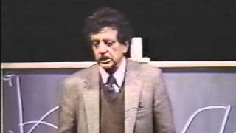
Notes:
This is part of a lecture given by renowned writer Kurt Vonnegut about the shape of a story.
It is a humorous illustration of the various structures a story can have.

Slide 4
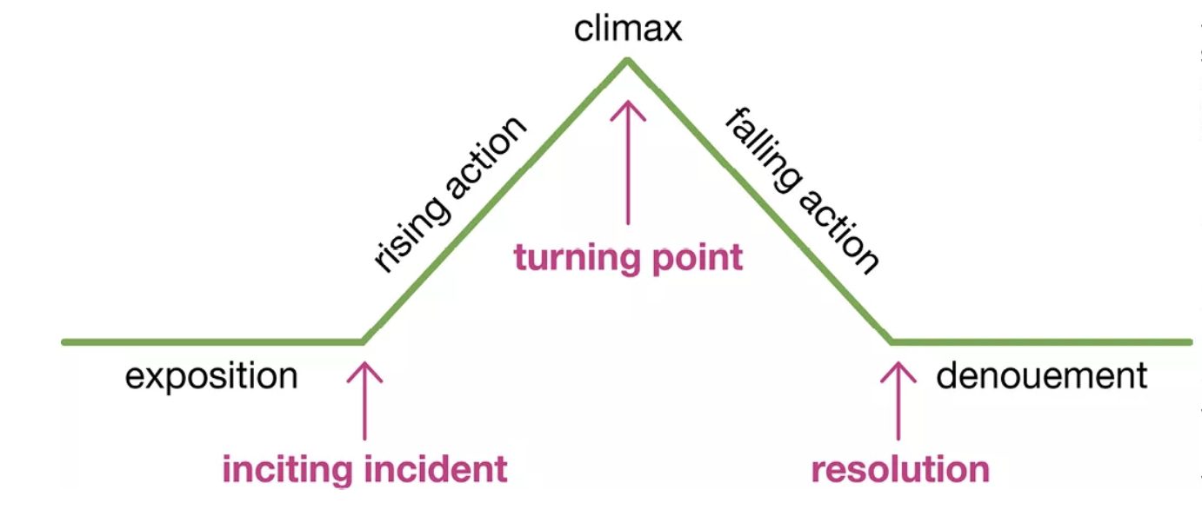
Freytag’s Pyramid
Notes:
Freytag’s Pyramid is a model for understanding the structure of a story or drama, created by German novelist and playwright Gustav Freytag in the 19th century. He observed that many classical stories and plays (especially Greek tragedies and Shakespearean drama) followed a predictable arc.

Slide 5
Exposition
This opening section of a story provides background information about the characters, the setting, and the basic situation. The exposition also describes the nature of key conflicts generally creating an unstable situation.
Notes:
This leads to the inciting incident. Exposition gives you all the important information you need to know about the character/setting/overall situation until something happens to change everything. This moment of change is the inciting incident. “Everything was as expected until…”

Slide 6
Rising Action
After an inciting incident or event, the conflict and complications the main character experiences begin to build.

Slide 7
Climax
The climax occurs when the emotional tension or suspense of the plot reaches its peak. It may include a turning point where the fortunes of the protagonist improve or worsen. Building to the climax usually occupies most of a story, and what follows is comparatively brief.

Slide 8
Falling Action
This section details the result (or fallout) of the climax or turning point. In this phase, conflicts often get resolved.
Notes:
The falling action are the events leading into the resolution; or moment in which the main conflict is settled.

Slide 9
Denouement/Resolution
Means “untying the knot.” It’s the very end of a story, when the conflict is over and things return to balance.
In fairy tales, this is often just “And they lived happily ever after.” In the past, writers sometimes used this part to explain the “moral of the story.”
But in modern stories, writers often end without a clear moral, leaving readers to decide the meaning for themselves.

Slide 10
The Story of an Hour
She opens the door, triumphant, carrying herself “like a goddess of Victory.”
This moment of empowerment represents the peak of her emotional journey.
Sitting by the open window, she observes signs of spring, blue skies, and hears lively sounds outside.
These details of setting awaken in her a new realization: her life will be free from her husband’s control.
She whispers “free, free, free!” as the sense of liberation grows stronger.
As she descends the stairs with her sister, Brently Mallard unexpectedly returns home, alive and unaware of the reported accident.
Louise fully embraces the idea of freedom: she imagines a long life ahead lived for herself alone.
She acknowledges that she sometimes loved her husband, but the recognition of self-assertion is more powerful.
Mrs. Louise Mallard, who has a heart condition, is told by her sister Josephine and her husband’s friend Richards that Brently Mallard has died in a railroad accident.
We learn she is fragile but also strong, and the stage is set for her emotional journey.
The doctors declare she died of “heart disease—of the joy that kills.”
The irony closes the story: society misreads her death as caused by joy, rather than despair at her lost freedom.
Louise retreats to her room alone after hearing the news, beginning her internal confrontation with grief and unexpected emotions.
Louise sees her husband alive, and the shock is too great. She collapses.
Notes:
Analyzing Plot Discussion Questions:
Is the plot arranged in chronological order? If not, how would you describe the arrangement and structure of the plot elements?
Does the plot involve foreshadowing? A flashback? If so, what is the purpose of this choice, and how does it contribute to your interpretation of the story?
Are the key conflicts internal or external? What complications intensify them?
What is the turning point or climax of the story?
How are the conflicts resolved? If there is no resolution, why not?

Slide 11
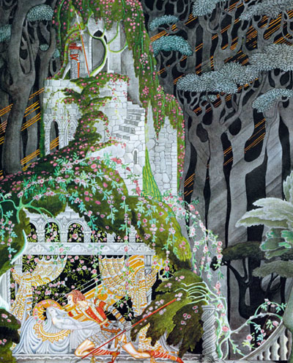
Fairy Tales
Ancient stories passed down through oral tradition
Blend entertainment with morals and cultural lessons
Established classic plot patterns: beginning → conflict → climax → resolution
Still shape literature, film, and drama today
Notes:
Fairy tales are some of the oldest and most enduring forms of storytelling. Passed down orally for centuries before being written, they capture universal human fears, desires, and morals through fantastical characters and events. Beyond entertainment, fairy tales shaped how stories are told: they established familiar plot structures—such as clear beginnings, rising conflicts, dramatic climaxes, and satisfying resolutions—that continue to influence literature, film, and drama today.

Slide 12
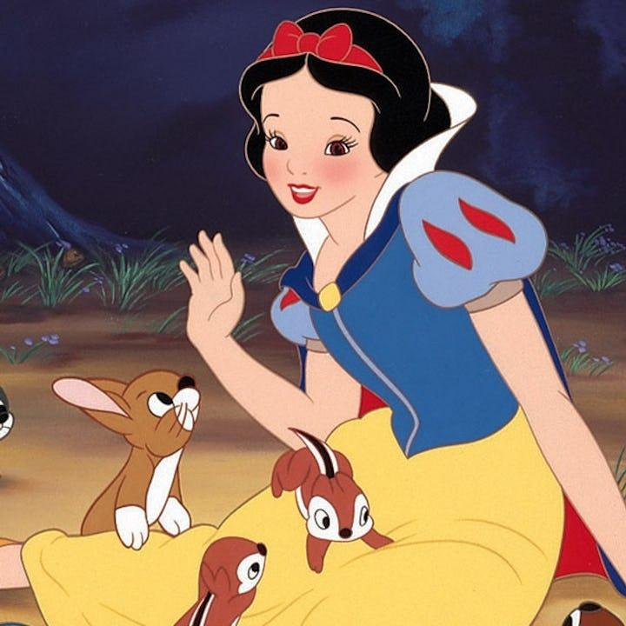
Snow White (Grimm’s Version)
Collected by Brothers Grimm in 19th century
Snow White escapes her jealous stepmother, the Queen
Lives with seven dwarfs; Queen tries to kill her three times
Poisoned apple puts her in a deathlike sleep
Prince awakens her; Queen is punished
Themes: jealousy, innocence, deception, justice
Notes:
The Brothers Grimm recorded Snow White in the early 19th century, preserving a folk tale that became one of the world’s most famous stories. In this version, Snow White is a young princess whose beauty arouses the envy of her stepmother, the Queen. Ordered into the forest to be killed, Snow White escapes and finds shelter with seven dwarfs. The Queen, in disguise, attempts to murder her three times—through a bodice, a poisoned comb, and finally a poisoned apple. Snow White falls into a deathlike sleep until a prince awakens her, leading to the Queen’s downfall. The tale highlights themes of jealousy, innocence, deception, and justice, while offering a clear example of the classic fairy-tale plot arc.

Slide 13
Verbal Irony: The literary example: Julius Caesar, Mark Antony on Brutus.
Antony speaks over Caesar's body, to a crowd, immediately after Brutus has helped kill him.
Mark Antony
Friends, Romans, countrymen, lend me your ears;
I come to bury Caesar, not to praise him.
The evil that men do lives after them;
The good is oft interrèd with their bones;
So let it be with Caesar. The noble Brutus
Hath told you Caesar was ambitious:
If it were so, it was a grievous fault,
And grievously hath Caesar answer'd it.
Here, under leave of Brutus and the rest—
For Brutus is an honourable man;
So are they all, all honourable men—
Come I to speak in Caesar's funeral.
He was my friend, faithful and just to me:
But Brutus says he was ambitious;
And Brutus is an honourable man.
He hath brought many captives home to Rome
Whose ransoms did the general coffers fill:
Did this in Caesar seem ambitious?
When that the poor have cried, Caesar hath wept:
Ambition should be made of sterner stuff:
Yet Brutus says he was ambitious;
And Brutus is an honourable man.
You all did see that on the Lupercal
I thrice presented him a kingly crown,
Which he did thrice refuse: was this ambition?
Yet Brutus says he was ambitious;
And, sure, he is an honourable man.
I speak not to disprove what Brutus spoke,
But here I am to speak what I do know.
You all did love him once, not without cause:
What cause withholds you then to mourn for him?
Notes:
He calls Brutus an honourable man, and repeats it through the speech.
He means the opposite. He knows he means the opposite. The crowd comes to hear it that way, and turns.
Two things worth drawing out:
Repetition is the technique. One use would be ambiguous. Said over and over against the evidence of the body, the word collapses. Antony never accuses Brutus of anything; he just says "honourable" until it means "murderer."
Verbal irony can be a weapon. It isn't only a joke. Antony uses it to move a crowd to riot while maintaining that he is saying nothing against anyone.

Slide 14
Narrative Perspective and Point of View
Point of view: is the position from which the narrator relates the events of a narrative.
Narrative Perspective: describes how narrators or characters see and experience their individual circumstances. Determines what information a narrator chooses to share.
Both influence what people believe about events in a story.

Slide 15
First-Person Point of View
A story told from a single character’s perspective, using pronouns such as I and we. It gives a vivid on-the-spot account of events and internal thoughts.
“If you really want to hear about it, the first thing you’ll probably want to know is where I was born…” The Catcher in the Rye by J.D. Salinger (1951)

Slide 16
Second-Person Point of View
Rare but not unheard of. It puts the reader right into the story. You are not just asked to imagine a character, but told that you are one.
“You are about to begin reading Italo Calvino’s new novel, If on a winter’s night a traveler. Relax. Concentrate. Dispel every other thought. Let the world around you fade.” If on a winter’s night a traveler by Italo Calvino (1979)

Slide 17
Third-Person Point of View
This type of narrator view all events in a story from a distance and does not typically play a role in the actual plot. Can feature limited or omniscient point of view. Uses pronouns such as he, she, and it
“When Mr. Bilbo Baggins of Bag End announced that he would shortly be celebrating his eleventy-first birthday with a party of special magnificence, there was much talk and excitement in Hobbiton.” The Lord of the Rings: The Fellowship of the Ring by J.R.R. Tolkien (1954)
Notes:
Limited POV = confined to the thoughts, feelings, and perceptions of one character at a time. The reader’s knowledge is “limited” — we only know what that character knows, sees, or thinks.
Omniscient POV = The narrator has a “godlike” perspective: able to reveal the thoughts, feelings, and experiences of multiple characters, as well as provide commentary or background information the characters don’t know. The reader can see the bigger picture beyond any single character’s viewpoint.

Slide 18
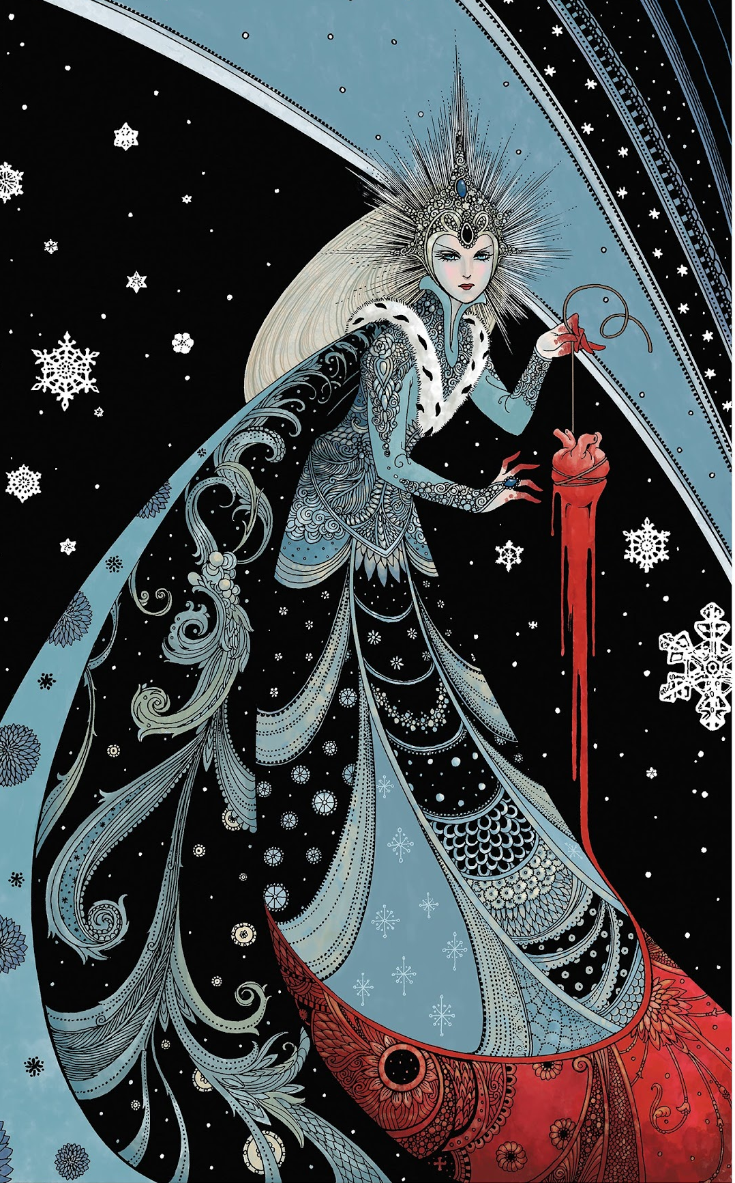
Snow, Glass, Apple
by Neil Gaiman (1994)
It is a retelling of the Brothers Grimm fairy tale Snow White, but from her stepmother's point of view.
Told from a first-person point of view, it completely changes the meaning of the original fairy-tale.
Notes:
Neil Gaiman’s Snow, Glass, Apples retells Snow White from the queen’s perspective. In this version, Snow White is a vampire-like creature who feeds on others, while the queen tries to protect her kingdom by destroying her. Despite the queen’s efforts — cutting out her heart, using poisoned fruit — Snow White survives and eventually engineers the queen’s death. The story inverts the classic fairy tale, making the queen sympathetic and Snow White monstrous.

Slide 19
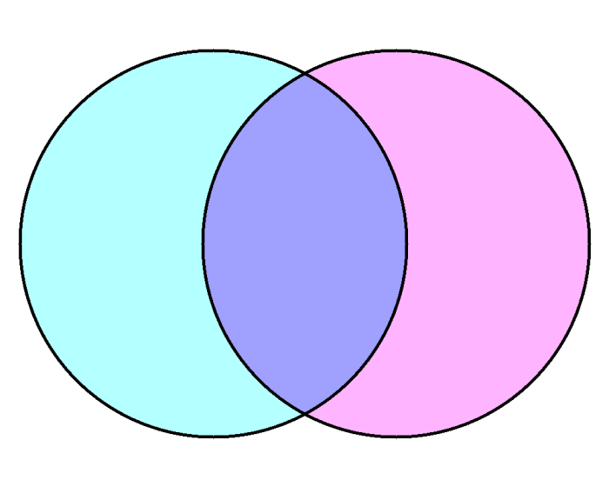
Grimm’s Snow White
Gaiman’s Snow, Glass, Apples
Notes:
You can work on this as a class or let them work on it in groups.
Grimm’s Snow White
Perspective: Third-person omniscient, traditional fairy-tale narrator.
Plot: Classic structure — good vs. evil, innocence rewarded, villain punished.
Snow White is innocent, passive, and victimized.
The Queen is unequivocally evil, driven by jealousy.
Moral simplicity: virtue triumphs over wickedness.
Ending: Snow White lives “happily ever after” with the prince; Queen dies gruesomely.
Purpose of structure:
Reinforces moral binaries (innocence vs. wickedness).
Builds suspense with repetition (three attempts by the Queen) before justice prevails.
Ends with closure — Snow White is rewarded, the Queen punished.
Meaning:
The plot affirms cultural values of virtue, beauty, and obedience.
Evil is externalized and defeated; goodness is preserved and celebrated.
Shared Elements
Both use familiar fairy-tale motifs: mirrors, poisoned apples, huntsman, dwarfs/forest folk, apparent death and revival.
Themes of beauty, envy, power, and survival are central.
The Queen and Snow White remain locked in a battle for dominance and identity.
Both stories end with the Queen destroyed and Snow White alive.
Linear, classic fairy-tale arc: exposition → conflict → climax → resolution. For the most part.
Snow White’s apparent death(s) and final revival lead to a clear moral outcome.
Gaiman’s Snow, Glass, Apples
Perspective: First-person narration by the Queen, an unreliable narrator.
Plot: Retelling inverts roles — the Queen is sympathetic, Snow White monstrous.
Snow White is depicted as vampiric, predatory, feeding on others’ blood and life.
The Queen frames her actions as necessary to protect her people.
Themes of truth vs. lies, unreliable memory, sexuality, and monstrosity.
Ending: The Queen is burned alive, claiming control of her own story.
Fragmented, confessional structure: told retrospectively in the Queen’s first-person voice.
Events unfold as memories, shifting between what the Queen saw, feared, or imagined
.
Purpose of structure:
Undermines the reliability of “truth” — we never know for sure what happened.
Shifts the moral center: the Queen frames herself as protector, Snow White as predator.
The climax (Snow White’s return and the Queen’s execution) reverses expectations — the “villain” is destroyed but the ending feels unjust.
Meaning:
Raises questions about who controls the story and how perspective shapes truth.
Highlights themes of sexuality, monstrosity, and survival.
Creates moral ambiguity — readers must decide whom to believe.
Interpretive Notes
Plot: Grimm’s tale reinforces moral binaries, while Gaiman destabilizes them, showing how narrative framing changes meaning.
Perspective: Grimm’s neutral, “all-seeing” narrator vs. Gaiman’s personal, confessional, unreliable narrator — demonstrating how shifting POV can completely reframe who is hero and who is monster.

Slide 20
Grimm’s Snow White
Gaiman’s Snow, Glass, Apples
Perspective: Third-person omniscient, traditional fairy-tale narrator.
Plot: Classic structure — good vs. evil, innocence rewarded, villain punished.
Snow White is innocent, passive, and victimized.
The Queen is unequivocally evil, driven by jealousy.
Moral simplicity: virtue triumphs over wickedness.
Ending: Snow White lives “happily ever after” with the prince; Queen dies gruesomely.
Both use familiar fairy-tale motifs: mirrors, poisoned apples, huntsman, dwarfs/forest folk, apparent death and revival.
Themes of beauty, envy, power, and survival are central.
The Queen and Snow White remain locked in a battle for dominance and identity.
Both stories end with the Queen destroyed and Snow White alive.
Perspective: First-person narration by the Queen, an unreliable narrator.
Plot: Retelling inverts roles — the Queen is sympathetic, Snow White monstrous.
Snow White is depicted as vampiric, predatory, feeding on others’ blood and life.
The Queen frames her actions as necessary to protect her people.
Themes of truth vs. lies, unreliable memory, sexuality, and monstrosity.
Ending: The Queen is burned alive, claiming control of her own story
Notes:
Show this after they have worked on it on their own first.
Grimm’s Snow White
Perspective: Third-person omniscient, traditional fairy-tale narrator.
Plot: Classic structure — good vs. evil, innocence rewarded, villain punished.
Snow White is innocent, passive, and victimized.
The Queen is unequivocally evil, driven by jealousy.
Moral simplicity: virtue triumphs over wickedness.
Ending: Snow White lives “happily ever after” with the prince; Queen dies gruesomely.
Purpose of structure:
Reinforces moral binaries (innocence vs. wickedness).
Builds suspense with repetition (three attempts by the Queen) before justice prevails.
Ends with closure — Snow White is rewarded, the Queen punished.
Meaning:
The plot affirms cultural values of virtue, beauty, and obedience.
Evil is externalized and defeated; goodness is preserved and celebrated.
Shared Elements
Both use familiar fairy-tale motifs: mirrors, poisoned apples, huntsman, dwarfs/forest folk, apparent death and revival.
Themes of beauty, envy, power, and survival are central.
The Queen and Snow White remain locked in a battle for dominance and identity.
Both stories end with the Queen destroyed and Snow White alive.
Linear, classic fairy-tale arc: exposition → conflict → climax → resolution. For the most part.
Snow White’s apparent death(s) and final revival lead to a clear moral outcome.
Gaiman’s Snow, Glass, Apples
Perspective: First-person narration by the Queen, an unreliable narrator.
Plot: Retelling inverts roles — the Queen is sympathetic, Snow White monstrous.
Snow White is depicted as vampiric, predatory, feeding on others’ blood and life.
The Queen frames her actions as necessary to protect her people.
Themes of truth vs. lies, unreliable memory, sexuality, and monstrosity.
Ending: The Queen is burned alive, claiming control of her own story.
Fragmented, confessional structure: told retrospectively in the Queen’s first-person voice.
Events unfold as memories, shifting between what the Queen saw, feared, or imagined
.
Purpose of structure:
Undermines the reliability of “truth” — we never know for sure what happened.
Shifts the moral center: the Queen frames herself as protector, Snow White as predator.
The climax (Snow White’s return and the Queen’s execution) reverses expectations — the “villain” is destroyed but the ending feels unjust.
Meaning:
Raises questions about who controls the story and how perspective shapes truth.
Highlights themes of sexuality, monstrosity, and survival.
Creates moral ambiguity — readers must decide whom to believe.
Interpretive Notes
Plot: Grimm’s tale reinforces moral binaries, while Gaiman destabilizes them, showing how narrative framing changes meaning.
Perspective: Grimm’s neutral, “all-seeing” narrator vs. Gaiman’s personal, confessional, unreliable narrator — demonstrating how shifting POV can completely reframe who is hero and who is monster.

Slide 21
Creative Writing Practice!
Choose a well-known fairy tale (e.g. Cinderella, Little Red Riding Hood, Beauty and the Beast, Snow White, etc.). Retell the story from the first-person point of view of a character who is not usually the narrator. You may choose:
A villain (the wolf, the witch, the stepmother)
A side character (a huntsman, a servant, the fairy godmother)
Or even an inanimate object (the glass slipper, the mirror, the poisoned apple)
Notes:
1.5 - 2 pages

