Slide 1
Elements of Fiction
Unit 1: Introduction to AP English Literature and Composition

Slide 2
Elements of Fiction
Character
Setting
Plot
Narrative Perspective (POV)
Notes:
In AP English Literature, we go beyond reading for enjoyment. We analyze how authors construct meaning through the elements of fiction:
Character – Not just “who the story is about,” but how a writer reveals traits, desires, and conflicts. Direct characterization tells us outright; indirect characterization requires us to interpret actions, dialogue, and others’ responses.
Setting – More than a backdrop. It can create mood, symbolize larger ideas, or influence a character’s choices. A crumbling house, a busy street, or a battlefield all change the way we understand a story.
Plot – The arrangement of events, from conflict to resolution. But in AP Literature, we pay attention to how the structure of the plot (flashbacks, nonlinear timelines, withheld information) creates meaning.
Narrative Perspective (Point of View) – The lens through which the story is told. Who speaks? Whose thoughts do we hear? What is left out? Choices in perspective shape tone, reliability, and reader interpretation.
These elements are never accidental: authors use them deliberately to shape theme, symbolism, and the reader’s emotional response.

Slide 3
“A woman sits alone in a room when someone knocks at the door.”
Notes:
Quick Activity: The “What If” Test
Purpose: To demonstrate that each element changes the meaning of a story.
Instructions:
Write this simple scenario on the board:
“A woman sits alone in a room when someone knocks at the door.”
Ask students, in groups of 2–3, to change one element of fiction and briefly explain how it alters the story’s meaning:
Character: Who is the woman? A queen? A child? A widow? How does her identity change the stakes?
Setting: Where is the room? A prison cell? A cottage in the woods? A hospital? How does the setting alter mood or tension?
Plot: What happens after the knock? Does someone enter? Does no one appear? Is the knock repeated? Each option changes the story’s direction.
Narrative Perspective: Who is telling this? The woman herself? An omniscient narrator? The person knocking? Each changes reliability and emphasis.
Groups share one change aloud. As a class, discuss how small shifts in elements change not just the story, but its possible themes and interpretations.

Slide 4
Character
Character is key to shaping a narrative.
  Internal and external conflict (i.e. protagonist vs. antagonist)
  Growth and change over the course of a story (bildungsroman/coming-of-age)
  Experience sudden realizations (epiphany)

Slide 5
Character
Characters are revealed through:
  Description
  Dialogue
  Behavior

Slide 6
Character Development
Authors develop characterization either directly or indirectly:
  Direct Characterization = The narrator tells us directly.
  Indirect Characterization = We figure it out from actions, words, thoughts, or how others respond.

Slide 7
Direct
Indirect
“Mr. Bingley was good-looking and gentlemanlike; he had a pleasant countenance, and easy, unaffected manners.”
Notes:
Answer: Direct - The light seemed to shine down upon him as he walked in the room, asif they were blinded, the women began to swoon at the sight of him. He was an example of propriety, greeting each one asif it were a normal reactition, though for him perhaps, it was.
A quick little quiz activity to see if students understand the difference between direct and indirect characterization.

Slide 8
Direct
Indirect
“He stretched out his arms toward the dark water in a curious way, and, far as I was from him, I could have sworn he was trembling.”
Notes:
Answer: Indirect

Slide 9
Direct
Indirect
“Talk not to me of blasphemy, man; I’d strike the sun if it insulted me.”
Notes:
Answer: Indirect

Slide 10
Direct
Indirect
“Snowball was a more vivacious pig than Napoleon, quicker in speech and more inventive, but was not considered to have the same depth of character.”
Notes:
Answer: Direct

Slide 11

The Story of an Hour
by Kate Chopin
A short story by American writer Kate Chopin, first published in 1894.
Centers on Mrs. Louise Mallard, who is told that her husband has died in a train accident.
Explores themes of marriage, independence, identity, and the role of women in the late 19th century.
Famous for its ironic twist ending and powerful commentary on gender roles.

Slide 12
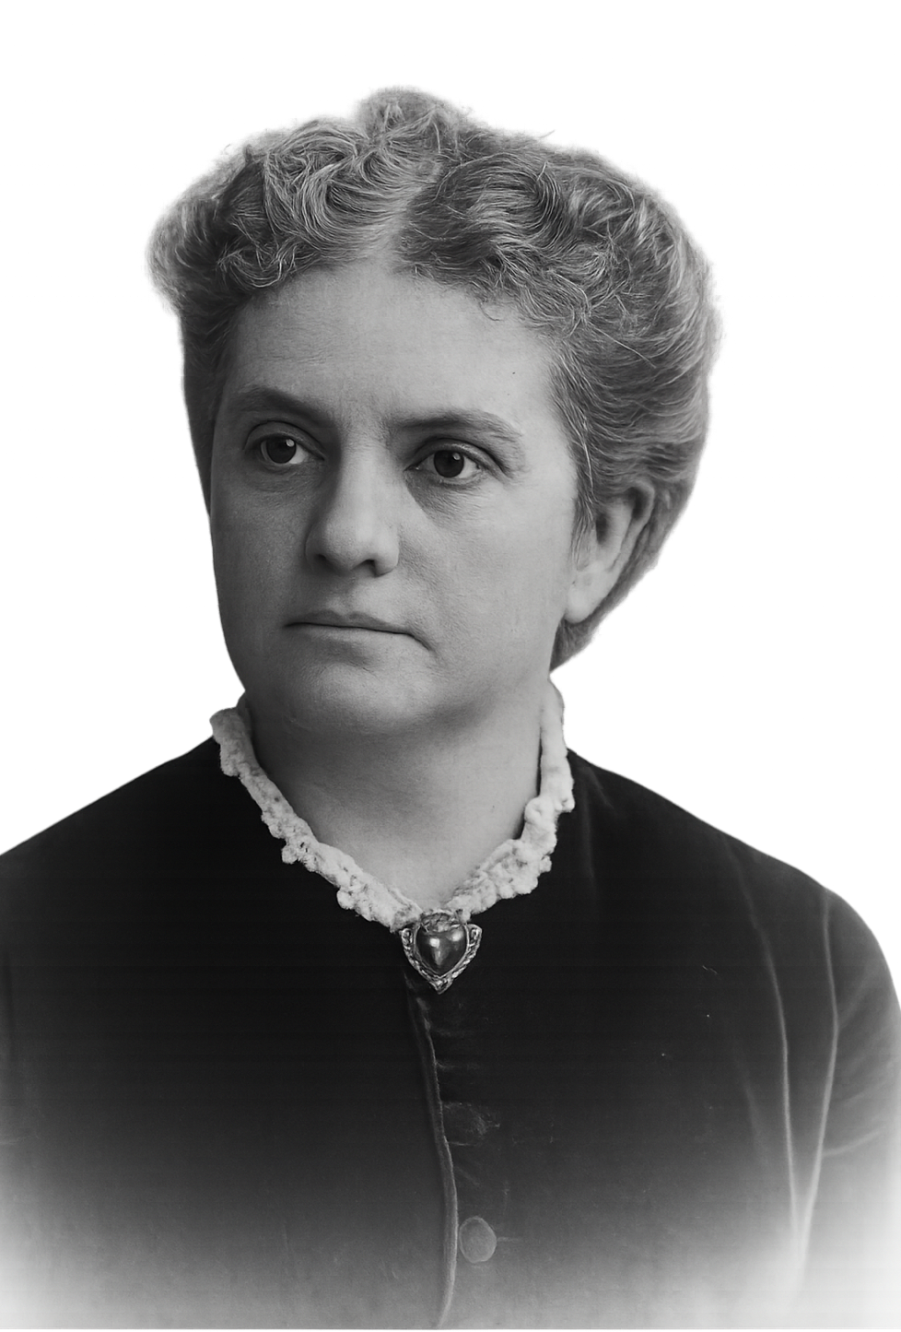
Kate Chopin (1850-1904)
An American author born in St. Louis, Missouri
One of five children in a wealthy family
After the death of her husband in 1883, she began writing to support herself and her children
Writing dealt with themes of marriage, motherhood, and limitations placed on women in society
Her work was controversial
Notes:
Historical Context for The Story of an Hour
Time period: 1890s America, late Victorian era
Social expectations:
Women defined by domesticity, marriage, motherhood
No right to vote yet
Limited legal rights over property and finances
Divorce was rare and heavily stigmatized
Chopin’s boldness:
Wrote about women’s private thoughts and inner conflicts
Characters longed for freedom and independence
Louise Mallard (The Story of an Hour) feels grief and liberation when told her husband has died
Why controversial:
Challenged the ideal of marriage as sacred and fulfilling
Suggested that domestic duty could feel like confinement
The Awakening (1899) condemned as “immoral” and “dangerous”
Legacy today:
Seen as a pioneer of feminist literature
Gave honest voice to women’s experiences
Themes of identity, freedom, and independence remain relevant

