Slide 1
Elements
of
Fiction
Setting

Slide 2


Two Moods, One Setting
Describe a house as if it is welcoming, beautiful, and idyllic on a bright sunny day.
Same house, but now: Describe it in a creepy, ominous, or horror tone.
Notes:
This pre-concept activity can be done individually or in pairs where one student does the happy house and one does the scary house.
Warm-Up (5 minutes)
Write two phrases on the board: “A dream of beauty” and “A haunting nightmare.”
Ask: How could the same place be described in both ways? Gather a few quick responses to prime them for duality of tone.
Task 1: Sunny Day Description (10–12 minutes)
Prompt: Describe a house as if it is welcoming, beautiful, and idyllic on a bright sunny day.
Encourage use of positive diction, imagery of light, warmth, color, and comfort.
Students write 1 short descriptive paragraph.
Task 2: Gothic Recast (10–12 minutes)
Same house, but now: Describe it in a gothic, ominous, or horror tone.
Encourage use of negative diction, imagery of shadows, silence, emptiness, and foreboding.
Students write a second descriptive paragraph.
Pair/Group Share (10 minutes)
Students exchange their two descriptions with a partner.
Partners underline words/phrases that made the biggest difference in tone.
Small groups discuss: Which details overlap? Which ones had to shift entirely?

Slide 3
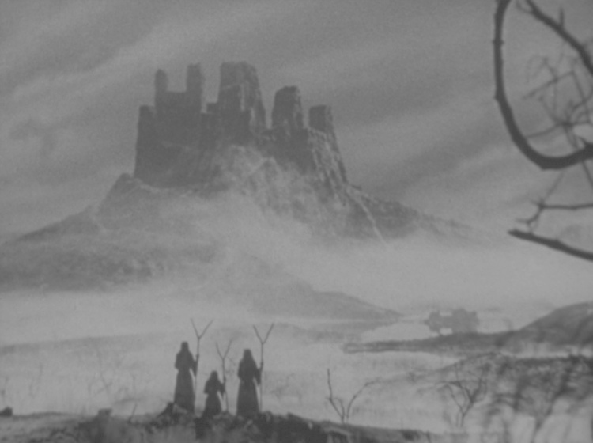
Setting
The time and place, or when and where, of a literary text that also contributes to the tone, mood, and meaning of the work.
“Setting illuminates character, not the other way around.” -Alice Dermont
Notes:
What is Setting?
The time and place of a story.
Includes the social, cultural, and historical context.
Creates the atmosphere or mood.
Why Does It Matter?
Shapes the characters’ actions and emotions.
Influences the themes and conflicts of the story.
Can work symbolically to reflect deeper meaning.
Think About:
When and where does the story happen?
What atmosphere does the writer create?
How might the setting reveal or shape a character’s state of mind?

Slide 4
Story of an Hour: Historical Context
In the Victorian Era, men and women existed in ‘separate spheres’.
Middle-class girls were educated not for careers, but to become the ideal wife—an “Angel in the House.”
Marriage, for many, was an avenue towards a semblance of freedom.
Notes:
“Separate Spheres” in the Victorian Era
Men and women were seen as having different, ‘natural’ roles.
Men: public sphere (work, politics, business).
Women: domestic sphere (home, morality, raising children).
Women were viewed as physically weaker but morally superior, meant to “balance” men’s corruption from the outside world.
This influence at home was actually used as a reason to deny women the vote.
Women’s Education & the “Angel in the House”
Middle-class girls were educated not for careers, but to become the ideal wife—an “Angel in the House.”
Instead of domestic skills, girls were trained in “accomplishments”: music, singing, drawing, dancing, languages, graceful manners.
Pride and Prejudice (Caroline Bingley) captures this expectation of a refined, well-rounded but feminine woman on the next slide.
Serious intellectualism was discouraged—“blue-stockings” (overly studious women) were mocked as unfeminine and undesirable.
Some even claimed too much study damaged women’s health and made them unmarriageable.
Marriage as a Business Transaction
Limited options: Middle- and upper-class women had few legal or financial rights; marriage was often their only route to stability.
Economic exchange: Families treated marriage as a way to secure wealth, property, or social advancement.
Dowries & inheritance: Women brought dowries; men offered name, income, and protection—marriage was a negotiation.
Social survival: A woman’s status and security depended on marrying “well,” not on personal ambition or education.
Romantic ideals vs. reality: Literature of the period often contrasts the ideal of love with the harsh economic and social pressures behind marriage.

Slide 5
“A woman must have a thorough knowledge of music, singing, drawing, dancing , and the modern languages….; and besides all this, she must possess a certain something in her air and manner of walking, the tone of her voice, her address and expressions…”(ch. 8)
- Pride and Prejudice

Slide 6
Realist Movement
The Realist movement was a 19th-century literary and artistic shift that sought to depict everyday life and ordinary people with truthful detail, rejecting romantic idealization in favor of social, psychological, and moral realism.
Notes:
Realism & Women’s Restraints in Society
Shift from Romantic idealization → Realist truth-telling
Realism rejected the exaggerated emotions and idealized heroines of Romanticism.
Instead, it focused on ordinary lives, exposing the realities of women’s social limitations.
Domestic focus
Realist writers often set their works in homes, small towns, and marriages—highlighting how women’s worlds were confined to the domestic sphere.
Psychological depth
Realism gave attention to women’s inner lives—their desires, frustrations, and conflicts with societal expectations.
Example: Kate Chopin’s The Story of an Hour shows Louise Mallard’s fleeting vision of freedom when her husband dies.
Critique of social norms
Realist texts often questioned marriage as an institution, the lack of autonomy for women, and the unequal power dynamics of gender.
Novels like Flaubert’s Madame Bovary or Wharton’s The House of Mirth reveal the dangers of women constrained by social roles.
Paving the way for feminist literature
By portraying women’s struggles realistically, Realist writers opened space for later feminist voices to directly challenge oppression.

Slide 7
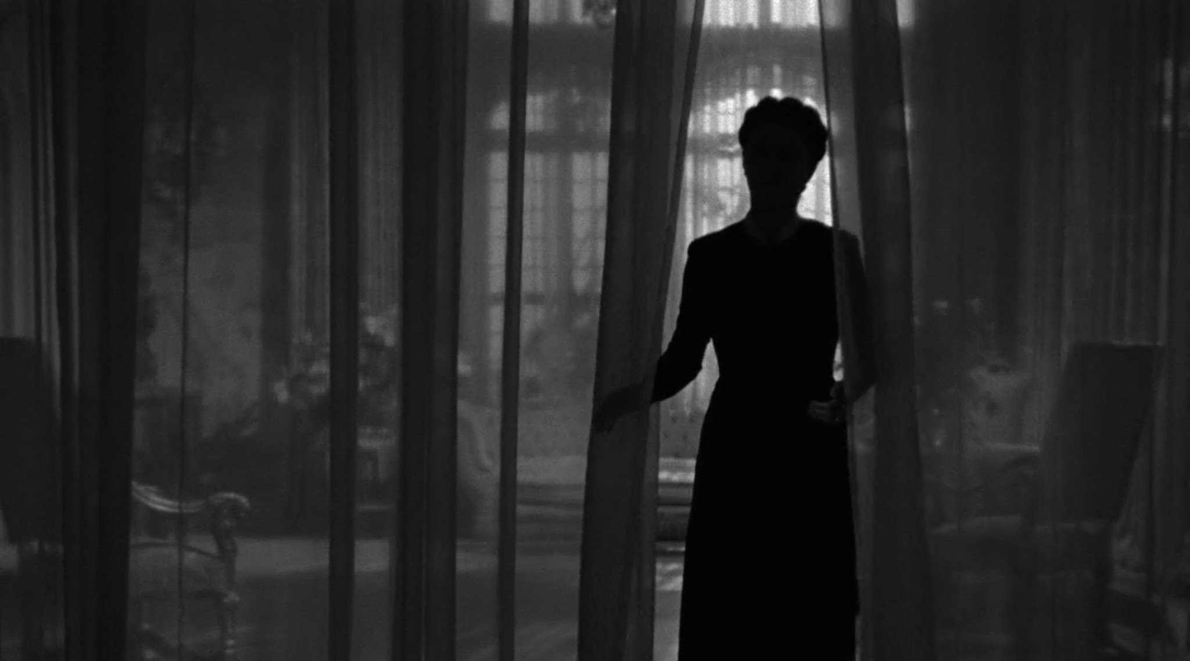
Rebecca (1938)
by Daphne Du Maurier
Rebecca by Daphne du Maurier follows an unnamed young woman who marries the wealthy widower Maxim de Winter and moves to his grand estate, Manderley, where she becomes obsessed with the lingering presence of his first wife, Rebecca.
In the Gothic tradition, it is characterized by psychological suspense and dark, brooding settings.
Notes:
Rebecca by Daphne du Maurier follows an unnamed young woman who marries the wealthy widower Maxim de Winter and moves to his grand estate, Manderley, where she becomes obsessed with the lingering presence of his first wife, Rebecca.
Inspired by her own jealously as her husband, a British leutenant, had been previously engaged to Jan Ricardo, a glamorous dark-haired figure. Du Maurier was apparently haunted by the suspicion that Browning remained attracted to Ricardo. The woman had committed suicide by jumping in front of a train.
In the Gothic tradition, it is characterized by psychological suspense and dark, brooding settings.

Slide 8
The Rebecca Notebook 1981
"Seeds began to drop. A beautiful home ... a first wife ... jealousy, a wreck, perhaps at sea, near to the house ... But something terrible would have to happen, I did not know what..."
"I want to build up the character of the first [wife] in the mind of the second...until wife 2 is haunted day and night...a tragedy is looming very close and CRASH! BANG! something happens."
Notes:
These are preliminary notes from Du Maurier about the inception of this story.
Helps shed some light on the ideas she had for the story and how vague and mysterious they are. Note how she maintains this dream-like, wistful tone in the story.

Slide 9
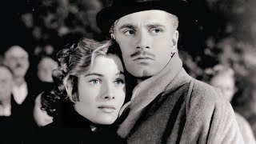
Notes:
Opening of Rebecca
This is the full film. Only play until 2:19.

Slide 10
Activity!
Please complete the T-Chart for Rebecca
The left side include quotes about the setting in Chapter 1
The right side explains what this reveals about the character
Notes:
Explain that this activity is building to writing an analytical paragraph. A strong paragraph has two essentials:
A claim (your argument about the text).
Evidence (a quotation or specific detail from the text that supports your claim).
At this stage they are practicing gathering evidence from a text. Noticing distinct phrases, impactful diction, or simply passages that feel meaningful. Then, they will provide an interpretation of what it may reveal about the character
Don’t have students complete the backside of the worksheet. After they finish the T-Chart everyone will share their findings and then they will try to find some unifying pattern amongst these quotes they gathered (maybe the idea of anxiety or disorientation or how Manderley is both beautiful and frightening) then students will create a claim based on the patterns they notice
Possible Claims about Setting & Inner Conflict
Du Maurier uses images of decay and overgrowth to show the narrator’s sense of loss and guilt.
The twisting, hidden drive reflects the narrator’s confusion and inability to see her future clearly.
The lifeless windows and empty house mirror the narrator’s feelings of isolation and invisibility.
The pressing woods symbolize the narrator’s fear of being trapped by memory and circumstance.
The mix of beauty (rhododendrons, moonlight) and menace (nettles, shadows) shows her conflicted emotions of desire and dread.
The grandeur of Manderley emphasizes the narrator’s feelings of unworthiness and exclusion.
The house as a “desolate shell” reflects the narrator’s regret and the emptiness of her past choices.
The setting blurs memory and reality, revealing her uncertainty about what is real and what is imagined.
Nature reclaiming Manderley (nettles, woods, overgrowth) symbolizes the narrator’s lack of control over her own life.
The dreamlike tone shows that Manderley exists less as a real place than as a haunting symbol of the narrator’s inner conflict.

Slide 11
Analytical Paragraph
Claim: In the opening of Rebecca, du Maurier uses repeated images of confusion and decay to mirror the narrator’s uneasy state of mind.
Evidence: For example, she describes “the drive wound away… twisting and turning… narrow and unkempt” and “the nettles were everywhere… choking the flowers.”
Commentary: These details suggest that the narrator feels both uncertain about her future and overwhelmed by neglect and loss, showing how Manderley becomes a reflection of her own anxiety and insecurity.
Notes:
A claim (your argument about the text).
Evidence (a quotation or specific detail from the text that supports your claim).
How and Why the evidence supports your claim and how it ties into the larger ideas/themes of the work.

Slide 12
More Nuanced Example
Claim: In the opening chapter of Rebecca, du Maurier’s descriptions of Manderley reveal the narrator’s inner sense of fear and disorientation.
Evidence & Commentary: For example, the narrator observes that “the drive wound away in front of me, twisting and turning as it had always done, but as I advanced I was aware that a change had come upon it; it was narrow and unkempt, not the drive that we had known” The twisting, overgrown road suggests not just physical difficulty but also the narrator’s own inner confusion and uncertainty about the path ahead in her life. Later, she describes how “the woods, always a menace even in the past, had triumphed in the end. They crowded, dark and uncontrolled, to the borders of the drive” The image of menacing woods pressing inward mirrors her feelings of entrapment and fear, showing how the setting itself reflects her anxious and haunted state of mind.
Notes:
If your class is really good

