Slide 1

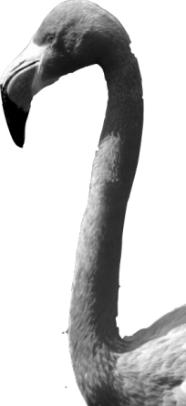
CHAPTER 1
Exploring Data
Introduction
Data Analysis:
Making Sense of Data

Slide 2
Data Analysis: Making Sense of Data
IDENTIFY the individuals and variables in a set of data
CLASSIFY variables as categorical or quantitative

Slide 3
Data Analysis
Statistics is the science of data.
  Data Analysis is the process of organizing, displaying, summarizing, and asking questions about data.
Individuals
objects described by a set of data
Variable
any characteristic of an individual
Categorical Variable
places an individual into one of several groups or categories.
Quantitative Variable
takes numerical values for which it makes sense to find an average.

Slide 4
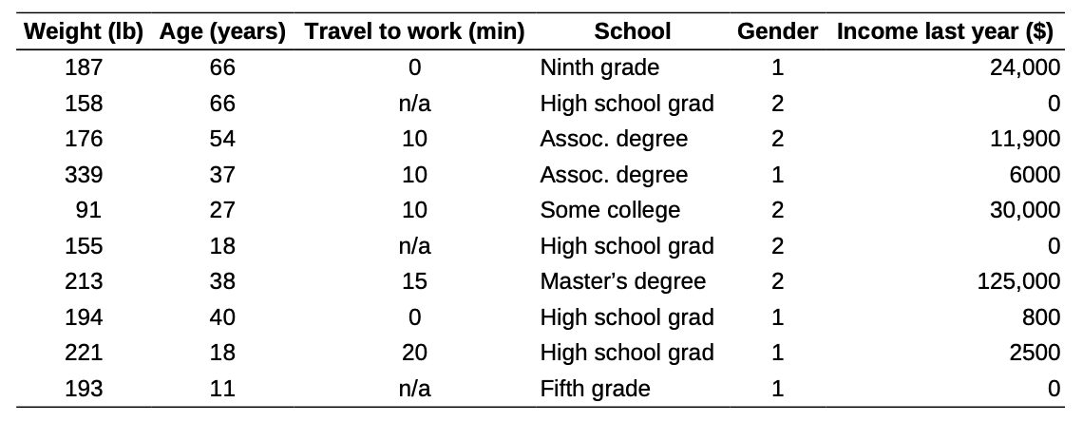
Exercises
At the Census Bureau website www.census.gov, you can view detailed data collected by the American Community Survey. The following table includes data for 10 people chosen at random from the more than 1 million people in households contacted by the survey. “School” gives the highest level of education completed.

Slide 5
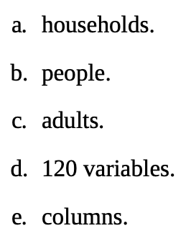
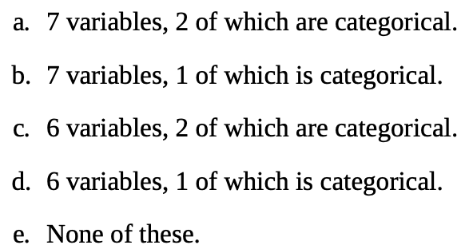
Exercises
a) The individuals in this data set are: b) This data set contains:

Slide 6
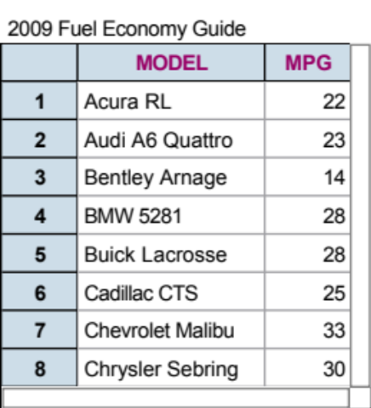
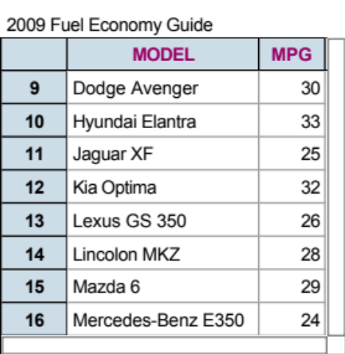
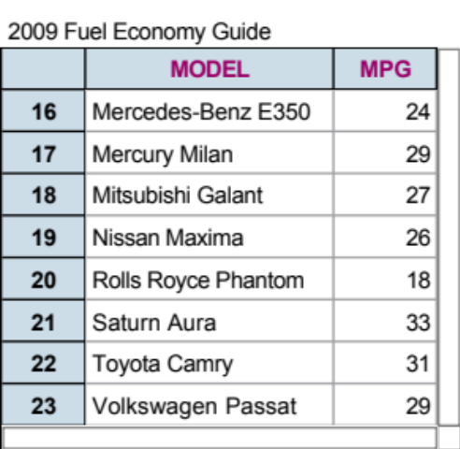
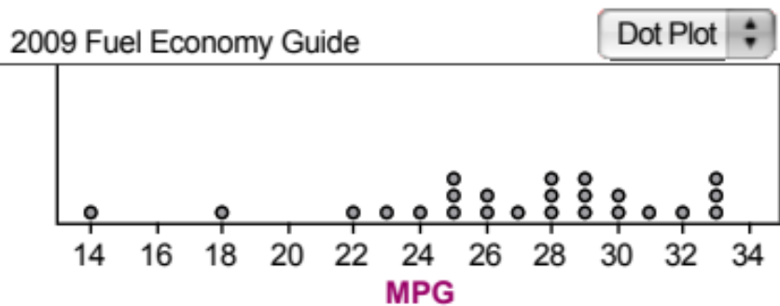
Data Analysis
A variable generally takes on many different values.
We are interested in how often a variable takes on each value.
Distribution
tells us what values a variable takes and how often it takes those values.
Dotplot of MPG Distribution
Variable of Interest:
MPG

Slide 7
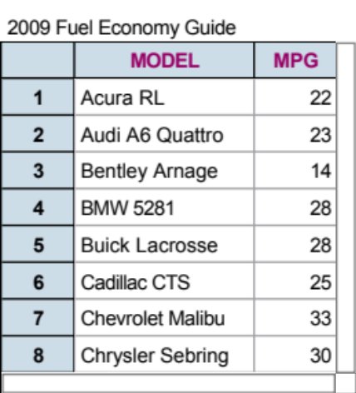
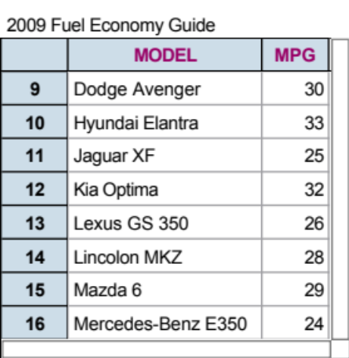
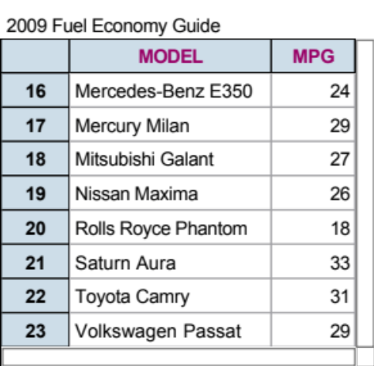

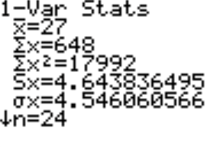
How to Explore Data
Examine each variable by itself.
Then study relationships among the variables.
Start with a graph
or graphs
Add numerical summaries

Slide 8
From Data Analysis to Inference
Population
Sample
Collect data from a representative Sample...
Make an Inference about the Population.
Perform Data Analysis, keeping probability in mind…

Slide 9
Data Analysis: Making Sense of Data
A dataset contains information on individuals.
For each individual, data give values for one or more variables.
Variables can be categorical or quantitative.
The distribution of a variable describes what values it takes and how often it takes them.
Inference is the process of making a conclusion about a population based on a sample set of data.

