Slide 1

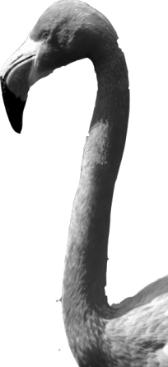
CHAPTER 1
Exploring Data
1.1
Analyzing Categorical Data

Slide 2
Analyzing Categorical Data
DISPLAY categorical data with a bar graph
IDENTIFY what makes some graphs of categorical data deceptive
CALCULATE and DISPLAY the marginal distribution of a categorical variable from a two-way table
CALCULATE and DISPLAY the conditional distribution of a categorical variable for a particular value of the other categorical variable in a two-way table
DESCRIBE the association between two categorical variables

Slide 3




Categorical Variables
Categorical variables place individuals into one of several groups or categories.
Frequency Table
Format | Count of Stations
Adult Contemporary | 1556
Adult Standards | 1196
Contemporary Hit | 569
Country | 2066
News/Talk | 2179
Oldies | 1060
Religious | 2014
Rock | 869
Spanish Language | 750
Other Formats | 1579
Total | 13838
Relative Frequency Table
Format | Percent of Stations
Adult Contemporary | 11.2
Adult Standards | 8.6
Contemporary Hit | 4.1
Country | 14.9
News/Talk | 15.7
Oldies | 7.7
Religious | 14.6
Rock | 6.3
Spanish Language | 5.4
Other Formats | 11.4
Total | 99.9
Variable
Count
Percent
Values

Slide 4
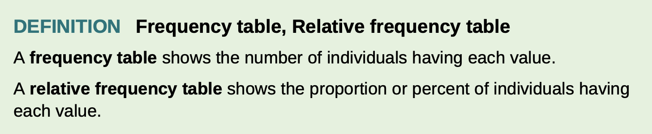
Frequency table, Relative frequency table

Slide 5
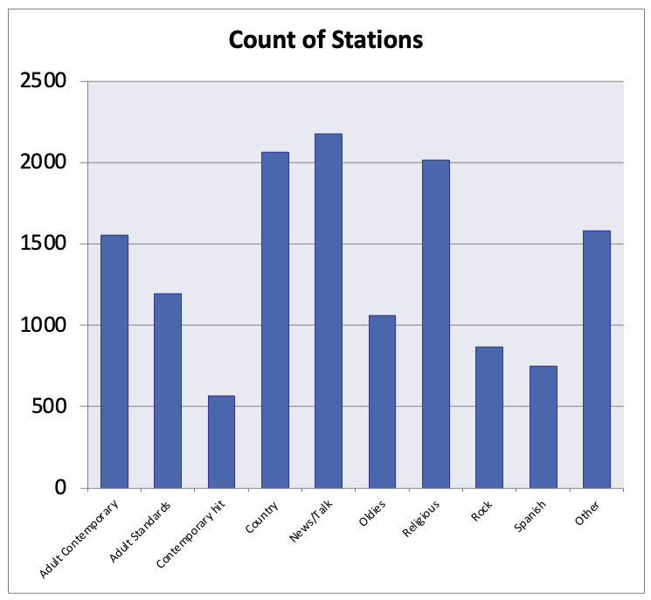
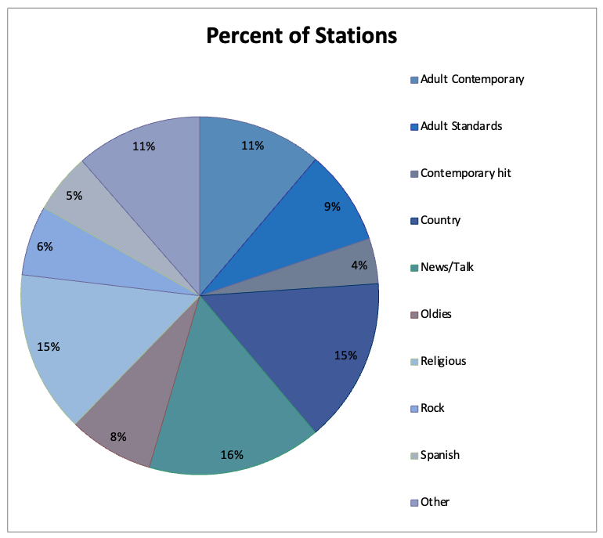
Displaying Categorical Data
Frequency tables can be difficult to read.
Sometimes is is easier to analyze a distribution by displaying it with a bar graph or pie chart.
Frequency Table
Format | Count of Stations
Adult Contemporary | 1556
Adult Standards | 1196
Contemporary Hit | 569
Country | 2066
News/Talk | 2179
Oldies | 1060
Religious | 2014
Rock | 869
Spanish Language | 750
Other Formats | 1579
Total | 13838
Relative Frequency Table
Format | Percent of Stations
Adult Contemporary | 11.2
Adult Standards | 8.6
Contemporary Hit | 4.1
Country | 14.9
News/Talk | 15.7
Oldies | 7.7
Religious | 14.6
Rock | 6.3
Spanish Language | 5.4
Other Formats | 11.4
Total | 99.9

Slide 6
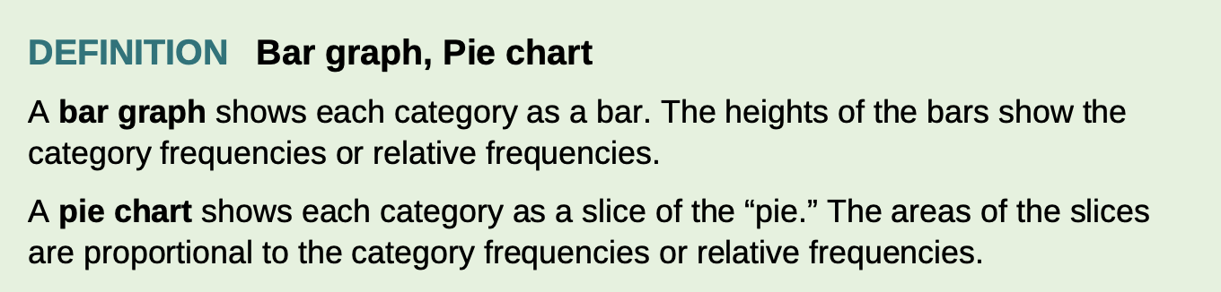
Bar graph or pie chart

Slide 7
Graphs: Good and Bad
Bar graphs compare several quantities by comparing the heights of bars that represent those quantities. Our eyes, however, react to the area of the bars as well as to their height.
When you draw a bar graph, make the bars equally wide.
It is tempting to replace the bars with pictures for greater eye appeal.
Don’t do it!
There are two important lessons to keep in mind:
beware the pictograph, and
watch those scales.

Slide 8
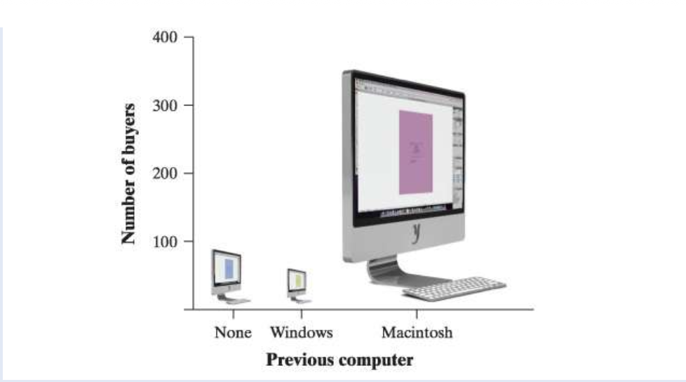
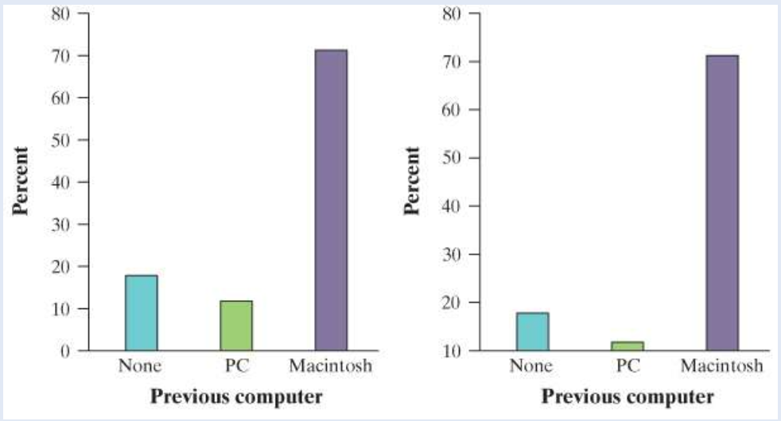
Example

Slide 9
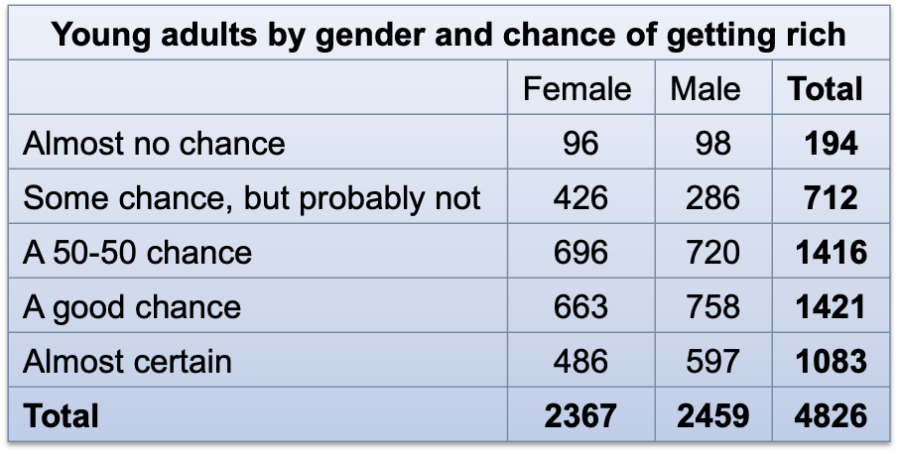
Two-Way Tables and Marginal Distributions
When a dataset involves two categorical variables, we begin by examining the counts or percents in various categories for one of the variables.
A two-way table describes two categorical variables, organizing counts according to a row variable and a column variable.
What are the variables described by this
two-way table?
How many young adults were surveyed?

Slide 10
Two-Way Tables and Marginal Distributions
The marginal distribution of one of the categorical variables in a two-way table of counts is the distribution of values of that variable among all individuals described by the table.
Note: Percents are often more informative than counts, especially when comparing groups of different sizes.
How to examine a marginal distribution:
Use the data in the table to calculate the marginal distribution (in percents) of the row or column totals.
Make a graph to display the marginal distribution.

Slide 11
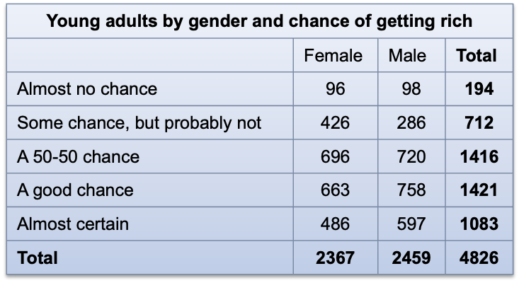
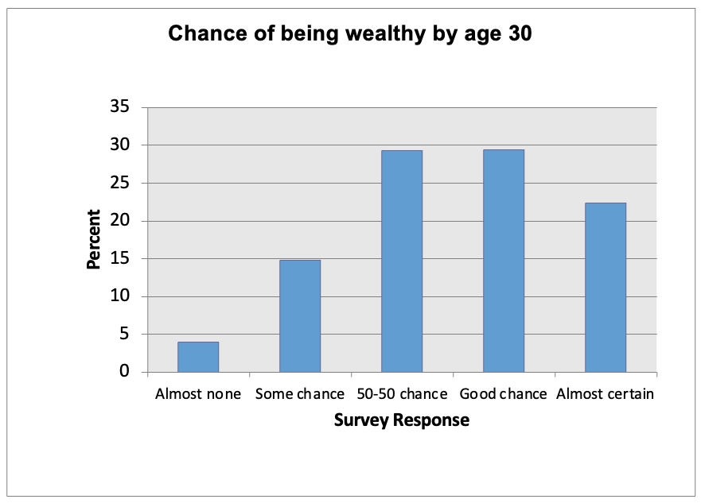
Two-Way Tables and Marginal Distributions
Examine the marginal distribution of chance of getting rich.
Response | Percent
Almost no chance | 194/4826 = 4.0%
Some chance | 712/4826 = 14.8%
A 50-50 chance | 1416/4826 = 29.3%
A good chance | 1421/4826 = 29.4%
Almost certain | 1083/4826 = 22.4%

Slide 12
Relationships Between Categorical Variables
A conditional distribution of a variable describes the values of that variable among individuals who have a specific value of another variable.
How to examine or compare conditional distributions:
Select the row(s) or column(s) of interest.
Use the data in the table to calculate the conditional distribution (in percents) of the row(s) or column(s).
Make a graph to display the conditional distribution.
  Use a side-by-side bar graph or segmented bar graph to compare distributions.

Slide 13
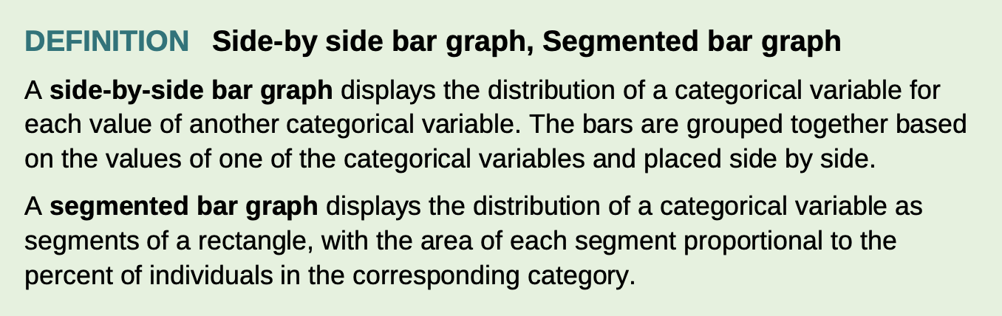
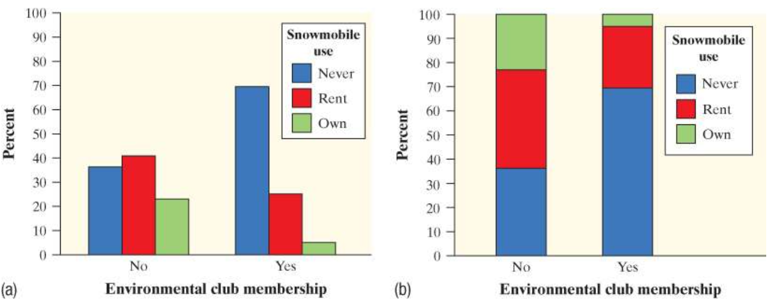
Side-by-side bar graph and segmented bar graph

Slide 14
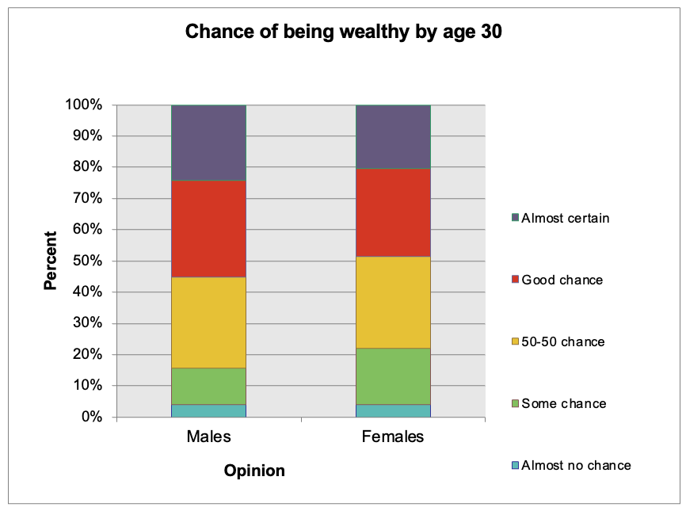
Relationships Between Categorical Variables
Calculate the conditional distribution of opinion among males. Examine the relationship between gender and opinion.
Response | Male
Almost no chance | 98/2459 = 4.0%
Some chance | 286/2459 = 11.6%
A 50-50 chance | 720/2459 = 29.3%
A good chance | 758/2459 = 30.8%
Almost certain | 597/2459 = 24.3%
Female
96/2367 = 4.1%
426/2367 = 18.0%
696/2367 = 29.4%
663/2367 = 28.0%
486/2367 = 20.5%

Slide 15
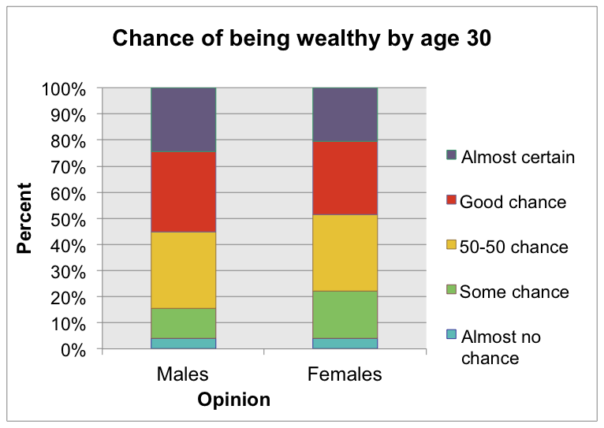
Relationships Between Categorical Variables
Can we say there is an association between gender and opinion in the population of young adults?
Making this determination requires formal inference, which will have to wait a few chapters.
Caution!
Even a strong association between two categorical variables can be influenced by other variables lurking in the background.

Slide 16
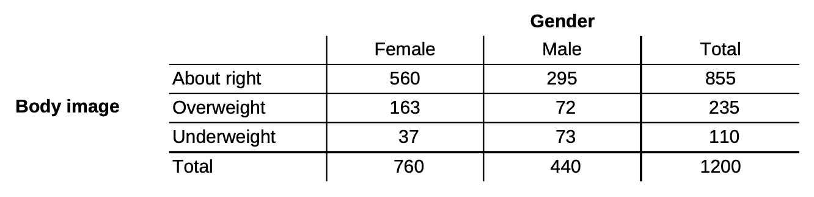
Exercises
A random sample of 1200 U.S. college students was asked, “What is your perception of your own body? Do you feel that you are overweight, underweight, or about right?” The two-way table summarizes the data on perceived body image by gender.
(a) What percent of respondents feel that their body weight is about right?
(b) What proportion of the sample is female?
(c) What percent of respondents are males and feel that they are overweight or underweight?

Slide 17
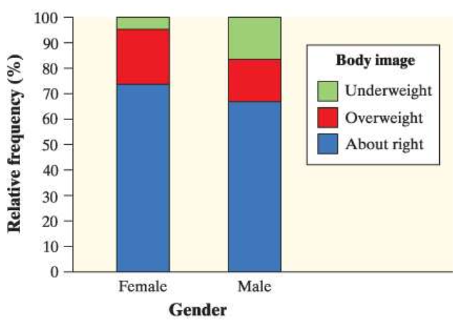
Exercises
(a) Of the respondents who felt that their body weight was about right, what proportion were female?
(b) Of the female respondents, what percent felt that their body weight was about right?
(c) The segmented bar graph displays the distribution of perceived body image by gender. Describe what this graph reveals about the association between these two variables for the 1200 college students in the sample.

Slide 18
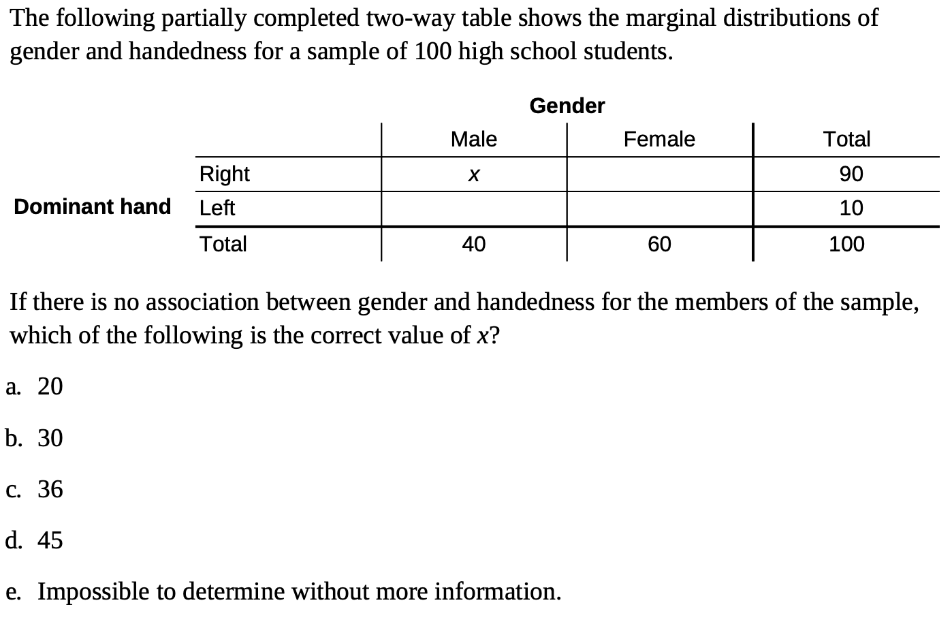
Exercises

Slide 19
Data Analysis: Making Sense of Data
DISPLAY categorical data with a bar graph
IDENTIFY what makes some graphs of categorical data deceptive
CALCULATE and DISPLAY the marginal distribution of a categorical variable from a two-way table
CALCULATE and DISPLAY the conditional distribution of a categorical variable for a particular value of the other categorical variable in a two-way table
DESCRIBE the association between two categorical variables

