Slide 1

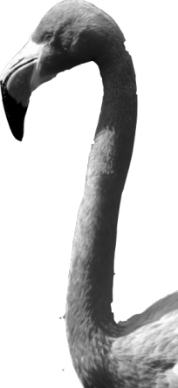
CHAPTER 1
Exploring Data
1.2
Displaying Quantitative Data with Graphs

Slide 2
Displaying Quantitative Data with Graphs
MAKE and INTERPRET dotplots and stemplots of quantitative data
DESCRIBE the overall pattern of a distribution and IDENTIFY any outliers
IDENTIFY the shape of a distribution
MAKE and INTERPRET histograms of quantitative data
COMPARE distributions of quantitative data

Slide 3
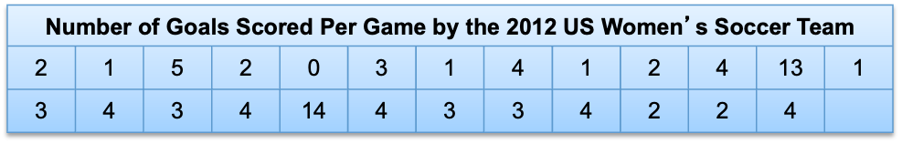

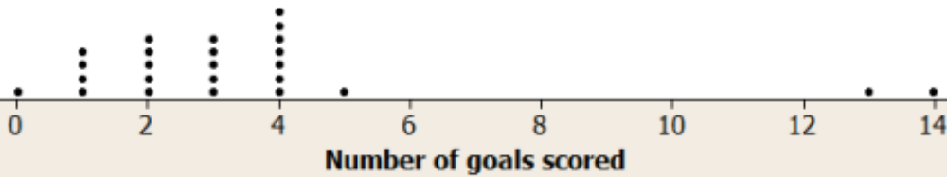
Dotplots
One of the simplest graphs to construct and interpret is a dotplot. Each data value is shown as a dot above its location on a number line.
How to make a dotplot:
Draw a horizontal axis (a number line) and label it with the variable name.
Scale the axis from the minimum to the maximum value.
Mark a dot above the location on the horizontal axis corresponding to each data value.

Slide 4
Examining the Distribution of a Quantitative Variable
The purpose of a graph is to help us understand the data. After you make a graph, always ask, “What do I see?”
How to Examine the Distribution of a Quantitative Variable
In any graph, look for the overall pattern and for striking departures from that pattern.
Describe the overall pattern of a distribution by its:
  Shape
  Center
  Spread
Note individual values that fall outside the overall pattern. These departures are called outliers.
Don’t forget your SOCS!

Slide 5
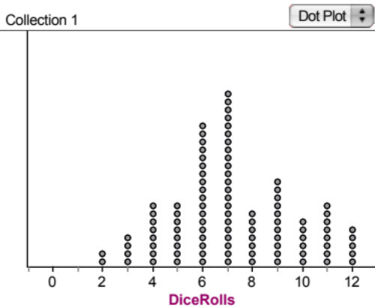
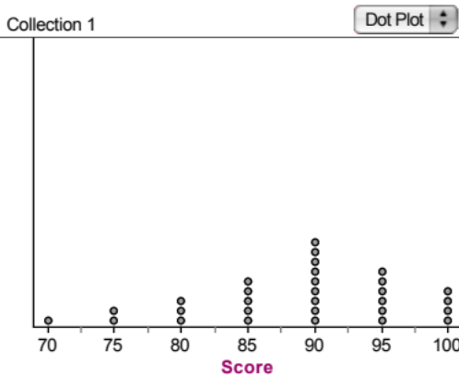
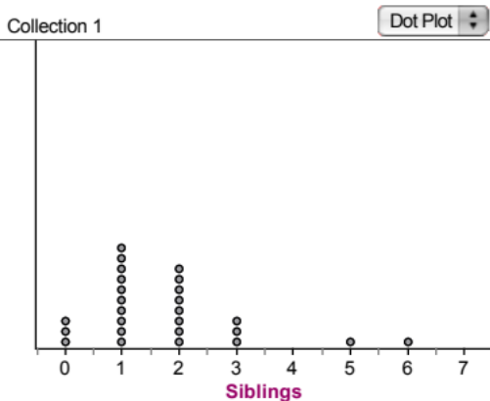
Describing Shape
When you describe a distribution’s shape, concentrate on the main features. Look for rough symmetry or clear skewness.
A distribution is roughly symmetric if the right and left sides of the graph are approximately mirror images of each other.
A distribution is skewed to the right (right-skewed) if the right side of the graph (containing the half of the observations with larger values) is much longer than the left side.
It is skewed to the left (left-skewed) if the left side of the graph is much longer than the right side.
Symmetric
Skewed-left
Skewed-right

Slide 6
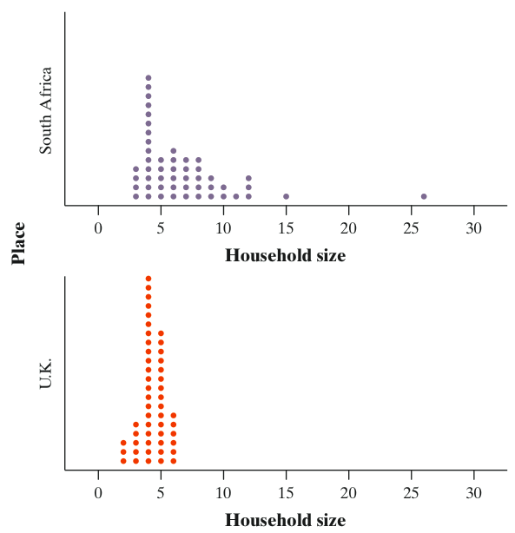
Comparing Distributions
Some of the most interesting statistics questions involve comparing two or more groups.
Always discuss shape, center, spread, and possible outliers whenever you compare distributions of a quantitative variable.
Compare the distributions of household size for these two countries.
Don’t forget your SOCS!

Slide 7
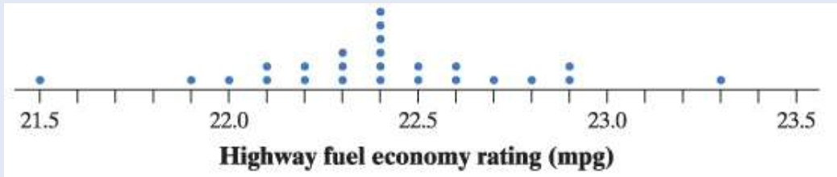
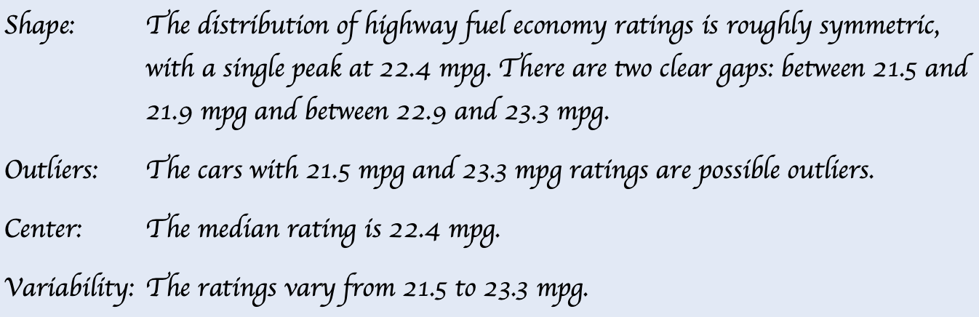
Exercises
Here is a dotplot of the highway fuel economy ratings for a sample of 25 model year 2018 Toyota 4Runners tested by the EPA. Describe the distribution.

Slide 8
Stemplots
Another simple graphical display for small data sets is a stemplot. (Also called a stem-and-leaf plot.)
Stemplots give us a quick picture of the distribution while including the actual numerical values.
How to make a stemplot:
Separate each observation into a stem (all but the final digit) and a leaf (the final digit).
Write all possible stems from the smallest to the largest in a vertical column and draw a vertical line to the right of the column.
Write each leaf in the row to the right of its stem.
Arrange the leaves in increasing order out from the stem.
Provide a key that explains in context what the stems and leaves represent.

Slide 9
Stemplots
These data represent the responses of 20 female AP Statistics students to the question, “How many pairs of shoes do you have?” Construct a stemplot.
50 | 26 | 26 | 31 | 57 | 19 | 24 | 22 | 23 | 38
13 | 50 | 13 | 34 | 23 | 30 | 49 | 13 | 15 | 51
1
2
3
4
5
1 93335
2 664233
3 1840
4 9
5 0701
1 33359
2 233466
3 0148
4 9
5 0017
Key: 4|9 represents a female student who reported having 49 pairs of shoes.
Stems
Add leaves
Order leaves
Add a key

Slide 10
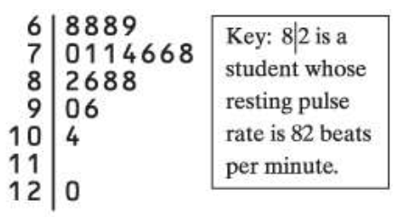
Exercises
Here are data on the resting pulse rates (beats per minute) of 19 middle school students:
shows a stem-plot of these data.

Slide 11
Stemplots
When data values are “bunched up”, we can get a better picture of the distribution by splitting stems.
Two distributions of the same quantitative variable can be compared using a back-to-back stemplot with common stems.
Females
Males
50 | 26 | 26 | 31 | 57 | 19 | 24 | 22 | 23 | 38
13 | 50 | 13 | 34 | 23 | 30 | 49 | 13 | 15 | 51
14 | 7 | 6 | 5 | 12 | 38 | 8 | 7 | 10 | 10
10 | 11 | 4 | 5 | 22 | 7 | 5 | 10 | 35 | 7
Females
333
95
4332
66
410
8
9
100
7
Males
0 4
0 555677778
1 0000124
1
2 2
2
3
3 58
4
4
5
5
0
0
1
1
2
2
3
3
4
4
5
5
“split stems”
Key: 4|9 represents a student who reported having 49 pairs of shoes.

Slide 12
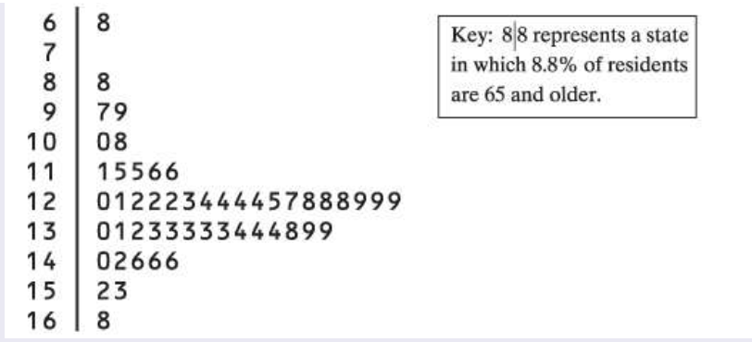
Exercises
Here is a stemplot of the percent of residents aged 65 and older in the 50 states and the District of Columbia:
The low outlier is Alaska. What percent of Alaska residents are 65 or older?
Ignoring the outlier, the shape of the distribution is?
The center of the distribution is close to?

Slide 13
Histograms
Quantitative variables often take many values. A graph of the distribution may be clearer if nearby values are grouped together.
The most common graph of the distribution of one quantitative variable is a histogram.
How to make a histogram:
Divide the range of data into classes of equal width.
Find the count (frequency) or percent (relative frequency) of individuals in each class.
Label and scale your axes and draw the histogram. The height of the bar equals its frequency. Adjacent bars should touch, unless a class contains no individuals.

Slide 14

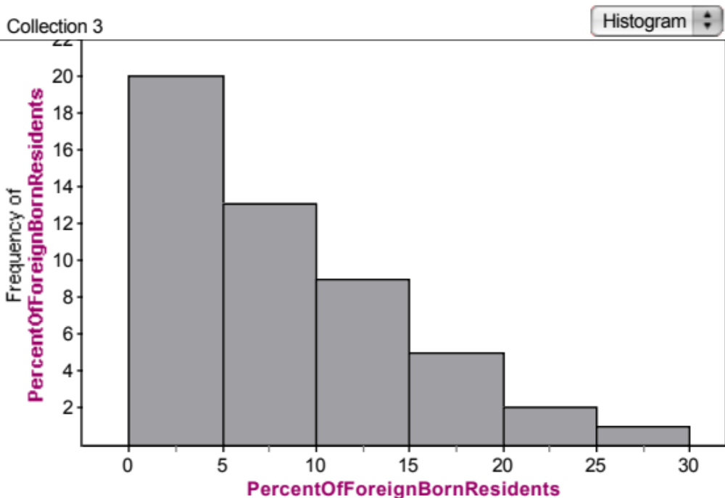

Histograms
This table presents data on the percent of residents from each state who were born outside of the U.S.
Frequency Table
Class | Count
0 to <5 | 20
5 to <10 | 13
10 to <15 | 9
15 to <20 | 5
20 to <25 | 2
25 to <30 | 1
Total | 50
Number of States
Percent of foreign-born residents

Slide 15
Using Histograms Wisely
Here are several cautions based on common mistakes students make when using histograms.
Cautions!
Don’t confuse histograms and bar graphs.
Don’t use counts (in a frequency table) or percents (in a relative frequency table) as data.
Use percents instead of counts on the vertical axis when comparing distributions with different numbers of observations.
Just because a graph looks nice, it’s not necessarily a meaningful display of data.

Slide 16
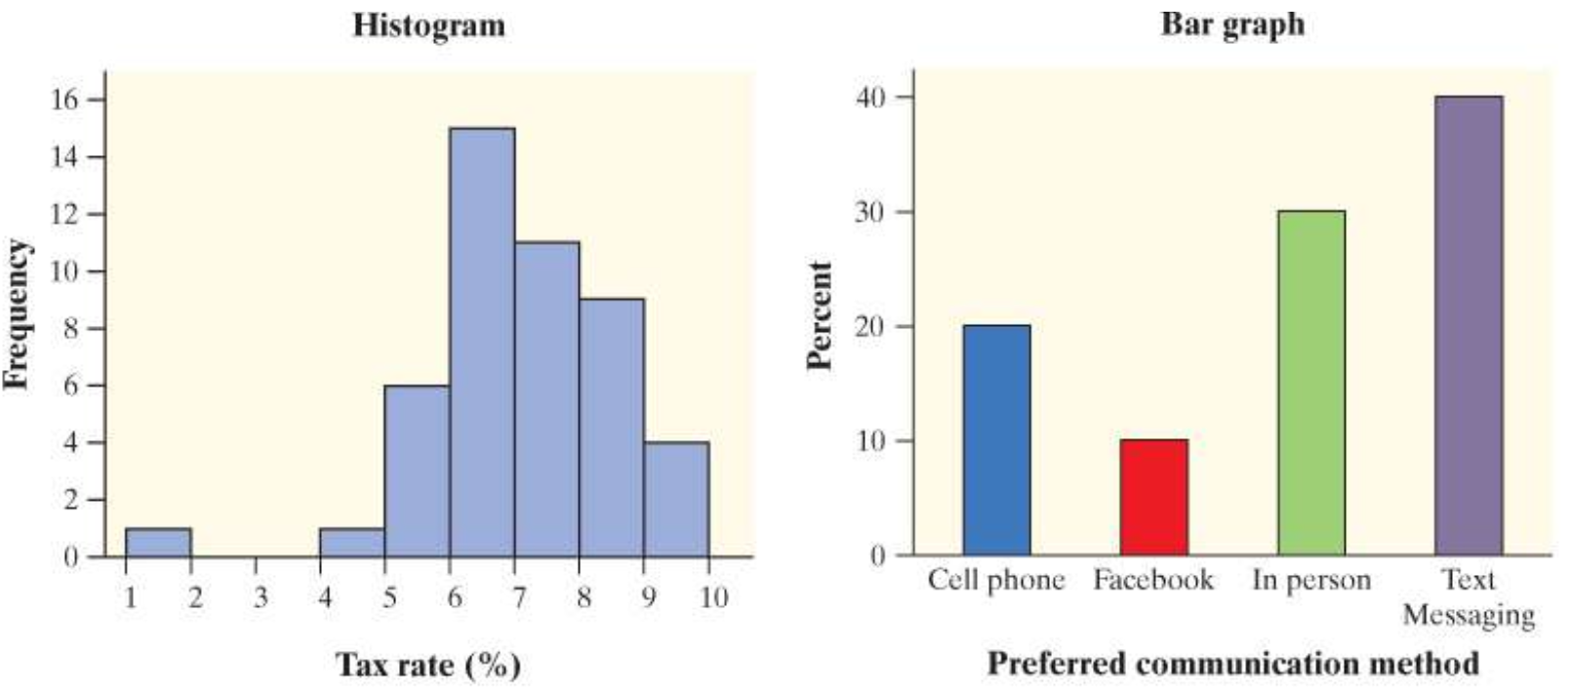
Histogram and bar graph

Slide 17
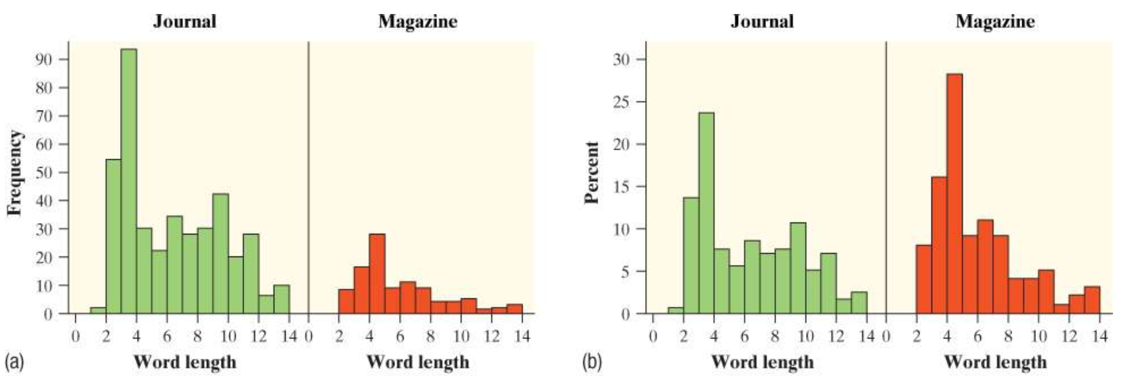
Use percents when comparing distributions with different numbers of observations

Slide 18
Data Analysis: Making Sense of Data
MAKE and INTERPRET dotplots and stemplots of quantitative data
DESCRIBE the overall pattern of a distribution
IDENTIFY the shape of a distribution
MAKE and INTERPRET histograms of quantitative data
COMPARE distributions of quantitative data

