Slide 1
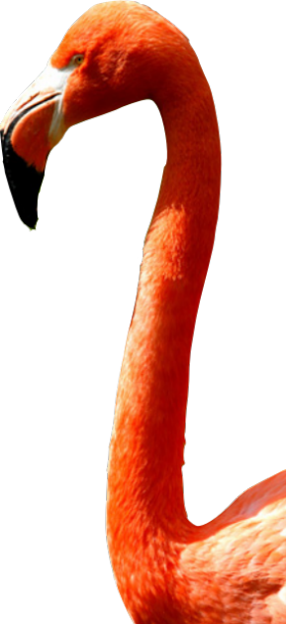
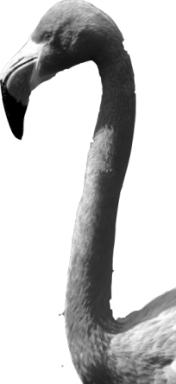
CHAPTER 1
Exploring Data
1.3
Describing Quantitative Data with Numbers

Slide 2
Describing Quantitative Data with Numbers
CALCULATE measures of center (mean, median).
CALCULATE and INTERPRET measures of spread (range, IQR, standard deviation).
CHOOSE the most appropriate measure of center and spread in a given setting.
IDENTIFY outliers using the 1.5 × IQR rule.
MAKE and INTERPRET boxplots of quantitative data.
USE appropriate graphs and numerical summaries to compare distributions of quantitative variables.

Slide 3

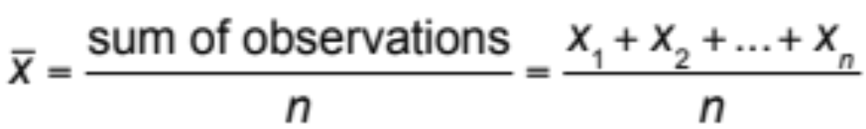
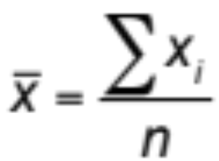
Measuring Center: The Mean
The most common measure of center is the ordinary arithmetic average, or mean.
To find the mean (pronounced “x-bar”) of a set of observations, add their values and divide by the number of observations. If the n observations are x₁, x₂, x₃, …, x_{n}, their mean is:
In mathematics, the capital Greek letter Σ is short for “add them all up.” Therefore, the formula for the mean can be written in more compact notation:

Slide 4
Measuring Center: The Median
Another common measure of center is the median. The median describes the midpoint of a distribution.
The median is the midpoint of a distribution, the number such that half of the observations are smaller and the other half are larger.
To find the median of a distribution:
Arrange all observations from smallest to largest.
If the number of observations n is odd, the median is the center observation in the ordered list.
If the number of observations n is even, the median is the average of the two center observations in the ordered list.

Slide 5
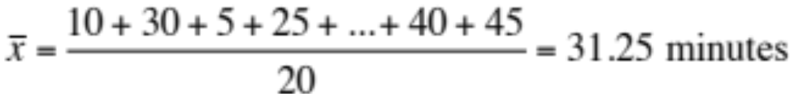
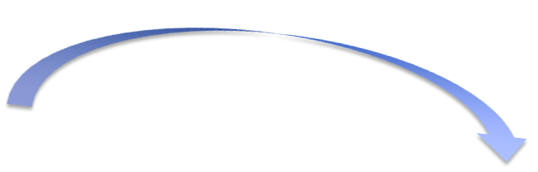
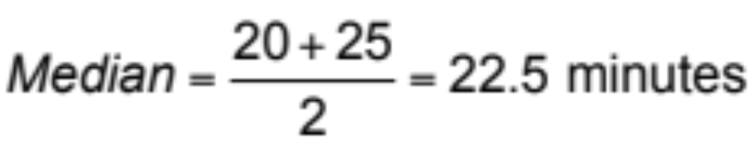
Measuring Center
Use the data below to calculate the mean and median of the commuting times (in minutes) of 20 randomly selected New York workers.
10 | 30 | 5 | 25 | 40 | 20 | 10 | 15 | 30 | 20 | 15 | 20 | 85 | 15 | 65 | 15 | 60 | 60 | 40 | 45
0 5
1 005555
2 0005
3 00
4 005
5
6 005
7
8 5
Key: 4|5 represents a New York worker who reported a 45-minute travel time to work.

Slide 6
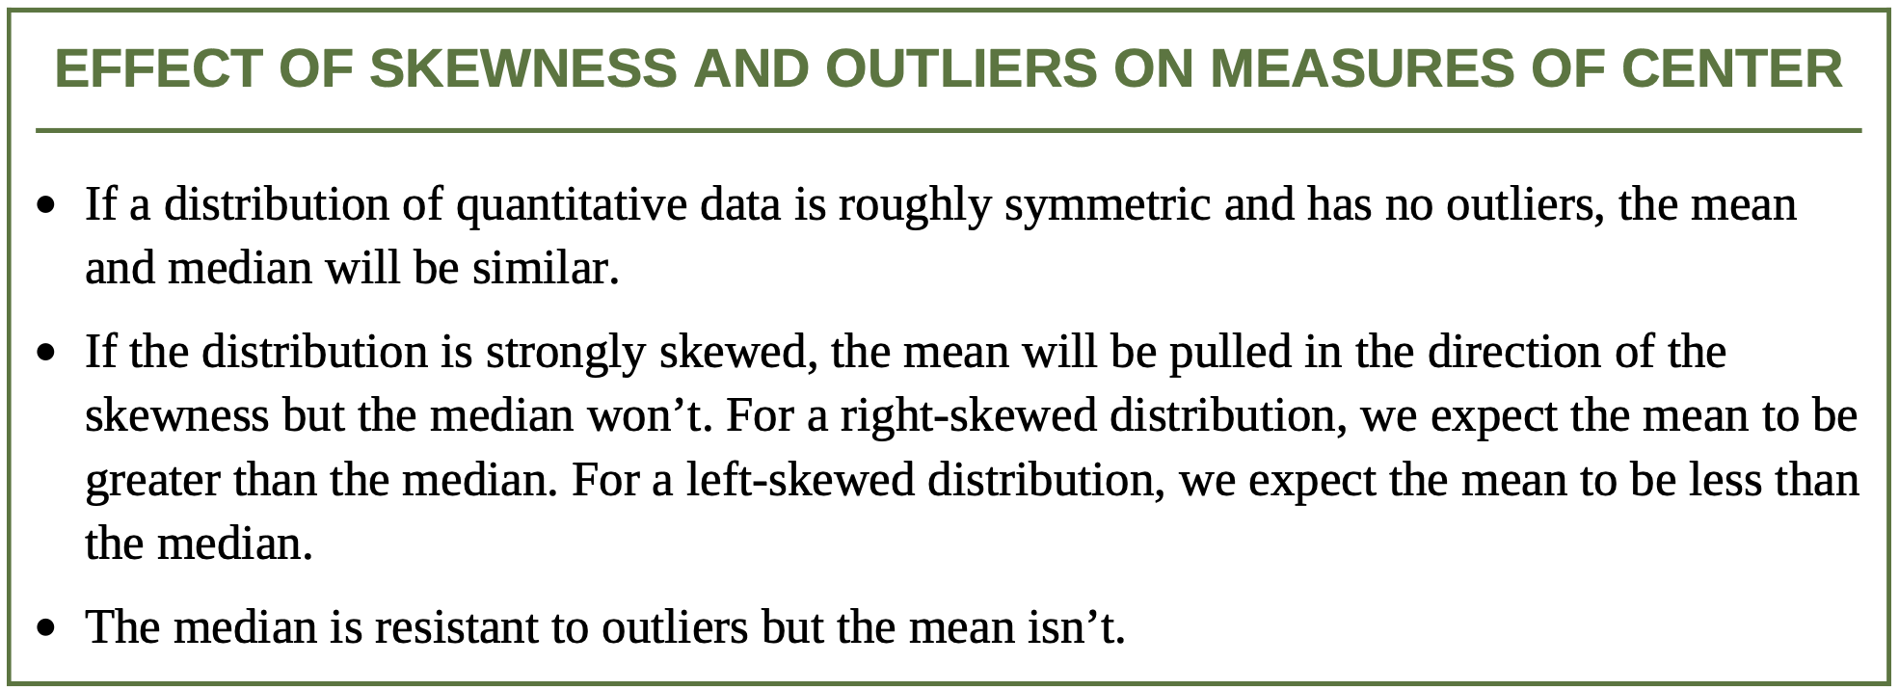
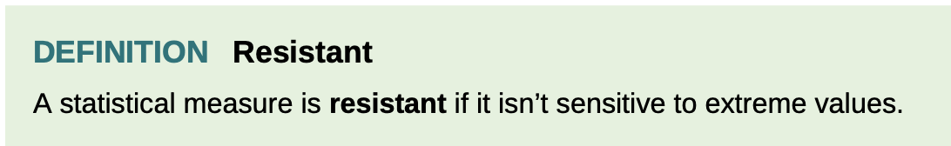
Mean and Median

Slide 7
Measuring Spread: The Interquartile Range (IQR)
A measure of center alone can be misleading.
A useful numerical description of a distribution requires both a measure of center and a measure of spread.
How To Calculate The Quartiles And The IQR:
To calculate the quartiles:
Arrange the observations in increasing order and locate the median.
The first quartile Q₁ is the median of the observations located to the left of the median in the ordered list.
The third quartile Q₃ is the median of the observations located to the right of the median in the ordered list.
The interquartile range (IQR) is defined as:
IQR = Q₃ – Q₁

Slide 8


Find and Interpret the IQR
Travel times for 20 New Yorkers:
10 | 30 | 5 | 25 | 40 | 20 | 10 | 15 | 30 | 20 | 15 | 20 | 85 | 15 | 65 | 15 | 60 | 60 | 40 | 45
5 | 10 | 10 | 15 | 15 | 15 | 15 | 20 | 20 | 20 | 25 | 30 | 30 | 40 | 40 | 45 | 60 | 60 | 65 | 85
5 | 10 | 10 | 15 | 15 | 15 | 15 | 20 | 20 | 20 | 25 | 30 | 30 | 40 | 40 | 45 | 60 | 60 | 65 | 85
Q₁ = 15
Median = 22.5
Q₃= 42.5
IQR = Q₃ – Q₁
= 42.5 – 15
= 27.5 minutes
Interpretation: The range of the middle half of travel times for the New Yorkers in the sample is 27.5 minutes.

Slide 9

Identifying Outliers
In addition to serving as a measure of spread, the interquartile range (IQR) is used as part of a rule of thumb for identifying outliers.
The 1.5 x IQR Rule for Outliers
Call an observation an outlier if it falls more than 1.5 x IQR above the third quartile or below the first quartile.
In the New York travel time data, we found Q₁=15 minutes, Q₃=42.5 minutes, and IQR=27.5 minutes.
For these data, 1.5 x IQR = 1.5(27.5) = 41.25
Q₁ - 1.5 x IQR = 15 – 41.25 = -26.25
Q₃+ 1.5 x IQR = 42.5 + 41.25 = 83.75
Any travel time shorter than -26.25 minutes or longer than 83.75 minutes is considered an outlier.
0 5
1 005555
2 0005
3 00
4 005
5
6 005
7
8 5

Slide 10
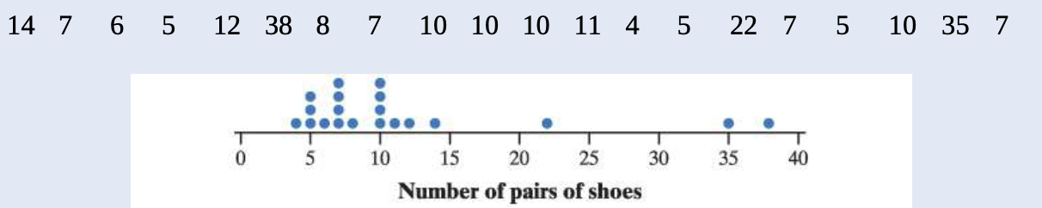
Exercises
How many pairs of shoes does a typical teenage boy own? To find out, two AP Statistics students surveyed a random sample of 20 male students from their large high school and recorded the number of pairs of shoes that each boy owned. Here are the data, along with a dot-plot, please find the interquartile range.

Slide 11
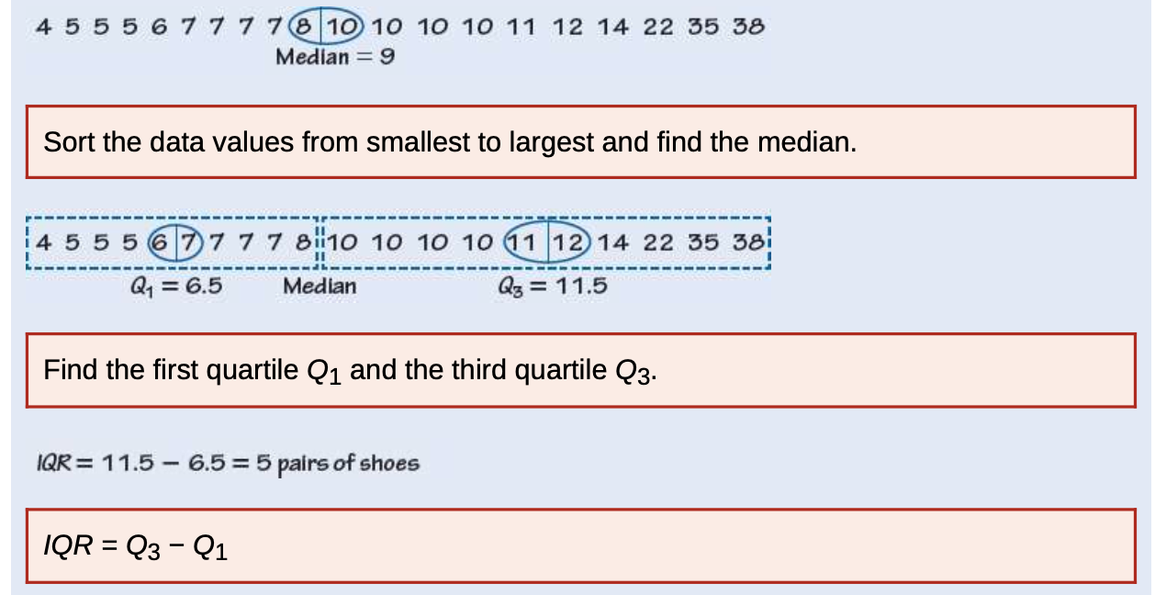
Exercises

Slide 12
The Five-Number Summary
The minimum and maximum values alone tell us little about the distribution as a whole. Likewise, the median and quartiles tell us little about the tails of a distribution.
To get a quick summary of both center and spread, combine all five numbers.
The five-number summary of a distribution consists of the smallest observation, the first quartile, the median, the third quartile, and the largest observation, written in order from smallest to largest.
Minimum Q₁ Median Q₃ Maximum

Slide 13
Boxplots (Box-and-Whisker Plots)
The five-number summary divides the distribution roughly into quarters. This leads to a new way to display quantitative data, the boxplot.
How To Make A Boxplot:
A central box is drawn from the first quartile (Q₁) to the third quartile (Q₃).
A line in the box marks the median.
Lines (called whiskers) extend from the box out to the smallest and largest observations that are not outliers.
Outliers are marked with a special symbol such as an asterisk (*).

Slide 14




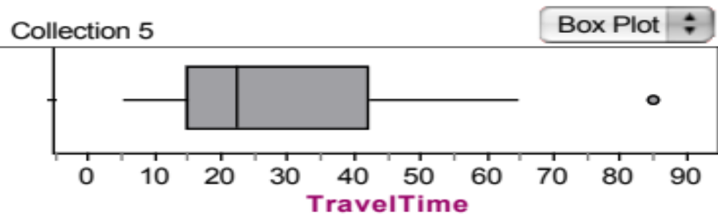
Construct a Boxplot
Consider our New York travel time data:
10 | 30 | 5 | 25 | 40 | 20 | 10 | 15 | 30 | 20 | 15 | 20 | 85 | 15 | 65 | 15 | 60 | 60 | 40 | 45
5 | 10 | 10 | 15 | 15 | 15 | 15 | 20 | 20 | 20 | 25 | 30 | 30 | 40 | 40 | 45 | 60 | 60 | 65 | 85
Min=5
Q₁ = 15
Median = 22.5
Q₃= 42.5
Max=85
Recall, this is an outlier by the
1.5 x IQR rule

Slide 15
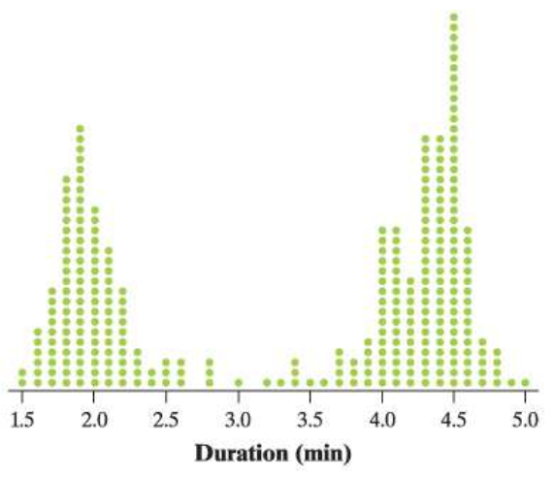
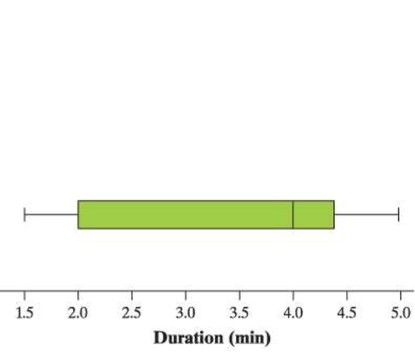
Boxplot
Notice: boxplots don’t show gaps, clusters, or peaks.

Slide 16
Exercises
Some students purchased pumpkins for a carving contest. Before the contest began, they weighed the pumpkins. The weights in pounds are shown here.
a. Make a boxplot of the data.
b. Explain why the median and IQR would be a better choice for summarizing the center and variability of the distribution of pumpkin weights than the mean and standard deviation.

Slide 17
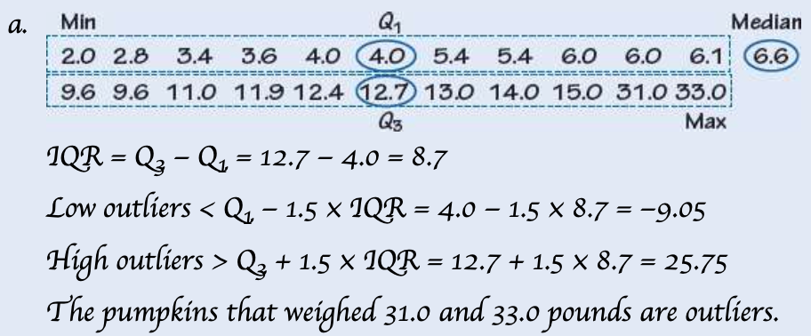
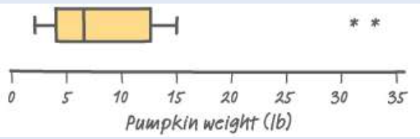
Exercises
b. The distribution of pumpkin weights is skewed to the right with two high outliers. Because the mean and standard deviation are sensitive to outliers, it would be better to use the median and IQR, which are resistant.

Slide 18
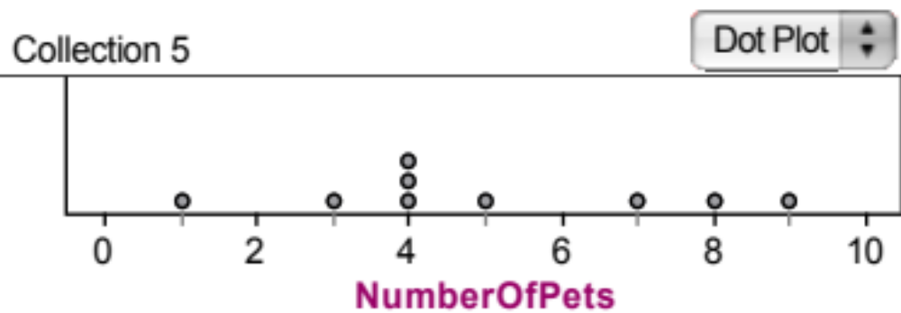

Measuring Spread: The Standard Deviation
The most common measure of spread looks at how far each observation is from the mean. This measure is called the standard deviation.
Consider the following data on the number of pets owned by a group of 9 children.
Calculate the mean.
Calculate each deviation.
    deviation = observation – mean
deviation: 1 - 5 = - 4
deviation: 8 - 5 = 3
= 5

Slide 19

Measuring Spread: The Standard Deviation
x_{i} | (x_{i}-mean) | (x_{i}-mean)²
1 | 1 - 5 = -4 | (-4)² = 16
3 | 3 - 5 = -2 | (-2)² = 4
4 | 4 - 5 = -1 | (-1)² = 1
4 | 4 - 5 = -1 | (-1)² = 1
4 | 4 - 5 = -1 | (-1)² = 1
5 | 5 - 5 = 0 | (0)² = 0
7 | 7 - 5 = 2 | (2)² = 4
8 | 8 - 5 = 3 | (3)² = 9
9 | 9 - 5 = 4 | (4)² = 16
 | Sum=? | Sum=?
3) Square each deviation.
4) Find the “average” squared deviation. Calculate the sum of the squared deviations divided by (n-1)…this is called the variance.
5) Calculate the square root of the variance…this is the standard deviation.
“average” squared deviation = 52/(9-1) = 6.5 This is the variance.
Standard deviation = square root of variance =

Slide 20
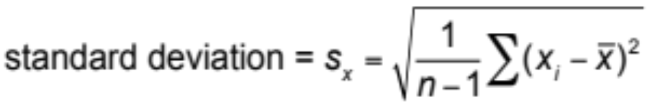
Measuring Spread: The Standard Deviation
The standard deviation s_{x} measures the average distance of the observations from their mean. It is calculated by finding an average of the squared distances and then taking the square root.
The average squared distance is called the variance.

Slide 21
Choosing Measures of Center and Spread
We now have a choice between two descriptions for center and spread
Mean and Standard Deviation
Median and Interquartile Range
Choosing Measures of Center and Spread
The median and IQR are usually better than the mean and standard deviation for describing a skewed distribution or a distribution with outliers.
Use mean and standard deviation only for reasonably symmetric distributions that don’t have outliers.
NOTE: Numerical summaries do not fully describe the shape of a distribution. ALWAYS PLOT YOUR DATA!

Slide 22
Organizing a Statistical Problem
As you learn more about statistics, you will be asked to solve more complex problems. Here is a four-step process you can follow.
How to Organize a Statistical Problem: A Four-Step Process
State: What’s the question that you’re trying to answer?
Plan: How will you go about answering the question? What statistical techniques does this problem call for?
Do: Make graphs and carry out needed calculations.
Conclude: Give your conclusion in the setting of the real-world problem.

Slide 23
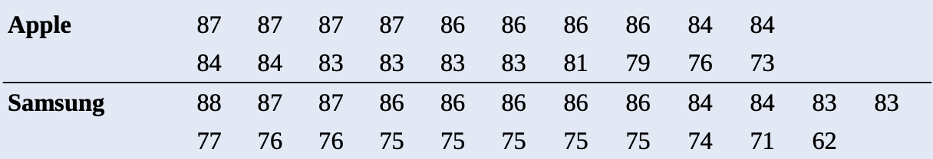
Exercises
In a recent year, Consumer Reports rated many tablet computers for performance and quality. Based on several variables, the magazine gave each tablet an overall rating, where higher scores indicate better ratings. The overall ratings of the tablets produced by Apple and Samsung are given here, along with parallel boxplots and numerical summaries of the data.

Slide 24
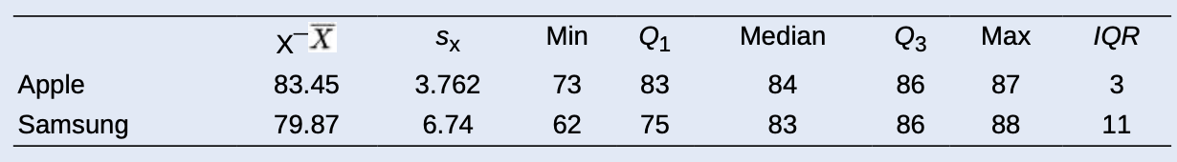
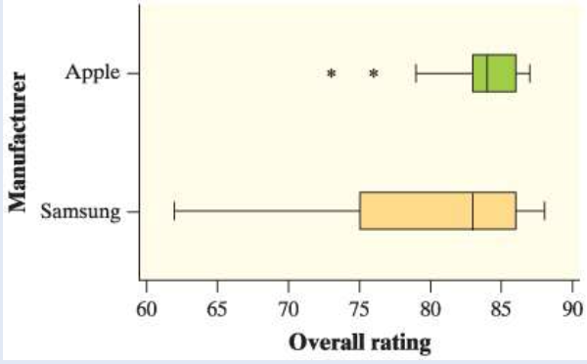
Exercises
Compare the distributions of overall rating for Apple and Samsung.

Slide 25
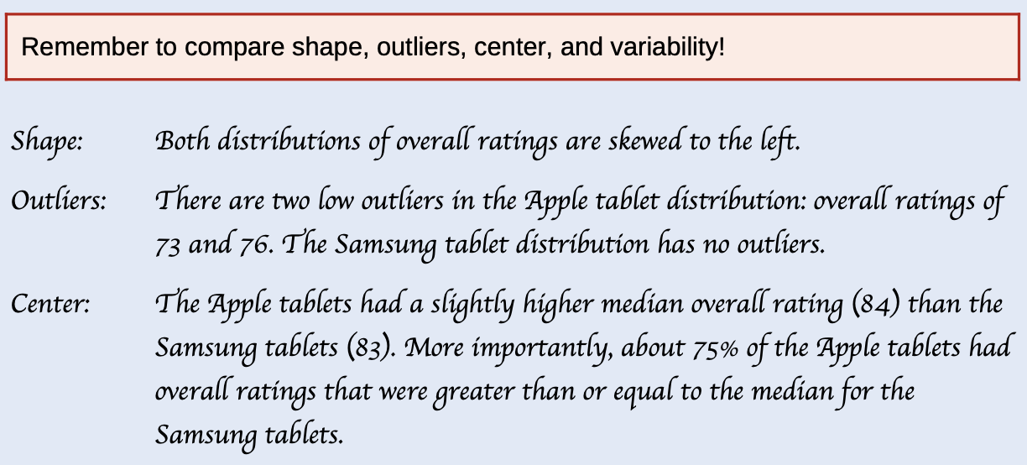
Exercises

Slide 26
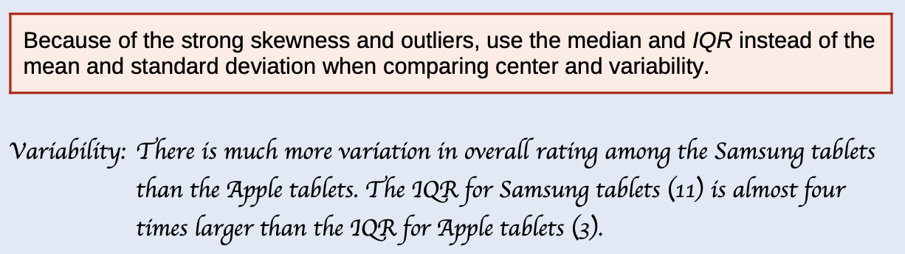
Exercises

Slide 27
Data Analysis: Making Sense of Data
CALCULATE measures of center (mean, median).
CALCULATE and INTERPRET measures of spread (range, IQR, standard deviation).
CHOOSE the most appropriate measure of center and spread in a given setting.
IDENTIFY outliers using the 1.5 × IQR rule.
MAKE and INTERPRET boxplots of quantitative data.
USE appropriate graphs and numerical summaries to compare distributions of quantitative variables.

