Slide 1
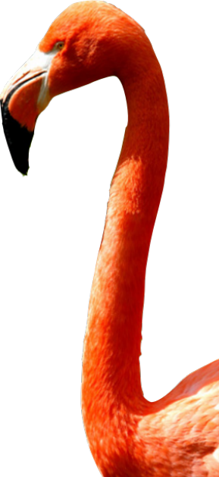
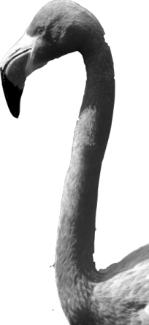
CHAPTER 2
Modeling Distributions of Data
2.1
Describing Location in a Distribution

Slide 2
Describing Location in a Distribution
FIND and INTERPRET the percentile of an individual value within a distribution of data.
ESTIMATE percentiles and individual values using a cumulative relative frequency graph.
FIND and INTERPRET the standardized score (z-score) of an individual value within a distribution of data.
DESCRIBE the effect of adding, subtracting, multiplying by, or dividing by a constant on the shape, center, and spread of a distribution of data.

Slide 3
Measuring Position: Percentiles
One way to describe the location of a value in a distribution is to tell what percent of observations are less than it.
The p^{th} percentile of a distribution is the value with p percent of the observations less than it.
Example
Jenny earned a score of 86 on her test. How did she perform relative to the rest of the class?
6 7
7 2334
7 5777899
8 00123334
8 569
9 03
6 7
7 2334
7 5777899
8 00123334
8 569
9 03
Her score was greater than 21 of the 25 observations. Since 21 of the 25, or 84%, of the scores are below hers, Jenny is at the 84th percentile in the class’s test score distribution.

Slide 4
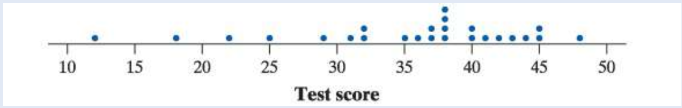
Exercises
Refer to the dot-plot of 25 scores on Mr. Tabor’s first statistics test.
a. Find the percentile for Jacob, who scored 18 on the test.
b. Maria’s test score is at the 48th percentile of the distribution. Interpret this value in context. What score did Maria earn?

Slide 5
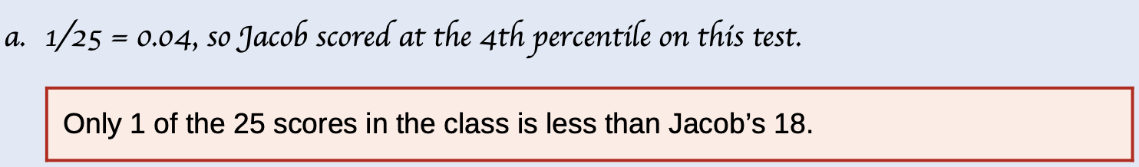
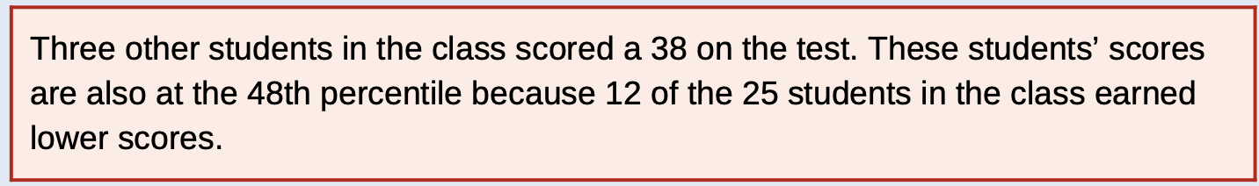
Exercises
b. 48% of students in the class earned a lower test score than Maria. Because (0.48)(25)=12 , Maria scored higher than 12 of the 25 students. Then Maria earned a 38 on the test.

Slide 6
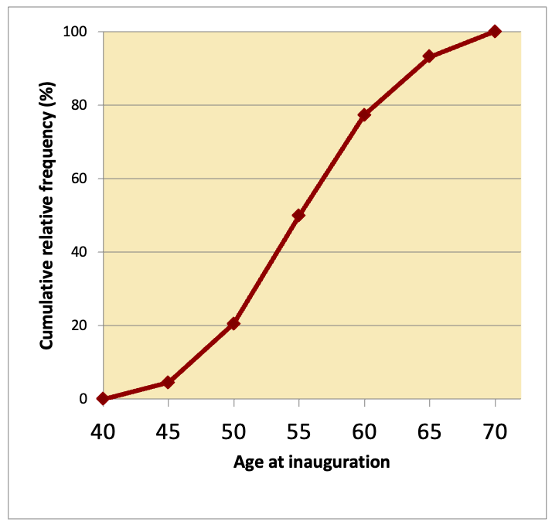
Cumulative Relative Frequency Graphs
A cumulative relative frequency graph displays the cumulative relative frequency of each class of a frequency distribution.
Age of First 44 Presidents When They Were Inaugurated
Age | Frequency | Relative frequency | Cumulative frequency | Cumulative relative frequency
40-44 | 2 | 2/44 = 4.5% | 2 | 2/44 = 4.5%
45-49 | 7 | 7/44 = 15.9% | 9 | 9/44 = 20.5%
50-54 | 13 | 13/44 = 29.5% | 22 | 22/44 = 50.0%
55-59 | 12 | 12/44 = 34% | 34 | 34/44 = 77.3%
60-64 | 7 | 7/44 = 15.9% | 41 | 41/44 = 93.2%
65-69 | 3 | 3/44 = 6.8% | 44 | 44/44 = 100%

Slide 7
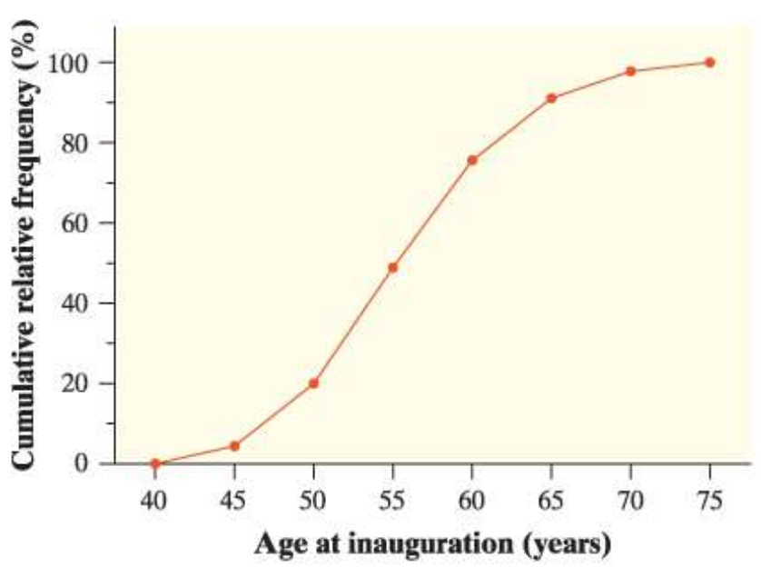
Example
The graph shows the completed cumulative relative frequency graph for the presidential age at inauguration data. Use the graph to help you answer each question.
a. Was Barack Obama, who was first inaugurated at age 47, unusually young?
b. Estimate and interpret the 65th percentile of the distribution.

Slide 8
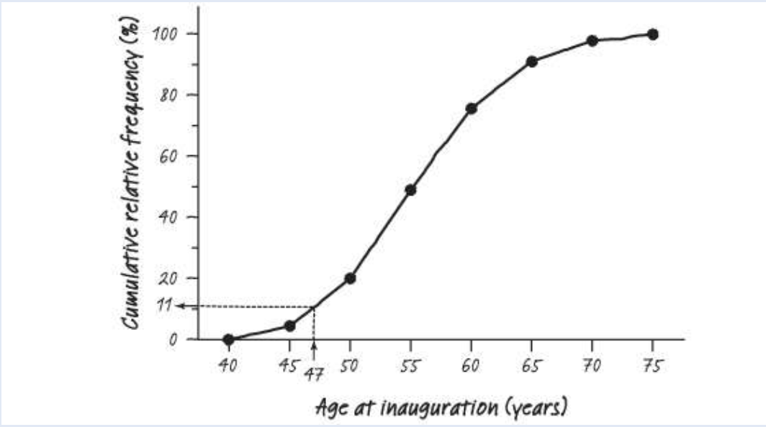
Example
a. Barack Obama’s inauguration age places him at about the 11th percentile. About 11% of the first 45 U.S. presidents first took office at a younger age than Obama did. So Obama was fairly young, but not unusually young, when he took office.

Slide 9
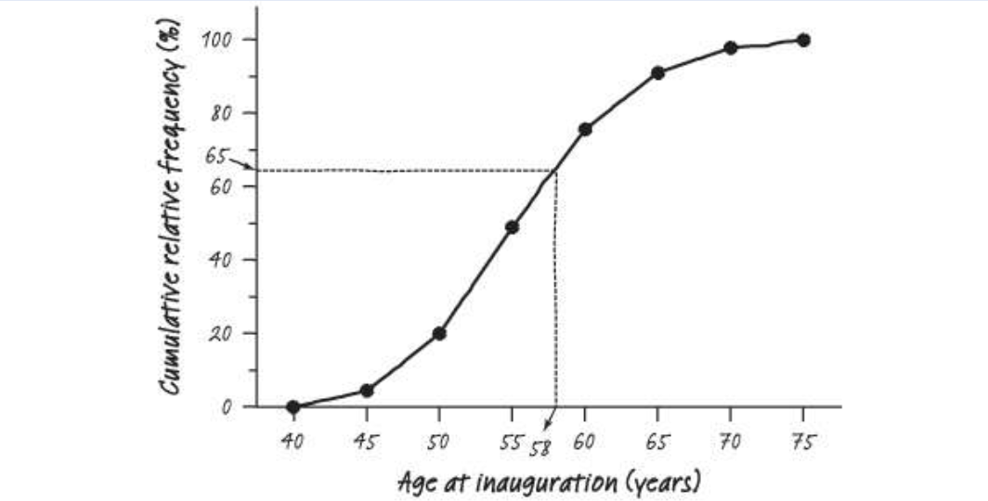
Example
b. The 65th percentile is about 58 years old. About 65% of the first 45 U.S. presidents were younger than 58 when they took office.

Slide 10
Exercises
Select the best answer. Mark receives a score report detailing his performance on a statewide test. On the math section, Mark earned a raw score of 39, which placed him at the 68th percentile. This means that:
a. Mark did better than about 39% of the students who took the test.
b. Mark did worse than about 39% of the students who took the test.
c. Mark did better than about 68% of the students who took the test.
d. Mark did worse than about 68% of the students who took the test.
e. Mark got more than half of the questions correct on this test.

Slide 11
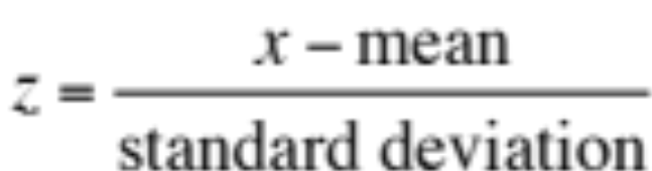
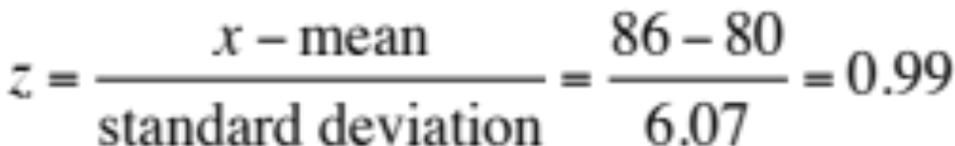
Measuring Position: z-Scores
A z-score tells us how many standard deviations from the mean an observation falls, and in what direction.
If x is an observation from a distribution that has known mean and standard deviation, the standardized score of x is:
A standardized score is often called a z-score.
Example
Jenny earned a score of 86 on her test. The class mean is 80 and the standard deviation is 6.07. What is her standardized score?

Slide 12
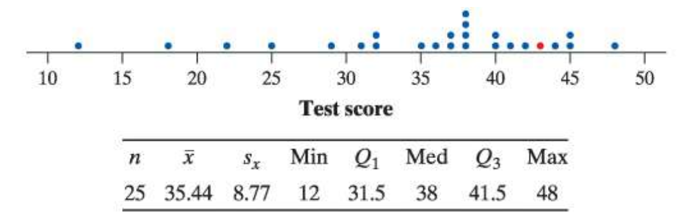
Example
These data are from Mr. Tabor’s first statistics test. The figure here shows a dot-plot of the data, along with numerical summaries. Emily’s score of 43 is marked in red on the dot-plot.
a. Find and interpret the z-score for Jacob, who earned an 18 on the test.
b. Tamika had a standardized score of 0.292. Find Tamika’s test score.

Slide 13

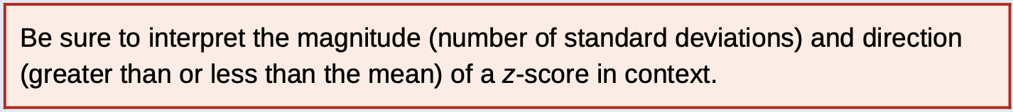
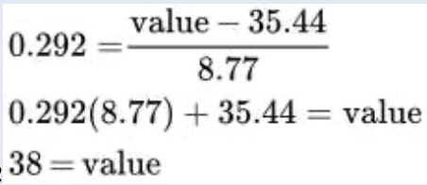
Example
a.
Jacob’s test score is 1.99 standard deviations below the class mean of 35.44.
b.
Tamika’s test score was 38.

Slide 14
Transforming Data
Transforming converts the original observations from the original units of measurements to another scale. Transformations can affect the shape, center, and spread of a distribution.
Effect of Adding (or Subtracting) a Constant
Adding the same number a to (subtracting a from) each observation:
  adds a to (subtracts a from) measures of center and location (mean, median, quartiles, percentiles), but
  Does not change the shape of the distribution or measures of spread (range, IQR, standard deviation).

Slide 15
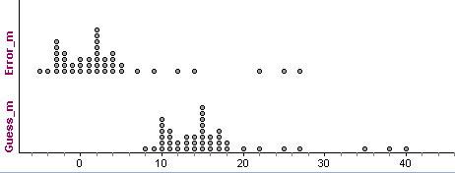
Transforming Data
Example
Examine the distribution of students’ guessing errors by defining a new variable as follows:
error = guess − 13
That is, we’ll subtract 13 from each observation in the data set. Try to predict what the shape, center, and spread of this new distribution will be.
 | n | Mean | sx | Min | Q1 | M | Q3 | Max | IQR | Range
Guess(m) | 44 | 16.02 | 7.14 | 8 | 11 | 15 | 17 | 40 | 6 | 32
Error (m) | 44 | 3.02 | 7.14 | -5 | -2 | 2 | 4 | 27 | 6 | 32

Slide 16
Transforming Data
Transforming converts the original observations from the original units of measurements to another scale. Transformations can affect the shape, center, and spread of a distribution.
Effect of Multiplying (or Dividing) by a Constant
Multiplying (or dividing) each observation by the same number b:
  multiplies (divides) measures of center and location (mean, median, quartiles, percentiles) by b
  multiplies (divides) measures of spread (range, IQR, standard deviation) by |b|, but
  does not change the shape of the distribution

Slide 17
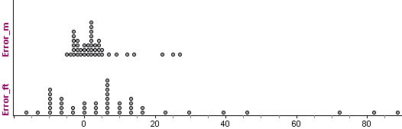
Transforming Data
Example
Because our group of Australian students is having some difficulty with the metric system, it may not be helpful to tell them that their guesses tended to be about 2 to 3 meters too high. Let’s convert the error data to feet before we report back to them. There are roughly 3.28 feet in a meter.
 | n | Mean | s_{x} | Min | Q₁ | M | Q₃ | Max | IQR | Range
Error (m) | 44 | 3.02 | 7.14 | -5 | -2 | 2 | 4 | 27 | 6 | 32
Error(ft) | 44 | 9.91 | 23.43 | -16.4 | -6.56 | 6.56 | 13.12 | 88.56 | 19.68 | 104.96

Slide 18

Exercises
During the winter months, the temperatures at the Starnes’s Colorado cabin can stay well below freezing (32°F, or 0°C) for weeks at a time. To prevent the pipes from freezing, Mrs. Starnes sets the thermostat at 50°F. She also buys a digital thermometer that records the indoor temperature each night at midnight. Unfortunately, the thermometer is programmed to measure the temperature in degrees Celsius. Following are a dot-plot and numerical summaries of the midnight temperature readings for a 30-day period.
Use the fact that , to help you answer the following
questions.

Slide 19
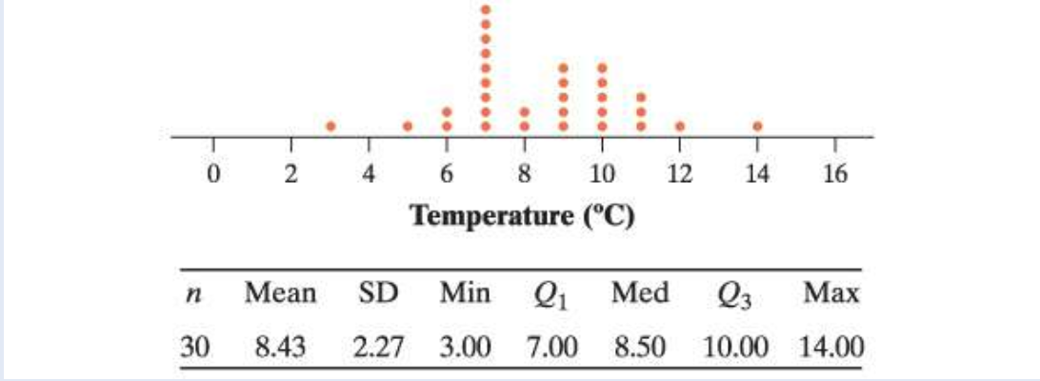
Exercises
a. Find the mean temperature in degrees Fahrenheit. Does the thermostat setting seem accurate?
b. Calculate the standard deviation of the temperature readings in degrees Fahrenheit. Interpret this value in context.

Slide 20
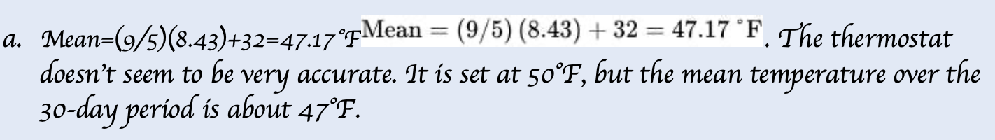
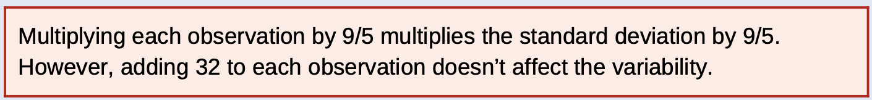
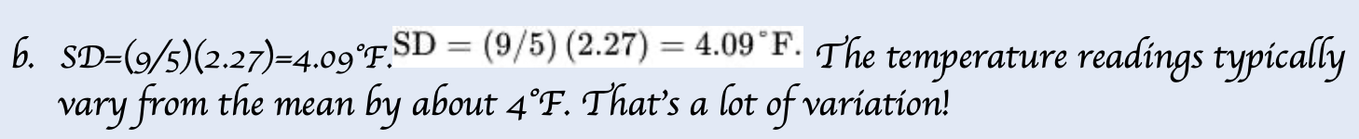
Exercises

Slide 21
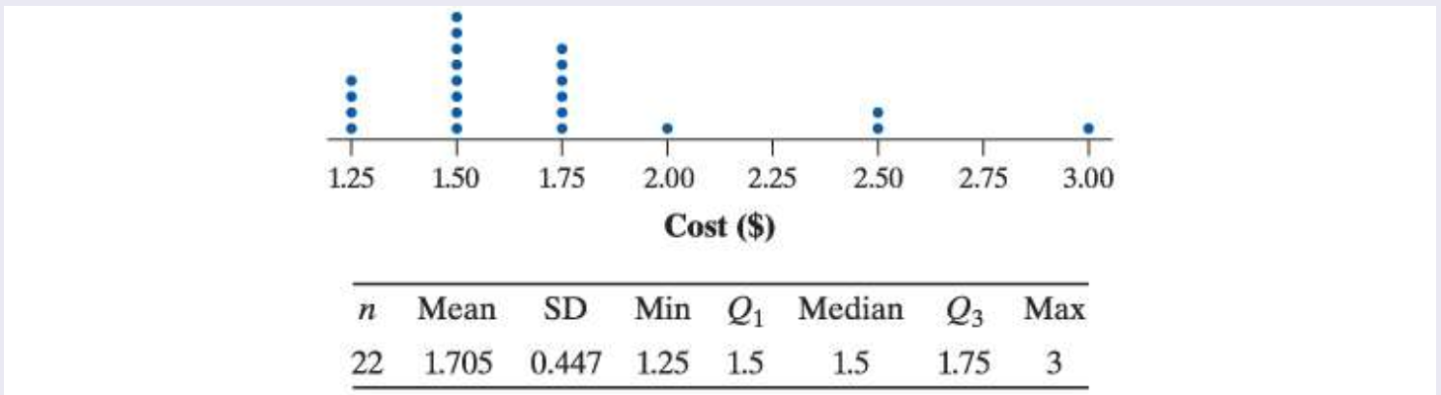
Exercises
Knoebels Amusement Park in Elysburg, Pennsylvania, has earned acclaim for being an affordable, family-friendly entertainment venue. Knoebels does not charge for general admission or parking, but it does charge customers for each ride they take. How much do the rides cost at Knoebels? The figure shows a dot-plot of the cost for each of 22 rides in a recent year, along with summary statistics.

Slide 22
Exercises
1. Suppose you convert the cost of the rides from dollars to cents ($1=100 cents). Describe the shape, mean, and standard deviation of the distribution of ride cost in cents.
2. Knoebels’ managers decide to increase the cost of each ride by 25 cents. How would the shape, center, and variability of this distribution compare with the distribution of cost in Question 1?
3. Now suppose you convert the increased costs from Question 2 to z-scores. What would be the shape, mean, and standard deviation of this distribution? Explain your answers.

Slide 23
Exercises
Converting the cost of the rides from dollars to cents will not change the shape. However, it will multiply the mean and standard deviation by 100.
Adding 25 cents to the cost of each ride will not change the shape of the distribution, nor will it change the variability. It will, however, add 25 cents to the measures of center (mean, median).
Converting the costs to z-scores will not change the shape of the distribution. It will change the mean to 0 and the standard deviation to 1.

Slide 24
Describing Location in a Distribution
FIND and INTERPRET the percentile of an individual value within a distribution of data.
ESTIMATE percentiles and individual values using a cumulative relative frequency graph.
FIND and INTERPRET the standardized score (z-score) of an individual value within a distribution of data.
DESCRIBE the effect of adding, subtracting, multiplying by, or dividing by a constant on the shape, center, and spread of a distribution of data.

