Slide 1

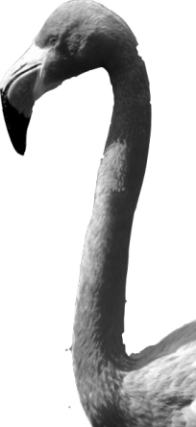
CHAPTER 2
Modeling Distributions of Data
2.2
Density Curves and
Normal Distributions

Slide 2
Density Curves and Normal Distributions
ESTIMATE the relative locations of the median and mean on a density curve.
ESTIMATE areas (proportions of values) in a Normal distribution.
FIND the proportion of z-values in a specified interval, or a z-score from a percentile in the standard Normal distribution.
FIND the proportion of values in a specified interval, or the value that corresponds to a given percentile in any Normal distribution.
DETERMINE whether a distribution of data is approximately Normal from graphical and numerical evidence.

Slide 3
Exploring Quantitative Data
In Chapter 1, we developed a kit of graphical and numerical tools for describing distributions. Now, we’ll add one more step to the strategy.
Exploring Quantitative Data
Always plot your data: make a graph, usually a dotplot, stemplot, or histogram.
Look for the overall pattern (shape, center, and spread) and for striking departures such as outliers.
Calculate a numerical summary to briefly describe center and spread.
4. Sometimes the overall pattern of a large number of observations is so regular that we can describe it by a smooth curve.

Slide 4
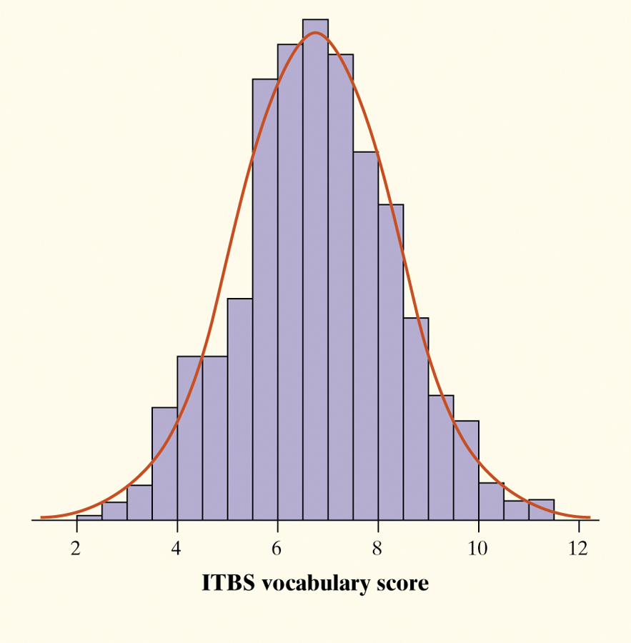
Density Curves
A density curve is a curve that
  is always on or above the horizontal axis, and
  has area exactly 1 underneath it.
A density curve describes the overall pattern of a distribution. The area under the curve and above any interval of values on the horizontal axis is the proportion of all observations that fall in that interval.
Example
The overall pattern of this histogram of the scores of all 947 seventh-grade students in Gary, Indiana, on the vocabulary part of the Iowa Test of Basic Skills (ITBS) can be described by a smooth curve drawn through the tops of the bars.

Slide 5
Describing Density Curves
Our measures of center and spread apply to density curves as well as to actual sets of observations.
Distinguishing the Median and Mean of a Density Curve
The median of a density curve is the equal-areas point, the point that divides the area under the curve in half.
The mean of a density curve is the balance point, at which the curve would balance if made of solid material.
The median and the mean are the same for a symmetric density curve. They both lie at the center of the curve. The mean of a skewed curve is pulled away from the median in the direction of the long tail.

Slide 6
Example
Suppose you use a calculator or computer random number generator to produce a number between 0 and 2 (like 0.84522 or 1.1111119). The random number generator will spread its output uniformly across the entire interval from 0 to 2 as we allow it to generate a long sequence of random numbers.
a. Draw a density curve to model this distribution of random numbers. Be sure to include scales on both axes.
b. About what percent of the randomly generated numbers will fall between 0.87 and 1.55?
c. Estimate the 65th percentile of this distribution of random numbers.

Slide 7
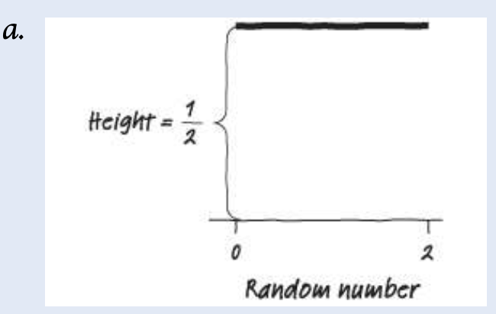
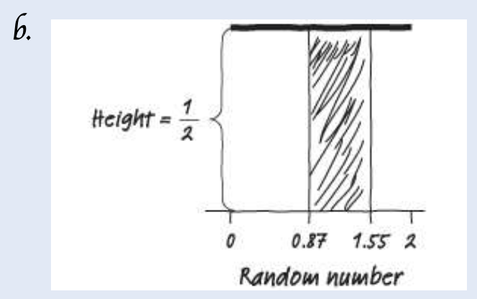
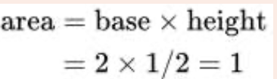
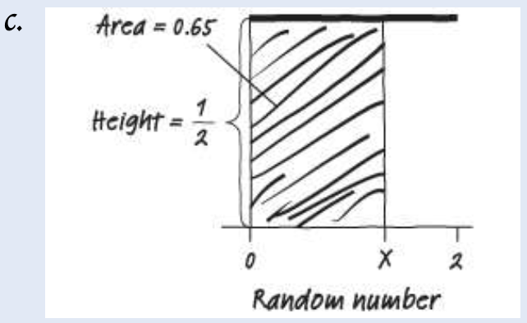
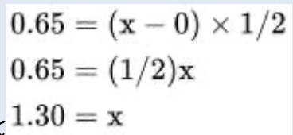
Example

Slide 8
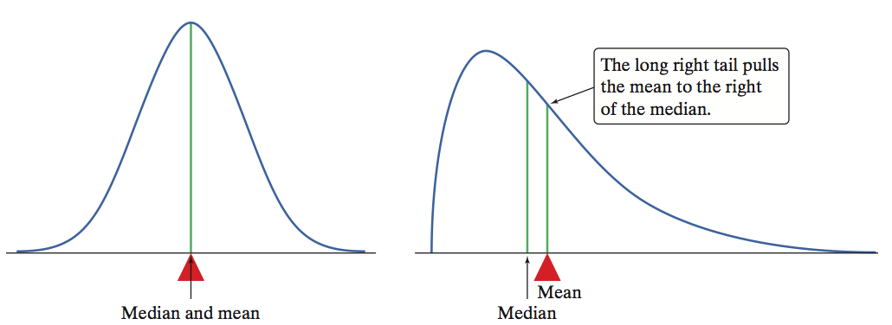
Describing Density Curves
A density curve is an idealized description of a distribution of data.
We distinguish between the mean and standard deviation of the density curve and the mean and standard deviation computed from the actual observations.
The usual notation for the mean of a density curve is µ (the Greek letter mu). We write the standard deviation of a density curve as σ (the Greek letter sigma).

Slide 9
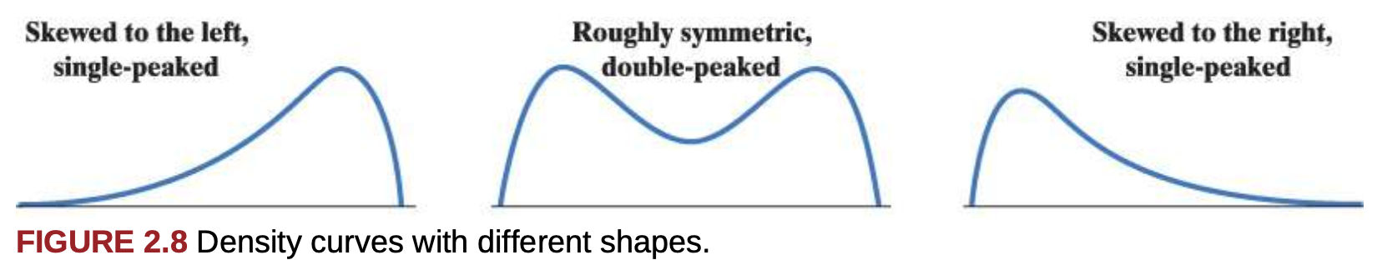
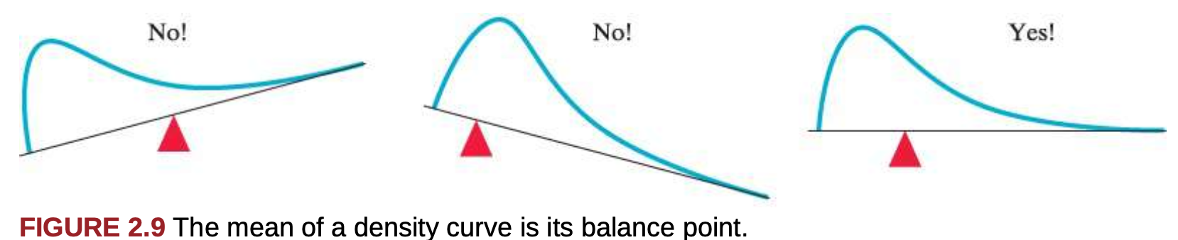
Describing Density Curves

Slide 10
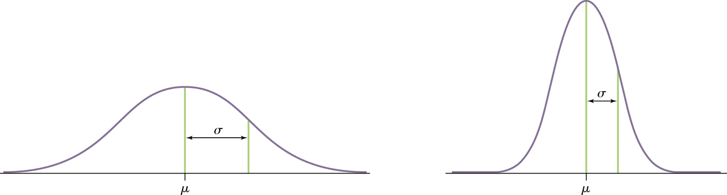
Normal Distributions
  One particularly important class of density curves are the Normal curves, which describe Normal distributions.
    All Normal curves have the same shape: symmetric, single-peaked, and bell-shaped
    Any specific Normal curve is completely described by giving its mean µ and its standard deviation σ.

Slide 11
Normal Distributions
Why are the Normal distributions important in statistics?
Normal distributions are good descriptions for some distributions of real data.
Normal distributions are good approximations of the results of many kinds of chance outcomes.
Many statistical inference procedures are based on Normal distributions.
A Normal distribution is described by a Normal density curve. Any particular Normal distribution is completely specified by two numbers: its mean µ and standard deviation σ.
  The mean of a Normal distribution is the center of the symmetric Normal curve.
  The standard deviation is the distance from the center to the change-of-curvature points on either side.
  We abbreviate the Normal distribution with mean µ and standard deviation σ as N(µ,σ).

Slide 12
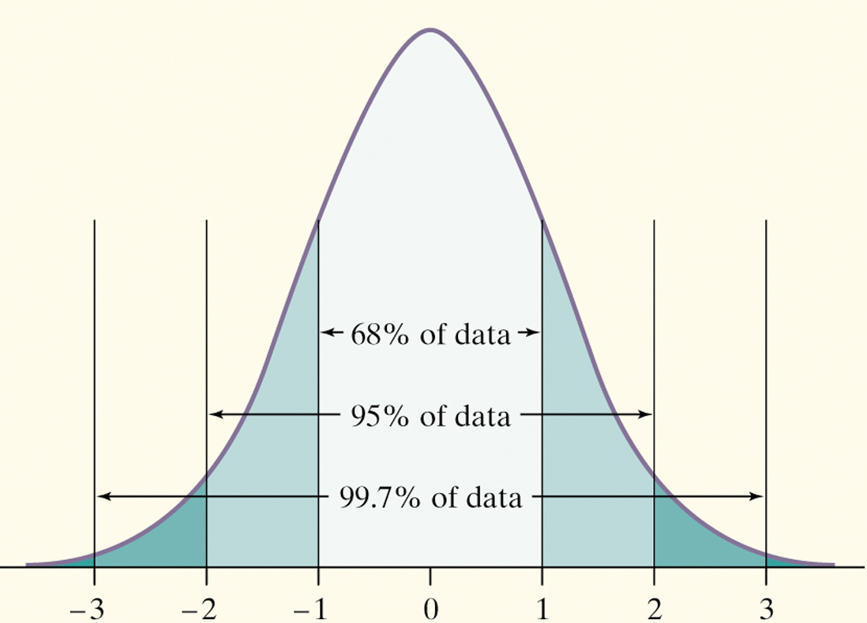
The 68-95-99.7 Rule
Although there are many Normal curves, they all have properties in common.
The 68-95-99.7 Rule
In the Normal distribution with mean µ and standard deviation σ:
  Approximately 68% of the observations fall within σ of µ.
  Approximately 95% of the observations fall within 2σ of µ.
  Approximately 99.7% of the observations fall within 3σ of µ.

Slide 13
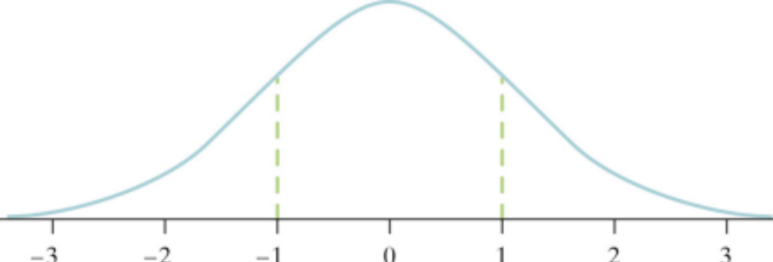
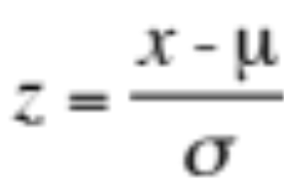
The Standard Normal Distribution
All Normal distributions are the same if we measure in units of size σ from the mean µ as center.
The standard Normal distribution is the Normal distribution with mean 0 and standard deviation 1.
If a variable x has any Normal distribution N(µ,σ) with mean µ and standard deviation σ, then the standardized variable
has the standard Normal distribution, N(0,1).

Slide 14

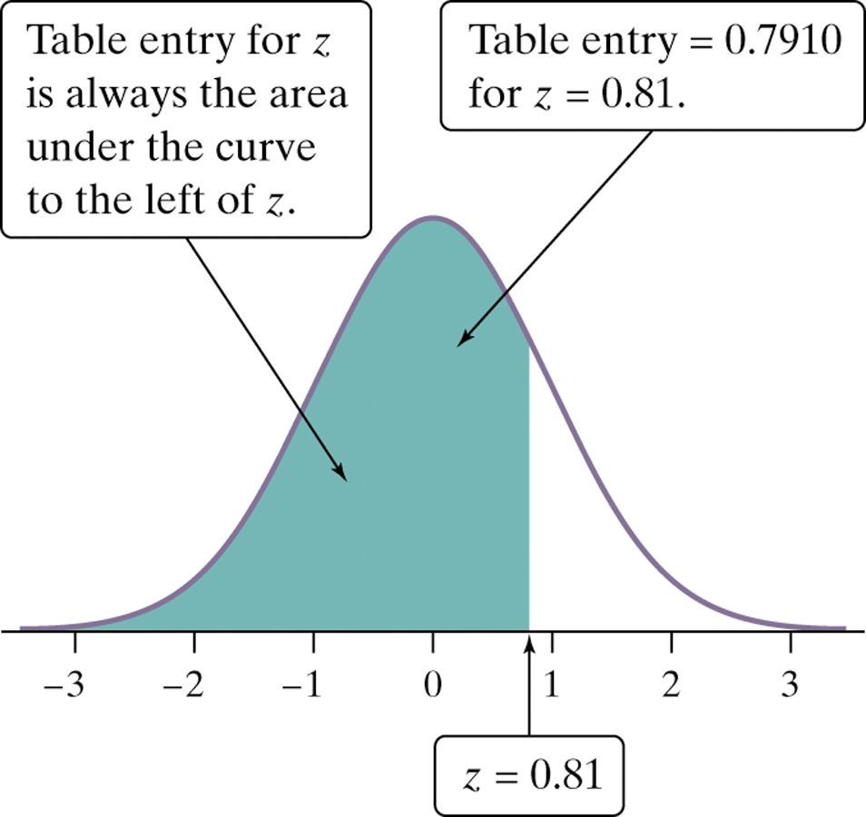
The Standard Normal Table
The standard Normal Table (Table A) is a table of areas under the standard Normal curve. The table entry for each value z is the area under the curve to the left of z.
Suppose we want to find the proportion of observations from the standard Normal distribution that are less than 0.81.
We can use Table A:
P(z < 0.81) =
.7910
Z | .00 | .01 | .02
0.7 | .7580 | .7611 | .7642
0.8 | .7881 | .7910 | .7939
0.9 | .8159 | .8186 | .8212

Slide 15
Normal Distribution Calculations
We can answer a question about areas in any Normal distribution by standardizing and using Table A or by using technology.
How To Find Areas In Any Normal Distribution
Step 1: State the distribution and the values of interest. Draw a Normal curve with the area of interest shaded and the mean, standard deviation, and boundary value(s) clearly identified.
Step 2: Perform calculations—show your work! Do one of the following: (i) Compute a z-score for each boundary value and use Table A or technology to find the desired area under the standard Normal curve; or (ii) use the normalcdf command and label each of the inputs.
Step 3: Answer the question.

Slide 16
Working Backwards: Normal Distribution Calculations
Sometimes, we may want to find the observed value that corresponds to a given percentile. There are again three steps.
How To Find Values From Areas In Any Normal Distribution
Step 1: State the distribution and the values of interest. Draw a Normal curve with the area of interest shaded and the mean, standard deviation, and unknown boundary value clearly identified.
Step 2: Perform calculations—show your work! Do one of the following: (i) Use Table A or technology to find the value of z with the indicated area under the standard Normal curve, then “unstandardize” to transform back to the original distribution; or (ii) Use the invNorm command and label each of the inputs.
Step 3: Answer the question.

Slide 17
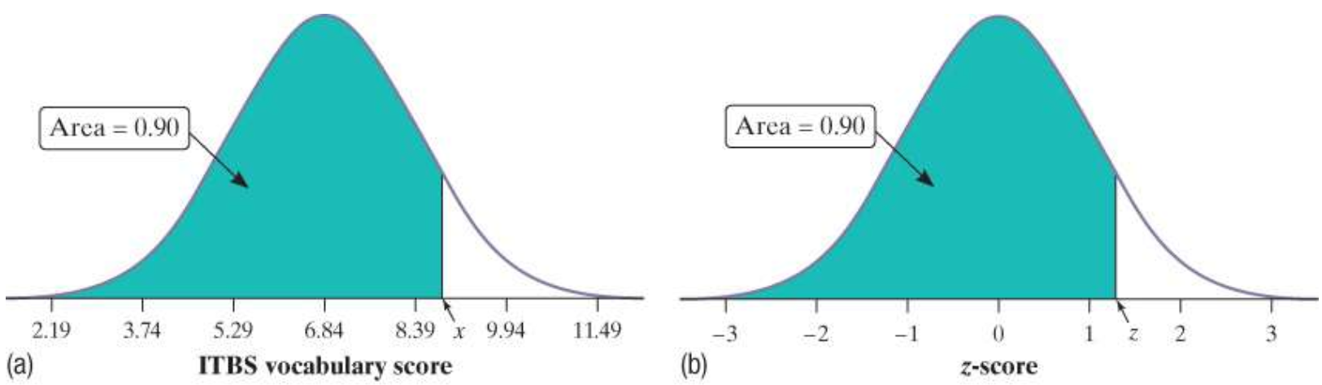
Working Backwards: Normal Distribution Calculations
For instance, suppose we want to estimate the 90th percentile of the distribution of ITBS vocabulary scores for Gary, Indiana, seventh-graders. The figure (a) shows the Normal curve with mean μ=6.84 and standard deviation σ=1.55 that models this distribution. We’re looking
for the ITBS score x that has 90% of the area to its left. The figure (b) shows the standard Normal distribution with the corresponding area shaded.

Slide 18
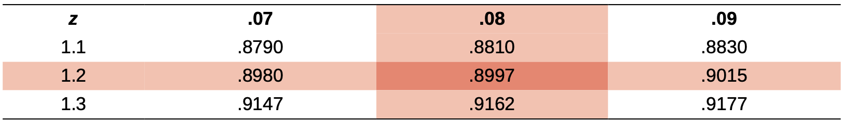
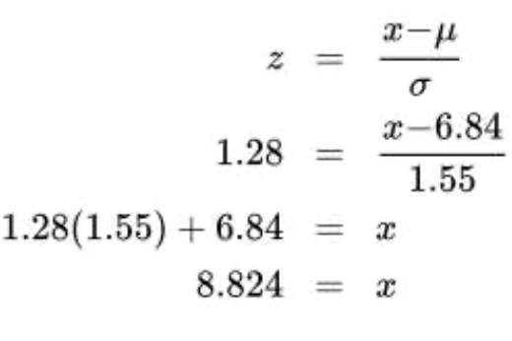
Working Backwards: Normal Distribution Calculations
We can use Table A or technology to find the z-score with an area of 0.90 to its left. Because Table A gives the area to the left of a specified z-score, all we have to do is find the value closest to 0.90 in the middle of the table. From the reproduced portion of Table A, you can see that the desired value is z=1.28. Then we “unstandardize” to get the corresponding ITBS vocabulary score x.
So the 90th percentile of the distribution of ITBS vocabulary scores for Gary, Indiana, seventh-graders is 8.824.

Slide 19
Exercises
Many studies on automobile safety suggest that when automobile drivers must make emergency stops, the stopping distances follow an approximately Normal distribution. Suppose that for one model of car traveling at 62 mph under typical conditions on dry pavement, the mean stopping distance is μ=155 ft, with a standard deviation of σ=3 ft.
a. About what percent of cars of this model would take more than 158 feet to make an emergency stop? Show your method clearly.
b. A car of this model that takes 158 feet to make an emergency stop would be at about what percentile of the distribution? Justify your answer.

Slide 20
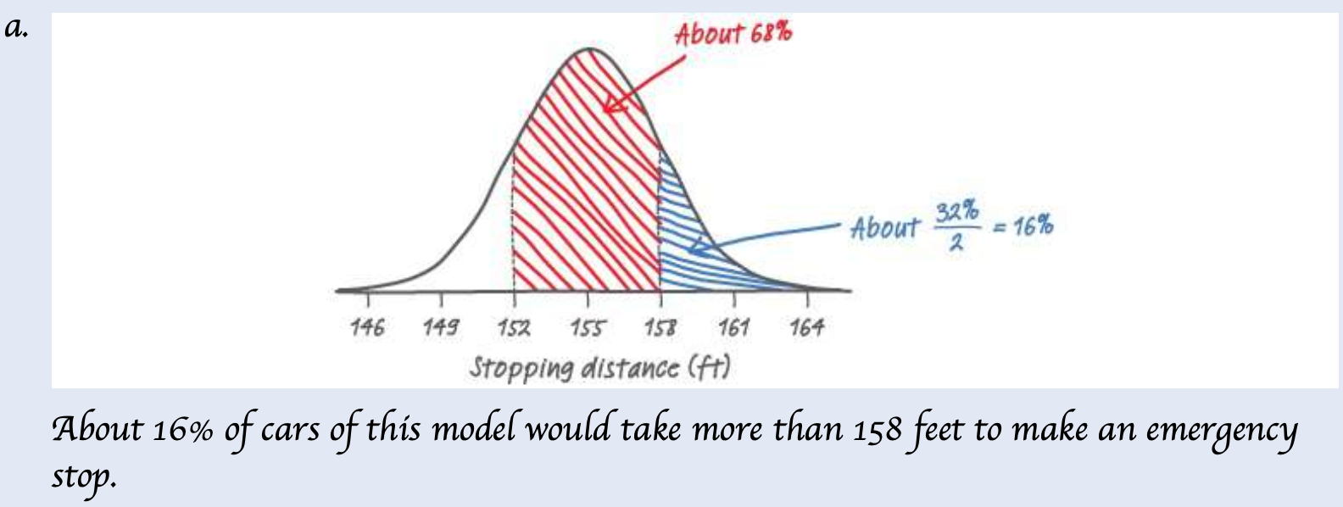
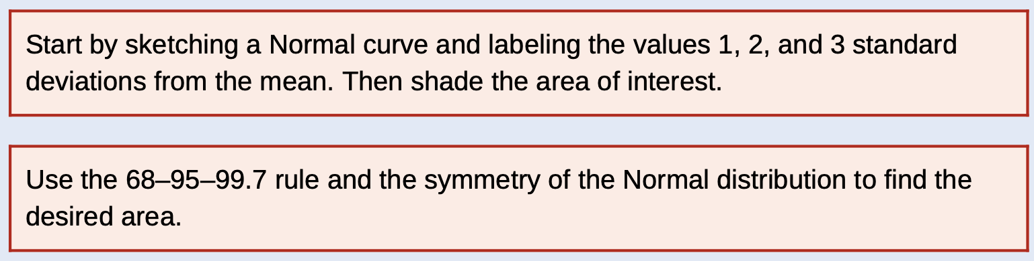
Exercises
b. About the 84th percentile because about 100%−16%=84% of cars of this model would stop in less than 158 feet.

Slide 21
Exercises
As noted in the preceding example, studies on automobile safety suggest that stopping distances follow an approximately Normal distribution. For one model of car traveling at 62 mph, the mean stopping distance is μ=155 ft with a standard deviation of σ=3 ft. Danielle is driving one of these cars at 62 mph when she spots a wreck 160 feet in front of her and needs to make an emergency stop. About what percent of cars of this model when going 62 mph would be able to make an emergency stop in less than 160 feet? Is Danielle likely to stop safely?

Slide 22
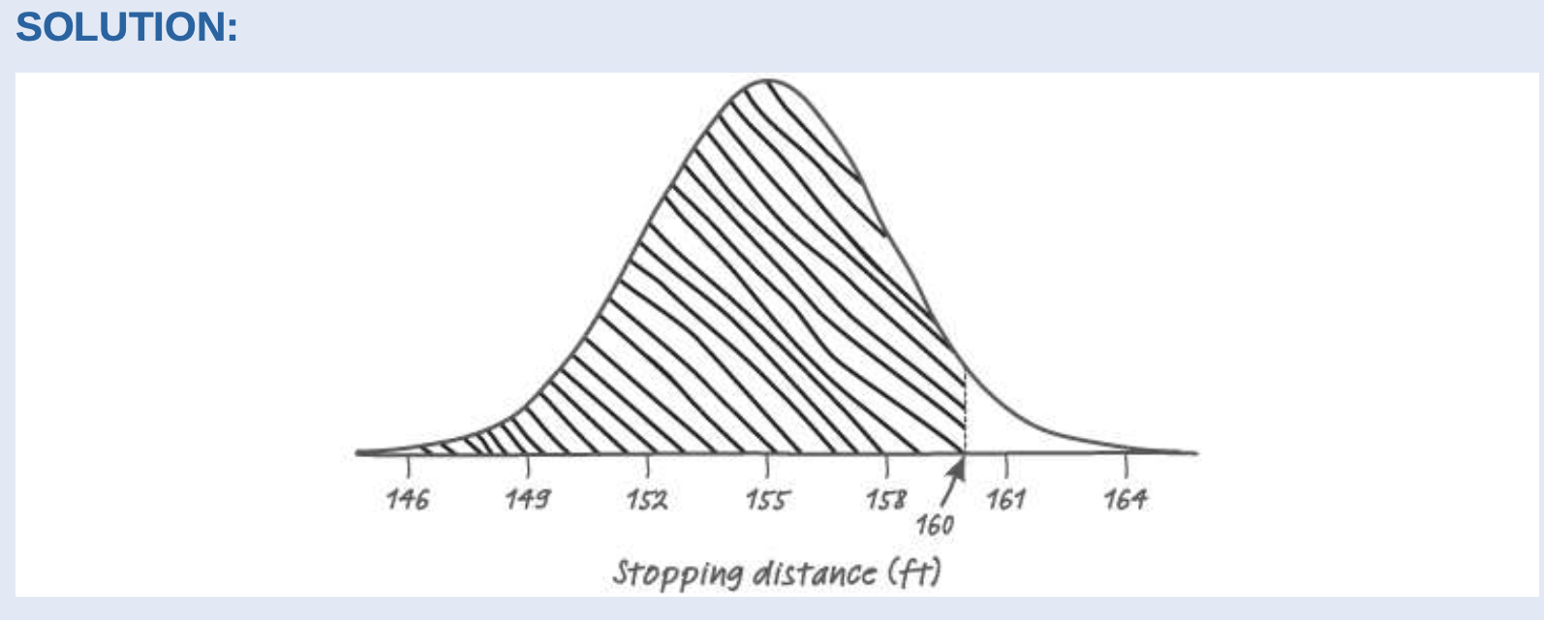

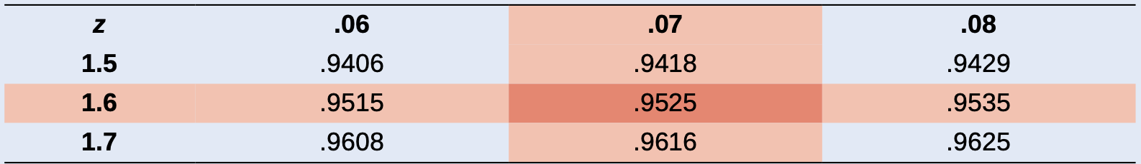
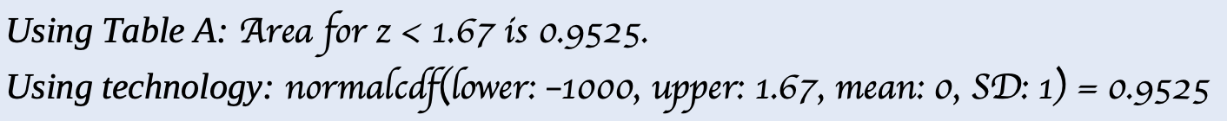
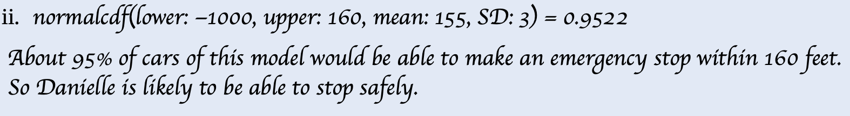
Exercises

Slide 23
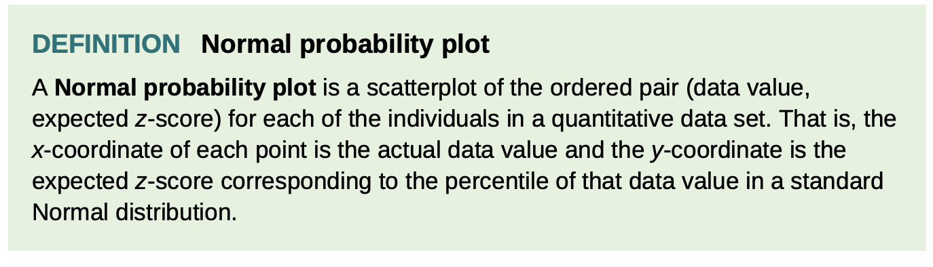
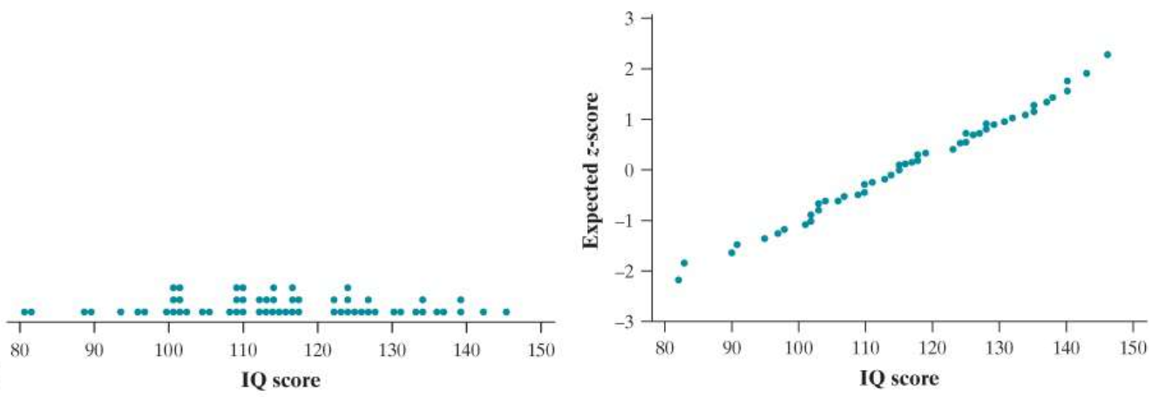
Normal probability plot

Slide 24
Assessing Normality
The Normal distributions provide good models for some distributions of real data.
Many statistical inference procedures are based on the assumption that the population is approximately Normally distributed.
A Normal probability plot provides a good assessment of whether a data set follows a Normal distribution.
Interpreting Normal Probability Plots
If the points on a Normal probability plot lie close to a straight line, the plot indicates that the data are Normal.
Systematic deviations from a straight line indicate a non-Normal distribution.
Outliers appear as points that are far away from the overall pattern of the plot.

Slide 25
Density Curves and Normal Distributions
ESTIMATE the relative locations of the median and mean on a density curve.
ESTIMATE areas (proportions of values) in a Normal distribution.
FIND the proportion of z-values in a specified interval, or a z-score from a percentile in the standard Normal distribution.
FIND the proportion of values in a specified interval, or the value that corresponds to a given percentile in any Normal distribution.
DETERMINE whether a distribution of data is approximately Normal from graphical and numerical evidence.

