Slide 1
BASICS IN JAVA
-M.MOSESH PAUL RAJ

Slide 2
TABLE OF CONTENTS
DATA TYPES
OBJECT
ACCESS MODIFIERS
TYPE CASTING
RECURSION

Slide 3
Primitive
A primitive data type specifies the size and type of variable values, and it has no additional methods.
DATA TYPE | DEFAULT SIZE | DESCRIPTION
boolean | 1 bit | Stores true or false values
char | 2 byte | Stores a single character/letter or ASCII values
byte | 1 byte | Stores whole numbers from -128 to 127
short | 2 byte | Stores whole numbers from -32,768 to 32,767
int | 4 byte | Stores whole numbers from -2,147,483,648 to 2,147,483,647
long | 8 byte | Stores whole numbers from -9,223,372,036,854,775,808 to 9,223,372,036,854,775,807
float | 4 byte | Stores fractional numbers. Sufficient for storing 6 to 7 decimal digits
double | 8 byte | Stores fractional numbers. Sufficient for storing 15 decimal digits

Slide 4
Primitive Example
class Primitive{
public static void main(String[] args){
int a = 10;
int b = a;
System.out.println(a);
System.out.println(b);
a=5;
System.out.println(a);
System.out.println(b);
}
}
Output
10
10
5
10

Slide 5
Non-Primitive
Non-primitive types store references to the memory locations where the actual data is held
Primitive types are predefined (already defined) in Java. Non-primitive types are created by the programmer and is not defined by Java (except for string).
Examples of non-primitive types are String, Arrays, Classes,Interface, etc.
wrapper classes in Java are also considered as non-primitive types.
byte - Byte
short - Short
int - Integer
long - Long
float - Float
double - Double
char - Character
boolean - Boolean

Slide 6
Non-Primitive Example
public class ReferenceExample{
public static void main(String[] args){
int[] array1 = {10,20,30};
int[] array2 = array1;
System.out.println(array1[0]);
System.out.println(array2[0]);
array1[0]=50;
System.out.println(array1[0]);
System.out.println(array2[0]);
}
}
Output
10
10
50
50

Slide 7
OBJECT
An entity that has state and behavior is known as an object e.g., chair, bike, marker, pen, table, car, etc.
There are three steps when creating an object from a class:
Declaration: A variable declaration with a variable name with an object type.
Instantiation: The 'new' key word is used to create the object.
Initialization: The 'new' keyword is followed by a call to a constructor. This call initializes the new object.
General syntax : ClassName objectName = new ClassName();
For Example, Pen is an object. Its name is Reynolds; color is white, known as its state. It is used to write, so writing is its behavior.

Slide 8
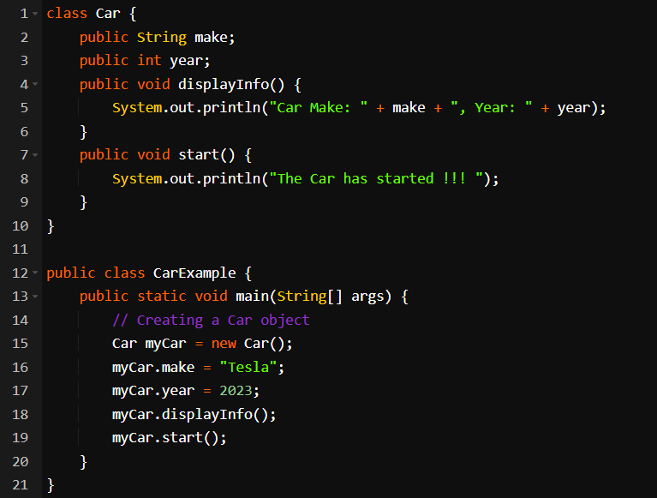

EXAMPLE

Slide 9
ACCESS MODIFIERS
The access modifiers in Java specifies the accessibility or scope of a field, method, constructor, or class.
Private : Class only
default : Package only
Protected : Package + All subclasses
public: Everywhere

Slide 10
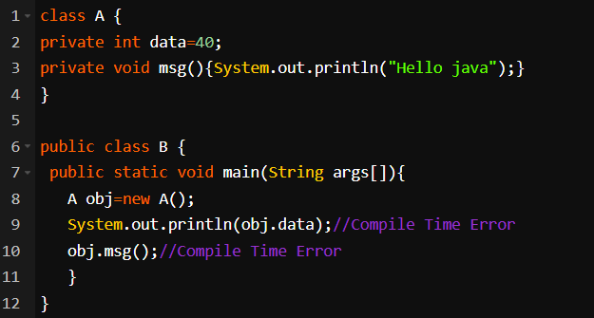
PRIVATE
The private access modifier is accessible only within the class.

Slide 11
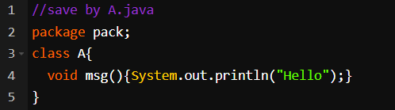
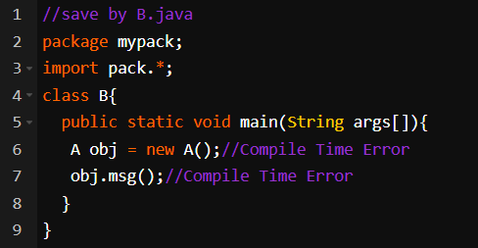
DEFAULT
If you don't use any modifier, it is treated as default by default. The default modifier is accessible only within package. It cannot be accessed from outside the package. It provides more accessibility than private

Slide 12
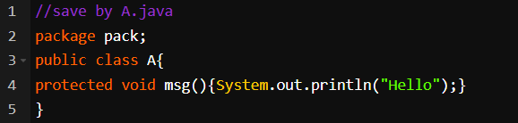
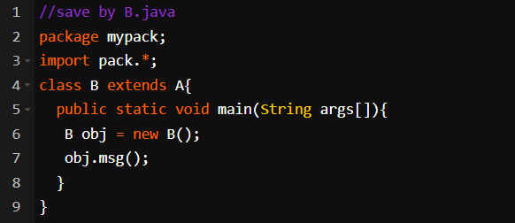
PROTECTED
The protected access modifier is accessible within package and outside the package but through inheritance only.

Slide 13
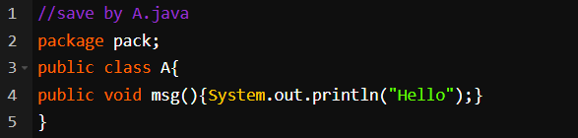
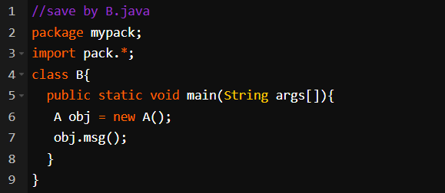
PUBLIC
The public access modifier is accessible everywhere. It has the widest scope among all other modifiers.

Slide 14
Let's understand the access modifiers in Java by a simple table
Access Modifier | Within class | Within package | Outside package by subclass only | Outside package
private | YES | NO | NO | NO
default | YES | YES | NO | NO
protected | YES | YES | YES | NO
public | YES | YES | YES | YES

Slide 15
TYPE CASTING
Type casting is the process of converting a value from one data type to another.
Types of Type Casting :
Implicit Casting (Widening Conversion)
Automatic conversion by Java.
From a smaller to a larger data type.
Explicit Casting (Narrowing Conversion)
Requires manual intervention using a cast operator.
From a larger to a smaller data type.

Slide 16
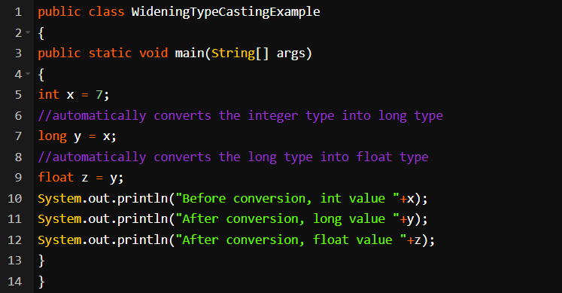
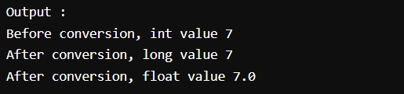
Implicit Casting
Happens automatically when storing a value of a smaller data type into a variable of a larger data type.
Example :

Slide 17
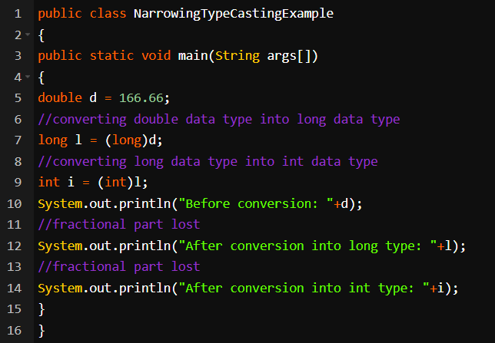
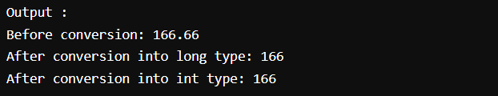
Explicit Casting
Must be done manually by placing the target type in parentheses in front of the value to be converted.
Example :

Slide 18
RECURSION
Recursion in Java is the process in which a method calls itself directly or indirectly. It's a powerful technique used to solve problems that can be broken down into smaller, similar subproblems.
Syntax :
returntype methodname(){
//code to be executed
methodname();//calling same method
}
recursion in Java can be broadly categorized into two types based on how the method calls itself,
Direct Recursion
Indirect recursion

Slide 19
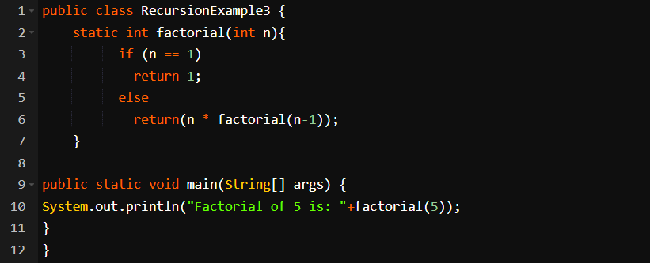

Direct Recursion
In direct recursion, a function calls itself directly.
It's the most common form of recursion.
Example :

Slide 20
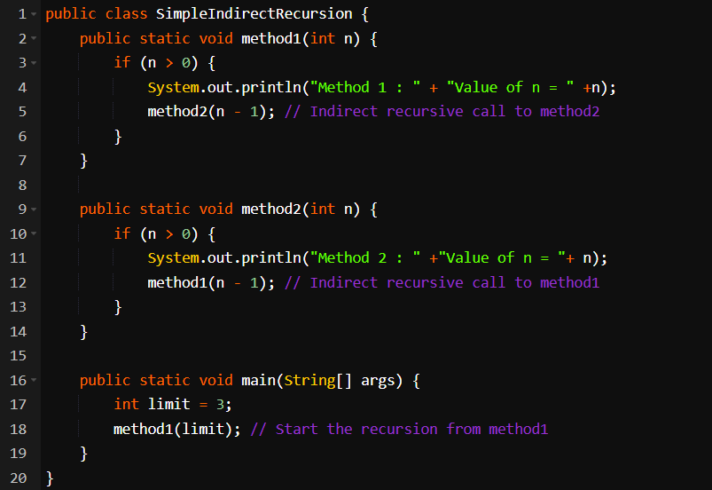
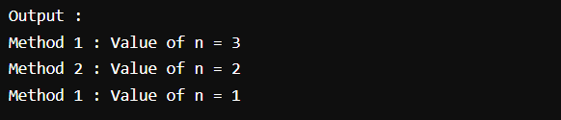
Indirect Recursion
In indirect recursion, function A calls function B, and function B calls function A (either directly or indirectly). It involves multiple functions calling each other in a circular manner.
Example :

Slide 21
THANK YOU

