Slide 1
Report On Machine Learning
Presented By :- Moses J
ENG19CS0187
CSE ‘D’ Section
Dayananda Sagar University

Slide 2
Outline & Content
1.Introduction to Machine Learning
2.Supervised,Unsupervised and reinforcement Learning.
3.Data warehouse and Data Mining
4.Implementing all Machine Learning Algorithm
5.Applications of ML in different domains-health care and telecom.

Slide 3
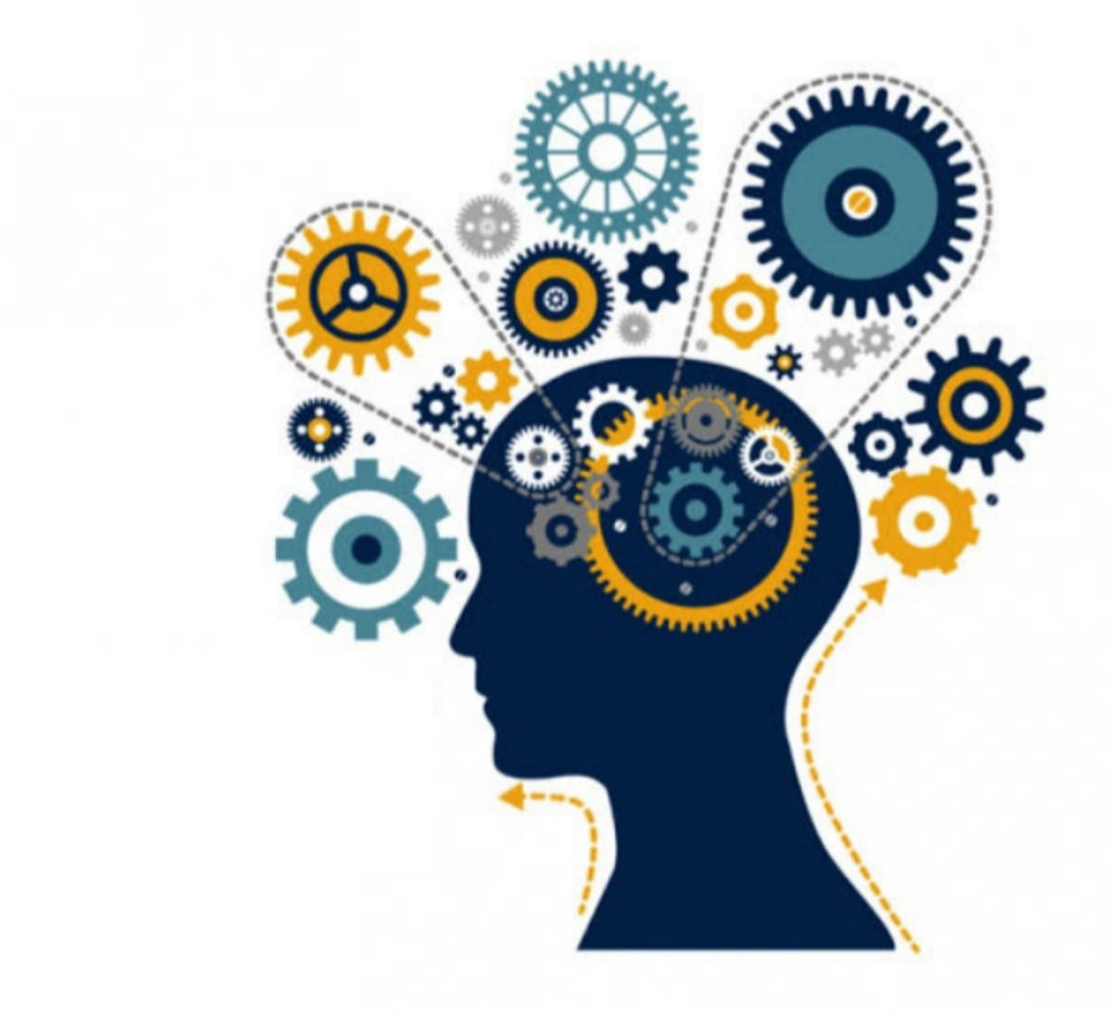
Machine learning
Machine learning is a subset of artificial intelligence which renders computer
to learn and act like humans by feeding data and information without being explicitly programmed.
As intelligence requires knowledge ,it is necessary for the computers to acquire knowledge.
Machine learning is a algorithm that has ability to learn from past experiences.

Slide 4
Introduction to Machine Learning
Supervised learning - Train Me!!
Unsupervised Learning - I am self sufficient in learning
Reinforcement Learning - My Life My rules(Hit & Trial)!

Slide 5
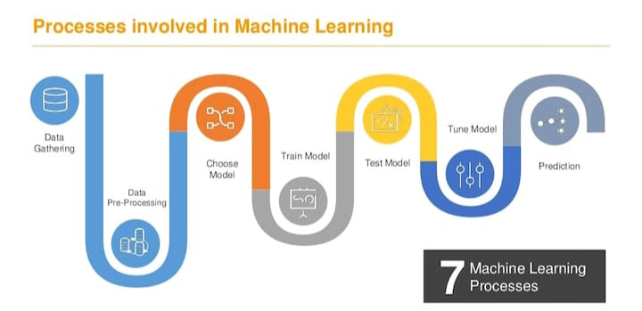

Slide 6
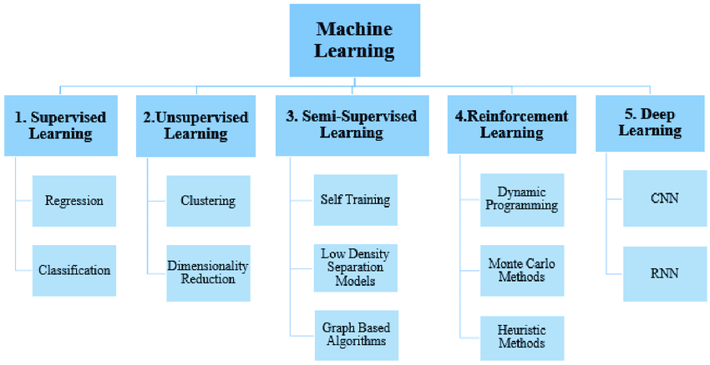
Types of machine learning

Slide 7
Supervised learning

Slide 8
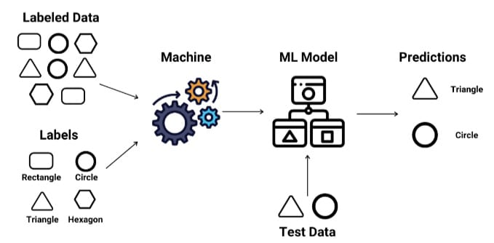
Supervised Learning is a type of machine learning where we will teach the machine using labelled data/trained data.
Here the machine will be rendered with a label set of input and output data in the training phase itself.

Slide 9
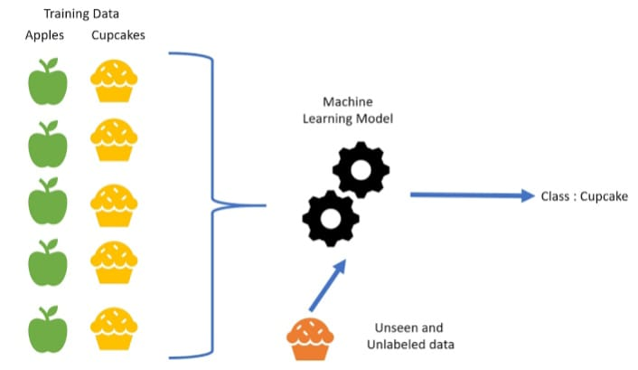
The machine feds training data where both the input and output is label and only thing the algo is to do is to map the input to the output so training data is acting like a teacher or a guide.so once algo is trained and then it is tested with its new data.

Slide 10
Unsupervised learning

Slide 11
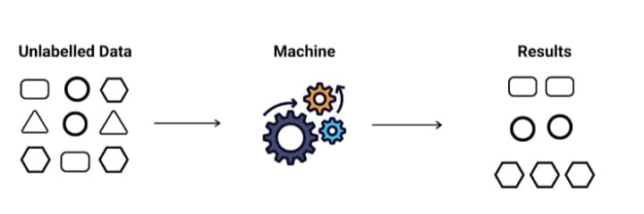
In Unsupervised Learning the machine is trained on unlabelled data without any guidance.
The machine has to figure out the data set given on its own since there is no supervisor and it has to find the hidden patterns in order to make predictions about the output.

Slide 12
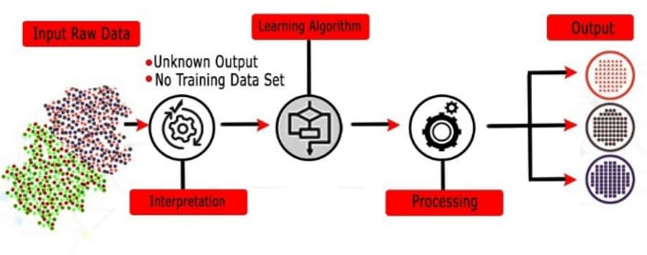
This type of problems can be used to solve association problems and clustering problems
Here machine is only given the input data so here the system has to understand itself from the input data that we gave to it does by finding patterns in the data

Slide 13
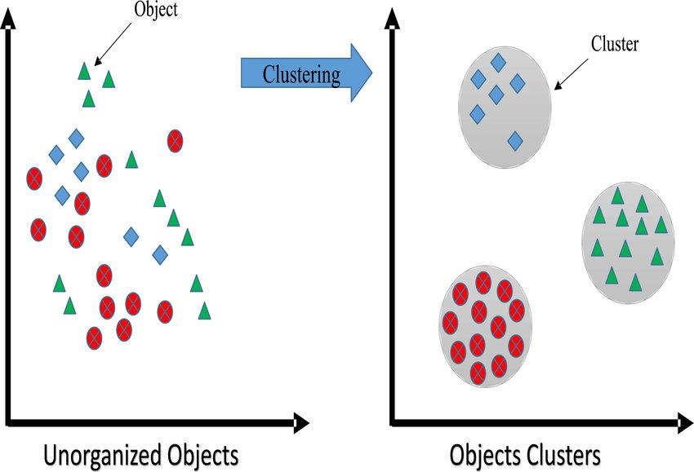

Slide 14
Reinforcement Learning

Slide 15
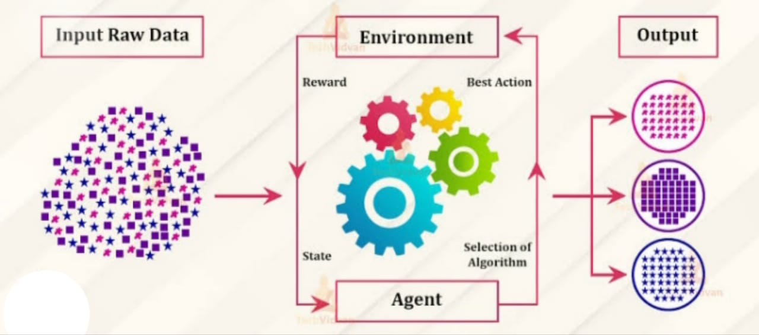
In Reinforcement Learning an agent interacts with its environment by producing actions and discovers errors or rewards.
Since there is no predefined data given to the machine it has to learn everything on its own and its starts by exploring and collecting data and the whole reinforcement learning process itself is training and testing phase.

Slide 16
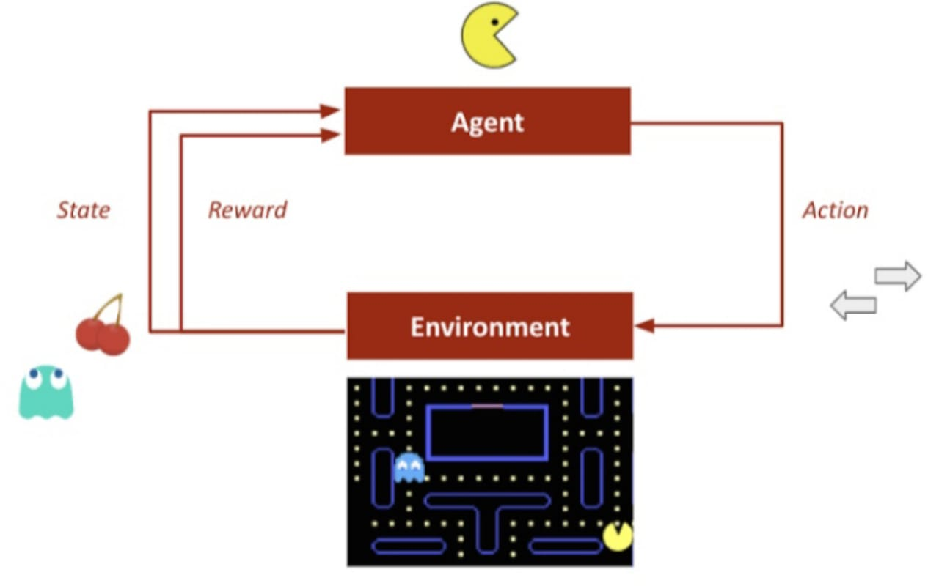

Slide 17
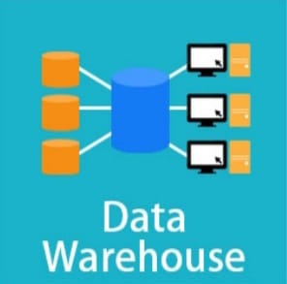
Data Warehouse

Slide 18
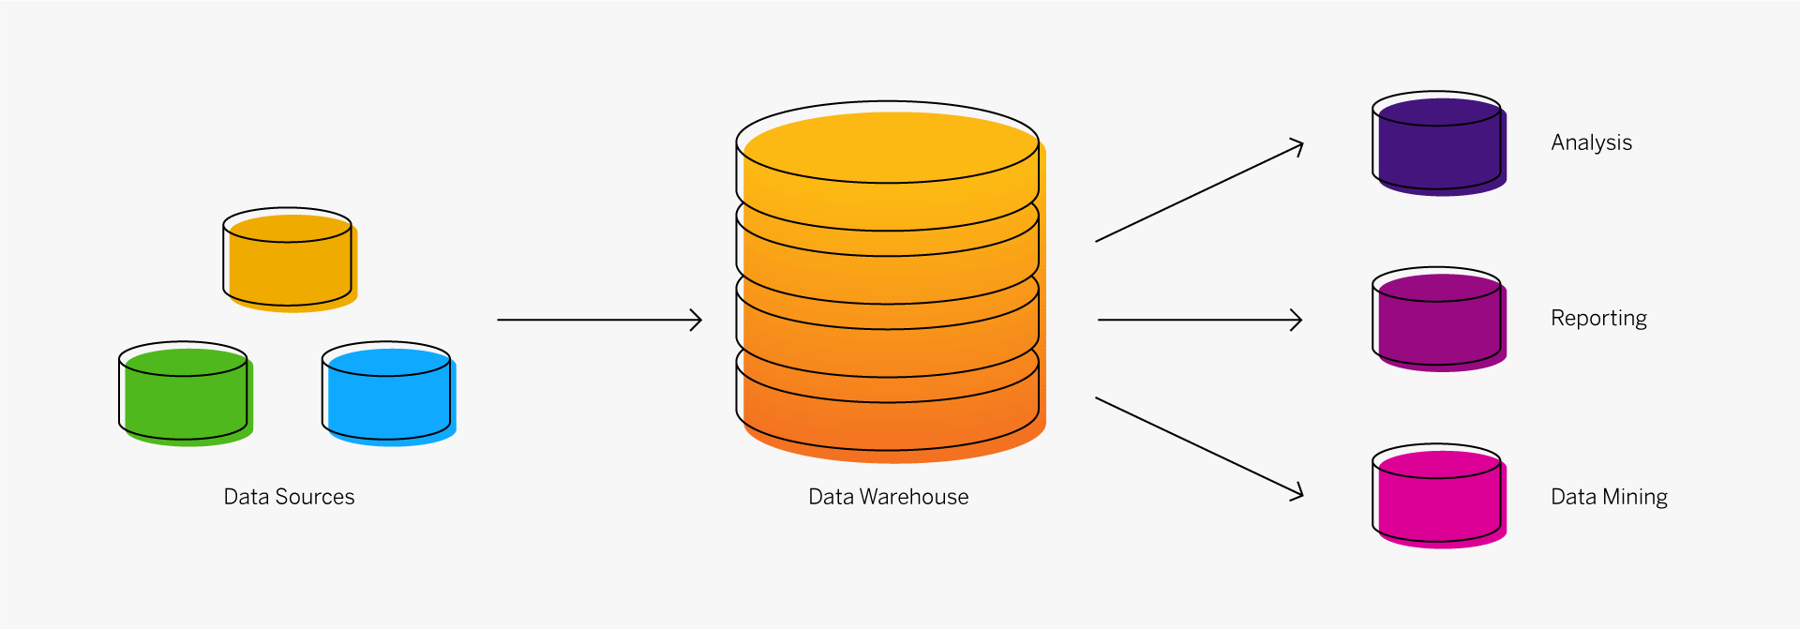
Data warehousing is combining data from multiple sources into one comprehensive and easily manipulated database.
The primary aim for data warehousing is to provide businesses with analytics results from data mining, OLAP, Scorecarding and reporting.

Slide 19
Need for Data warehouse
Information is now considered as a key for all the works.
Those who gather, analyze ,understand, and act upon information are winners.
Information have no limits,it is very hard to collect information from various sources, so we need an data warehouse from where we can get all the information.

Slide 20
DATA WAREHOUSING INCLUDES:-
Retrieving data
Analyzing data
Extracting data
Loading data
Transforming data
Managing data

Slide 21
DATA WAREHOUSE ARCHITECTURE
Data warehousing is designed to provide an architecture that will make cooperate data accessible and useful to users.
There is no right or wrong architecture.
The worthiness of architecture can be judged by its use and concept behind it.
Data warehouse can be architected in many different ways depending on the specific needs of business.

Slide 22
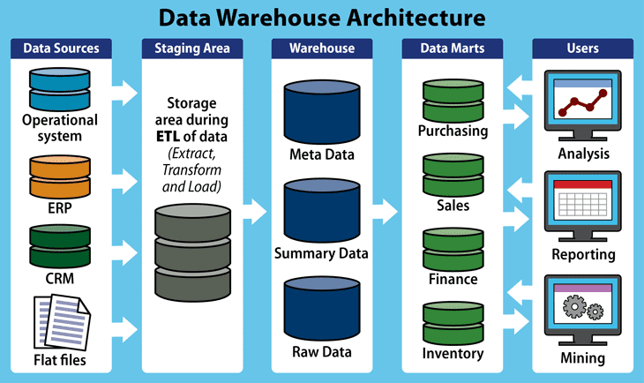

Slide 23
Operational systems
An operational data store (ODS) is basically a database that is used for being an temporary storage area for a data warehouse.
Its primary purpose is for handling data which are progressively in use.
Operational data store contains data which are constantly updated through the course of the business operations

Slide 24
ETL Process
ETL (Extract, Transform, Load) is used to copy data from:-
ODS to data warehouse staging area.
Data warehouse staging area to data warehouse.
Data warehouse to data mart.
ETL extracts data, transforms values of inconsistent data, cleanses "bad" data, filters data and loads data into a target database.

Slide 25
DW Staging Area
The Data Warehouse Staging Area is temporary location where data from source systems is copied.
It increases the speed of data warehouse architecture
It is very essential since data is increasing day by day.

Slide 26
Data Warehouse
The purpose of the Data Warehouse is to integrate corporate data
The amount of data in the Data Warehouse is massive. Data is stored at a very deep level of detail
This allows data to be grouped in unimaginable ways.
Data Warehouses does not contain all the data in the organization ,It's purpose is to provide base that are needed by the organization for strategic and tactical decision making.

Slide 27
Data Marts
ETL extract data from the Data Warehouse and send to one or more Data Marts for use of users.
Data marts are represented as shortcut to a data warehouse ,to save time
It is just an partition of data present in data warehouse.
Each Data Mart can contain different combinations of tables, columns and rows from the Enterprise Data Warehouse

Slide 28
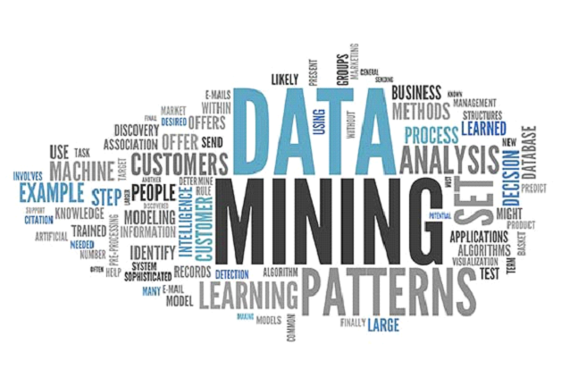
Data Mining

Slide 29
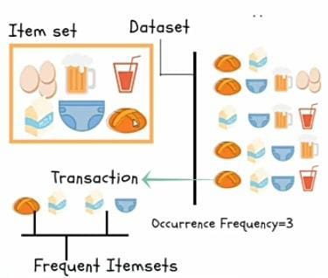
The non-trivial extraction of implicit, previously unknown, and potentially useful information from large databases.
Extremely large datasets
Useful knowledge that can improve processes
Cannot be done manually

Slide 30
How does data mining work?
Extract, transform, and load transaction data onto the data warehouse system
Store and manage the data in a multidimensional database system
Provide data access to business analysts and information technology professionals.
Analyze the data by application software.
Present the data in a useful format, such as a graph or table

Slide 31
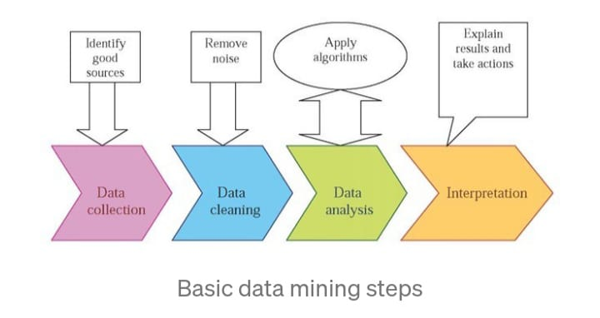

Slide 32
DATA MINING MEASURES
Accuracy
Clarity
Dirty Data
Scalability
Speed
Validation

Slide 33
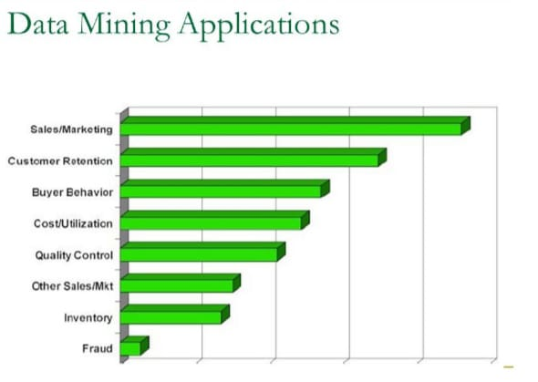

Slide 34
Linear regression

Slide 35
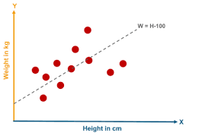
Linear regression is supervised learning approach to find relationship between one or more independent variables(predictions) denoted as x and dependent variables(target) denoted as y.
It can be used for the cases where we want to predict some continuous quantity

Slide 36
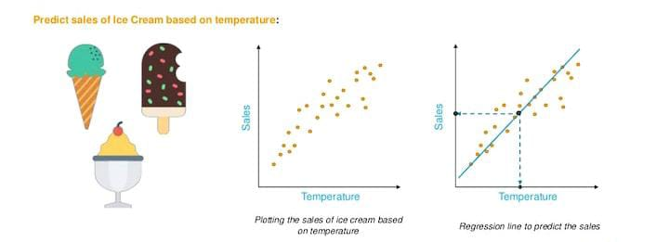
The best fit line can be found out by minimizing the distance between all the data points and the distance between regression line.
The best fit line is known as regression line and represented by a linear equation Y=a*X + b

Slide 37
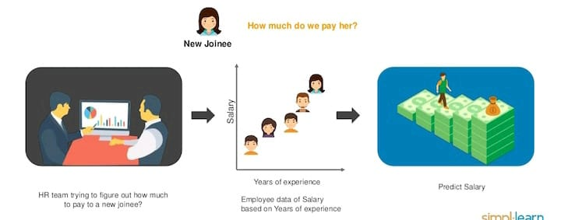
Linear regression : Predict employee salary based on years of experience.

Slide 38
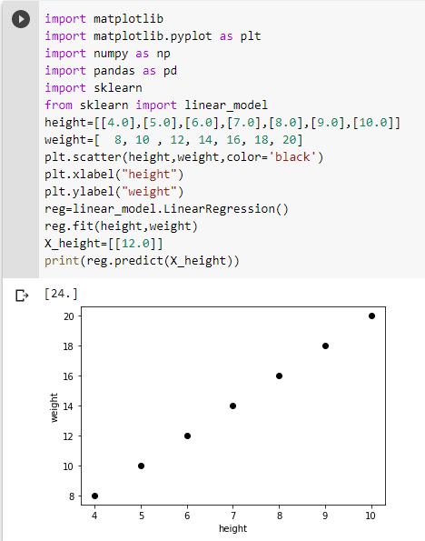
Implementation of Linear Regression

Slide 39
Logistic Regression

Slide 40
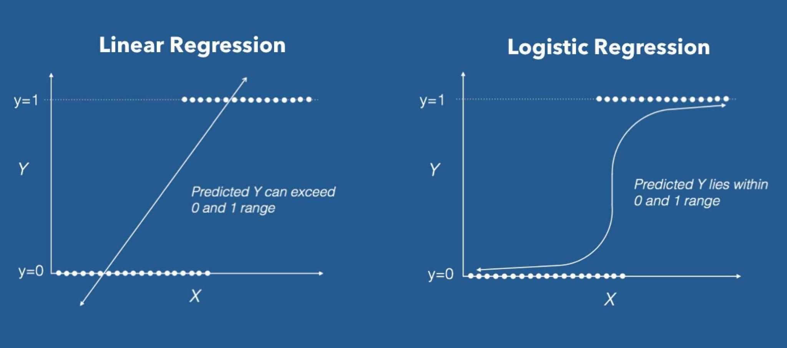
Logistic regression is a classification algorithm used to predict categorical values.
The logistic regression curve is known as the sigmoid curve (S curve)
Logistic regression is a method used to predict a dependent variable, given a set of independent variables,such that the dependent variable is categorical.

Slide 41
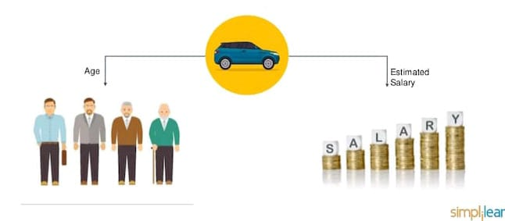
Dependent variable(y)-the response binary variable holding values like 0 or 1,yes or no,A,B or C
Independent variable(x)-the predicted variable used to predict the response variable
Logistic regression :- Predict if a person will buy SUV based on their age and estimated salary.

Slide 42
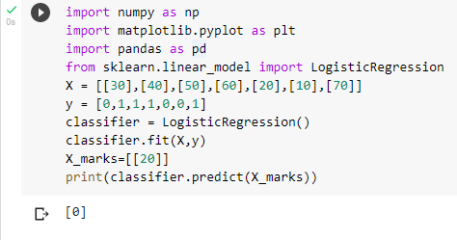
Implementation of Logistic Regression

Slide 43
Decision tree

Slide 44
Decision Tree is a Supervised learning technique that can be used for both classification and Regression problems.
Decision Tree is a tree where each node represents a feature(attribute),each link (branch) represents a decision and each leaf represents an outcome (categorical or continuous value).
In Decision tree there are 2 nodes , which are decision node and leaf node.
Decision tree are model where we break our data by making our decisions using series of conditions(questions).
Rootnode refers to the start of the decisions tree with max split
Node is the condition with multiple outcomes in the tree
Leaf is the final decision of a node from the condition(question)

Slide 45
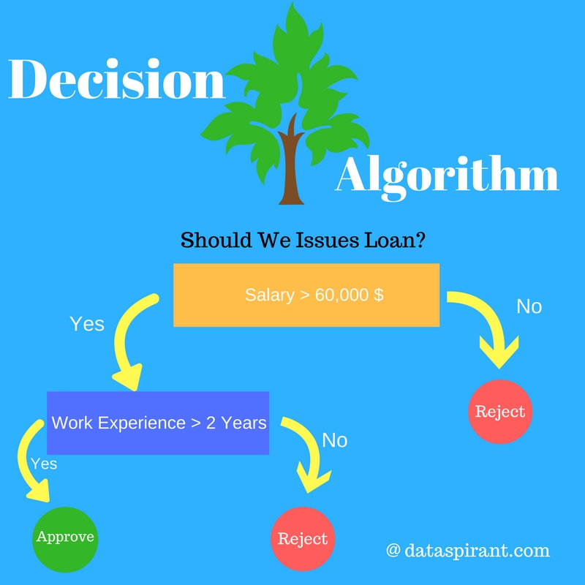

Slide 46
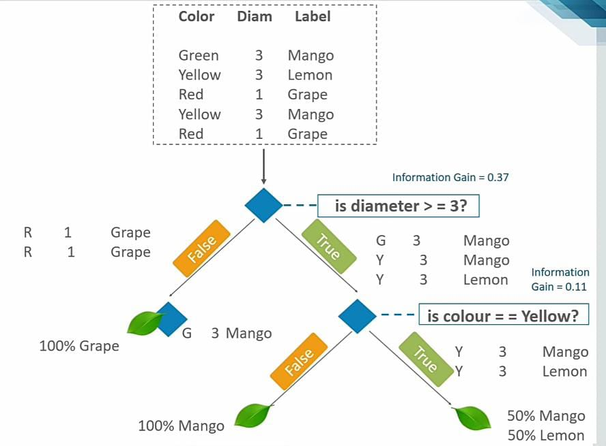

Slide 47
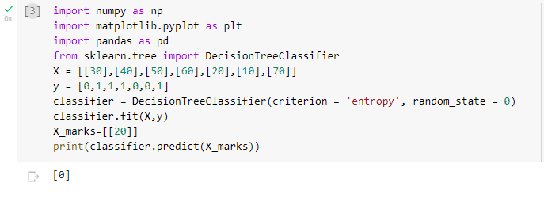
Implementation of Decision tree

Slide 48
Random forest

Slide 49
Random forest or random decision forest is a method that operates by constructing multiple decision trees during the training phase the decision of the majority of the tree choose a random forest as final decision.
Random forest is a machine learning technique that used to solve regression and classification problem.
It utilizes ensemble learning technique that combines many classified decision tree as to provide solutions to Complex problems.
A random forest algorithm consists of many decision trees.

Slide 50
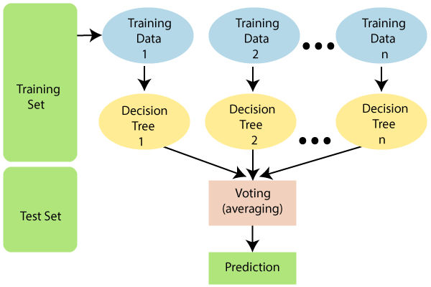

Slide 51
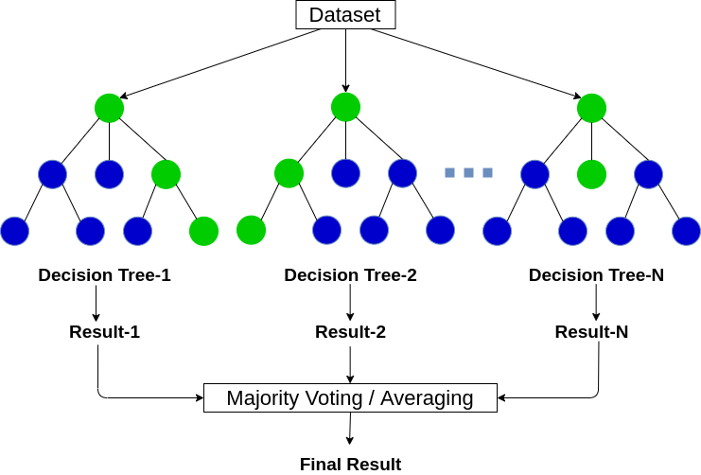

Slide 52
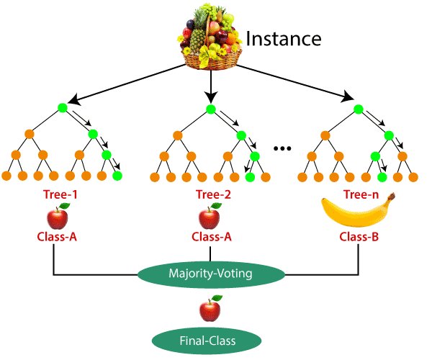

Slide 53
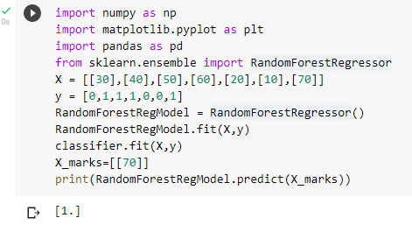
Implementation of Random Forest

Slide 54
KNN(K-nearest neighbour)

Slide 55
KNN is an powerful classification algorithm used in pattern recognization
It classifies a data point based on how its neighbours are classified.
KNN stores all available cases and classifies new cases based on similarity measure.
K in KNN is a parameter that refers to the number of nearest neighbours to include in the majority voting process

Slide 56
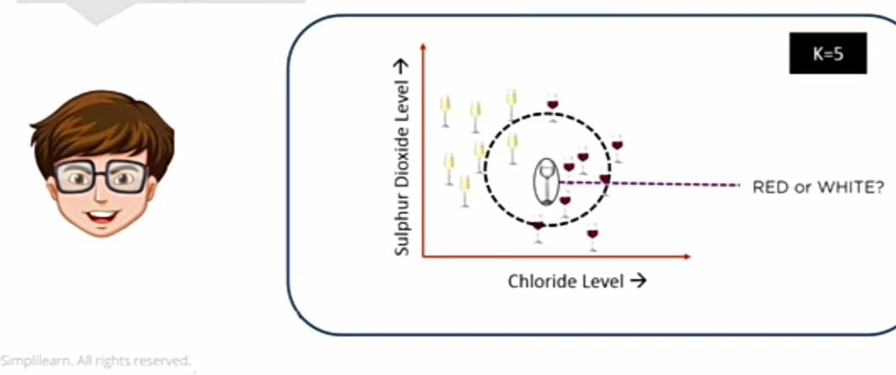
For K=5 here, the unknown point would be classified as red but not white, since there is only 1 white but there 4 out of 5 neighbours are red so the majority voting is considered.

Slide 57
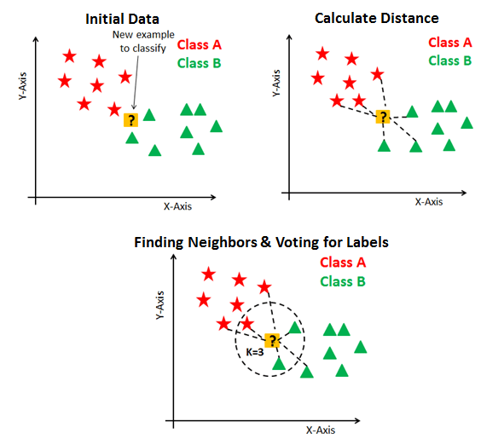

Slide 58
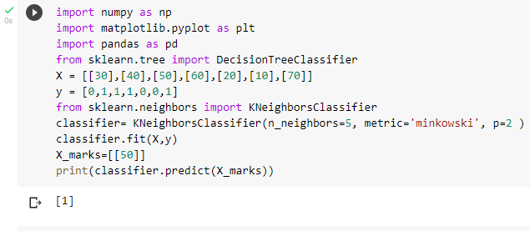
Implementation of KNN

Slide 59
SVM

Slide 60
Support Vector Machine (SVM) is a supervised machine learning algorithm which can be used for both classification or regression challenges
support vector machine is a discriminative classifier which intake training data ,the algorithm outputs and optimal hyperplane which categorises new example.
linear data has large margin classifier
Non linear classification introduced kernel.
In the SVM algorithm, we plot each data item as a point in n-dimensional space with the value of each feature being the value of a particular coordinate. Then, we perform classification by finding the hyper-plane that differentiates the two classes very well.

Slide 61
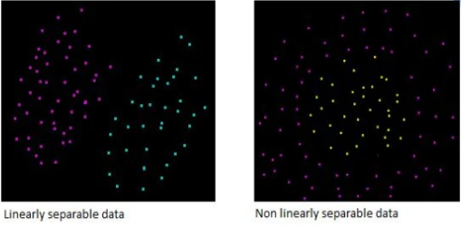
Linear vs NonLinear separable data

Slide 62
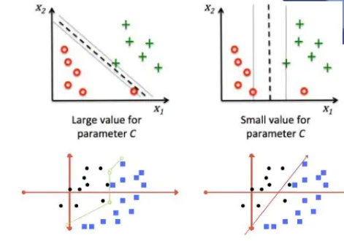
From the below snapshot here hyperplane will create two margin lines which has distance such that it can be easily mauja number such that two lines will be passing through one of the points in either side.

Slide 63
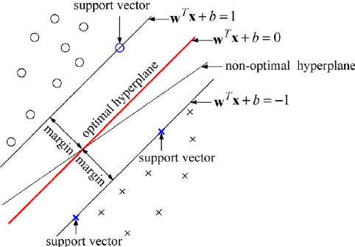

Slide 64
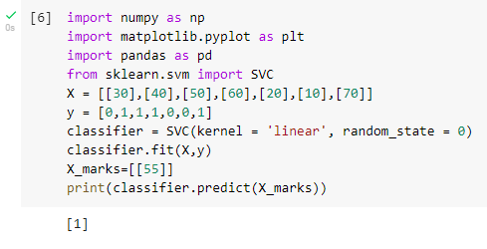
Implementation of SVM

Slide 65
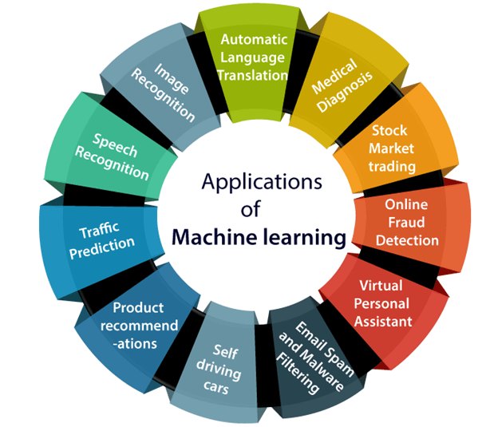
Applications of Machine Learning

Slide 66
Machine Learning for Healthcare

Slide 67
The first machine learning model that's being used in healthcare applications is unsupervised learning
In this technique uses unlabelled data as a training material for the machine learning model
and the most used example for this approach is clustering which is used to segment larger datasets and smaller groups based on similarities and come features between every piece of data and the data set.
unsupervised learning can also be used for anomaly detection the model in this case tries to identify rare and suspicious items within the dataset and usually these items don't fit in any of the subgroups of the dataset.
An example for the healthcare applications of unsupervised learning in real world is the protection of heart diseases by clustering and classification of data.

Slide 68
The second type of machine learning used in healthcare applications is supervised learning.
Supervised learning models uses label data as a training materials and from these label datasets the model learns the association between input and output.
As unsupervised learning every piece of data and the self-consciousness of an input and output in case of object detection the input as a picture and the output as the name of the object so we feed our model large number of examples to Train on, after the training process now the model with its object in any picture can detect it because it drained on a huge number of examples
An example of supervised learning and healthcare applications in real world can be seen in classification of lung nodules and also recognition of body organs from medical images

Slide 69
The third type of machine learning in the healthcare applications is reinforcement learning
Reinforcement learning is the model that tries to achieve a complex objective or goal to maximize a reward function programmed end to end and that is the same type of machine learning used
Autonomous robotic nanofabrication is a type of machine learning was used in the healthcare applications and real world and symptoms checking application for disease diagnosis

Slide 70
Applying Machine Learning to Healthcare
Healthcare sector is being transformed by the ability to record massive amounts of information.
Machine learning provides a way to automatically find patterns and reason about data
It enables healthcare professionals to move to personalized care known as precision medicine.

Slide 71
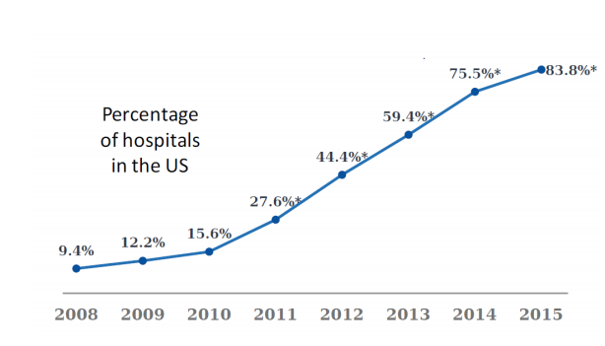
Why to use ML?
Adoption of Electronic Health Records (EHR) has increased 9x since 2008

Slide 72
conti...
Large datasets
MIT Laboratory for Computational Physiology de-identified health data from ~40K critical care patients
Demographics, vital signs, laboratory tests, medications, notes, …
Available data on nearly 230 million unique patients since 1995

Slide 73
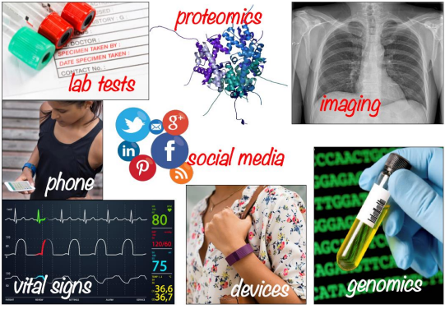
Why to use ML?
1.Diversity of digital health data

Slide 74
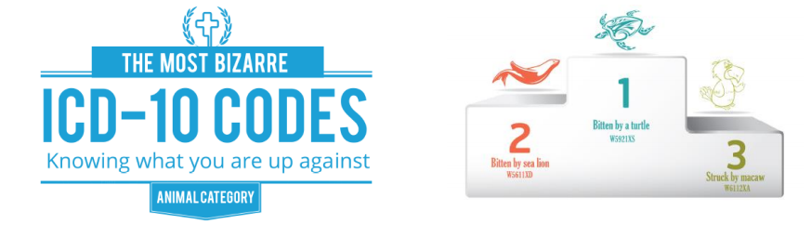
2.Standardization

Slide 75
What can machine learning do for the healthcare industry?
Improve quality of care and population health outcomes,while reducing healthcare costs.
Improve accuracy of diagnosis, prognosis, and risk prediction
Automate detection of relevant findings in pathology, radiology, etc
Discover new medical knowledge.
Reduce medication errors and adverse events.
Model and prevent spread of hospital acquired infections.

Slide 76
Example Application: Improve accuracy of diagnosis and risk prediction
New methods are developed for chronic disease risk prediction and visualization.
These methods give clinicians a comprehensive view of their patient population, risk levels, and risk factors, along with the estimated effects of potential interventions.

Slide 77
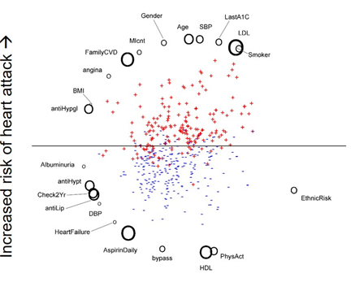

Slide 78
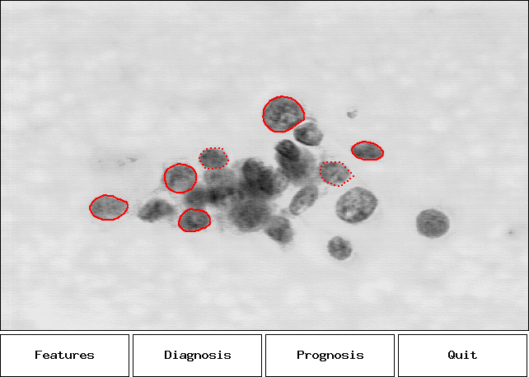
Example Application: Breast Cancer Diagnosis

Slide 79
Machine learning for Telecom

Slide 80
Cognition in Telecom
Memory - store results and outcomes
Learning - Supervised and Unsupervised
Judgement - Cost functions
Perception - Behavioral signature detection
Multi-model - Social network to Radio network
Reasoning - Decision trees and rules.

Slide 81
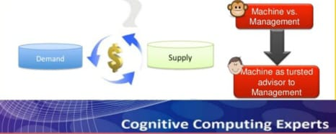
1.Predictions about…
Customers - Behaviour, Experience, chum
Devices-Uptake,Performance,Failure
Networks - Performance,Failure
Services - uptake ,Performance, Failure, Network Impact
2.customer Segmentation and recommendations.

Slide 82
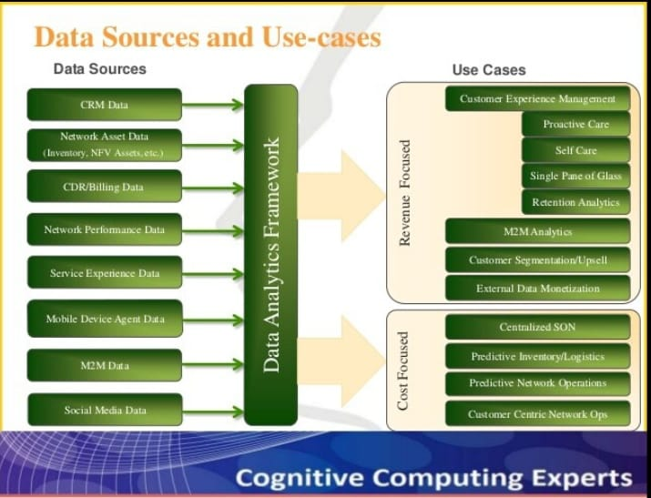

Slide 83


