Slide 1

HealthAware SL
Digital Health Awareness Platform for Sierra Leone
MIT Licensed
SDG 3 · 2 · 6
Open Source DPG
Notes:
Welcome slide. This is HealthAware SL — a Digital Public Good for Sierra Leone. Introduce the team and briefly explain the project context before advancing.

Slide 2
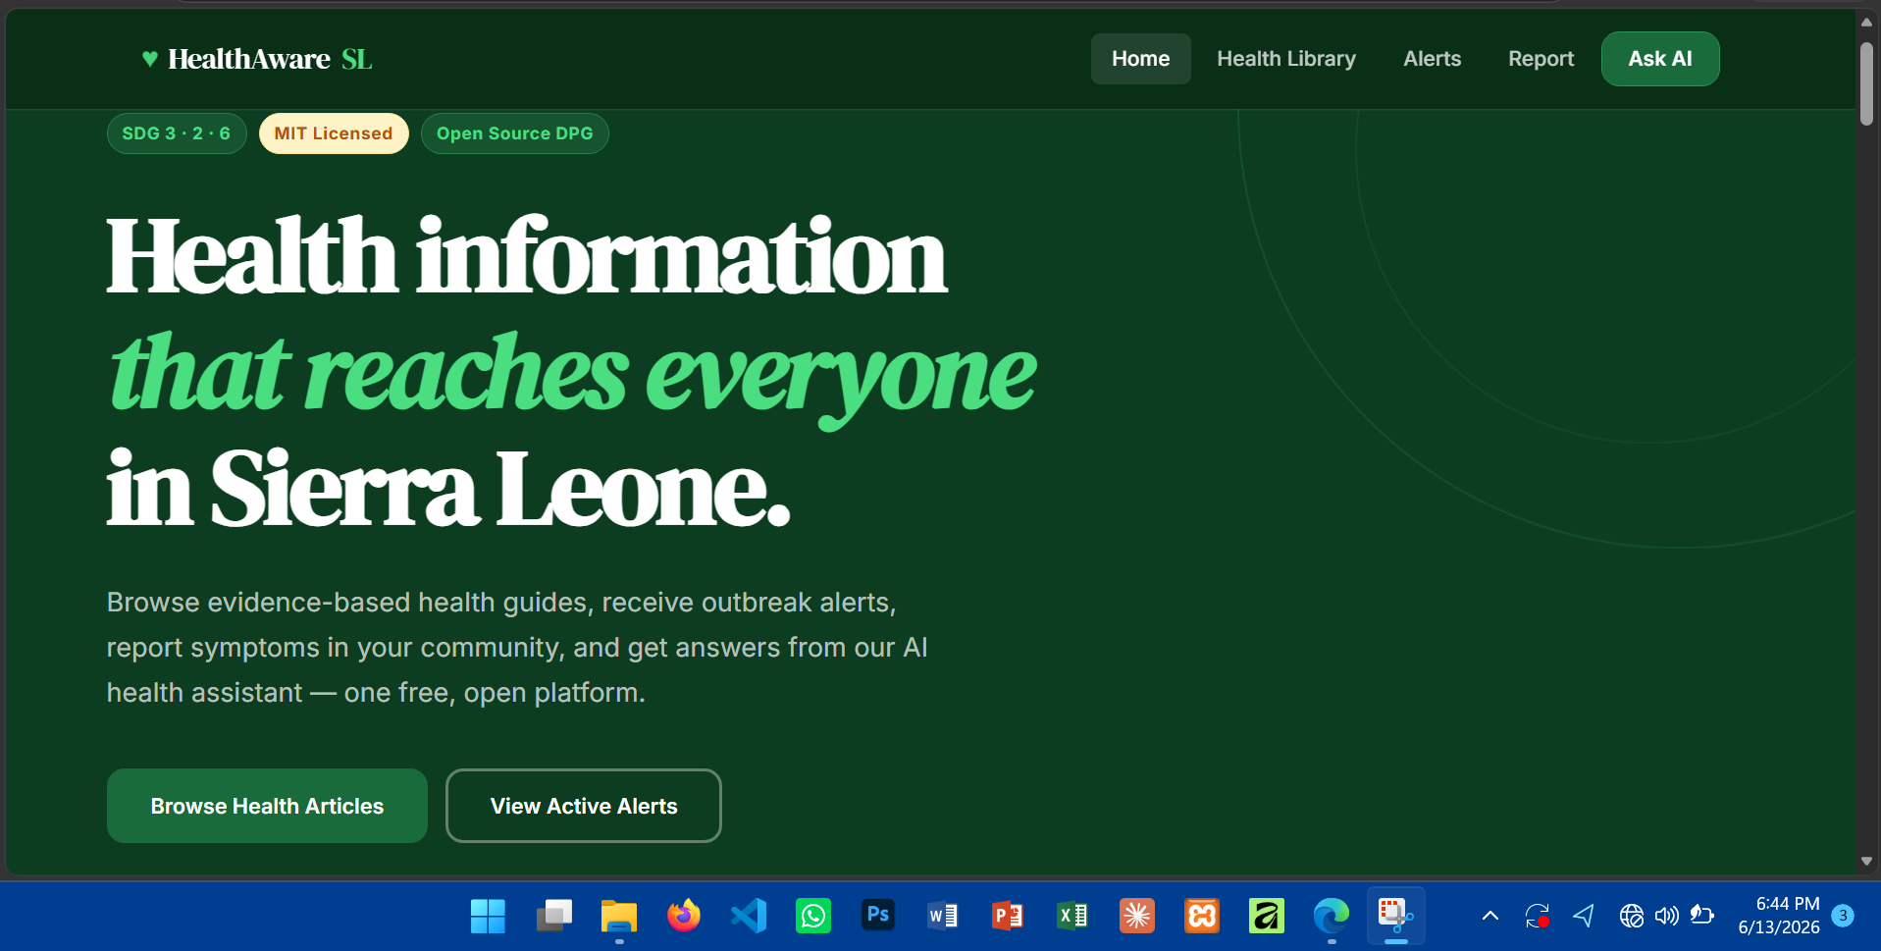

Slide 3
THE
CHALLENGE
#1
Malaria
Sierra Leone faces some of the world's most acute public health challenges, compounded by limited access to timely, accurate health information.
443
Maternal deaths per 100,000 live births (WHO 2023)
33%
A digital public good can bridge this gap.
of under-5 children affected by malnutrition
Notes:
Talk through each statistic and explain why these are not just numbers — they represent preventable deaths and suffering. Emphasise the information gap as a key driver.

Slide 4





Our Solution
Home Dashboard
Health Library
Alert System
Live stats, latest alerts & quick navigation
6 searchable articles across SDG health topics
Outbreak notifications with email subscription
Community Reporting
AI Health Assistant
Anonymous district-level health concern reporting
Claude-powered Q&A contextualised for Sierra Leone
Notes:
Walk through each module. Emphasise that all five work together seamlessly in a single application — users don't need to switch tools.

Slide 5
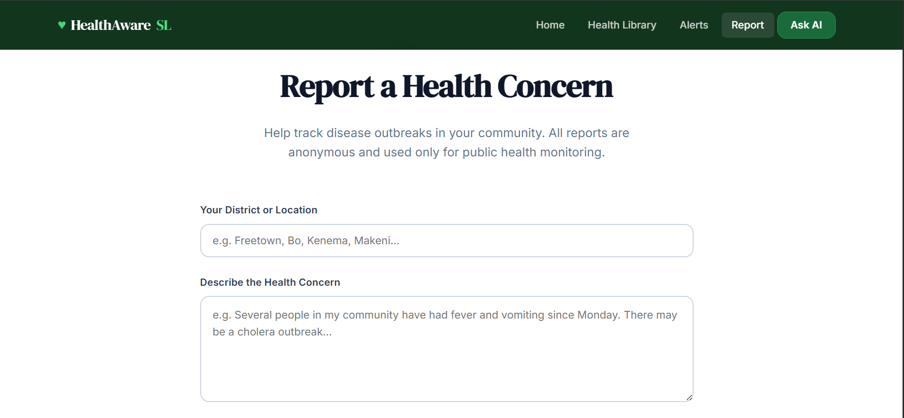

Slide 6




Open Source
& Legal
Framework
Privacy by Default
Minimum data collection. Clear consent at every form. No PII stored unnecessarily.
ECOWAS Compliant
MIT LICENSE
Aligns with the ECOWAS Supplementary Act on Personal Data Protection.
✓ Free to use, modify & distribute
✓ Commercial and non-commercial use
✓ No obligation to open-source changes
DPG Standard
✓ Approved by Digital Public Goods Alliance
Meets Digital Public Goods Alliance requirements for open licensing & data.
✓ Maximises adoption by governments & NGOs
Notes:
Explain WHY MIT was chosen — not just what it is. Discuss the DPG standard requirement and how privacy is embedded in the UX, not bolted on.

Slide 7
Platform Features
What users experience on HealthAware SL
📚
🔔
📝
🤖
Health Library
Alert System
Community Reporting
AI Assistant
• 6 evidence-based articles
• 3 severity tiers (red/amber/blue)
• Anonymous submissions
• Claude Sonnet 4 powered
• Search & category filter
• Outbreak, campaign & info alerts
• District-level geolocation
• Sierra Leone context prompt
• SDG-tagged content
• Email subscription system
• Disease surveillance data
• Free-text health questions
• Authority-sourced guidance
• Privacy notice on all forms
• Instant submission confirmation
• Recommends professional care
Notes:
Walk through each feature card briefly. If doing a live demo, this is a good cue to switch to the actual application.

Slide 8
Data Accessibility &
Interoperability
{ }
JSON Export Ready
Schema maps directly to standard health data APIs
HEALTH ARTICLE JSON SCHEMA
</>
XML Compatible
{
Interoperates with legacy health information systems
"id": 1,
"title": "Malaria Prevention",
"category": "Prevention",
↗
RESTful Integration
"sdg": "SDG 3",
Claude API integration via standard HTTPS REST calls
"summary": "...",
"tips": ["...", "..."],
"author": "Ministry of Health, SL",
⊕
Open Standards
"date": "2026-03-01"
}
ISO 8601 dates, UTF-8 encoding, MIME types
Notes:
The data schema is the invisible backbone of interoperability. Explain how the same data can be consumed by government dashboards, WHO systems, or mobile apps with no changes.

Slide 9
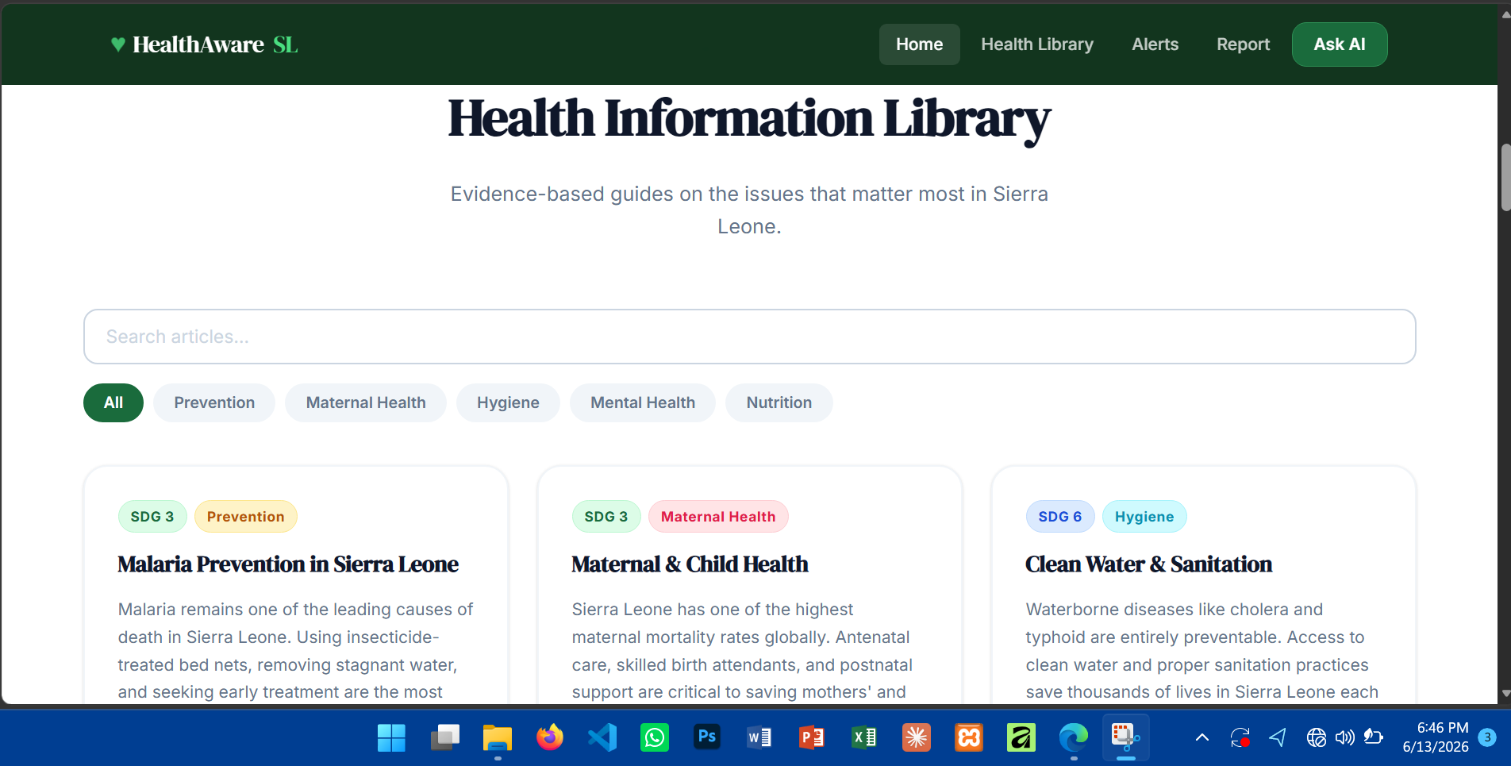

Slide 10
HealthAware SL
CONCLUSION
HEALTHAWARE SL contribution to Sierra Leone's digital public health infrastructure. By combining a curated health information library, a real-time alert system, community health reporting, and an AI-powered health assistant within a single, freely licensed, open-source web application, the platform demonstrates that digital public goods can be both technically sophisticated and deeply responsive to the real needs of communities in low-resource environments.
GROUP PROJECT
Notes:
Close with impact. Remind the audience that every feature was built with a real Sierra Leonean in mind. Invite questions and offer to demo any specific feature.

