Slide 1
Health Information System
Moses Wamboga

Slide 2
Healthcare Management Challenges
Manual tracking of client health records across multiple programs
Difficulty managing enrollments across various health initiatives
Need for centralized client information system
Requirement for easy search and retrieval of client data

Slide 3
Architecture Diagram
[Client Browser] ↔ [React Frontend] ↔ [Express API] ↔ [MongoDB Database]

Slide 4
Tech Stack
Frontend: React.js with Material-UI
Backend: Node.js with Express.js
Database: MongoDB
Deployment: Vercel

Slide 5
System Design
Database Schema:
Programs Collection: id, name, description, requirements
- Clients Collection: id, name, contact, demographics
Enrollments Collection: id, clientId, programId, date, status
Component Architecture
Core modules: Programs, Clients, Enrollments
UI components: Forms, Lists, Search, Details views

Slide 6
Backend Implementation
Node.js/Express Setup
RESTful API structure
MongoDB connection via Mongoose(atlas online)
API routes organization by resource
Key Controllers
Programs Controller
Clients Controller
Enrollments Controller

Slide 7
Frontend Implementation
React Component Structure
Container/Presentational pattern
Material-UI for consistent styling
Responsive design for mobile compatibility
State Management:
React hooks for local state
Context API for shared state

Slide 8
Key Features
Health Program Management:
Create and manage health programs (TB, Malaria, HIV, etc.)
Program details and requirements tracking
Client Management:
Register new clients in the system
Search functionality for quick client lookup
Comprehensive client profiles
Enrollment System:
Enroll clients in multiple health programs
Track program participation

Slide 9
Security Implementation
Open Access Model:
System designed for internal team use
No authentication required for easier review
Data Validation:
Input validation on all forms
Error handling for API requests

Slide 10
Testing Strategy
API Testing:
Endpoint testing using Postman
Response validation
Frontend Testing:
Component rendering tests
User flow validation
Manual Testing:
User interface testing
Cross-browser compatibility

Slide 11
Deployment
Deployment Strategy:
Frontend: Deployed on Vercel
Backend: Node.js server deployment
Live Application:
URL: Healthcare information system
Repository:
GitHub: github

Slide 12
Technical Challenges
Challenges Faced:
MongoDB data relationships management
Implementing efficient client search
Managing state across components
Solutions Implemented:
Structured MongoDB schema design
Optimized search queries
Effective state management patterns

Slide 13
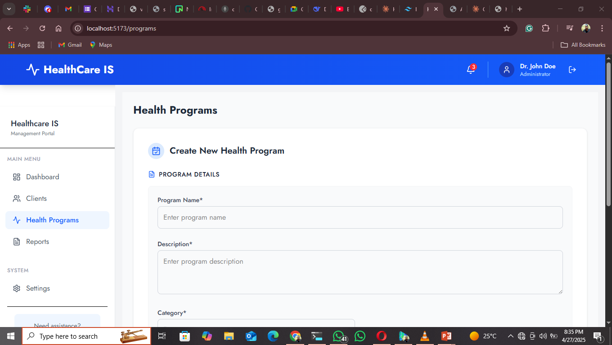
Demo
Live Demonstration
Creating health programs

Slide 14
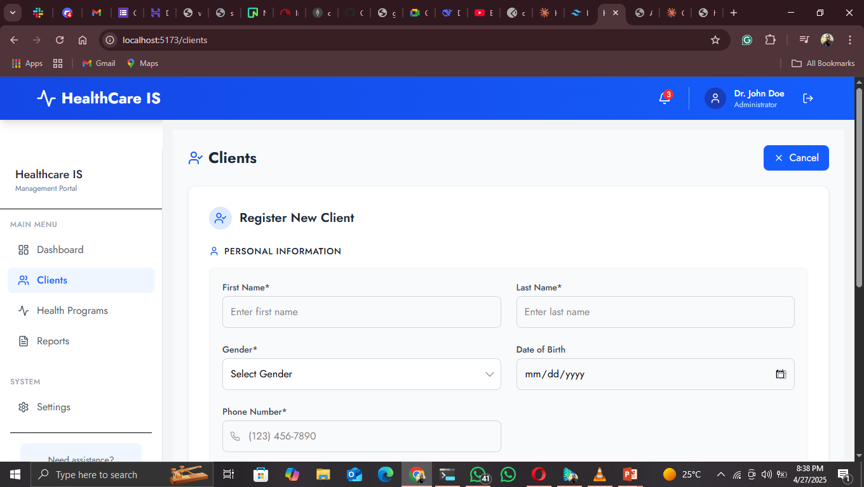
Demo
Registering new clients:

Slide 15
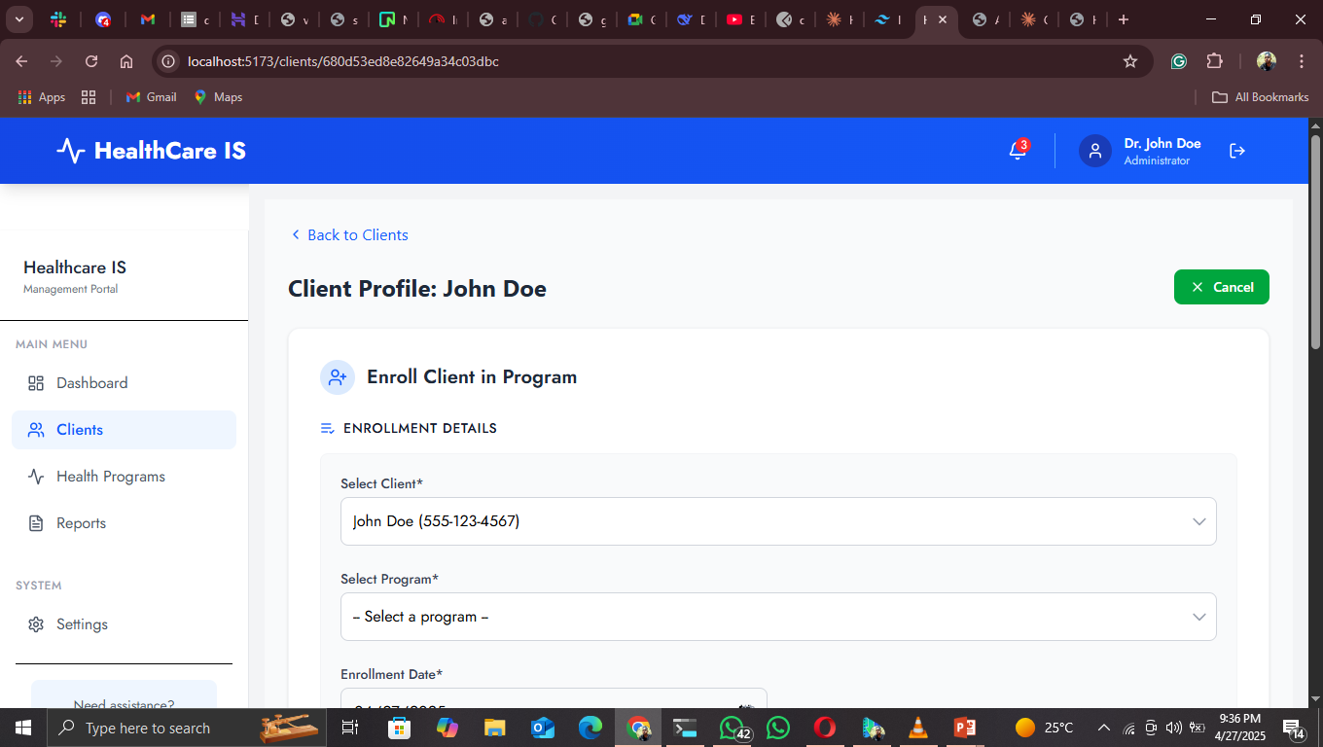
Demo
Enrolling clients in programs:

Slide 16
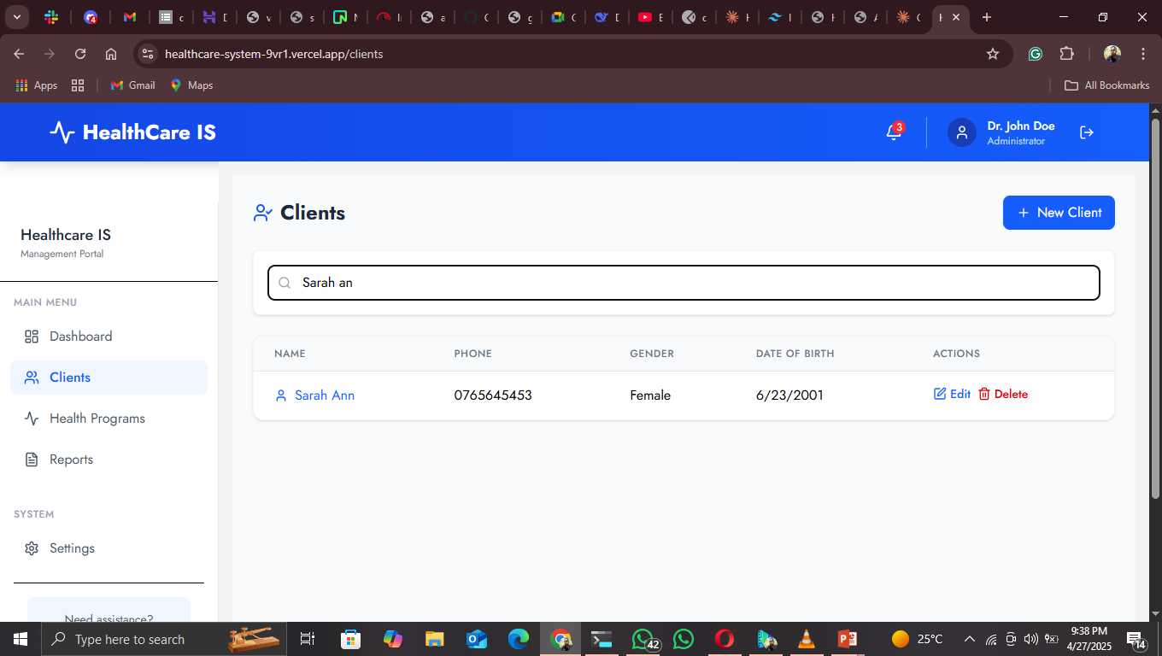
Demo
Searching for clients

Slide 17
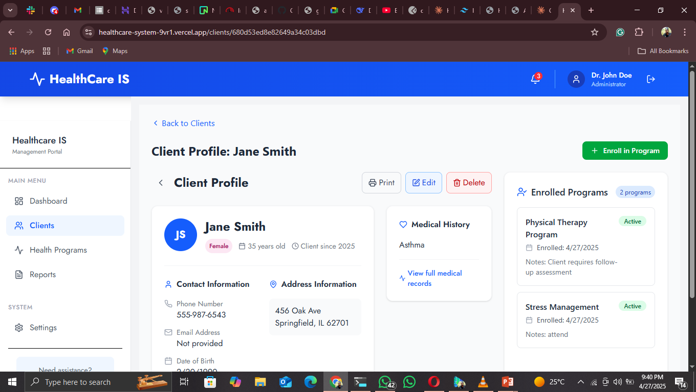
Demo
Viewing client profiles and program enrollments

Slide 18
END

