Slide 1
A node2vec Based fake news detection model using news source url
Mosharat Jahan
ID: 18701040
Supervisor: Mr.Rezaul Karim Associate Professor
Department of Computer Science and Engineering University of Chittagong

Slide 2


Problem statement
The main objective is to generate a model that can discriminate between “fake” and “true” news articles when it is trained with a certain dataset.
Fake
মুরগী হামলায় শেয়াল নিহত
News URL Collection
Real
টসে হেরে বোলিংয়ে বাংলাদেশ
Fake news detection model

Slide 3

Motivation
Even-increasing amount of information available for consumption
Creation of fake news is very easy with modern technology
Can we determine whether or not an article is unreliable using only the URL link the news was obtained from?

Slide 4
Related work
A URL search-based fake news detection model was proposed using a set of reliable links that shows 85% accuracy by Vishwakarma et al. in 2019.
A study on a link2vec-based fake news detection model using web search results was done in 2021 showing 83% accuracy by Jae-Seung Shim.
A noteworthy Research was done in the Bangla language using SVM and MNB classifiers that perform better than Nave Bayes which shows great performance in 2020 by Md Gulzar Hussain.
A. S. Sharma et al. proposed a hybrid extraction technique from text documents, merging TF-IDF and Word2Vec which may detect with the standard CNN architectures whether a text document in Bangla is not satire or satire with a precision of greater than 96%.

Slide 5

Methodology (proposed model)
https://www.banglatribune.com/sport/cricket/365937

Slide 6
Methodology (proposed model)
News Title | Label
যে ১০টি সম্ভাব্য কারণে সাহারা খাতুন অ্যাম্বুলেন্সে নির্বাচনী প্রচারণা চালিয়েছেন | Fake
Search Result
www.earki.com
Vectorization
[-1.4433004e-03 -3.3780243e-03 -5.0473986e-03 -2.9041581e-03 3.3509051e-03 -2.9211277e-03 6.5454496e-03 1.1984324e-03 -5.6580622e-03 7.3701553e-03 5.9618847e-03 4.2916266e-03 -5.3506605e-03 4.5489678e-03 3.1321039e-03 4.0510697e-03 3.3249231e-03 1.5154332e-03 -2.4766894e-03 6.5264413e-037.5095156e-03 2.9629711e-03 -2.2164024e-03 5.5683777e-0 9.5220190e-04 -6.6080661e-03 -6.4249570e-03 -1.8048100e-04 9.6663088e-04 -4.4870162e-03…………………………]

Slide 7
Methodology (comparison model)
Training Data
Test Data
Data Cleaning and Preprocessing
Feature Extraction
Classifier
Count Vectorizer
TF-IDF vectorizer
Evolution

Slide 8
Methodology (combined models)
Modeling
Evaluation
Google search
Link(URL)
Collection
News Article
SVM
CNN
Logistic regression
Node2vec based model
Dataset
Node2vec
Proposed model
News Content based model
Feature Extraction (Count vectorizer and TF-IDF vectorizer)
Comparison model

Slide 9
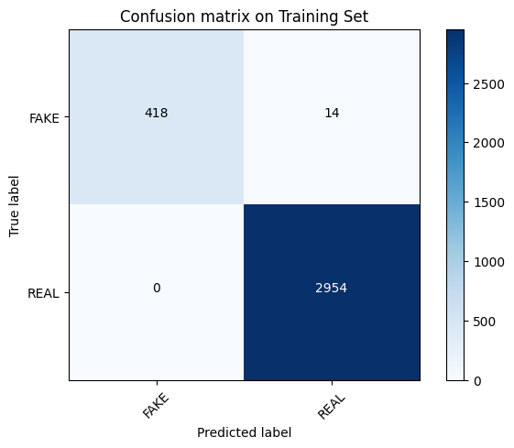

Experiment and evolution
SVM Model
 | Proposed Model Node2vec | Comparison Model News Content Based
Test Accuracy | 0.99 | 0.96
Train Accuracy | 0.99 | 0.98
Precision | 0.99 | 0.97
Recall | 1.0 | 0.98
F1 Score | 0.99 | 0.98
Node2vec
Content based

Slide 10


Experiment and Evolution
Logistic Regression Model
 | Proposed Model Node2vec | Comparison Model News Content Based
Test Accuracy | 0.97 | 0.95
Train Accuracy | 0.97 | 0.95
Precision | 0.97 | 0.88
Recall | 1.0 | 0.99
F1 Score | 0.98 | 0.97
Node2vec
Content based

Slide 11
Experiment and evolution
CNN Model
Comparison of Both Models
 | Proposed Model Node2vec | Comparison Model News Content Based
Test Accuracy | 0.87 | 0.86
Train Accuracy | 0.86 | 0.86
Precision | 0.87 | 0.86
Recall | 1.0 | 1.0
F1 Score | 0.93 | 0.92

Slide 12
Conclusion and future work
In this research we have proposed a model using Node2vec which has:
Low and better execution time than text based model
More than 95% accuracy for both ML model
Ability to work with data even if its unbalanced
Our Future research could continue to:
Work with datasets of different language
Collect more than one URL and use them together for classification
Apply different model to compare accuracy with Node2vec

Slide 13
Thank you!!!

