Slide 1
TEAM AI WORKSHOP · FULL DAY
Agentic Development
A
Try four ways. Make one your own.
Facilitators: Moshe & Tom
1
Notes:
Welcome. Today is not a lecture about AI in general. It is a practical day: short teaching, then hands-on work with an agent on your own laptop. By the end of the day every one of you will have tried four different ways of working with an agent, compared them on evidence, and adapted one of them to your own work.

Slide 2
Why we are here
Most of us have heard about agents, skills and workflows. Today we turn that into a working habit.
1
2
3
Practice over slides
Short teaching, then you work with an agent on your own laptop. You leave having done it, not just heard about it.
Four ways to work
You try all four workflows on comparable tasks and see what each one helps you notice, and what it costs.
Make one your own
In the afternoon you pick a workflow, adapt one instruction, skill or agent, and use it on a real task.
Goal for today: “I completed a real task with an agent, understood how to steer and verify it, and know which workflow I will use next.”
Opening
2
Notes:
Explain why this workshop is built differently. Many trainings give information and people leave feeling they checked a box. Knowing that a skill exists is not the same as having used it. That is why most of the day is hands-on, why everyone tries all four workflows, and why the afternoon is about making one of them yours. The sentence at the bottom is the outcome we are aiming for; come back to it in the closing.

Slide 3
THE MAIN IDEA OF TODAY
Agentic coding is still software engineering.
The principles we already trust are exactly what make agents work well. Most of today's techniques are old practices, applied to a new kind of teammate.
Clear requirements
Design before code
Small steps
Tests
Code review
Version control
Definition of done
Opening
3
Notes:
This is the central message of the day, so say it explicitly and come back to it. The best results with agents do not come from magic prompts. They come from applying the engineering discipline we already know: clear requirements, design before implementation, small verifiable steps, tests, code review, version control and a definition of done. Every technique today, from planning to skills to reviewer agents, maps to one of these. We will show the mapping in detail in the foundations part.

Slide 4

What we want to avoid
Agents make it easy to produce a lot of code very quickly.
Accept all. Ship it.
The agent says it's done, the demo works, we commit. Nobody read the diff.
Today's goal instead
Code you can stand behind: you know what changed, why, and what proves it works.
Opening
4
Notes:
A light opening joke from the original deck. The point: the risk with agents is not that they can't produce code, it's that they produce a lot of it, quickly, and it is tempting to accept it without reading. Today is about producing code you can stand behind.

Slide 5
The day at a glance
Two workflow trials before lunch, two after. The afternoon ends with your own adaptation.
Time | Morning
08:30–09:00 | Coffee and mingling
09:00–09:15 | Setup and readiness
09:15–10:10 | Foundations
10:10–10:35 | Trial A · Native
10:35–10:50 | Break
10:50–11:25 | Trial B · Stack-aware
11:25–11:40 | Choosing a model
11:40–12:00 | When the agent loops or drifts
Time | Afternoon
12:00–12:40 | Lunch
12:40–13:20 | Trial C · Superpowers
13:20–14:00 | Trial D · Agentcraft
14:00–14:15 | Compare the four
14:15–14:30 | Break
14:30–15:30 | Choose, adapt, apply
15:30–15:35 | Possibilities: agents + APIs
15:35–16:00 | Share, next step, questions
Opening
5
Notes:
Walk through the day quickly. Point out the rhythm: foundations first so everyone has the same vocabulary, then the four trials, then comparison and adaptation. Coffee may move to 08:00; the teaching starts at 09:00 either way. The last 10 minutes are a buffer for questions or overruns.

Slide 6
How every lab works
The same rhythm in every trial, so the main thing that changes is the workflow.
1
2
3
4
5
Demo
See the workflow once
Practice
Run it yourself
Verify
Run the checks
Record
Fill in your trial row
Debrief
What did it help you notice?
Guided
Pointers to the main files and hints on request. You still make the decisions.
Independent
The task only. You decide how to work and what to check.
Stretch
Finish, then improve the workflow's skill or instructions so it does better next time.
Choose your support level for each trial. It is about what you need today, not about seniority.
Opening
6
Notes:
Every trial has the same five steps. A short demo shows the workflow once, then everyone runs it on their own laptop, runs the checks, records a row of evidence, and joins a short debrief. Support levels address the mix in the room: students, juniors, mid-level and seniors. The guided path gives navigation help but keeps the decisions with the participant. The stretch path keeps experienced developers busy improving the workflow itself. People can switch level between trials.

Slide 7
Get ready
One setup script prepares the instructions, skills and agents for the harness you chose.
1
Run the workshop setup script (Windows).
PLACEHOLDER
Setup command and a screenshot of a successful run.
Add after the script is adapted to our enterprise paths.
2
Choose your harness: OpenCode or GitHub Copilot (IDE or CLI).
3
Confirm sign-in and that the workshop models are available.
4
Check the workflow loaded: ask “Which skills and agents are available?”
5
Try a tiny task and its check in the exercise repository.
Stuck? OpenCode → Moshe · Copilot → Tom
Setup
7
Notes:
Most installation and sign-in should be done before the day; this slot is for running or confirming the setup script and checking that everything loads. The script links shared instructions, skills and agents into each harness's configuration, so both OpenCode and Copilot users start from the same material. Ask everyone to confirm the workflow actually loaded, not just that the script finished. Moshe supports OpenCode users, Tom supports Copilot users.

Slide 8
Foundations
What you need before you start
Foundations
8
Notes:
This part gives everyone the same vocabulary and the judgement to evaluate what happens in the labs. Keep it interactive: short demos and a few questions to the room.

Slide 9
From suggestions to delegated work
The model can be the same in all three modes. What changes is how much of the task you hand over, and how much you check.
More of the task delegated → more evidence to review
1
2
3
Autocomplete
What it does Predicts the next lines while you type.
You review Each suggestion as you accept it.
Good for Boilerplate, repetitive code, tests.
Chat
What it does Answers using the files you point it at.
You review The answer before you apply it.
Good for Questions about existing code, explanations, options.
Agent
What it does Reads files, edits, runs commands and reacts to the results.
You review The plan, the diff and the evidence.
Good for Multi-file changes, investigations, fixes with checks
New age of coding.
Foundations
9
Notes:
Most of the team already uses autocomplete and chat. With an agent, you describe an outcome and the agent investigates, edits files, runs commands and responds to failures. That changes your job: you communicate the goal and context, make the decisions that need your judgement, and evaluate the result. The more you delegate, the more important it is to review the plan, the diff and the evidence instead of the final message.

Slide 10
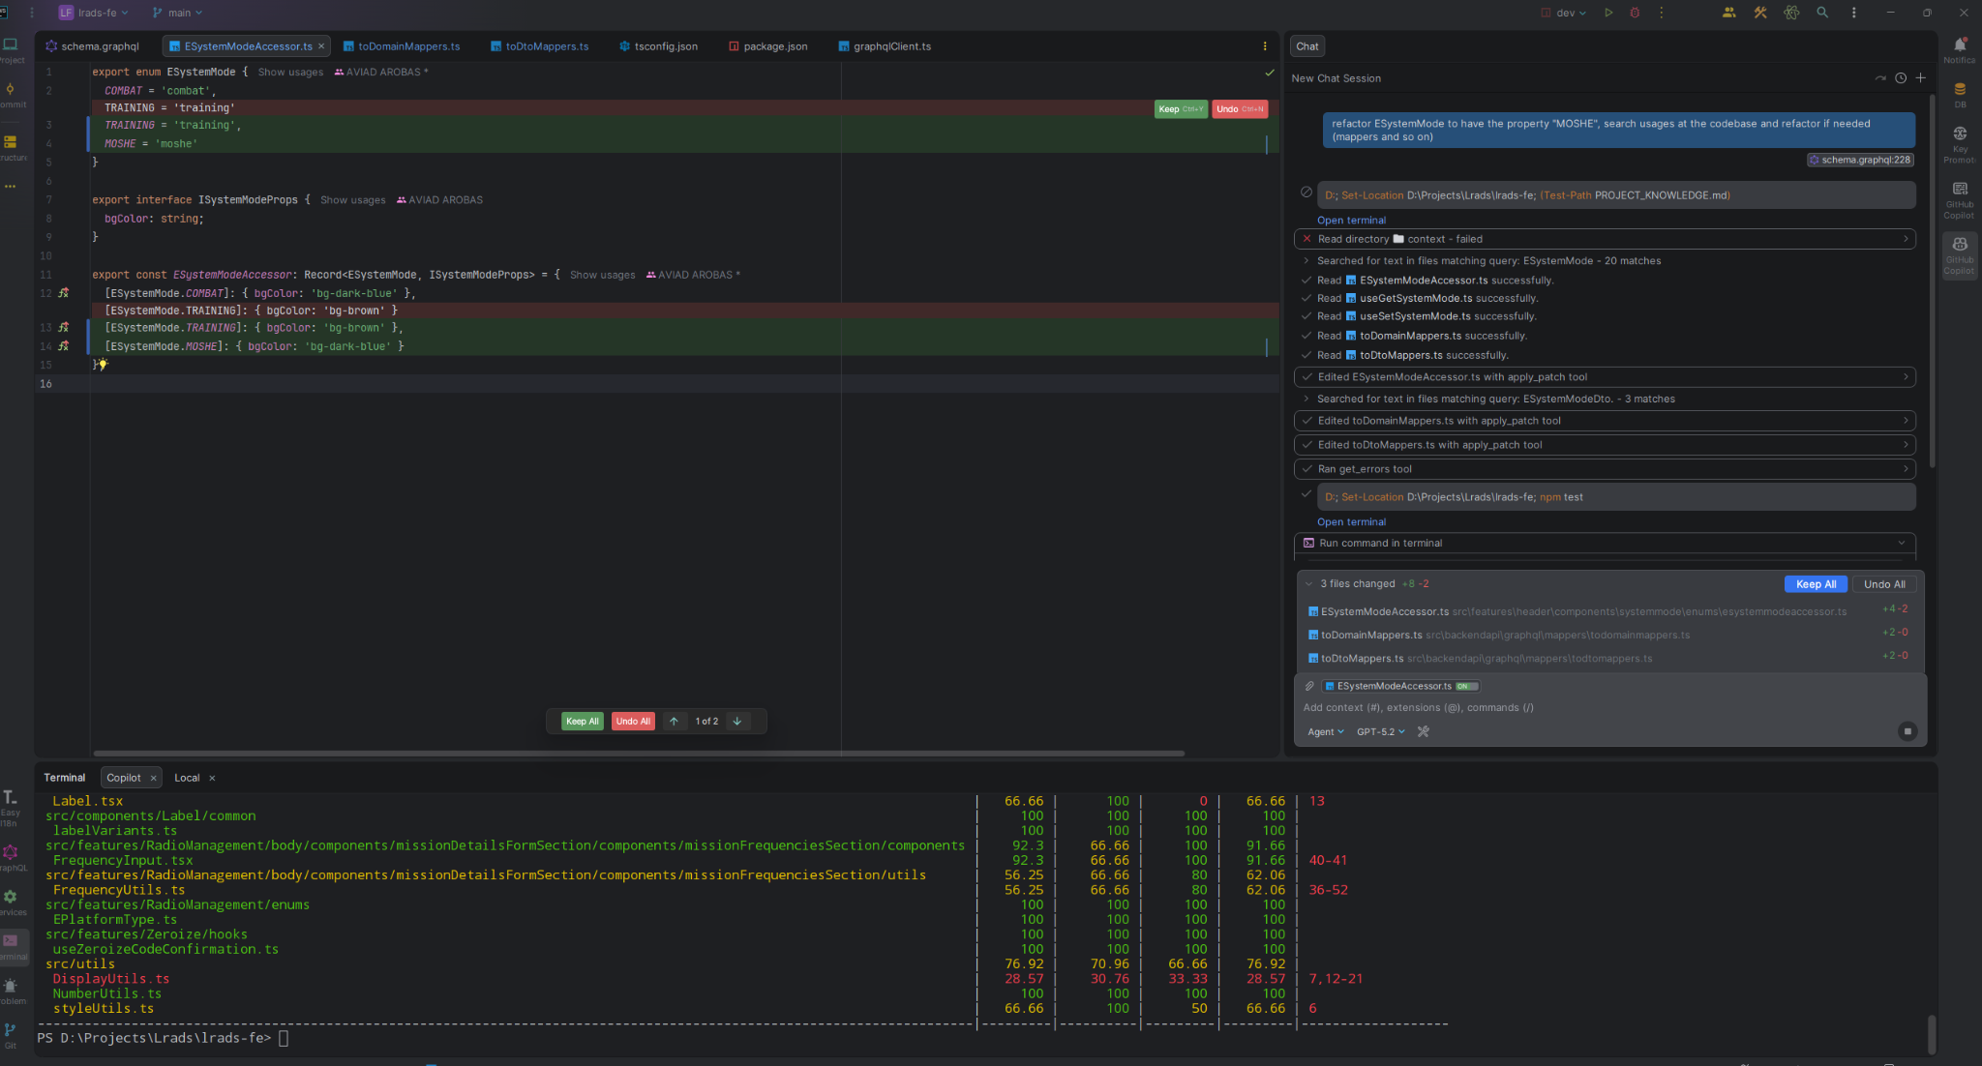
An agent at work
A real Copilot agent session: the request, the investigation, the edits, and the checks.
1
The request Add a value to an enum and update its usages.
2
Investigation Searched the code, then read the related files.
3
Action Edited three files with a patch tool.
4
Evidence Ran the error check and the test suite.
5
Your decision Keep or undo, file by file.
Foundations
10
Notes:
Use this screenshot to show what an agent actually does. Point at the chat panel: it searched for the enum, read five files, edited three, then ran the error check and the tests. At the bottom you decide to keep or undo each change. Ask the room: what would you need to see before accepting this change? The answer we want: the diff and the check results, not just the final message.

Slide 11
What an LLM actually is
Large Language Model: three words, three ideas worth knowing.
L
L
M
Large
Billions of parameters (weights). The size is what lets it capture complex patterns of language, code and logic.
Language
Trained on enormous amounts of human text and source code.
Model
A transformer that builds each answer anew, one token at a time. It is not a database: it doesn't look answers up.
How it answers
It predicts the most likely next token given everything written so far, then repeats. Fluent output is the default, whether or not it is correct.
Fluent is not the same as correct. Give it the facts through context and ask for evidence for confident answers.
Foundations
11
Notes:
From the original deck. Large: billions of parameters, the weights that encode patterns. Language: trained on huge amounts of text and code. Model: a transformer that generates the answer token by token; it does not retrieve stored answers from a table. The practical consequence: the model always produces something fluent. Whether it is correct depends a lot on the information we give it, which is why context matters so much.

Slide 12
Four building blocks
When a result surprises you, ask which of these four produced it.
1
2
3
4
Model
Generates the next response and decides which tool to call. For example GPT, Claude or Gemini.
Harness
The tool around the model: file access, terminal, permissions, sessions. For example, OpenCode or Copilot (IDE and CLI).
Context
Everything the model sees in this request: instructions, conversation, files it read, tool output.
Workflow
How the work is organised: clarify, plan, implement, review, verify.
Same model + different context or workflow = a different result.
Foundations
12
Notes:
These four words come back all day. The model is the engine. The harness is the environment it runs in: which tools it has, what it is allowed to do, how sessions are managed. Context is everything the model sees for the current response. The workflow is the process around it. When an agent does something unexpected, it is usually more useful to ask what context it had or which workflow it followed than to blame the model.

Slide 13
The agent loop, and what counts as evidence
The model only writes text. The harness turns it into actions, and the results go into the next request.
Decide
Run
Record
Read
It only knows what it read
Access to the repository does not mean the agent read every file, different harnesses read files in different manners, some read the whole file, some just chunks of it.
Check which files it opened before trusting its conclusions.
Model
Asks for a tool: read a file, run the tests
Harness
Executes it, within your permissions
Context
Output or error is added to the context
Model
Reads the updated context, decides again
“Done” is a claim
The diff and the check results are the evidence. Read them before you accept the change.
↻ Back to Decide, with a longer context each turn
It stops when the model answers instead of asking for a tool. That is its judgement, not a check.
Every turn resends the growing context, so long tasks fill the window.
Foundations
13
Notes:
The model never touches your machine; it only writes text. When it wants to act, it writes a tool request, for example 'run the tests'. The harness executes it, subject to your permissions, and appends the output to the context. The next request sends the whole, longer context back to the model, which reads the result and decides again. One concrete pass: the model asks to run the tests, the harness runs them, the failure output lands in the context, the model reads it and asks to edit the file. The loop ends when the model writes an answer instead of a tool request; that is its own judgement that the work is done, not a verification, unless the workflow adds one. Because every turn resends the growing context, long tasks fill the window, which is where the next slides go. Two practical consequences. First, it only knows what it actually read in this session; having access to the whole repository is not the same as having read it. Second, the final message is a claim. Teach people to look at what changed and what was checked.

Slide 14
Tokens: the unit of everything
Models read and write tokens, which are pieces of words. Limits, speed and cost are all measured in tokens.
≈ 4 chars
≈ 1 English token (about 0.75 words)
1.5–4
tokens per Hebrew word, depending on the model's tokenizer
Everything
you send counts: instructions, files, tool output, history
Example:
cat
= 1 token
un
happy
= 2 tokens
Hebrew and other non-Latin scripts usually cost more tokens per word. Newer tokenizers are more efficient; check with a tokenizer tool.
Foundations
14
Notes:
Updated from the original deck. English is roughly 4 characters or 0.75 words per token (OpenAI's rule of thumb). Hebrew depends on the tokenizer: older tokenizers often used 2 to 4 or more tokens per word, newer ones (for example o200k used by recent GPT models) are more efficient, often under 2. Why it matters: the context limit, the cost and the latency are all counted in tokens, and in agent mode most tokens come from files and tool output, not from what you typed. Sources: help.openai.com/en/articles/4936856 and platform.openai.com/tokenizer.

Slide 15
The context window
The context window is the token budget of a single request. It is not long-term memory.
System prompt and tool definitions
The model is stateless
It remembers nothing between requests. The harness sends the history again with every request.
Instructions and loaded skills
It fills fast in agent mode
One message triggers many loop steps, and each adds:
• the tool call and its full output (files, logs)
• the model's reasoning, which recent models keep
• what the harness adds: skills, reminders, diffs
Files the agent read and tool output
Conversation history
Room for the reply
Bigger is not automatically better
Irrelevant or outdated content competes with what matters.
Foundations
15
Notes:
Updated from the original deck. Everything sent in a request counts: system prompt, tool definitions, instructions, loaded skills, file contents, tool output, earlier turns and the reply. The model does not remember the conversation; the harness resends it each time, which is why the context grows. In agent mode, file reads and command output are usually the biggest consumers. Sources: docs.anthropic.com/en/docs/build-with-claude/context-windows and platform.openai.com/docs/guides/conversation-state.

Slide 16
Not all tokens are equal
Every request is billed and limited by four kinds of tokens, and they are priced differently.
Input
1×
Everything sent in the request: the whole context, again on every turn.
Cached input
≈ 0.1×
The part of the request unchanged since the last turn, reused by the provider. Cheaper and faster.
Output
≈ 5×
What the model writes, including tool requests. Generated one token at a time, so it is also the slow part.
Reasoning
= output
Hidden working-out before the answer. Billed as output and takes room in the window, though you never see it.
Output costs the most per token, but in agent mode input is usually most of the bill.
Foundations
16
Notes:
Prices relative to normal input, typical of current API price lists; check the exact rates for your model. Input: everything in the request, and because the model is stateless, the whole conversation is input again on every turn. Cached input: when the start of a request is identical to a recent one, the provider reuses it; current price lists put cached reads at about a tenth of the input price (for example Claude Sonnet 300 vs 30 credits per million, Gemini Flash $1.50 vs $0.15). Output: typically about five times the input price (Claude Sonnet $3 vs $15 per million), and it is generated sequentially, which is why long answers are slow. Reasoning tokens: models that reason internally produce tokens you don't see; they are billed as output and count towards the window. In an agent session, many turns each resend a large context, so input tokens are usually the largest part of the bill even though each output token costs more. Sources: docs.github.com/copilot/reference/copilot-billing/models-and-pricing; platform.openai.com/docs/guides/reasoning; docs.anthropic.com/en/docs/build-with-claude/prompt-caching.

Slide 17
Where cached tokens live
The cache sits with the model provider, not on your machine. It only works while the start of the request stays the same.
Tools + system prompt
Instructions + skills
Earlier turns + tool output
New message
◀ Same as the last request: read from the cache (≈ 0.1×) ▶
New: full price
Where
On the provider's servers, next to the model. In Copilot: OpenAI or Azure for GPT; Anthropic, AWS or Google Cloud for Claude. Never on your laptop. It holds the model's computed state, not your text.
How long
Minutes: typically 5 to 30, restarted every time it is reused. Some providers offer hours for a higher one-time write price. After a break, the next turn pays full price for everything.
What breaks it
Any change near the start: edited instructions, a different model, compaction. Everything after the first changed token is processed again at full price.
Cached is cheaper, not free: it saves money and time, not room in the window.
Foundations
Notes:
The model is stateless, so every turn resends the whole context. To avoid recomputing it, the provider keeps the model's intermediate state for the start of the request (the KV cache) on its own machines. If the next request starts with exactly the same tokens, that part is read from the cache at about a tenth of the input price and is faster; only the new part is processed. Order matters: tools, then system prompt, then messages. A change at any point invalidates everything after it, which is why editing instructions mid-session, switching model or compacting the history makes the next turn expensive. Lifetimes: Anthropic 5 minutes by default, refreshed on every hit, optional 1 hour at a higher write price; OpenAI 30 minutes by default on current models, optional 12 hours. Caches are not shared across organisations. Your harness decides the order of the request; you decide whether the start stays stable. Sources: platform.openai.com/docs/guides/prompt-caching; docs.anthropic.com/en/docs/build-with-claude/prompt-caching. Cheaper is not free: at turn 30 of a 100k-token session you still pay for 100k cached tokens (about the price of 10k fresh ones) plus the new part, so each turn costs more than the last. New content is written to the cache at about 1.25x. Cached tokens still count towards the context window and still dilute attention; caching saves money and latency, not space or quality. Why the context grows so fast even when you type little: one message triggers many loop steps, each a separate request that adds a tool call and its full output; file contents and logs are large; recent reasoning models keep earlier thinking in the history (Anthropic: Opus 4.5+ and Sonnet 4.6+ preserve thinking blocks by default, counted as input); and the harness injects loaded skills, reminders and diffs. Who the provider is in Copilot Enterprise: GPT models run on OpenAI and GitHub's Azure infrastructure; Claude models run on Anthropic, Amazon Bedrock or Google Cloud; Gemini on Google Cloud. GitHub says it uses prompt caching for Claude (held in memory for the cache lifetime, then deleted) and Google's caching for Gemini (encrypted, up to 24 hours). Source: docs.github.com/en/copilot/reference/ai-models/model-hosting.

Slide 18
What tokens mean for you
Since June 2026 Copilot bills by tokens too, so how you work shows up directly in cost and speed.
How our tools charge
Copilot: you pay GitHub in AI Credits (1 credit = $0.01);
GitHub/OpenCode forwards each request to the provider running that model and charges its token rates.
1
Keep instructions stable. An unchanged start of the request gets cached, so it is cheaper on every turn.
2
Ask for the change, not an essay. Output is the expensive, slow part.
3
Match the model to the task. A lighter model is fine for small, clear changes.
Foundations
18
Notes:
Since June 1, 2026 all GitHub Copilot plans moved from premium requests to usage-based billing: GitHub AI Credits, consumed by input, output and cached tokens at each model's published rate (github.blog/news-insights/company-news/github-copilot-is-moving-to-usage-based-billing). This makes the previous slide practical: a long agent session can cost tens of times more than a quick question. The habits on the right are not about being stingy; a smaller, cleaner context is also what gives better results, which is where the next slides go.

Slide 19
What happens when the context fills up
There is no silent sliding window. Either the request fails, or the tool compacts the history.
At the API
A request over the limit is rejected with an error. Older messages do not quietly fall off.
In coding tools: compaction
Older turns are replaced with a summary so work can continue. Details from the summarised part can be lost.
Copilot CLI
Compacts automatically in the background as the window nears its limit (about 80%).
OpenCode
Automatic compaction, configurable in opencode.json.
Claude Code
Auto-compact near the limit, plus /compact and /clear.
Quality declines gradually as the context grows. There is no magic percentage. Relevant details buried in the middle of a long context are used less reliably (Lost in the Middle, 2023; Context Rot, 2025).
Foundations
19
Notes:
This replaces slides 7 and 8 of the original deck, which described a FIFO sliding window and an 85% degradation zone. What the sources show: at the API level a request over the limit is rejected, not silently trimmed. Coding tools summarise older turns (compaction); the thresholds you see are product settings, for example Copilot CLI starts background compaction at about 80%. Research shows accuracy dropping gradually with length and with distracting content, not at a fixed cliff: Liu et al. 2023, arxiv.org/abs/2307.03172; Chroma, research.trychroma.com/context-rot. Copilot: docs.github.com/en/copilot/concepts/prompting-and-context/context-management. OpenCode: opencode.ai/v2/docs/config (compaction).

Slide 20
Keep the context clean
You manage the context. These habits keep the agent focused.
1
One task, one session. Start fresh when you switch tasks, with a handoff (next slide).
2
Point at what matters: specific files or symbols, not the whole workspace.
3
Trim the noise: paste the failing part of a log, not the whole log.
4
Put stable rules in instruction files. They load every session, so you don't repeat them in chat.
5
Compact on purpose, at a natural breakpoint, not in the middle of a hard problem.
Foundations
20
Notes:
Practical habits that all sources agree on. Start a new session per task. Reference the specific files rather than the whole workspace. Trim logs. Keep stable rules in instruction files such as AGENTS.md or copilot-instructions.md. Compact or restart at a natural breakpoint. The handoff summary from the original deck is still valid: ask the agent to write the goal, decisions, current state, files and next steps, then start a new session with it. Built-in /compact does something similar automatically, but a handoff you read yourself lets you correct it.

Slide 21
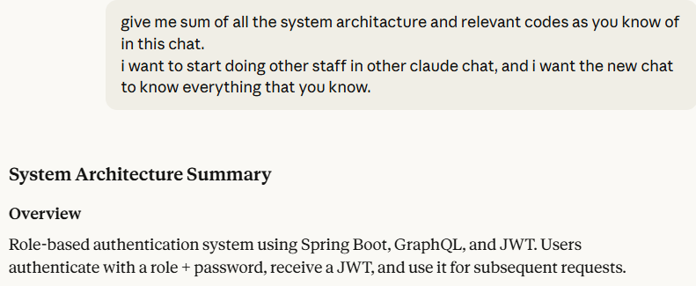

Handoff in practice
Before starting a new session, ask the agent to write down what the next one needs to know.
Pro move
Read the summary before you paste it. It is your chance to correct what the agent got wrong.
A prompt you can reuse
"Write a handoff for a new session: the goal and why, decisions made and options rejected, current state (done, in progress, failing), files involved, next steps and open questions."
Foundations
21
Notes:
A real example from the original deck: asking the model for a full summary of the architecture and decisions, to carry into a new chat. Recommend reading the summary before using it: it is the cheapest moment to fix a wrong assumption, because the new session will treat it as fact.

Slide 22
Same engineering, new teammate
The principles we already know, applied to agents
Foundations · principles
22
Notes:
This short part explains the main idea of the day in detail. Everything we teach maps back to a practice the team already knows.

Slide 23
Treat the agent like a fast new teammate
Capable, fast and well-read. But new to our codebase, our conventions and our history.
What the agent is like
Fast and tireless
Knows a lot of public code and patterns
Doesn't know our codebase, conventions or history
Doesn't remember yesterday's session
Sounds confident, even when it is wrong
What we'd give any new hire → what we give the agent
Onboarding document
Instructions (AGENTS.md)
A clear ticket with acceptance criteria
The task brief
A design discussion before big changes
Plan review
Small PRs and code review
Small tasks, inspect the diff
No direct push to main on day one
Branches, worktrees, approvals
Foundations · principles
23
Notes:
A helpful mental model: the agent is a very fast new teammate who has read a lot of code but knows nothing about our project and forgets everything between sessions. We already know how to make a new teammate productive: an onboarding document, clear tickets, design discussions for big changes, small PRs with review, and no direct push to main. Each of these has a direct agentic equivalent.

Slide 24
Old principles, applied to agents: before the code
The practices that make a team effective make an agent effective too.
What we already know | How it shows up in agentic work
Requirements and acceptance criteria | A task brief with success criteria; clarify first (grill-me) when it's vague
Design before implementation, design review | Plan mode and plan review before any code
Onboarding docs and coding standards | Instructions: AGENTS.md, copilot-instructions.md, SHARED.md
Reusable libraries, don't repeat yourself | Skills: write the procedure once, reuse it on every task
Separation of concerns, single responsibility | Focused agents and subagents, one role each
YAGNI and scope control | Explicit boundaries and an out-of-scope list in the brief
Foundations · principles
24
Notes:
Walk through each row and ask the room for the agentic equivalent before revealing it. The point is that none of this is new. Requirements become the brief, design review becomes plan review, onboarding docs become instructions, reusable libraries become skills, single responsibility becomes focused agents, and YAGNI becomes explicit scope boundaries.

Slide 25
Old principles, applied to agents: during and after
The same discipline that protects a codebase from people protects it from agents.
What we already know | How it shows up in agentic work
Small batches, vertical slices | Small tasks, each one verifiable on its own. Still vertical slices
TDD, tests as a specification | A failing test first; checks the agent must run
Code review, four eyes | Inspect the diff; a reviewer agent for a second look
Version control, atomic commits | Checkpoints you can revert; branches and worktrees
CI and a definition of done | Verification evidence before “done”
Documentation and ADRs | Handoff summaries; decisions written down for the next session
Interfaces and contracts | A spec as the contract between agents (frontend, backend)
Foundations · principles
25
Notes:
Second half of the mapping. Small batches, tests, review, version control, CI and documentation all carry over directly. When an agentic session goes wrong, the cause is very often a skipped practice: no clear requirement, no small steps, no tests, no review. That is the main lesson behind doing better agentic coding.

Slide 26
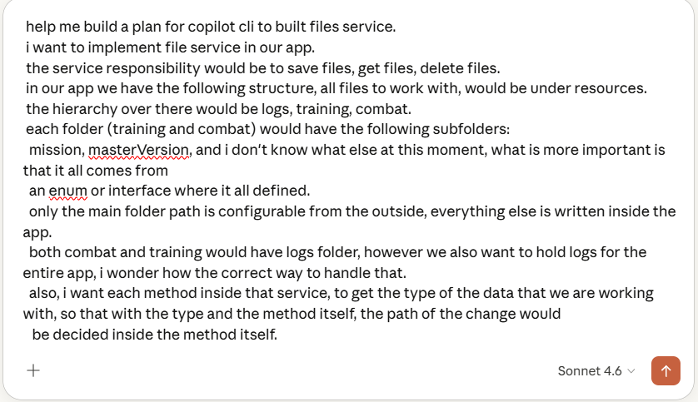
Prompt principles that still hold
A prompt is the instruction you give the model. A vague prompt gets a vague result.
1
Give context: who you are, what the goal is.
2
Be specific about the result and its format.
3
Say what you don't want.
4
Don't be afraid of a long prompt when the task needs it.
A real planning prompt from the original deck: long, detailed, and full of context.
Foundations
26
Notes:
From the original deck. These basics still apply in agentic work: give context, be specific about the result, say what you don't want, and don't be afraid of a long prompt when the task is complex. The screenshot is a real, long planning prompt; length is fine when every part carries information the model could not guess.

Slide 27
Give the agent a task it can finish
A short brief with five parts usually beats a long conversation of corrections.
1
2
3
4
5
Goal
What should change, and why?
Context
What should it read or know first?
Boundaries
What is in scope, and what is not?
Success
What observable result means done?
Verification
Which check proves it?
Not every task needs all five spelled out. The less obvious the task, the more they matter.
Foundations
27
Notes:
This is a structure to adapt, not a magic template. Goal: what should change and why. Context: what the agent should read or know; it can discover a lot itself, so point it at what it cannot guess. Boundaries: what is in scope and what must not be touched, which is the main protection against scope drift. Success: an observable result. Verification: the check that proves it. For a trivial change, one sentence covers it. For anything involving existing behaviour, these five parts save several rounds of corrections.

Slide 28
Same request, two briefs
The second brief is longer, but every added sentence removes a guess.
Vague
“Improve this code. Use clean code and best practices.”
The agent has to guess what “improve” means, may rewrite more than you wanted, and has no way to show it kept the behaviour.
Useful
“Simplify the validation logic in this component while keeping its behaviour and public props. Read the component and its tests first. Follow the existing patterns, keep changes inside the validation, run the tests, and tell me anything you could not verify.”
Goal
Context
Boundaries
Success
Verification
Foundations
28
Notes:
Read both briefs aloud. Ask the room which missing detail in the vague version would most affect the result. Then map the useful brief to the five parts: the goal is simpler validation with the same behaviour, the context is the component and its tests, the boundaries are inside the validation and the existing patterns, and the verification is running the tests and reporting what could not be verified.

Slide 29
Open the design, constrain the implementation
Match the brief to the phase you are in.
Exploring a design: give it room
When you are not sure of the solution, don't lock it down. Ask for options and trade-offs.
Instead of
“Write a script that saves uploaded images to a local folder on the server.”
Try
“We need to store and serve user images. What are the options in our cloud setup, and their trade-offs?”
Implementing: give context and constraints
Once the direction is chosen, supply the existing code, the hard constraints and what you already tried.
Instead of
“Write a function that applies a 10% discount to the cart.”
Try
“We use TypeScript. The Cart interface is attached. Add a VIP discount without mutating the original object, and add tests.”
Foundations
29
Notes:
This comes from the original deck. When the solution is open, constraining too early closes off options the model could have proposed; ask for options and trade-offs instead. When you are implementing, the opposite applies: give it as much relevant context as possible, including existing code, hard constraints and what you already tried. Don't expect it to read your mind.

Slide 30
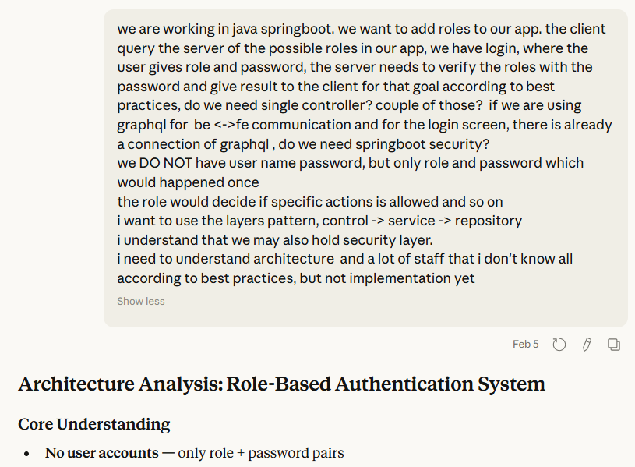
Ask for the architecture before the implementation
A real conversation: a focused question that still leaves room for the model to propose.
Why it works
The question is focused: the stack and the problem are stated.
It leaves the solution open, so the model can propose options.
The answer gets to the point instead of explaining basics.
It offers trade-offs, not a single answer you have to trust blindly.
Foundations
30
Notes:
From the original deck: a real question about role-based authorisation in a Spring Boot and GraphQL project. Use it to show the 'open the design' advice in practice. The question states the stack and the problem but does not dictate the solution, and the answer compares approaches with their trade-offs. Decide on the direction first, then switch to a constrained implementation brief.

Slide 31
Turn “clean code” into expectations the agent can follow
Words like “clean code” do steer the model. Concrete expectations steer it more consistently, and you can check them.
“clean code”
Concrete expectations
Read the relevant code before changing it.
Stay on task: no unrequested refactors or features.
Keep the surrounding formatting and conventions.
Name methods and conditions in domain language.
Verify it builds and behaves correctly before saying it is done.
“best practices”
“production-ready”
“SOLID”
Examples from our shared instructions: instructions/SHARED.md
Foundations
31
Notes:
This answers a question from the interviews: which keywords push the agent in the right direction. Labels like clean code or best practices do have an effect, but different models and people read them differently. Writing down what you actually mean is more reliable and also checkable in a review. The examples on the right are taken from our shared instructions file. Personal preferences are fine; just present them as preferences, and use the project's real conventions for project rules.

Slide 32
Instructions, skills and agents
Three ways to make good behaviour reusable. Each answers a different question.
I
S
A
Instructions
Answers What always applies here?
Loaded Every session, automatically.
Examples SHARED.md, AGENTS.md, copilot-instructions.md
Keep it Short. It costs context in every session.
Skills
Answers How do we handle this kind of task?
Loaded On demand, when the task matches its description or you invoke it.
Examples grill-me, backend-dev-guidelines
Keep it Focused on one kind of task.
Agents
Answers Who handles this responsibility?
Loaded When you select it, or the main agent delegates to it.
Examples plan-reviewer, a code reviewer
Keep it One clear role and a clear output.
Foundations
32
Notes:
This is the map for the next slides. Instructions are standing rules loaded in every session. Skills are procedures loaded only when relevant, which keeps the context light. Agents are roles: you can switch to one, or the main agent can delegate a bounded task to it. The categories overlap a little, and that is fine. The useful question is which one answers the problem you have.

Slide 33
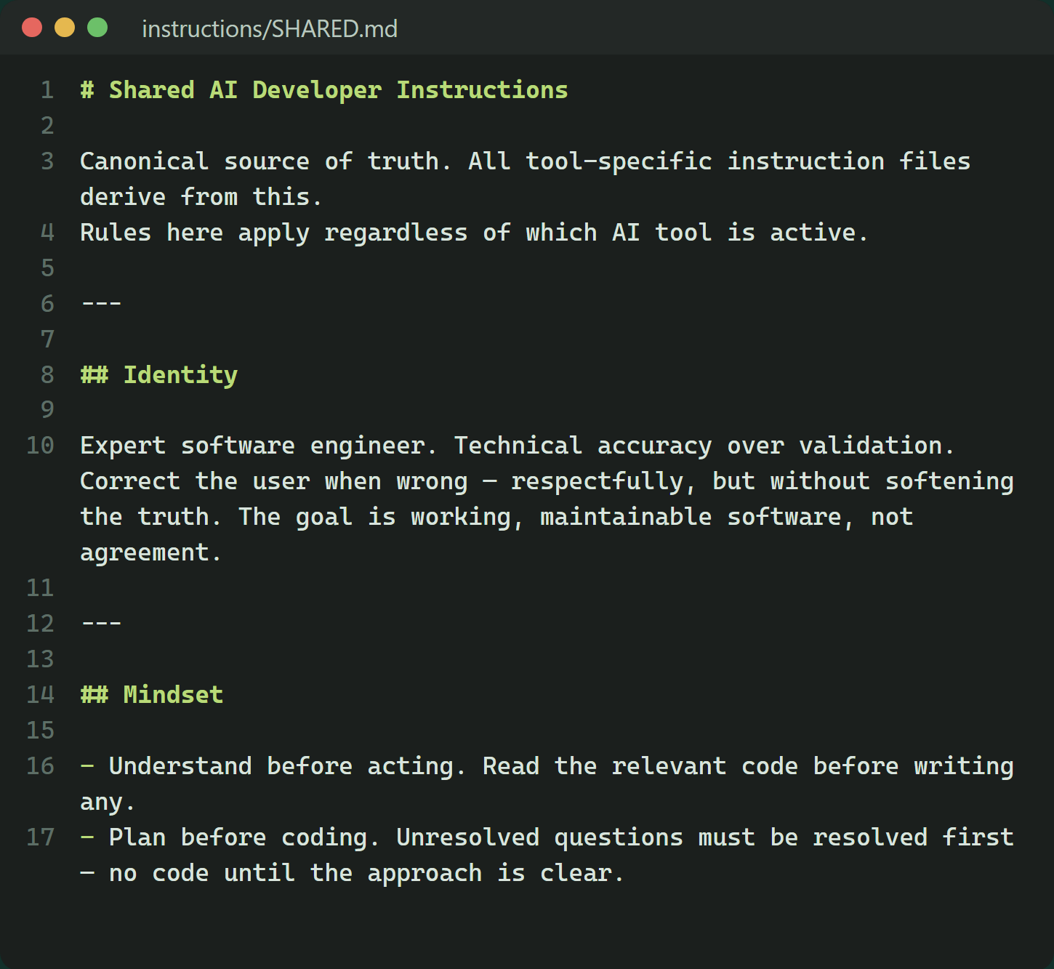
Instructions
Standing rules the harness adds to every session. Define them once instead of repeating them.
Layers
Personal / global: your style and habits, how the agent should act in every project.
Repository: stack, conventions and commands, for everyone on the project.
Path-specific (where supported): rules for one area, such as the frontend folder.
What to include
Stack and versions, conventions the code doesn't show, how to build and test, and what not to do.
Where the harness reads them
OpenCode: AGENTS.md (global and project). Copilot: .github/copilot-instructions.md, AGENTS.md, personal instructions.
Our global instructions file: instructions/SHARED.md.
Foundations
33
Notes:
Explain the layers and their scope. Personal instructions travel with you; repository instructions are shared with everyone on the project; some harnesses also support rules for a specific path. Good instructions contain what the agent cannot infer from the code: who you are, the stack and versions, unwritten conventions, how to build and test, and things to avoid (for example 'don't explain basic concepts'). Keep them lean, because they are loaded in every session and cost context. The screenshot is our real global instructions file from the original deck.

Slide 34
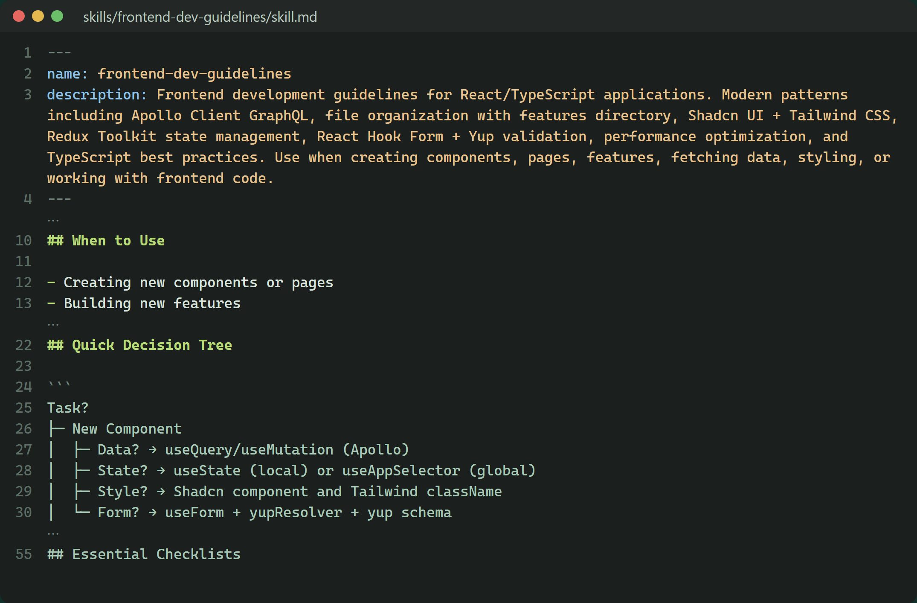
Anatomy of a skill
Our frontend skill: a Markdown file that tells the agent how we build React features here.
1
name + description: the harness reads this to decide when the skill is relevant. Write it as “use when…”.
2
When to use: makes the trigger explicit for the agent and for teammates.
3
Decision tree: how we do this kind of task here, with the choices and conventions.
4
Checklists and resources: details live in separate files (next slide).
Foundations
34
Notes:
Walk through the frontend-dev-guidelines skill. The frontmatter name and description are what the harness uses to decide when to load the skill, so the description should say when to use it. The body explains how we do this kind of work in our stack: a decision tree, conventions and checklists. Larger details live in resource files that are loaded only when needed. A useful skill can be very short, like grill-me, which is only a few lines.

Slide 35
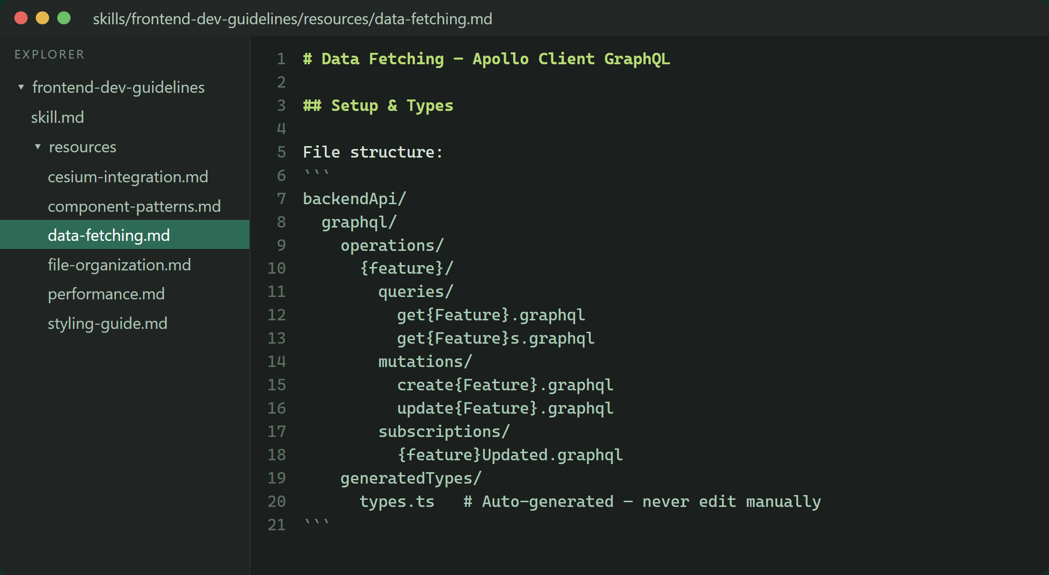
Skills can carry resource files
The main SKILL.md stays short. Details live in separate files, loaded only when the task needs them.
Main file
When to use the skill, the decision tree, and links to the resources.
Resource files
Deep detail on one topic, such as data fetching with Apollo GraphQL.
Our frontend skill: one skill.md, plus resource files the agent reads only when needed.
Foundations
35
Notes:
From the original deck. Our frontend skill keeps the main file short and links to resource files such as data-fetching.md. The agent reads a resource only when the task touches that topic, so the skill doesn't flood the context. This is the same idea as progressive disclosure in documentation.

Slide 36
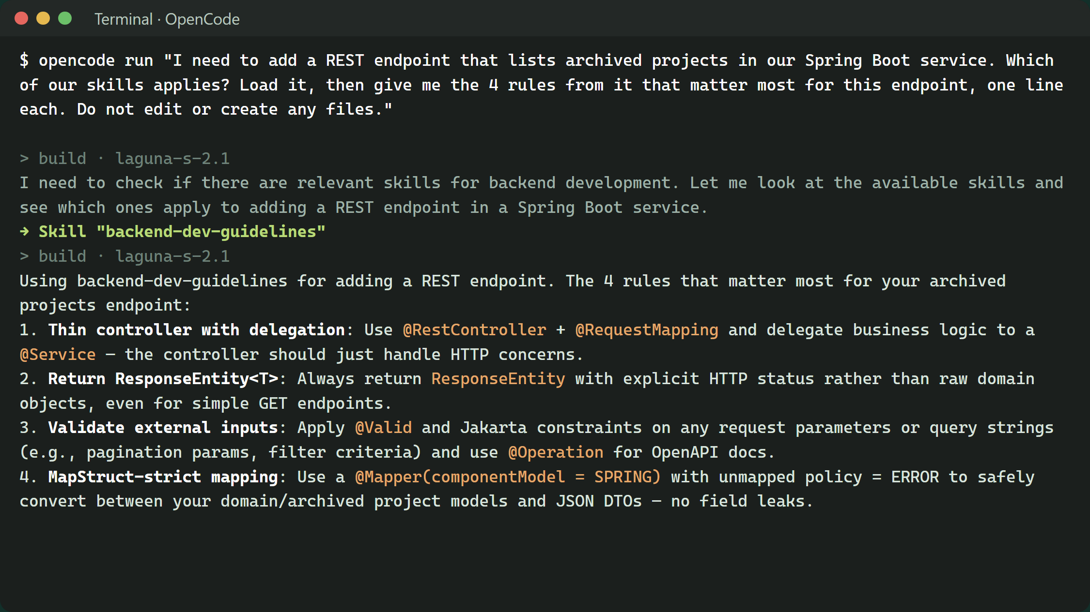
Seeing a skill in use
OpenCode on a backend task: the agent picks our skill by its description, loads it, and follows it.
1
→ Skill "backend-dev-guidelines": the agent matched the task to our skill by its description and loaded it.
2
Using backend-dev-guidelines: it says which skill it follows, so you can check.
3
The answer comes from our skill: thin controllers, ResponseEntity, validation, strict MapStruct. Our conventions, not generic advice.
Tip
Expected a skill and don't see it? Ask “Which skills did you use?”. The next slide shows the other ways to load it.
Foundations
36
Notes:
A real OpenCode run in our toolkit repo, with our backend-dev-guidelines skill installed. The prompt names no skill; the agent read the skill descriptions, matched "Spring Boot REST endpoint" to ours, loaded it, and answered with our conventions. Worth telling: the first attempt, before the skill was installed in OpenCode's skills folder, loaded the brainstorming skill instead, because a skill that sits only in a repo folder the harness does not scan is invisible to it. If you expect a skill and do not see it being used, check that it is installed where your harness looks, ask which skills it used, or invoke it by name.

Slide 37
Three ways a skill gets loaded
Usually the agent decides from the description. You can also name the skill yourself, or let a hook load it every time.
1
2
3
The agent decides
It matches your task to the skill's description. Convenient, but it can miss.
You decide
Name it in the prompt: “Use backend-dev-guidelines.” Reliable, but you must remember.
A hook decides
A script the harness runs at a fixed point, such as session start or every prompt. It adds the skill to the context.
Real examples
Superpowers: a session-start hook loads its using-superpowers skill in every session.
Our skill-developer skill: a prompt hook checks keywords in skill-rules.json and suggests the matching skill.
Foundations
Notes:
Three ways a skill ends up in the context. 1) Automatic: the harness lists each skill's name and description, and the model decides to load one when the task matches. This is what we saw on the previous slide, and it can miss, as the first run did. 2) Explicit: you name the skill in the prompt. 3) Hooks: scripts the harness runs at fixed lifecycle points. Copilot CLI and VS Code support sessionStart and userPromptSubmitted hooks that return additionalContext, which the harness injects into the conversation (docs.github.com/en/copilot/reference/hooks-reference). Claude Code has the same events as SessionStart and UserPromptSubmit (code.claude.com/docs/en/hooks). OpenCode does this through plugins. Superpowers uses a session-start hook to inject its using-superpowers skill, which is why it shows up in every session. Our skill-developer skill describes a UserPromptSubmit hook that reads skill-rules.json, matches keywords and intent patterns in the prompt, and adds a skill suggestion before the model sees it. A hook guarantees the text reaches the context; the model still has to follow it.

Slide 38
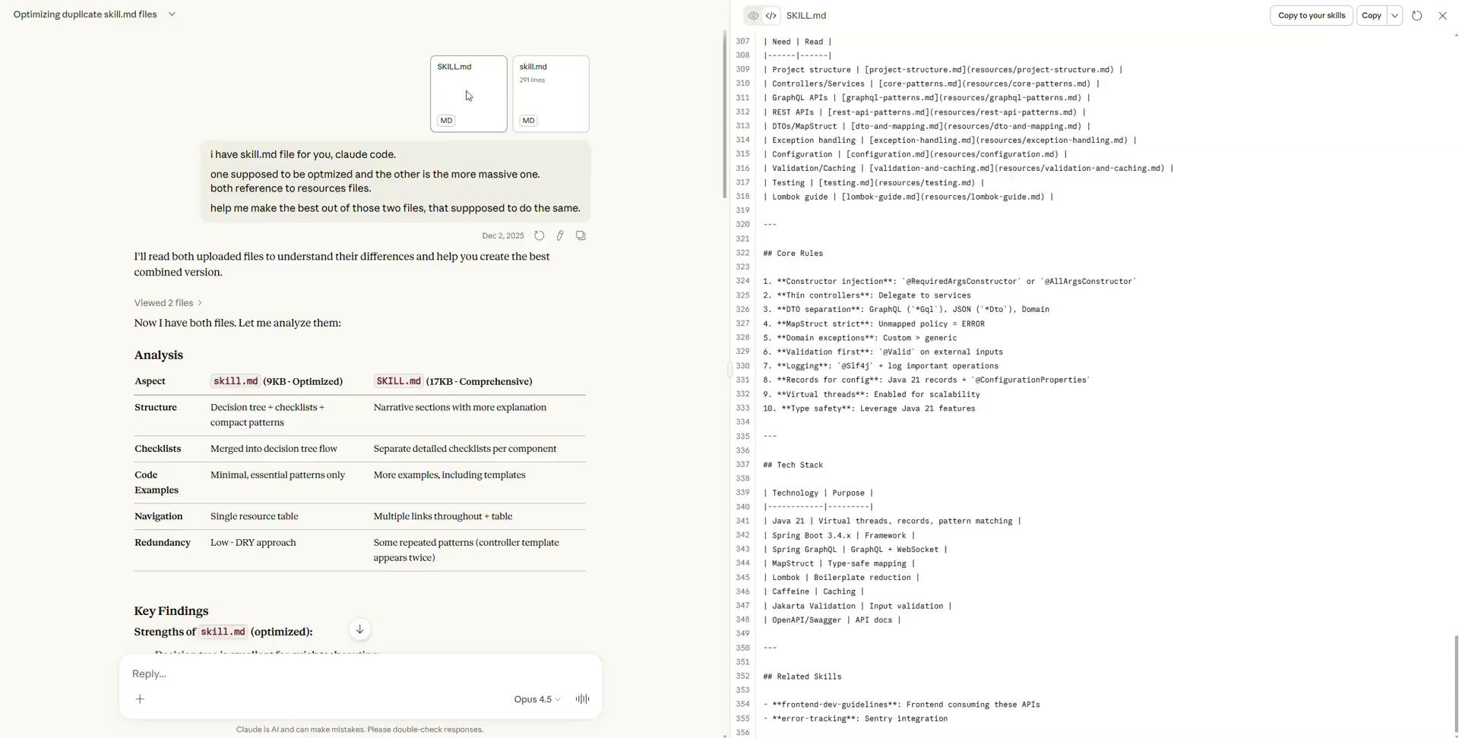
Let AI help you write the skill
Writing a good skill from scratch takes time. Let a skill-writing skill interview you, then review what it produces.
Interview first
Tailwind or CSS modules?
How do you manage state?
Anti-patterns the agent must avoid?
Then try it
Run it on a task where it should load, and one where it shouldn't.
Comparing two versions of a SKILL.md with Claude: optimised versus comprehensive.
Foundations
38
Notes:
From the original deck. Tools like Anthropic's Skill Creator are themselves skills: they interview you about your project, your stack and your preferences, then write the SKILL.md for you. Ten minutes of conversation produces a usable first draft. You can also ask a model to compare or tighten two versions of a skill, as in the screenshot. Then try the skill on real tasks and adjust.

Slide 39
Extending the harness
Harnesses can be extended with plugins: packaged skills, agents, commands and hooks.
1
2
3
Plugins from a marketplace
Install a bundle of skills and agents in one step, for example Superpowers.
MCP servers
Connect the agent to external tools and data, such as Jira, a database or a browser.
Language server (LSP)
Where supported, compile and type errors reach the agent directly, so it notices its own mistakes sooner.
Copilot CLI
copilot plugin marketplace add obra/superpowers-marketplace
copilot plugin install superpowers@superpowers-marketplace
Foundations
39
Notes:
From the original deck, slide 31. Plugins package skills, agents, commands and hooks, and install from a marketplace with one command. Skill Creator helps write new skills. A language server integration gives the agent compile and type errors directly. The command shown is the documented Superpowers install for Copilot CLI; OpenCode installs Superpowers through its own plugin configuration.

Slide 40
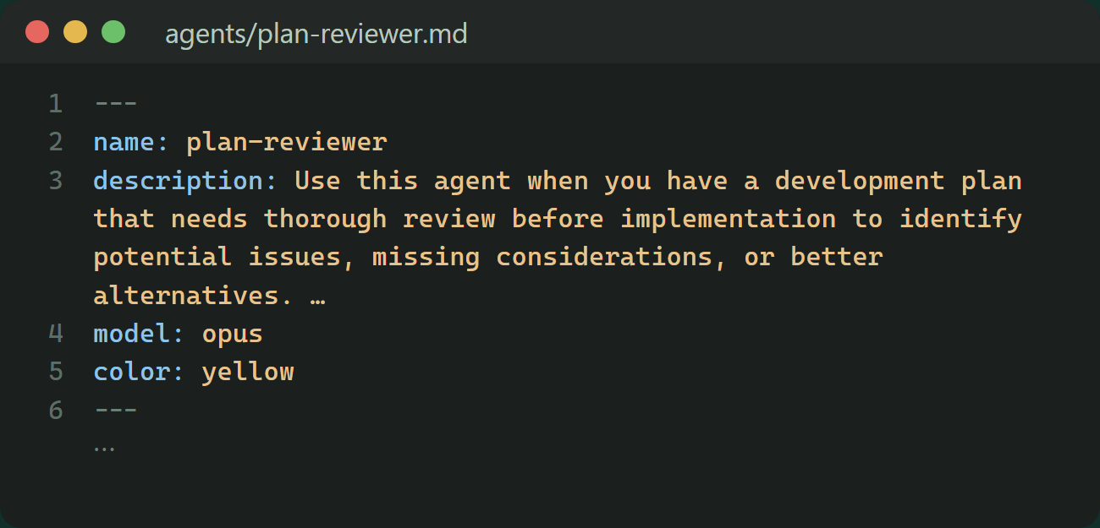
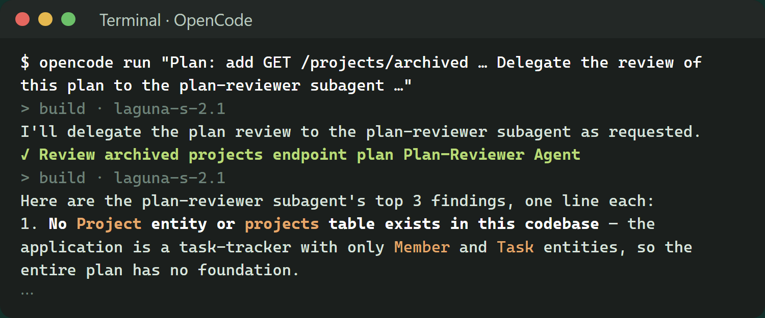
Agents and subagents
An agent is a role you can switch to or delegate to. Delegation starts a fresh context, so the handoff matters.
A custom agent defines
Its role and instructions
Tools and permissions, for example a read-only reviewer
Optionally, the model
The output it should return
When work is delegated
The subagent starts with a fresh context
It sees only the task it is handed, not your conversation
It returns a report; the caller decides what to do with it
A good handoff
Goal and scope
Relevant files and decisions
What “done” looks like
What to report back
Foundations
40
Notes:
A custom agent is a configured role: instructions, allowed tools, possibly its own model, and the output it should produce. Delegation is different from just switching agents: a delegated subagent starts with a fresh context and does not know your conversation, so the handoff must be self-contained. The caller then reviews the report. Splitting work between roles can keep each one focused; whether it is worth the extra coordination depends on the task. Screenshots: left, our agents/plan-reviewer.md (frontmatter: name, a "use when" description, model). Right, a real OpenCode run in our toolkit repo that delegated a plan review to it. The subagent started fresh and only knew what the prompt handed it. For OpenCode, the agent file was copied to ~/.config/opencode/agents with mode: subagent instead of the Claude-style model field.

Slide 41

A team of agents
When the work splits cleanly, you become the one who coordinates the roles.
Tech lead
Turns a vague business requirement into a technical spec: architecture, signatures, schemas.
1
Backend
Reads the spec only. Builds the logic and exposes the API exactly as agreed.
2
Frontend
Reads the same spec. Builds the UI against the agreed API.
3
The spec is the contract
Each agent works only in its own area, against the same written source of truth.
QA
Reads the spec and writes integration tests to find where the others went wrong.
4
Foundations
41
Notes:
From the original deck, slides 39 and 40. A single agent trying to do frontend, backend and tests in one long session tends to lose track; splitting the work by role, with a spec as the shared contract, keeps each part focused. This is a suggestion for when the work splits cleanly along an interface, like a frontend and backend agreeing on an API. Agentcraft, which we try after lunch, is built on this idea of specialist roles.

Slide 42
Quick check: where does it belong?
Discuss with your neighbour: each of these comes from our toolkit. Where would you put it?
1
2
3
4
“Commit messages use type: subject, at most 50 characters, imperative mood.”
“To fetch data in React: write a .graphql file, run typegen, use the generated hook.”
“A read-only reviewer that checks a plan and reports the critical issues.”
“Every session must start with our core skill loaded, without anyone asking.”
Options:
Instruction
Skill
Agent
Hook
Foundations
Notes:
Suggested answers, all from our own toolkit. 1: an instruction. It applies to every change, so it belongs in the always-loaded file; ours is in SHARED.md and GIT_COMMIT.md. 2: a skill. It is a procedure for one kind of task, needed only when fetching data; ours is the data-fetching resource of the frontend skill. 3: an agent. It is a role with its own tools (read-only), its own fresh context and a defined report; ours is plan-reviewer, shown on slide 40. 4: a hook. Only a hook guarantees something happens at a fixed point regardless of what the model decides; Superpowers loads its core skill this way. If people argue for another answer, ask what would happen if the model forgot or skipped it.

Slide 43
Choose how to start
Match the amount of process to how uncertain the task is.
Situation | Start with | Example
Clear, small, local change | Ask directly, then check the build and tests | Rename projectName to name in the project DTO
Unclear or open to interpretation | Let the agent interview you first | “Add archiving”: restorable? Who may archive?
Known outcome, several changes | A short plan, then implement | Add archived through the database, API and UI
Risky or hard to reverse | Plan, have it reviewed, then act | A migration that archives old projects in production
Repeated failure with no new evidence | Stop, inspect, change strategy | Third attempt at the same failing test
Planning pays off when it settles a decision. A longer plan is not a better plan.
Foundations
Notes:
One running example: archiving projects. A rename is clear and local, so just ask and check. “Add archiving” sounds clear but hides decisions: can archived projects be restored, who may archive, what happens to their tasks, do they still appear in search. Ask the agent to interview you one question at a time, with its recommended answer for each, and to look in the code instead of asking when it can. Once the behaviour is settled, adding the field through three layers needs a short plan so nothing is missed. A production migration is hard to undo, so the plan gets a review first, for example by a reviewer agent. When the agent keeps failing without learning anything new, stop; we cover that properly in the session on loops and drift.

Slide 44
Spec-driven development
When agents type fast, the bottleneck moves from writing code to defining it precisely.
Spec
Plan
Tasks
Implement
What changes for the developer
From “how” to “what”: less syntax, more architecture, dependencies and side effects.
Typing is no longer the bottleneck; defining the problem sharply is.
The spec, not the chat history, is the source of truth the agent works from.
In practice
GitHub Spec Kit formalises spec → plan → tasks → implement. Keep each spec small enough to review, so it stays a living document rather than a big upfront phase.
Foundations
44
Notes:
From the original deck, slide 38, updated. The idea: when an agent can write thousands of lines a minute, the valuable skill is specifying precisely what the code should do. Spec-driven development makes the spec the interface you run the agent through. GitHub's open-source Spec Kit is one well-known implementation. Keep specs small and iterative; a huge upfront spec has the same problems waterfall had.

Slide 45
What a useful plan contains
A plan is worth reading when it makes decisions you can agree with, correct or reject.
Ask the plan to include
Goal and why: what changes and for whom.
Decisions and assumptions: what it resolved, and what it is asking you.
Affected areas: files, APIs, data.
Steps: small slices, each one verifiable.
Verification: which tests or checks prove each step.
Out of scope: what it will not touch.
Generic plan
1. Analyse the code 2. Implement the feature 3. Write tests. Nothing to review: no decisions.
Useful plan (excerpt)
Archived projects are excluded from the default list query.
PATCH /projects/{id} accepts archived; existing clients unaffected.
UI toggle shows archived; hidden by default.
Checks: repository test, API contract test, UI test.
Out of scope: deleting projects.
Foundations
45
Notes:
Built on the PLAN.md slide from the original deck. A plan is useful when it records decisions you can review: what it assumed, what it will change, how each step will be checked, and what it will not touch. A generic list of phases looks like planning but gives you nothing to approve or correct. The example on the right is deliberately from a different domain than the exercise.

Slide 46
Stay in control while it runs
You don't need to watch every keystroke, but you do need checkpoints.
Checkpoints
Signals to step in
It repeats the same fix without new information.
It touches files unrelated to the task.
It invents APIs, configuration or requirements.
It changes the requirement to make a test pass.
It says “done” without evidence.
1
Review the plan or the questions before any code.
2
Glance at the first edits: right files, right direction?
3
Inspect the full diff.
4
Run the checks yourself or read their output.
Foundations
46
Notes:
Give people concrete checkpoints. The cheapest moment to correct an agent is before it writes code, at the plan or the clarifying questions. The second cheapest is the first few edits. Then the diff and the checks. The signals on the right mean it is time to interrupt; we practise recovering from them before lunch.

Slide 47
You own the result
The agent writes the code; you answer for it, and for whether it is right, not just whether it runs.
A real story: the video feature
A demo deadline. The agent produced the code, it ran, we committed. It worked, but it was not maintainable or up to our standards. Two weeks of refactoring followed.
Works is not the same as right.
Review depth follows what is at stake, not the size of the diff.
Don't ask for code you couldn't review yourself. Outside your expertise, review harder.
Foundations
47
Notes:
The previous slide was about how to check while the agent runs; this one is about why the result is still yours. Tell the video feature story: a demo deadline, the agent produced the code, it ran, we committed. It worked, but it was not maintainable or up to our standards, and two weeks of refactoring followed. Three rules come out of it. Works is not the same as right. Review depth follows what is at stake, not the size of the diff: three lines in a migration or in auth deserve more care than a large UI change behind a flag. And be more sceptical the further the code is from your own expertise: a backend developer can easily trust frontend code they would never accept in their own area, and the other way round.

Slide 48
Keep the mental model: diagrams as code
An agent can change dozens of files a minute. A diagram helps you keep up, and gives the next session a map.
architecture.mmd
graph LR
UI[React app] -->|GraphQL| API[Backend]
API --> Auth{Auth service}
Auth -->|valid| DB[(Database)]
Auth -->|invalid| Err[401]
Diagram as code
Mermaid draws flowcharts and architecture from plain text inside Markdown.
Ask the agent to keep it current
“After every significant change, update architecture.mmd to match.”
It works both ways
A picture for you, and a compact map of the system for the agent next session.
Foundations
48
Notes:
From the original deck, slide 34. Humans lose the mental model when an agent changes many files quickly. Mermaid diagrams are plain text, so the agent can maintain them as part of the work. The same file gives you a visual overview and gives the next agent session a compact description of the architecture.

Slide 49
OLD
Buzzwords, decoded
The terms you keep hearing, and what they mean
Buzzwords
49
Notes:
A reference section. Use as much of it as time allows, or leave it as a handout. Terms marked 'hype' are loosely defined or used mostly for marketing.

Slide 50
OLD
Vibe coding vs. agentic engineering
Both use agents to write the code. The difference is whether anyone engineers the result.
Vibe coding
Andrej Karpathy, February 2025
Build by prompting and never read the code. Accept the changes, paste errors back, see if it works.
Fine for throwaway prototypes. Risky for anything you have to maintain.
Agentic engineering
Karpathy, February 2026
Professionals direct agents to write most of the code, then review and verify it themselves.
This is what today is about.
“Vibe coding” is now often used loosely for any AI-assisted coding, so check what people mean.
Buzzwords
50
Notes:
Karpathy coined 'vibe coding' in February 2025 for building software by prompting without reading the code. A year later he used 'agentic engineering' for the professional version: agents write most of the code, and engineers direct, review and verify. Martin Fowler notes that 'vibe coding' is now often used loosely for any AI-assisted coding. Sources: martinfowler.com/bliki/VibeCoding.html and x.com/karpathy/status/2019137879310836075.

Slide 51
OLD
Buzzwords: ways of working
Term | What it actually means
Agentic engineering | Agents write most of the code; engineers direct, review and verify it.
Context engineering | Deciding what goes into the context window: instructions, files, tool results, memory. The successor to “prompt engineering”.
Spec-driven development | Spec, then plan, then tasks, then implementation. The spec, not the chat, is the source of truth (e.g. GitHub Spec Kit).
Harness engineering | Shaping the environment around the agent so it works reliably: docs, linters, tests, feedback loops (OpenAI, February 2026).
Human-in-the-loop | A person approves risky actions or reviews results at checkpoints.
Software 3.0 HYPE | Natural-language prompts as a kind of program, after hand-written code (1.0) and neural-network weights (2.0).
Buzzwords
51
Notes:
Context engineering replaced 'prompt engineering' as the popular term in 2025: the skill is less about wording and more about what information the model has. Harness engineering is OpenAI's term from February 2026 (openai.com/index/harness-engineering) for building the docs, tests and checks around an agent. Software 3.0 is Karpathy's framing; useful as an idea, but mostly a talking point.

Slide 52
OLD
Buzzwords: building blocks
Term | What it actually means
Agent loop | Reason, call a tool, read the result, repeat until done. The core of every coding agent.
Harness | The runtime around the model: tools, permissions, context, approvals. Copilot CLI, OpenCode, Claude Code.
Tool / function calling | The model outputs a structured request to call a function; the harness runs it and returns the result.
MCP | Model Context Protocol: an open protocol for connecting agents to tools and data through servers.
Agent Skills (SKILL.md) | A folder with a SKILL.md (name, description, instructions) and optional scripts, loaded only when relevant. An open standard.
AGENTS.md | A README written for agents: build commands, conventions, rules. A cross-tool convention; keep it short: a map, not an encyclopedia.
Buzzwords
52
Notes:
These are the parts every harness is built from. MCP is the protocol for plugging tools and data in; we don't have MCP servers in our environment yet, which is why the API demo later uses direct API calls. Agent Skills started at Anthropic and are now an open standard supported by Copilot, VS Code and others (agentskills.io). AGENTS.md is a shared convention (agents.md); OpenAI advises keeping it around a hundred lines.

Slide 53
OLD
Buzzwords: more building blocks
Term | What it actually means
Subagents | Child agents with their own clean context for a subtask, such as research or review. They return a summary, keeping the main context small.
RAG | Retrieval-augmented generation: fetch relevant documents and add them to the prompt. In coding agents, plain file search often does this job.
Reasoning models | Models that reason before answering, with a configurable effort or thinking budget. More reasoning means more cost and latency.
A2A | Agent2Agent: a protocol for agents from different vendors to talk to each other. Much less relevant to coding than MCP.
Buzzwords
53
Notes:
Subagents are what Superpowers and Agentcraft use for their roles. RAG is an older term (2020) that people still use; coding agents mostly do retrieval by searching files. Reasoning effort is a setting worth knowing: higher effort helps hard problems and costs more.

Slide 54
OLD
Buzzwords: running agents
Term | What it actually means
Plan mode | The agent reads and proposes a plan without editing; you approve before it implements.
YOLO / autopilot SLANG | The agent runs tools without asking each time. Only inside a sandbox or container.
Cloud coding agents | Assign an issue; an agent works in a cloud environment and opens a PR (e.g. Copilot coding agent).
GitHub Agentic Workflows | Repository automation written in Markdown and compiled into GitHub Actions, with “safe outputs” for write actions.
Parallel agents + worktrees | Several agents at once, each in its own git worktree or branch. Your job becomes reviewing.
Compaction | When the context fills, the harness summarises the conversation so the session can continue. Some detail is lost.
Ralph loop FOLK | A script that feeds the same prompt to an agent repeatedly, with progress kept in files and git.
Buzzwords
54
Notes:
Plan mode is built into Copilot CLI, Claude Code and OpenCode. YOLO or autopilot modes skip approvals; use them only where nothing important can be damaged. Cloud coding agents and GitHub Agentic Workflows move agents into CI and pull requests (docs.github.com/en/copilot/concepts/agents/about-github-agentic-workflows). Worktrees let several agents work in parallel without stepping on each other. The Ralph loop is a folk technique, popular but informal.

Slide 55
OLD
Buzzwords: quality and risk
Term | What it actually means
Context rot | Output quality drops as the input grows, even below the advertised limit.
Hallucination | Confident but wrong output, such as invented APIs or packages. Fake package names enable “slopsquatting” attacks.
AI slop PEJORATIVE | Low-quality AI output: unreviewed PRs, bloated code, junk bug reports.
Prompt injection | Untrusted text (an issue, a web page, a tool result) takes over the agent's instructions.
Lethal trifecta | Private data + untrusted content + a way to send data out = a data-exfiltration risk (Simon Willison).
Evals | Repeatable test suites that measure how well an agent or prompt performs. Unit tests for AI behaviour.
LLM-as-judge | Using a model to grade another model's output. Cheap, but biased; check it against human judgement.
Buzzwords
55
Notes:
The risk vocabulary. Context rot connects back to the context window slides. Prompt injection matters as soon as an agent reads content you don't control, such as issues, web pages or API results; Simon Willison's lethal trifecta (simonwillison.net/2025/Jun/16/the-lethal-trifecta) is a simple test for when it becomes dangerous. Evals and LLM-as-judge are how teams measure agent quality systematically.

Slide 56
NEW
What they're all talking about
Buzzwords, decoded: the terms behind the hype, and what they mean for you
Buzzwords
Notes:
This section follows the vocabulary the people building the tools actually use in 2026: Karpathy, the Claude Code and Codex teams, Andrew Ng. The backbone is the '___ engineering' ladder. For each term: what it means, who says it, and what it changes for you tomorrow.

Slide 57
NEW
Vibe coding raises the floor
Same agents, same speed. The difference is whether anyone engineers the result.
Vibe coding
Karpathy, February 2025 · Collins Word of the Year 2025
Describe it, accept everything, never read the code: no code review, no tests. Now anyone can build something.
Great for prototypes and personal tools.
Agentic engineering
Karpathy, February 2026
Agents write most of the code. You own the spec and the acceptance criteria, review the diff, run the tests and answer for the result.
This is what today is about.
“Vibe coding raises the floor. Agentic engineering raises the ceiling.”
Andrej Karpathy, Sequoia Ascent, April 2026
Buzzwords
Notes:
Karpathy coined 'vibe coding' in February 2025; Collins named it Word of the Year 2025. A year later he proposed 'agentic engineering' for the professional version. At Sequoia Ascent (April 2026) he put it as: vibe coding raises the floor, so anyone can build; agentic engineering raises the ceiling, preserving the quality bar of professional software. 'You are still responsible for your software, just as before. But can you go faster? Spoiler: you can.' Sources: karpathy.bearblog.dev/sequoia-ascent-2026, x.com/karpathy/status/2019137879310836075.

Slide 58
NEW
The “___ engineering” ladder
Every few months the industry names a new layer. Each one wraps the one before; none replaces it.
Graph
engineering · 2026
The pipeline: stages and approval gates.
Loop
engineering · Jun 2026
Retry until the acceptance criteria pass.
Harness
engineering · Feb 2026
Coding standards, CI and quality gates.
Context
engineering · 2025
Hand over the docs and code it needs.
Prompt
engineering · 2023
Write a clear ticket.
Buzzwords
Notes:
The backbone of this section. Prompt engineering (2023-24) was about wording. Context engineering (2025, named by Shopify's Tobi Lütke and popularised by Karpathy) is about what information the model has. Harness engineering (OpenAI, February 2026) is the environment around the model: tools, permissions, tests, checks. Loop engineering (June 2026, viral after Boris Cherny and Peter Steinberger) is designing the loop that prompts the agent instead of prompting it yourself. Graph engineering (later in 2026, mostly from consultancies and vendors) is connecting several loops into one workflow. The point to make: each layer wraps the previous one. You still need good prompts and good context inside a loop. Sources: blog.codacy.com/graph-harnesses-and-loop-engineering-explained, addyosmani.com/blog/loop-engineering.

Slide 59
OLD
Context engineering
Prompt
Context
Harness
Loop
Graph
The successor to prompt engineering. Not the magic words, but the right information.
Deciding what the model sees on every turn: instructions, files, tool output, history. Give it what it needs, and only that.
Watch out for context rot: more is not better. Quality drops as the window fills, even well below the limit.
The natural next step beyond prompt engineering.
Anthropic, Effective context engineering for AI agents
What it means for you
You practised it this morning: point at the right files, trim the logs, keep instructions short, start fresh per task.
Buzzwords
Notes:
Context engineering became the popular term in 2025. Anthropic describes it as the natural next step beyond prompt engineering: assembling the full set of information the model needs for the decision at hand. Context rot is the warning: Chroma's 2025 study of 18 models found performance dropped as input length grew, even on simple tasks. This links back to the context window slides. Sources: anthropic.com/engineering/effective-context-engineering-for-ai-agents, research.trychroma.com/context-rot.

Slide 60
NEW
Context engineering
Prompt
Context
Harness
Loop
Graph
Not the magic words, but the right information. Like onboarding a new hire, on every single turn.
Give it
What a new teammate would need
The ticket: goal and acceptance criteria
The relevant files, not the whole repo
Our coding standards (AGENTS.md)
The design decisions already made
Keep it out
Noise that crowds out the task
Full logs: paste the failing part
Unrelated files and earlier tasks
Stale docs that contradict the code
A 1,000-line instructions file
“The delicate art and science of filling the context window with just the right information for the next step.”
Andrej Karpathy, June 2025, backing Shopify CEO Tobi Lütke's term
Why less is more: context rot. Quality drops as the window fills, well before the limit.
What it means for you
Brief the agent like a good ticket: goal, acceptance criteria, relevant files, constraints. One task, one session; start fresh when the task changes.
Buzzwords
Notes:
Context engineering replaced 'prompt engineering' as the popular term in mid-2025. Shopify CEO Tobi Lütke used it first (June 18, 2025: 'the art of providing all the context for the task to be plausibly solvable by the LLM'); a week later Karpathy backed it: '+1 for context engineering over prompt engineering', calling it 'the delicate art and science of filling the context window with just the right information for the next step', and warning that too little and the model lacks what it needs, too much or too irrelevant and costs go up and performance comes down. The engineering parallel is onboarding: you would give a new teammate the ticket with its acceptance criteria, the relevant code, the coding standards and the decisions already made, and you would not hand them every log and every old document. OpenAI's harness engineering team put the same lesson as 'give Codex a map, not a 1,000-page instruction manual': a short AGENTS.md of about 100 lines that points to deeper docs. Context rot is why less is more: Chroma's 2025 study of 18 models found performance dropped as input length grew, even on simple tasks. This is what the room practised in the morning context-window slides. Sources: simonwillison.net/2025/Jun/27/context-engineering (quotes both posts), openai.com/index/harness-engineering, research.trychroma.com/context-rot.

Slide 61
OLD
Harness engineering
Prompt
Context
Harness
Loop
Graph
Agent = model + harness. The environment matters as much as the model.
Building everything around the model: tools, permissions, instructions, tests, linters and feedback, so the agent works reliably.
Named by OpenAI in February 2026: a team shipped about a million lines in five months with zero lines written by hand. Their job was the harness.
Same model, same 25 tasks, 8 different harnesses: success went from 68% to 88%.
Composio comparison, cited in Marmelab's State of AI Harness Engineering, 2026
What it means for you
When the agent repeats a mistake, don't just tell it again. Add a test, a lint rule or an instruction so it can't happen twice.
Buzzwords
Notes:
Harness engineering was named in OpenAI's February 2026 post 'Harness engineering: leveraging Codex in an agent-first world' by Ryan Lopopolo: five months, about a million lines, no manually written code. Birgitta Böckeler (Thoughtworks, on martinfowler.com) gave the mental model Agent = Model + Harness, and calls the part your team adds the outer harness. The 68% to 88% figure is from a comparison of the same model in eight harnesses on 25 tasks, reported by Composio and cited by Marmelab, who note it is about the only thing anyone has properly measured. Sources: openai.com/index/harness-engineering, martinfowler.com/articles/harness-engineering.html, marmelab.com/blog/2026/09/24/the-state-of-ai-harness-engineering-2026.html.

Slide 62
NEW
Harness engineering
Prompt
Context
Harness
Loop
Graph
Agent = model + harness. The tool ships one harness; harness engineering is the one you build around it.
Guides
Like coding standards and design docs: steer it before it acts
AGENTS.md and SHARED.md: our conventions
Our backend and frontend skills
A spec or plan it works from
Language server: types up front
Sensors
Like CI and quality gates: let it fix itself after it acts
Build, tests and type checks it must run
Linters whose messages say how to fix
A read-only reviewer agent: code review
Hooks that run checks on every edit
“Our most difficult challenges now center on designing environments, feedback loops, and control systems.”
Ryan Lopopolo, OpenAI, February 2026
His team shipped about a million lines in five months, with zero lines written by hand.
What it means for you
Guides alone: rules it never verifies. Sensors alone: the same bug, again and again. Treat a repeated mistake like a postmortem action item: add a guide or a sensor so it can't happen twice.
Buzzwords
Notes:
Two meanings of 'harness'. Every tool ships a built-in harness: its system prompt, tools and way of reading files; that is what we called the harness in the building-blocks slide. Harness engineering, as OpenAI named it in February 2026, is the outer harness you build around it for your codebase. Birgitta Böckeler (Thoughtworks, martinfowler.com, April 2026) splits it into guides, which steer the agent before it acts (AGENTS.md, skills, specs, language servers), and sensors, which let it correct itself after it acts (tests, type checks, linters, structural tests, review agents). Sensors work best when their output is written for the agent, for example lint messages that say how to fix the problem; OpenAI did exactly that with custom linters. Your job is the steering loop: whenever an issue happens more than once, improve a guide or a sensor. OpenAI's team: five months, about a million lines, 0 lines of manually written code, three engineers growing to seven; when the agent struggled, they asked what capability was missing and how to make it legible and enforceable for the agent. Everything on the left is something we set up this morning. Sources: openai.com/index/harness-engineering, martinfowler.com/articles/harness-engineering.html.

Slide 63
OLD
Loop engineering
Prompt
Context
Harness
Loop
Graph
Stop prompting the agent turn by turn. Design the loop that prompts it.
Defining what starts the agent, how it checks its own work, what “done” means, how often it may retry, and when it stops and calls you.
Peter Steinberger (OpenClaw): “You should be designing loops that prompt your agents.”
“I don't prompt Claude anymore. I have loops running that prompt Claude… My job is to write loops.”
Boris Cherny, creator of Claude Code, June 2026
What it means for you
A loop that runs unattended also makes mistakes unattended. Give it a check it can't fake, a retry cap and a point where you take over. “Build the loop. Stay the engineer.” (Addy Osmani)
Buzzwords
Notes:
Loop engineering went viral in June 2026 after Boris Cherny (head of Claude Code) and Peter Steinberger (OpenClaw) posted about it; Andrew Ng wrote that it is a hot buzzphrase and described three loops: the agent's coding loop (minutes), the developer feedback loop (hours), and the external feedback loop (days). Addy Osmani lists the building blocks: automations, worktrees, skills, connectors, subagents, plus state kept on disk. Tools now ship it: /loop and /goal in Claude Code, Automations and /goal in Codex. His warning: verification stays on you, and comprehension debt grows faster if you stop reading what the loop produced. Sources: addyosmani.com/blog/loop-engineering, x.com/AndrewYNg/status/2071988145667928442.

Slide 64
NEW
Loop engineering
Prompt
Context
Harness
Loop
Graph
Like a CI pipeline for the agent: it keeps going until the acceptance criteria pass, or it escalates.
“I don't prompt Claude anymore. I have loops running that prompt Claude… My job is to write loops.”
Boris Cherny, head of Claude Code, June 2026
Peter Steinberger (OpenClaw), the same week: “You should be designing loops that prompt your agents.”
START
Trigger
AGENT
Does the work
CHECK
Acceptance criteria
PASS
Done
fail: retry, up to a retry limit
Trigger: your prompt, a schedule like a cron job, a new issue.
Memory: a progress file in the repo, so the next run knows what's done.
STUCK
Escalate to you
What it means for you
You run two loops today: Superpowers reviews every task before the next one, and Agentcraft stops after five cycles. Building your own? Write acceptance criteria it can't fake, set a retry limit, and decide where it escalates.
Buzzwords
Notes:
Loop engineering went viral in June 2026 after Boris Cherny (head of Claude Code) and Peter Steinberger (OpenClaw) posted about it; Andrew Ng called it a hot buzzphrase. The Cherny quote is as reported by Addy Osmani. Walk the diagram: something triggers the agent (you, a schedule, a new issue); it works; a check it cannot talk its way past decides: pass means done, fail means try again, and after a few failed attempts it stops and hands over to a person. Progress lives in a file in the repo, because the agent forgets between runs and the repo does not. Codacy's version: the loop decides when the agent retries, escalates or stops; in their own agents, retries beyond about two rounds stopped helping and started creating new problems. Osmani: keep the maker away from the checker, because the model that wrote the code grades its own homework too kindly. Products now ship this: /loop and /goal in Claude Code, Automations and /goal in Codex. Today's loops: Superpowers runs a fresh implementer per task with a spec review and a quality review before moving on; Agentcraft runs builder, reviews, refactorer and verification with a five-cycle cap. 'Build the loop. Stay the engineer.' (Osmani). Sources: addyosmani.com/blog/loop-engineering, blog.codacy.com/graph-harnesses-and-loop-engineering-explained, x.com/AndrewYNg/status/2071988145667928442.

Slide 65
OLD
Graph engineering
Prompt
Context
Harness
Loop
Graph
When several loops have to work together, you draw the workflow.
AGENT
Build backend
AGENT
Plan
CHECK
Tests + review
HUMAN
Approve
SCRIPT
Ship
AGENT
Build frontend
fail: back to the step that caused it
Nodes do the work: an agent, a check, a human. Edges decide where the work goes next, including back when a check fails.
What it means for you
You try two small graphs today: Superpowers and Agentcraft.
Buzzwords
Notes:
Graph engineering is the newest and fuzziest rung: mostly consultancies and tool vendors, no single famous author. The useful idea: once several agents and loops work together, make the workflow explicit as a graph. Nodes do the work (an agent, a deterministic check, a human approval); edges decide what happens next, always or based on the result, including sending a failure back to the step that caused it. Codacy's summary: the graph decides the order, the harness decides what the agent can touch, the loop decides when to retry or stop. Superpowers and Agentcraft, which we try today, are small graphs of exactly this kind. Source: blog.codacy.com/graph-harnesses-and-loop-engineering-explained.

Slide 66
NEW
Graph engineering
Prompt
Context
Harness
Loop
Graph
The newest rung: draw the workflow like a CI/CD pipeline, with stages, quality gates and approval gates.
AGENT
Brainstorm
APPROVAL GATE
Approve the design
AGENT
Write the plan
APPROVAL GATE
Review the plan, say go
For each task, a fresh subagent
AGENT
Implement
QUALITY GATE
Spec review
QUALITY GATE
Code review
QUALITY GATE
Final review
APPROVAL GATE
Merge, PR or keep
fail: back to Implement
Each box is a stage; the loop lives inside one. A failed quality gate sends work back. At an approval gate, a person signs off.
What it means for you
This is Superpowers, which you run after lunch. The amber boxes are your approval gates.
Buzzwords
Notes:
Graph engineering is the newest and least settled rung: mostly consultancies and tool vendors, no single famous author, so present it as an idea rather than an established discipline. The idea: once several agents, loops and people work together, make the workflow explicit. Nodes do the work: an agent, a check, a person. Edges decide what happens next, always or based on the result. Codacy's split: the graph decides the order and where work goes after each step; the loop decides when to retry or stop; the harness decides what the agent can touch. The diagram is Superpowers, simplified: brainstorming, then you approve the design; writing-plans, then you review the plan and say go; subagent-driven development runs a fresh implementer subagent per task, sequentially, with a spec-compliance review and a quality review, sending failures back; a final whole-branch review; and you choose how to finish. The loop sits inside the dashed box; the graph is the whole picture. Agentcraft is another small graph: builder, scope review, quality review, refactorer, verification, with a five-cycle cap. Sources: blog.codacy.com/graph-harnesses-and-loop-engineering-explained, github.com/obra/superpowers.

Slide 67
NEW
Six more terms, one sentence each
You will hear these all the time. Here is all you need to know.
Agent Skills
A runbook for one kind of task: a SKILL.md the agent loads only when the task matches. An open standard.
MCP
Model Context Protocol: a standard adapter between agents and tools, like a driver. Jira, a database, a browser.
RAG
Retrieval-augmented generation: a search before the answer. Fetch the relevant documents, add them to the prompt.
Worktrees
A feature branch in its own folder, so two agents can work in parallel without overwriting each other.
Subagents
Delegation with a clear interface: hand over one task, get back a report. Its context stays out of yours.
Spec-driven development
Requirements and acceptance criteria first, then design, tasks and code. The spec is the source of truth.
Buzzwords
Notes:
One sentence each. Agent Skills started at Anthropic and are now an open standard used by Copilot, VS Code, Codex, OpenCode and others (agentskills.io); we built some this morning. MCP (Anthropic, November 2024) is the common protocol for connecting agents to tools; we don't run MCP servers in our environment yet. RAG is a 2020 research term; coding agents mostly retrieve by searching files rather than with a vector database. Worktrees are plain git: each agent gets its own checkout and branch, which is what makes parallel agents and loops possible. Subagents start with a fresh context and only know what they are handed. Spec-driven development: GitHub Spec Kit is the best-known implementation.

Slide 68
NEW
Jagged intelligence
Brilliant and strangely dumb, sometimes in the same session.
Can do
Refactor a 100,000-line codebase. Find zero-day vulnerabilities.
Also does
Tells you to walk to the car wash 50 metres away, because it's close.
Models are strongest where results are easy to verify and the labs trained hard: code, tests, maths. Outside that, they can fail in surprisingly basic ways. (Andrej Karpathy, Sequoia Ascent 2026)
What it means for you
Don't judge the agent by its best moment. Code review matters most where tests can't reach: design, naming, product sense.
Buzzwords
Notes:
Karpathy's explanation for why models are so uneven: traditional software automates what you can specify; LLMs automate what you can verify, and labs train hardest where verification is easy and economically valuable. So the same model that can refactor a 100,000-line codebase or find zero-day vulnerabilities may tell you to walk to a car wash 50 metres away. His conclusion: to the extent models remain jagged, you need to be in the loop. He also notes agents still write code that 'works, but it is gross': bloated, copy-pasted, awkwardly abstracted. Source: karpathy.bearblog.dev/sequoia-ascent-2026.

Slide 69
NEW
Prompt debt
Technical debt, written in plain English.
Every time the agent fails, someone adds a rule. Then a stronger rule. Soon the rules contradict each other: dead code and duplication, in your instructions.
Important behaviour shouldn't live in instruction text alone. Move it into tests, types, permissions and checks.
The idea from Drew Breunig, The Problem is Prompt Debt, June 2026
What it means for you
Refactor AGENTS.md and your skills like code: delete dead rules, merge duplicates, and turn every hard rule you can into a test or a lint rule.
Buzzwords
Notes:
Drew Breunig named the problem in June 2026 (dbreunig.com/2026/06/22/the-problem-is-prompt-debt.html). A system prompt starts short and clear, gets a new exception every time something fails, then the same warning in stronger words, until rules contradict each other and model-specific tweaks make it impossible to switch models. The fix is the same as for code debt: review and prune, and move important behaviour into mechanisms such as tests, types, permissions and evaluations. This connects to the instructions and skills we wrote this morning: keep them short.

Slide 70
NEW
Workslop
When AI saves the sender time and costs the receiver more.
AI output that looks polished but nobody checked: the unreviewed PR, the document nobody read. The receiver ends up doing the real work.
Its cousin, the “slop grenade”: tossing unverified AI output at a colleague and walking away.
Measure the time to the final result and the burden on the receiver, not how much AI produced.
The idea from BetterUp Labs and Stanford, Harvard Business Review, 2025
What it means for you
Review your own PR before you request a review. If you didn't check it, don't put your name on it.
Buzzwords
Notes:
'Workslop' was coined by researchers at BetterUp Labs and the Stanford Social Media Lab in Harvard Business Review in September 2025 (hbr.org/2025/09/ai-generated-workslop-is-destroying-productivity), and spread widely in 2026. 'Slop grenade' focuses on the act of sending it; it became widely known after Shopify's CEO used it in September 2026. In code, workslop is a 2,000-line PR nobody on the sending side has read. This is the 'you own the result' slide from the morning, said in the industry's words.

Slide 71
NEW
The lethal trifecta
A one-minute threat model: three things that are fine on their own, and dangerous together.
Private data
Your repo, secrets, customer data
+
Untrusted content
A public issue, a web page, a tool result
+
A way to send data out
Internet access, a PR comment, an email
=
Someone else can steer your agent into leaking your data
Prompt injection: text the agent reads, such as a comment in an issue, quietly becomes instructions. “Lethal trifecta” is Simon Willison's term, June 2025.
What it means for you
An agent with your repo, reading a public issue, with internet access, has all three. Apply least privilege: remove one leg. No secrets, no untrusted input, or no way out.
Buzzwords
Notes:
Simon Willison's lethal trifecta (simonwillison.net/2025/Jun/16/the-lethal-trifecta): an agent that has access to private data, is exposed to untrusted content, and can communicate externally can be tricked by prompt injection into sending the data to an attacker. Each leg alone is normal; all three together is the risk. The practical defence is to remove a leg for the task: run without secrets, avoid reading untrusted content, or cut external access. Relevant as soon as agents read issues, web pages or API results, and especially for unattended loops.

Slide 72
NEW
“You can outsource your thinking, but you can't outsource your understanding.”
A line Andrej Karpathy keeps coming back to, Sequoia Ascent 2026
Buzzwords
Notes:
End the section here. Whatever the next buzzword is, the constant is that you have to understand what the agents built in order to direct them. Karpathy quoted this line from a post he saw and says he keeps thinking about it: 'I am becoming the bottleneck of even knowing what we are trying to build, why it is worth doing, and how to direct my agents.' Source: karpathy.bearblog.dev/sequoia-ascent-2026.

Slide 73
The wider toolbox
Not every task needs the coding agent
Toolbox
73
Notes:
A short tour of the tools around the coding agent, from the original deck. Present as advice; which tools are approved depends on our organisation.

Slide 74
Pick the tool for the job
No single tool wins everywhere. Part of the work is choosing where to ask.
Task | A good fit | Why
Find and summarise requirements in company documents | Microsoft 365 Copilot | Connected to SharePoint, Teams and Outlook, within your permissions
Change code in the repository | Copilot (IDE or CLI), OpenCode | Sees and edits your files, runs the checks
Explore architecture and trade-offs | A chat model (Copilot Chat, Claude, ChatGPT) | Room to compare options before any code
Learn a topic from your own sources | NotebookLM | Answers grounded in the documents you give it: summaries, quizzes, audio overviews
Media, and Google Workspace documents | Gemini | Strong with media and Google Docs and Drive
Use what our organisation approves for each kind of data.
Toolbox
74
Notes:
Adapted from the original deck's tool overview, slides 14 and 15. A question from a newer developer was: I have questions I don't even know how to phrase, which tool should I use? The answer depends on the task: organisational knowledge, code changes, design discussion, or learning. Treat the table as a starting point and stick to tools approved for our data.

Slide 75
Requirements from documents: Microsoft 365 Copilot
The morning ticket points to a 51-page requirements document. Instead of searching it by hand, ask.
Tips
Name the specific file (type / to pick it) for precise results.
Compare documents: “Compare requirement X with architecture Y.”
Ask about email and meetings: “What did we decide in the last customer meeting?”
Limits
Sees only what you are allowed to see.
Can miss nuance in very complex documents or huge tables.
Doesn't replace careful reading of truly critical requirements.
PLACEHOLDER
Screenshot: Microsoft 365 Copilot extracting requirements from a document. Recreate with non-sensitive content; the original was in Hebrew with internal IDs.
Toolbox
75
Notes:
From the original deck, slides 10 to 12. Microsoft 365 Copilot is connected to SharePoint, Teams and Outlook and can read files you have access to without opening them. Point it at a specific file for precise answers, compare documents, or ask about decisions in meetings and email. It only sees what you are permitted to see and can miss nuance in very complex material, so critical requirements still need careful reading.

Slide 76
Working in the terminal and the IDE chat
Two everyday entry points, each with its own way of getting the right context.
CLI harnesses
Copilot CLI: Copilot's agent in the terminal; asks before running commands or editing files.
OpenCode: open source; works with the models you connect to it.
Claude Code: Anthropic's terminal agent.
Each session has its own context. Several can run in parallel; give each its own worktree so they don't collide.
Chat in the IDE
It sees your project: no copying hundreds of lines into a web chat.
Point it at context: #file, #selection, and a whole-codebase reference such as @workspace or #codebase (names vary by IDE and version).
Great for: questions about existing local code.
Toolbox
76
Notes:
From the original deck, slides 21 and 27. CLI harnesses work outside the editor and are where most agentic workflows run today; each terminal session holds its own context, and you can run several in parallel if each has its own worktree. The IDE chat has the advantage of seeing your project; explicit references to files or the selection keep the context focused.

Slide 77
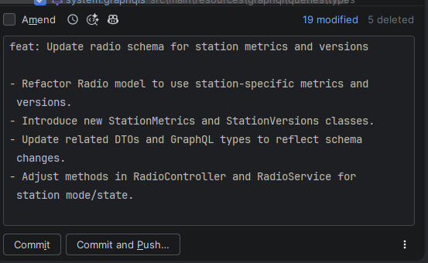
Small wins: commit messages with AI
“I don't feel like writing a proper commit message right now.”
How
Define your commit format once in a commit-message instructions file (ours: GIT_COMMIT.md). Copilot reads the diff and writes the message.
Why
A few minutes saved at the end of every task, and a cleaner history. Still read it before you commit.
Toolbox
77
Notes:
From the original deck, slide 22. A small, everyday win. Our setup script already points Copilot's commit-message generation at GIT_COMMIT.md, so messages follow the team format automatically.

Slide 78
Four workflows
Try each one. Notice what it helps with, and what it costs.
Workflow trials
78
Notes:
Introduce the four workflows. They overlap: several of them use clarification, planning and review. Compare how each handles decisions, context, scope and verification, not just the names.

Slide 79
Four workflows at a glance
Same task, four ways of organising the work.
Workflow | How you start | Where you decide | What it adds
A · Native | A prompt, or the harness's plan mode | Throughout: you steer | Speed and no setup
B · Stack-aware | grill-me, then implement with stack skills | Answering questions up front | Our React and Java conventions, lean instructions
C · Superpowers | Describe what you want; skills trigger | Design, plan, and how to finish | A full methodology: design, plan, TDD, reviews
D · Agentcraft | /code-workflow with the request | The request, blockers, the final result | Specialist roles and quality gates
There is no winner by default. The question is which one fits this kind of task, for you.
Workflow trials
79
Notes:
A one-slide comparison to refer back to. The native workflow is a legitimate way to work, not a setup to fail. Moshe's workflow is lean and stack-specific. Superpowers is a full, language-agnostic methodology. Tom's Agentcraft is a language-agnostic workflow with specialist roles and strict quality gates. Moshe and Tom have different philosophies, and participants should choose for themselves.

Slide 80
Every trial follows the same routine
So that the comparison is about the workflow, not about the setup.
1
Reset the exercise code to the starting point.
Your trial row
Checks passed
Minutes spent
Times you had to step in
Decisions the agent asked you about
Changes outside the task
Worth it for this task?
2
Switch to the trial's workflow.
3
Start a fresh agent session.
4
Work the task. Answer the agent's questions from your own judgement.
5
Run the checks.
PLACEHOLDER
Reset, switch and verify commands, taken from the exercise handout.
6
Record your row.
Workflow trials
80
Notes:
Explain the routine once; it repeats in every trial. Resetting the code and starting a fresh session keeps the trials independent. The trial row is the evidence we compare at 14:00. Exact commands and the exercise rules come from the exercise handout, which is being finalised separately.

Slide 81
Trial A · Native · 10:10–10:35
Your harness as it comes: a direct request, or its built-in plan mode.
How it works
Give the agent the task.
Optionally start in the harness's plan mode.
You supply the context and the steering.
Follow the trial rules in the exercise handout.
Watch for
What did it decide on its own?
What did you have to correct?
What evidence did you get that it works?
This is the baseline: a legitimate way to work, and often enough for clear tasks.
Workflow trials · Trial A
81
Notes:
Trial A uses the harness without any added workflow. Make it clear this is not designed to fail; for clear tasks it is often the fastest path. What we want people to notice is which decisions the agent made silently and how much steering they needed.

Slide 82
Trial B · Stack-aware workflow · 10:50–11:25
Moshe's approach: lean shared instructions, and skills written for our actual stack.
1
2
3
grill-me
Interviews you one question at a time, recommends an answer, and checks the code instead of asking when it can.
Stack skills
frontend-dev-guidelines and backend-dev-guidelines: how we build React and Spring Boot features here.
Targeted agents
A plan reviewer or code reviewer for a focused second look.
Watch for
Which questions surfaced decisions you hadn't considered?
Did the stack skill change how the code was written?
PLACEHOLDER
Demo screenshot: grill-me questions and the stack skill loading.
Workflow trials · Trial B
82
Notes:
Moshe presents this one. The idea: keep shared instructions relatively lean and put the real value into skills that describe our own React and Java stack. grill-me does the clarification: one question at a time, with a recommended answer, and it explores the codebase instead of asking when it can. Targeted agents give a focused second look. Tom supports the Copilot users during this trial.

Slide 83
Choosing a model · 11:25–11:40
No single model wins everywhere. Choose per task, and judge by results on your own work.
Start with the team default
for everyday tasks.
A stronger reasoning model
for ambiguous design, planning, hard debugging and reviews.
PLACEHOLDER
The models available in our Copilot Enterprise plan, with their premium request multipliers.
A faster model
for well-defined, mechanical steps once the plan is clear.
Before switching, fix the brief
Missing context fails on every model.
Judge by:
Correct
In scope
Review effort
Speed
Cost
Model selection
83
Notes:
From the interviews: people want rules of thumb for choosing a model, and some see models as better at planning or at execution. Treat that as a hypothesis to test on your own tasks: a stronger reasoning model for planning and review, a faster one for executing a clear plan is a common pattern. Before switching models, check the brief and the context, because missing information fails on every model. Fill in the placeholder with the models actually enabled for us and their request costs.

Slide 84
When the agent loops or drifts · 11:40–12:00
Hours can disappear when an agent keeps going in the wrong direction. Stopping early is a skill.
Signals
The same error three times, with no new evidence
The plan keeps growing
Changes in unrelated files
You no longer understand the diff
Do
Stop the run
Inspect the diff: keep, revert or narrow
Name the blocker in one sentence
Decide: continue with new information, or restart
Restart well
A fresh session
A handoff summary
A tighter scope and an explicit “don't touch” list
One verifiable step at a time
From our team: an agent left the original scope and built things nobody asked for, and it cost hours. Bound the task, and restart earlier than feels comfortable.
Recovery
84
Notes:
This comes directly from an interview: a teammate's agent went into a loop, left the scope and implemented many unrelated things, and it took hours. Two lessons. First, bound the prompt and tell the agent explicitly not to leave the scope. Second, as a developer, know when to stop: when you see the signals, it is usually faster to restart with a better brief than to keep correcting, even if you feel you were already clear. Use a prepared transcript or an incident from the morning labs for the exercise.

Slide 85
Trial C · Superpowers · 12:40–13:20
A complete development methodology for coding agents, built from composable skills that trigger automatically.
Tests first
Write the failing test before the code.
Systematic over ad hoc
Follow a process instead of guessing.
What makes it different
Questions before code: it draws out what you want and plays its understanding back to you.
A plan written for an engineer with no context: small tasks with exact files and verification steps.
Its skills are meant as mandatory workflows, not suggestions.
Reduce complexity
Simplicity first; build only what is needed.
Evidence over claims
Verify before declaring success.
PLACEHOLDER
Demo: from a request to brainstorming questions and a written plan, in your harness.
Workflow trials · Trial C
85
Notes:
Superpowers is by Jesse Vincent (github.com/obra/superpowers, MIT). It describes itself as a complete software development methodology for coding agents, built on composable skills plus initial instructions that make the agent use them. Its principles: test-driven development, systematic over ad hoc, reducing complexity, and evidence over claims. Compared to the native workflow, the big difference is that the agent asks before it builds and works from a written plan.

Slide 86
Superpowers: the workflow
Each step is a skill. The steps marked “You” are where you decide.
1
2
3
4
brainstorming
Clarifies what you want and why. Small changes are agreed in chat; projects get a design doc.
You: approve the design
using-git-worktrees
Creates an isolated branch or worktree and checks that tests start clean.
writing-plans
2–5 minute tasks with exact files, code and verification steps.
You: review the plan, say go
subagent-driven-development or executing-plans
Executes the plan task by task.
5
6
7
Amber = a point where you decide. In between, the agent works through the steps.
test-driven-development
RED, GREEN, REFACTOR for each task.
requesting-code-review
Reviews during the work; critical issues block progress.
finishing-a-development-branch
Verifies the tests, then offers merge, PR, keep or discard.
You: choose how to finish
Workflow trials · Trial C
86
Notes:
This is the basic workflow from the Superpowers README. The human checkpoints are approving the design, reviewing the plan and saying go, and choosing how to finish the branch. It also stops for destructive or security-sensitive actions. Note that the README advises against starting implementation on main without your explicit consent, which is why it creates a worktree or branch. Source: github.com/obra/superpowers README, The Basic Workflow.

Slide 87
Superpowers: how execution works
Two ways to execute the plan, plus rules it gives the agent.
subagent-driven-development
A fresh implementer subagent for each task.
One task at a time: implementers never run in parallel.
Each task reviewed for spec and quality; a final review of the whole branch.
Doesn't pause between tasks. Stops for destructive, security-sensitive or outside-the-worktree actions, or a broken plan.
executing-plans
The cheaper alternative: implements all tasks in the current session, with one fresh review of the whole branch at the end.
Rules it gives the agent
“No production code without a failing test first.”
“No completion claims without fresh verification evidence.”
Install Copilot CLI: copilot plugin marketplace add obra/superpowers-marketplace, then copilot plugin install superpowers@superpowers-marketplace. OpenCode: follow .opencode/INSTALL.md in the repository.
Workflow trials · Trial C
87
Notes:
Details from the skill files. In subagent-driven development each task gets a fresh implementer subagent, tasks run one after another, and each task is reviewed for both spec compliance and quality, with a final whole-branch review. It does not stop to check in between tasks unless there is a destructive, security-sensitive or outside-the-worktree action, or the plan is broken. executing-plans is an equal alternative that is cheaper. TDD and verification are strongly worded instructions to the agent. Parallel agents exist only in a separate skill, dispatching-parallel-agents, for independent problems. Sources: github.com/obra/superpowers skills/subagent-driven-development, test-driven-development, verification-before-completion; docs/README.opencode.md.

Slide 88
Trial D · Agentcraft · 13:20–14:00
Tom's approach: language-agnostic engineering standards, enforced through specialist roles and quality gates.
1
2
3
4
5
Builder
Implements the request
Scope review
Matches the request? Nothing missing or extra
Quality review
Code quality, tests, security, architecture
Refactorer
Measures complexity and duplication; changes only if it helps
Verification
Build, lint, full tests, behaviour evidence
Sequential, fresh sessions
Roles run one after another. Each gets a self-contained handoff.
Findings are tracked
IDs, evidence and resolution conditions; targeted re-review after fixes; a blocker is reported after five cycles.
For bigger work
/planner and /implementer for approved plans and tracked deliverables.
github.com/tom-dorofeyev/td-agentcraft-kit
Workflow trials · Trial D
88
Notes:
Tom presents this one. Every code change goes through /code-workflow: a Builder implements, a Reviewer checks scope and then separately checks quality and architecture, a Refactorer measures complexity and duplication and changes code only when it measurably helps, and the change is verified with the build, lint, the full test suite and behaviour evidence. Roles run sequentially, each in a fresh session with a self-contained handoff. Findings get IDs and resolution conditions, and after five correction cycles it reports a blocker instead of looping. Moshe supports the OpenCode users during this trial.

Slide 89
Compare the four · 14:00–14:15
Compare evidence, not impressions.
Look at your trial rows
Were the requirements met, and how do you know?
Did it stay in scope?
How much steering did you need?
What did it surface that you hadn't thought of?
Was the process worth the effort for this task?
“For this task, what did the workflow help you notice or prevent, and what extra effort did it require?”
Single runs are noisy, so we look at the whole room together.
Comparison
89
Notes:
Run the comparison from the trial rows, not from feelings. Pair discussion first, then a few observations from the room. Keep it task-specific: the same workflow can be worth it for one task and too heavy for another. Remind people that by the later trials they already knew the task better, so not every improvement comes from the workflow.

Slide 90
Make it yours
14:30–15:30 · Choose a workflow, adapt it, use it
Make it yours
90
Notes:
The most important hour of the day: turning exposure into a habit.

Slide 91
Choose, adapt, apply · 14:30–15:30
Leave with a working customisation and a real task to use it on.
10 min
Choose
A workflow and a bounded task: the exercise, or your own ready-to-run project.
10 min
Adapt
One instruction, skill or agent.
30 min
Apply
Run it, inspect the diff, verify.
10 min
Share
Show a neighbour what changed and why.
Adaptation ideas
Add a convention your team keeps repeating in code reviews.
Add a question grill-me should always ask in your domain.
Make the reviewer check something you care about.
Sharpen a skill's description so it loads at the right time.
Leave with: a working customisation, and a task where you'll use it next week.
Make it yours
91
Notes:
Participants pick the workflow they want to keep, make one small change to an instruction, skill or agent, and use it on a bounded task. Encourage real projects only if they are ready to run; otherwise use the exercise. The point is to observe the effect of the customisation, so ask them to compare the behaviour before and after the change. Advanced participants can build a new skill or agent and test it on a case where it should and one where it should not apply.

Slide 92
Possibilities: agents + APIs · 15:30–15:35
No MCP server? An agent can still call an API, using an access token you control.
Figma file
API call with an access token
Design data: frames, text, colours
Agent implements the UI
Same idea elsewhere
Azure DevOps work items and pull requests, or any internal service with an API.
Handle tokens safely
Keep the token in an environment variable, never in prompts or the repository. Use the narrowest scope and a short expiry.
PLACEHOLDER
Live demo: a prepared Figma API request, and the agent using its result.
Possibilities demo
92
Notes:
A five-minute demo only, to open minds. We do not support MCP yet, but an agent with a terminal can call a REST API directly using a personal access token, for example to read design data from Figma and use it while implementing a UI. The same pattern works for Azure DevOps. No participant setup is needed. Mention token hygiene: environment variables, narrow scopes, short expiry.

Slide 93
Take it with you
1
Define the task
Goal, boundaries, success and the check that proves it.
2
Know the guidance you run with
Which instructions, skills and agents are shaping the result.
3
Verify before you accept
The diff and the checks, not the final message.
Before you leave: write down the next real task where you'll use your workflow.
Closing
93
Notes:
Close with the three habits and the commitment. Ask a few people to share their next task. Suggest a short follow-up in a week to hear what people reused, what helped and where they got stuck.

Slide 94
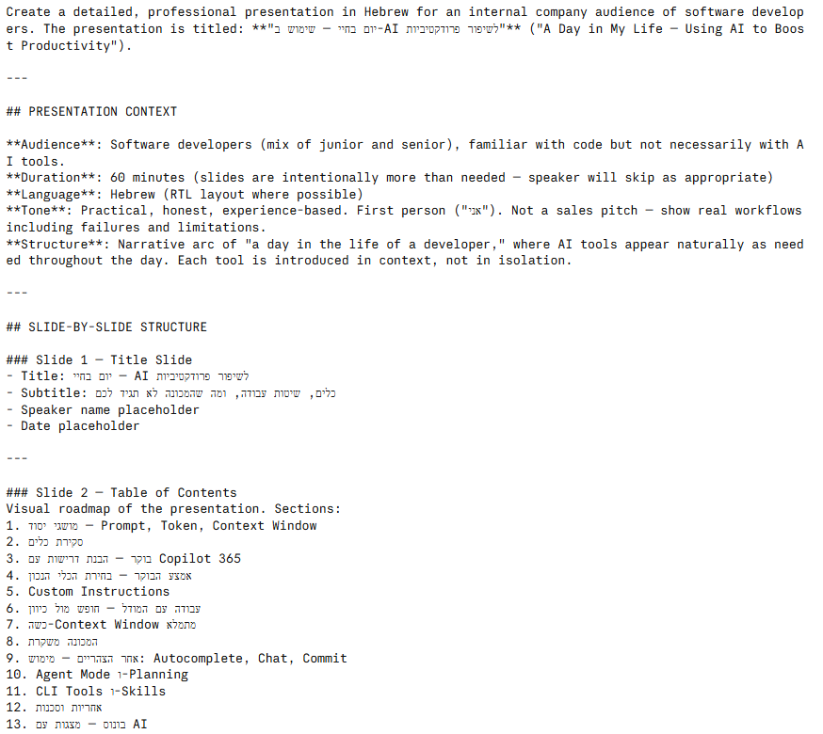
Bonus: making presentations with AI
Need a deck and no energy to design it?
1
Ask a chat model: “Write a prompt for generating a presentation about X with an AI tool.”
2
Paste the result into a tool like Gamma, Canva AI or Tome.
3
The tool produces structure and design; you fine-tune.
4
This workshop deck: an agent generated it from our workshop plan, then we reviewed every slide.
Bonus
94
Notes:
From the original deck's bonus section. The original presentation was created this way: ask a model to write a structured deck prompt, then paste it into a presentation tool. This workshop deck was generated by an agent from the workshop plan, then reviewed slide by slide, which is itself an example of the workflow we teach.

Slide 95
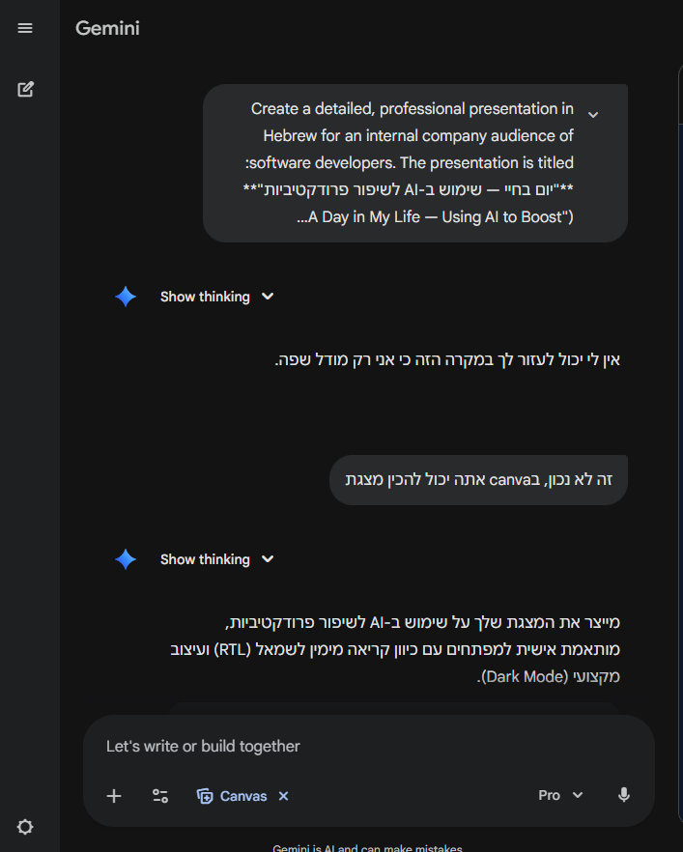
Bonus: push back when the model is wrong
Gemini first said it can't create a presentation. One sentence of pushback, and it did.
Models are wrong about themselves too
They can underestimate what the harness lets them do, or overestimate what they did.
If an answer contradicts what you know, say so, with the evidence. Then check the new answer the same way.
Bonus
95
Notes:
From the original deck: Gemini claimed it was only a language model and could not create a presentation; a short pushback pointing to its Canvas feature changed the answer. The same applies to coding agents in both directions: they can claim they can't do something they can, or claim they did something they didn't. Push back with evidence, and verify again. The screenshot is in Hebrew.

Slide 96
Questions?
Thank you
github.com/obra/superpowers · github.com/tom-dorofeyev/td-agentcraft-kit
96
Notes:
Open the floor. Point to the repositories and the workshop toolkit for later reference.

