Slide 1
JIGSAWS DATASET
A Surgical Activity Dataset for Human Motion Modeling

Slide 2
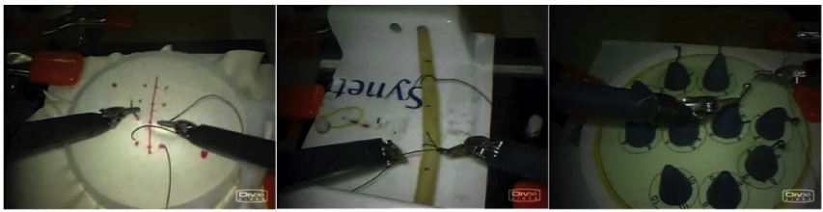
Task repetition
8 surgeon with different levels of skills
3 tasks : suturing, knot-tying, needle-passing
performing 5 repetitions
Trials 104 : 39 suturing, 36 knot-tying, 28 needle passing (16 trials failed)
Suturing
Knot-tying
Needle-passing

Slide 3
Environment
“Phantom” – simulated or artificial environment

Slide 4
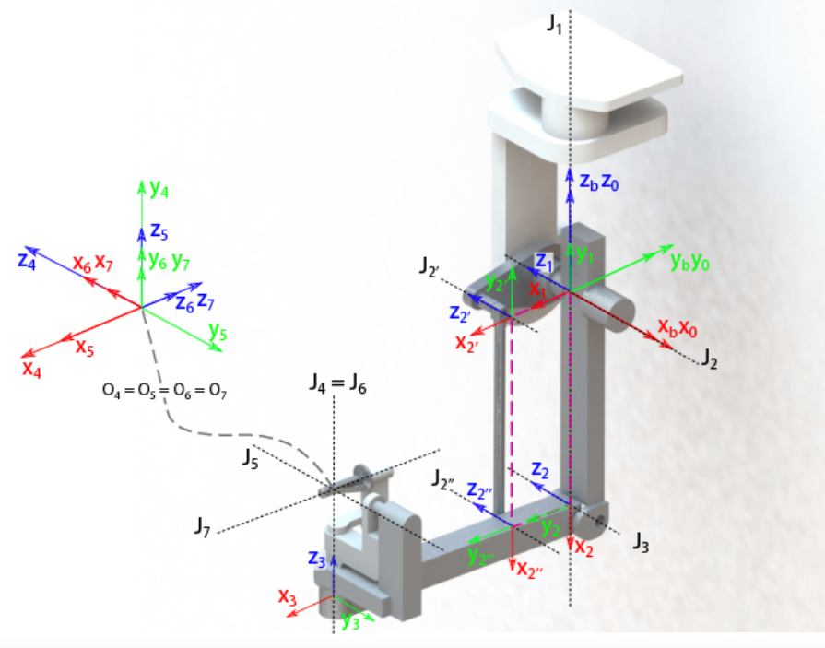
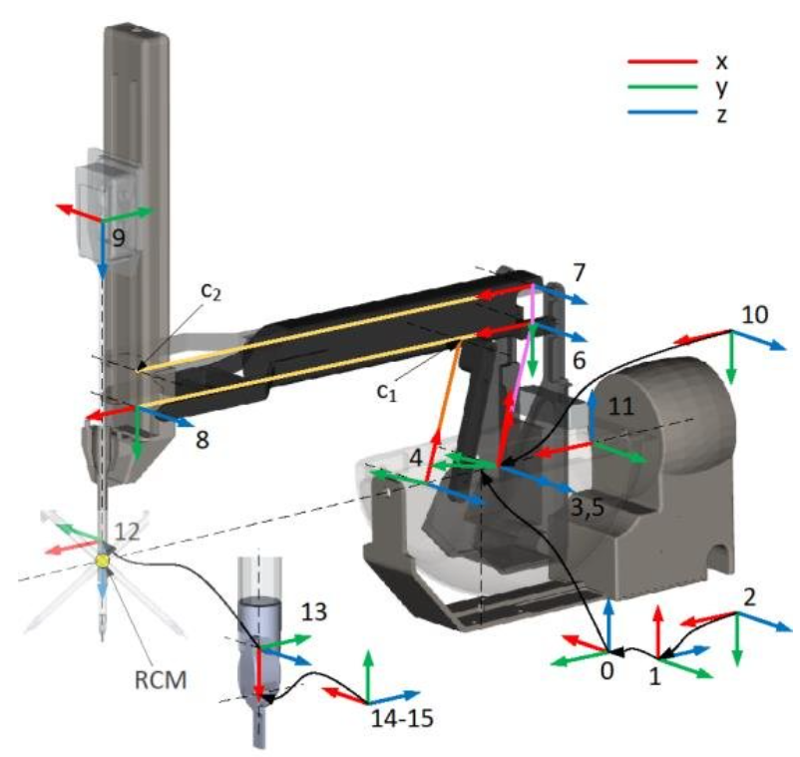
Data description
The data consists of kinematic data (30 Hz), video and manual annotations.
master tool manipulators (MTM)
Patient side manipulator (PSM)

Slide 5
The data represent the kinematics of : right PSM , left PSM, right MTM, left MTM.
Manipulator have 19 kinematics variables.
We get 19*4 = 76 dimensional data vector every timestamp.

Slide 6
kinematics variables
3 variables x, y, z - Cartesian local frame positions end effector.
9 variables rotation matrix – transfer kinematics variable from local to global frame.
3 variables x’, y’, z’ – Cartesian local frame linear velocities end effector.
3 variables α’ β’ γ’ – Euler angular velocities
1 variable θ - gripper angle

Slide 7
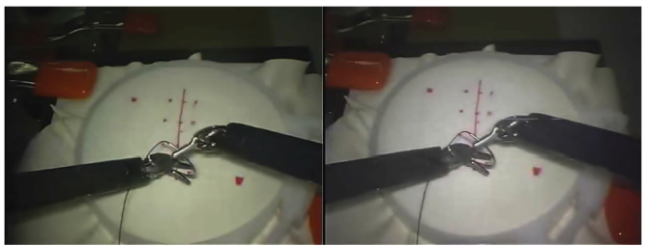
video data
30 Hz and at a resolution of 640 x 480
The video and kinematic data were synchronized such that each video frame corresponds to a kinematic data frame captured at the same instant of time.
Left camera “capture1”
Right camera “capture2”

Slide 8
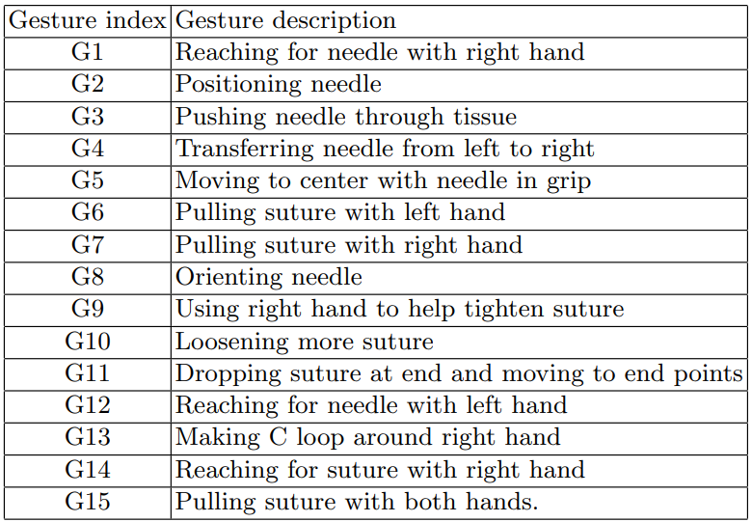
Manually annotation

Slide 9
Each annotation includes the name of the gesture, and the start and end frames in the video. The video frames correspond to the frames in the kinematic data (one-to-one mapping) because we synchronized them using a common global time.

