Slide 1
BGU-PatCut

Slide 2
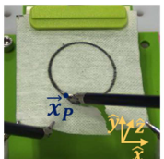
Task repetition
Experiment 1 - Pattern cutting force perturbation
Control group – 15 participants
Experiment group – 15 participants
Each one performed 24 trials
(15+15)*24 = 720 trials, 20 trials were removed – 700 trial.
Experiment 2 - Pattern cutting motion perturbation
Control group – 12 participants
Experiment group – 12 participants
Each one performed 24 trials
(12*12)*24 = 576, 22 trials were removed - 554 trials
experts, non-experts, mix?
Task – pattern cutting

Slide 3
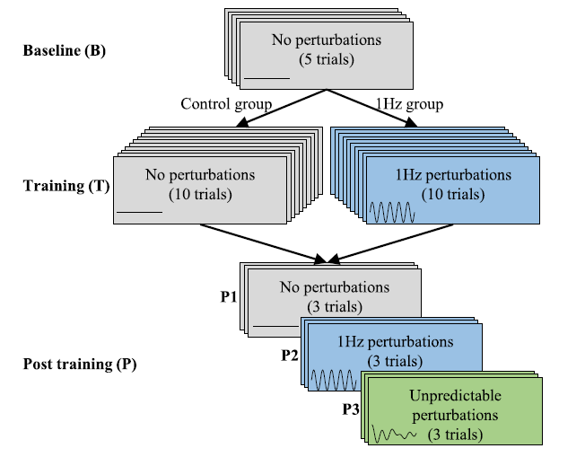
24 trials

Slide 4
Environment
“Phantom” – simulated or artificial environment

Slide 5
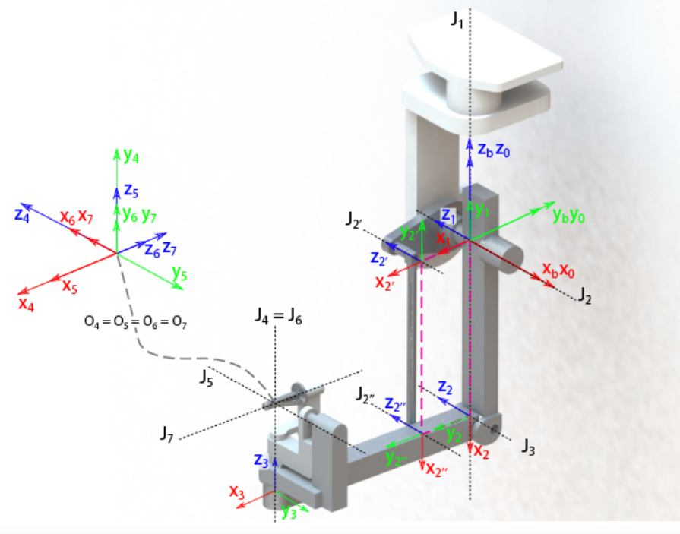
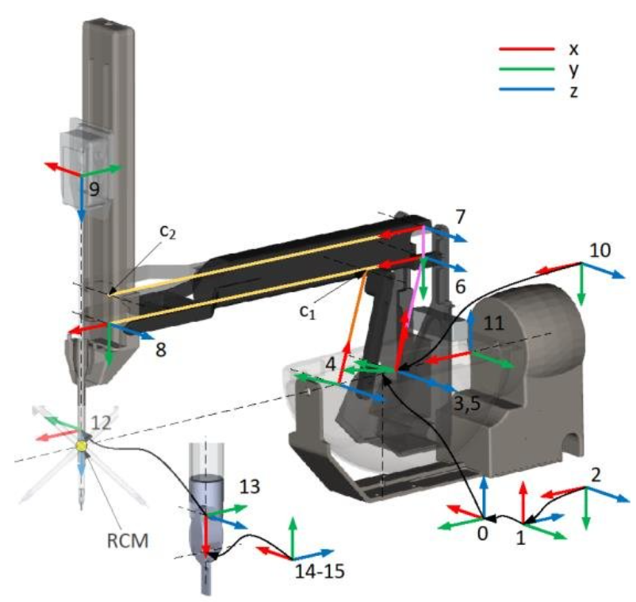
Data description
The data consists of kinematic data (30 Hz), video and manual annotations.
master tool manipulators (MTM)
Patient side manipulator (PSM)

Slide 6
kinematics variables
MTMR, MTML, PSM1 (right tool-curved scissors) and PSM2 (left tool- large needle driver):
Position ((לא צוין מיקום של איזה נקודה בגוף
Orientation
Velocity ((לא צוין מהירות של איזה נקודה בגוף
Wrench (?,בדרך כלל מתאר כוחות ומומנטים שפועלים על גוף)
Gripper (for MTM-right, MTM-left) (?grasping force)
Jaw (for PSM1 and PSM2) (?)

Slide 7
video data
Stereo video , 35 Hz 1080x810
The video and kinematic data were synchronized such that each video frame corresponds to a kinematic data frame captured at the same instant of time.

