Slide 1
Drunk@Home
MS4

Slide 2
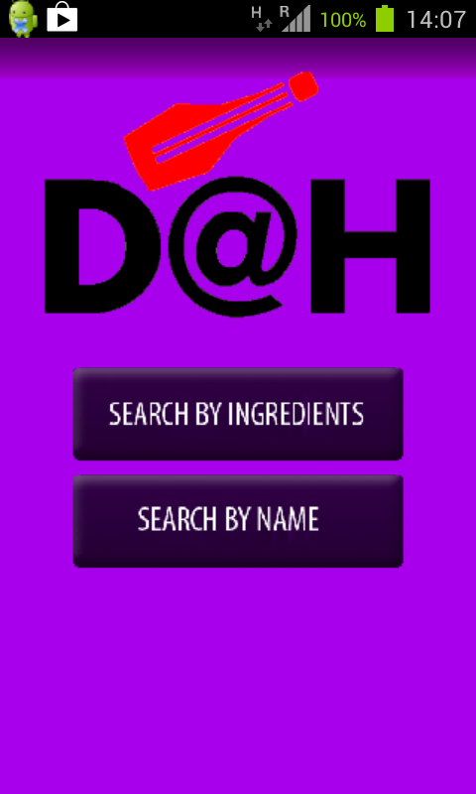
D@H Android App!
The D@H Team proudly
presents an exclusive Android
App!
Just Install the .apk
Available on the Github page
And Have Fun!

Slide 3
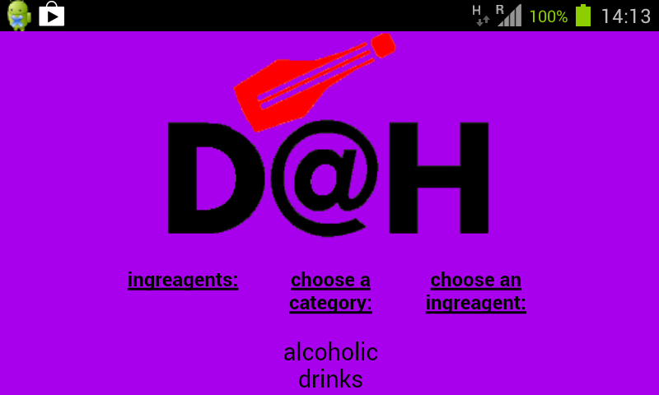
Android App Cont.
The Android app features the same (but redesigned for Android!) Search By Ingredients Feature!

Slide 4
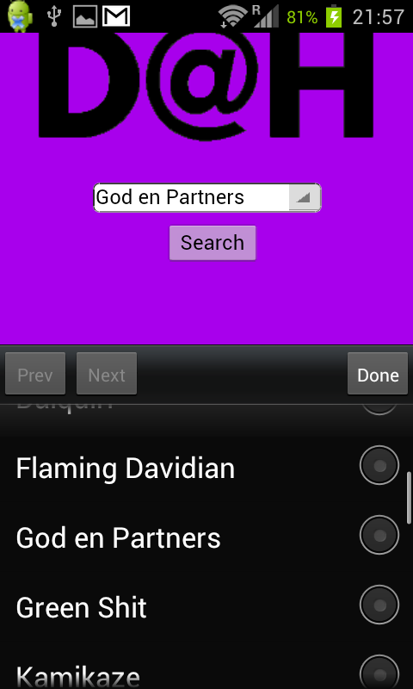
Android App Cont.
The Android App also Features
a Search By Name Feature
(although with no auto-complete…)
We turned it to “Search By
List” Feature that is available
Only for our exclusive android users!

Slide 5
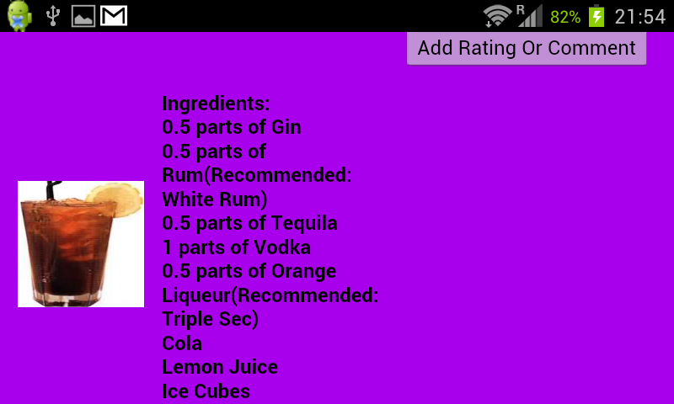
Android App Cont.
Enjoy!

Slide 6
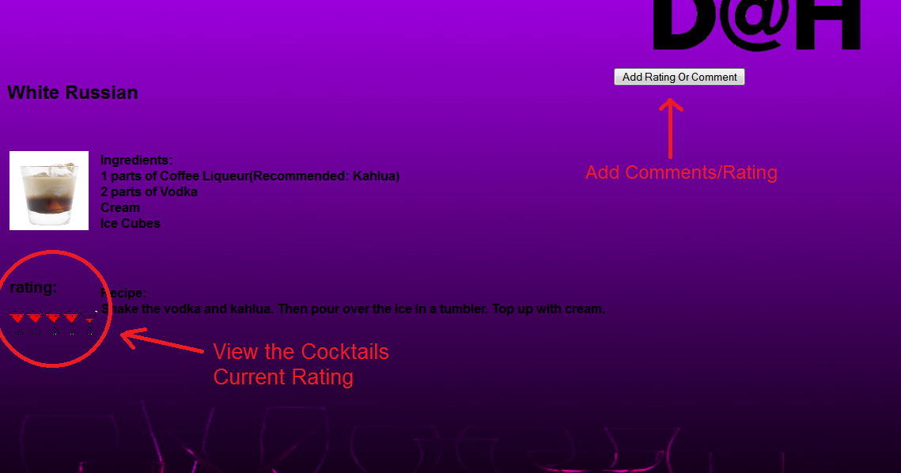
D@H Rating/Commenting System
D@H is Proud To present a Rating/Commenting System to our Cocktails!

Slide 7
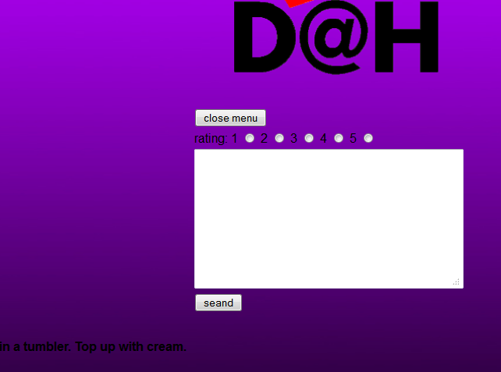
Rating/Commenting Cont.
Click on the “Add Rating or Comment” Button to add your own rating/comment!

Slide 8
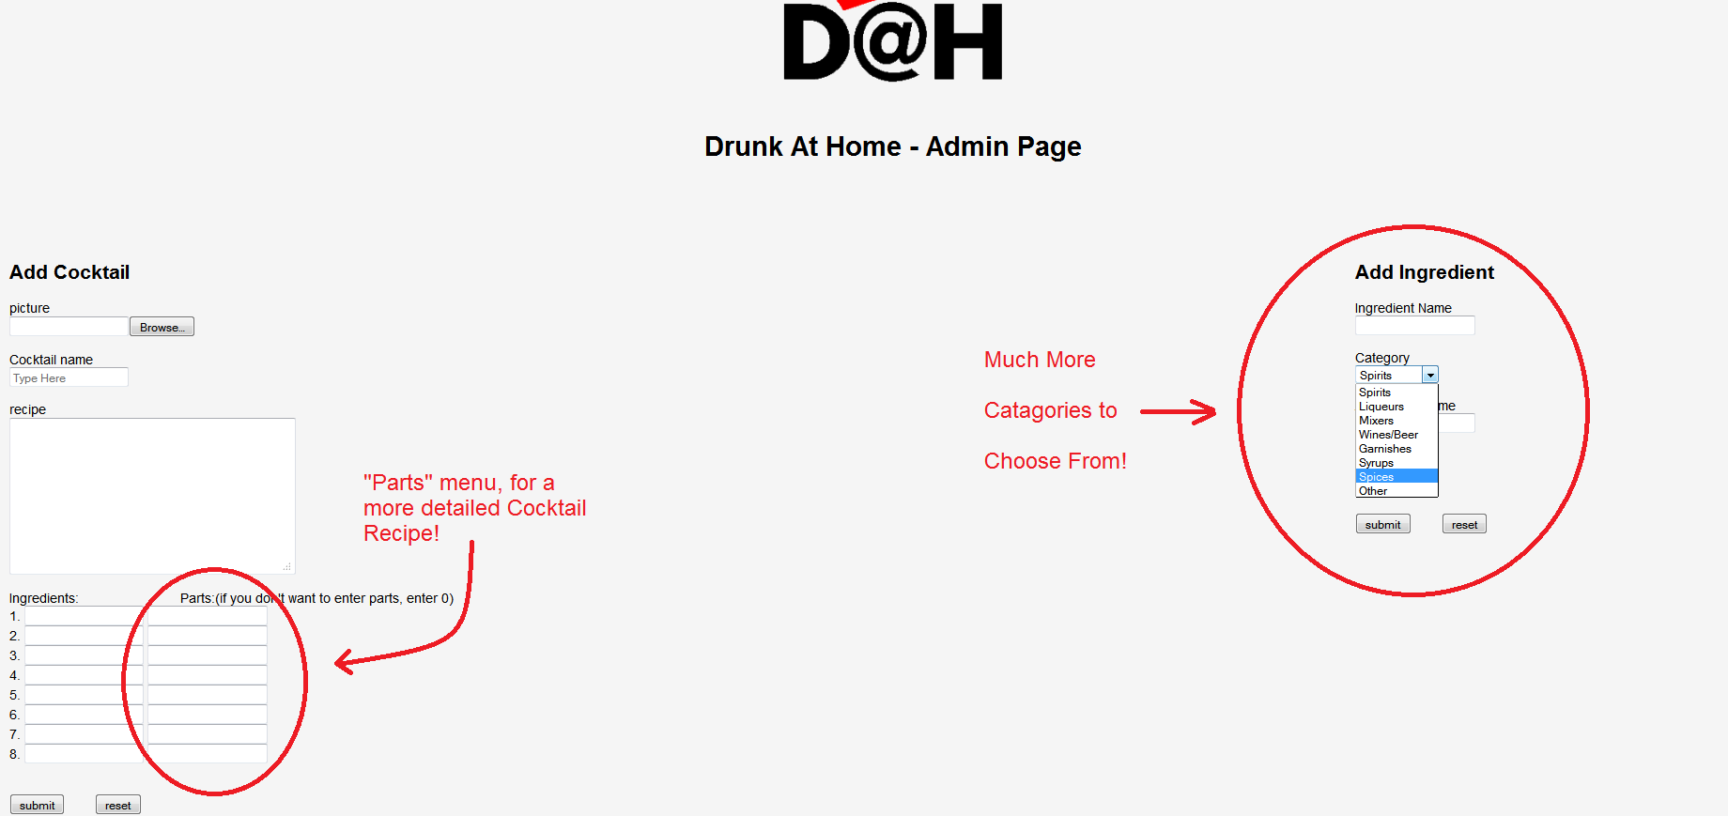
Admin Page Changes
The Admin Page went through an all-around overhaul, and now has exciting new features!

Slide 9
Other Changes
Check Out the “HELP” section on the website!
The DB Now Features REAL Cocktails and Ingredients!
Go and check it out!
HTTP://drunkathome.no-ip.org

