Slide 1
DRUNK@HOME MS3
“Search By Ingredients – MS3”

Slide 2
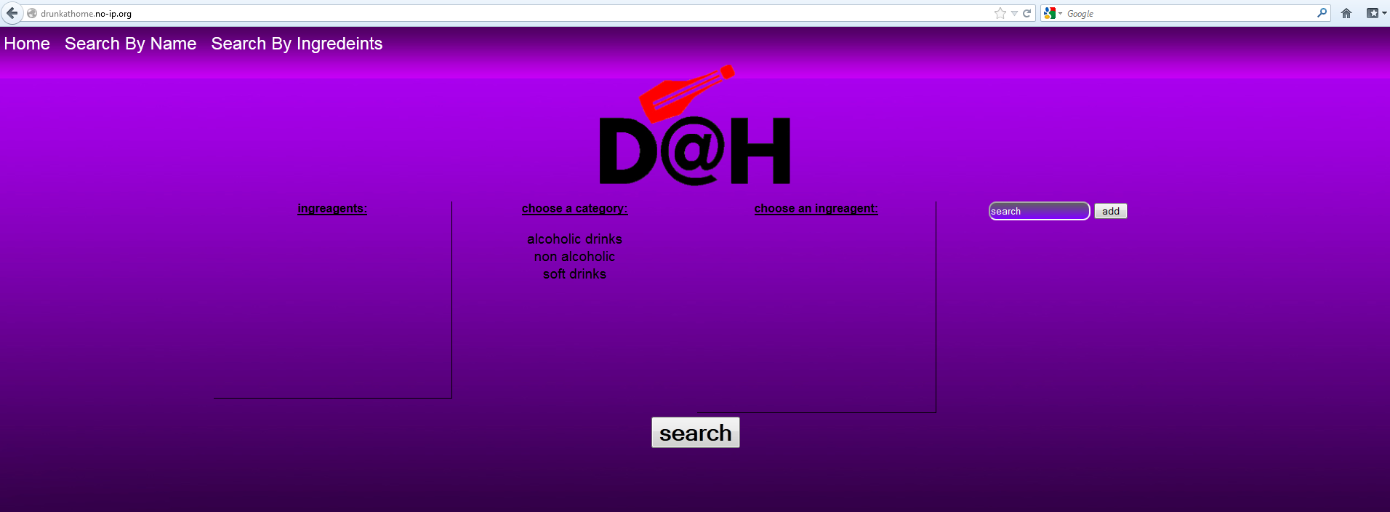
Website UI – Search By Ingredients
It’s DONE!

Slide 3
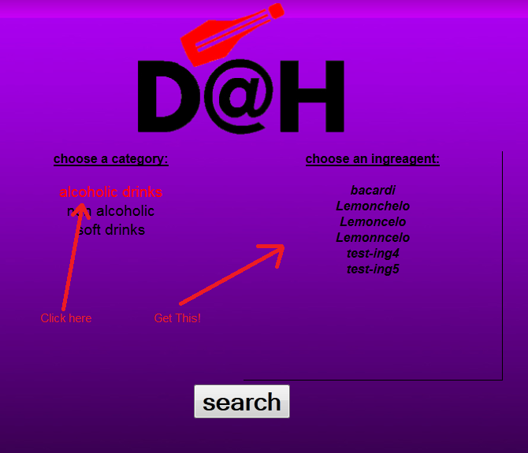
1. Clicking menus
Click on any category to see it’s available ingredients:

Slide 4
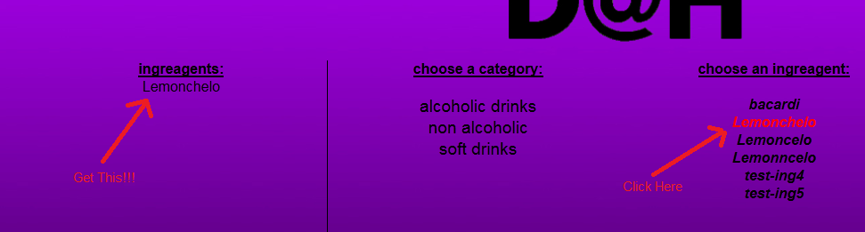
Clicking Menus – Cont.
Click on an ingredient to add it to the Ingredients List:

Slide 5
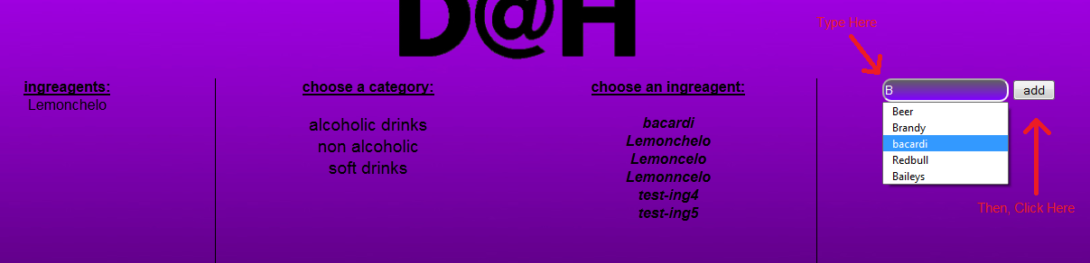
Manual search for Ingredient
Use the search box on the right to search for ingredients manually!

Slide 6
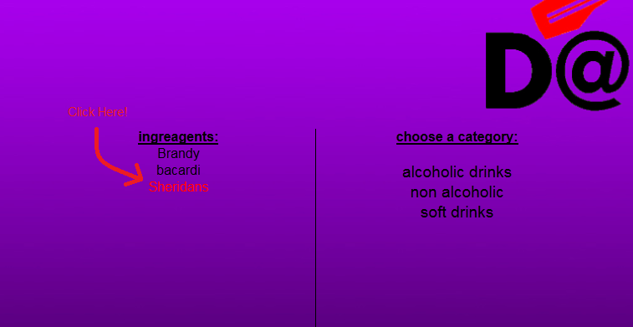
Removing a Selected Ingredient
You can remove a selected ingredient by simply clicking on at the Ingredient’s List!

Slide 7
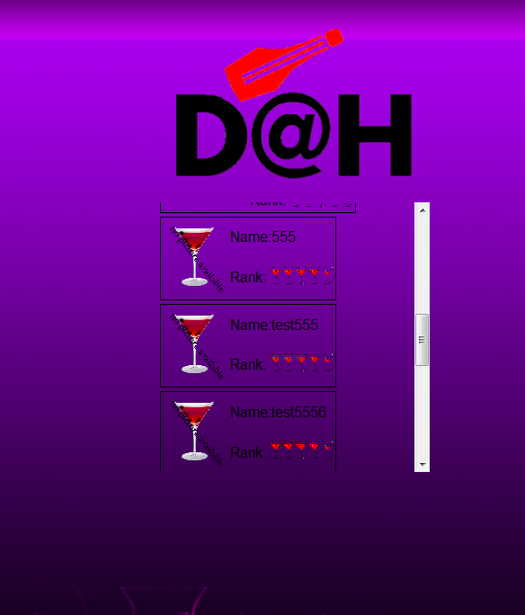
Choose your Cocktail!
After you clicked on the GIANT search button, select your cocktail from the available Cocktail list (results page)

Slide 8
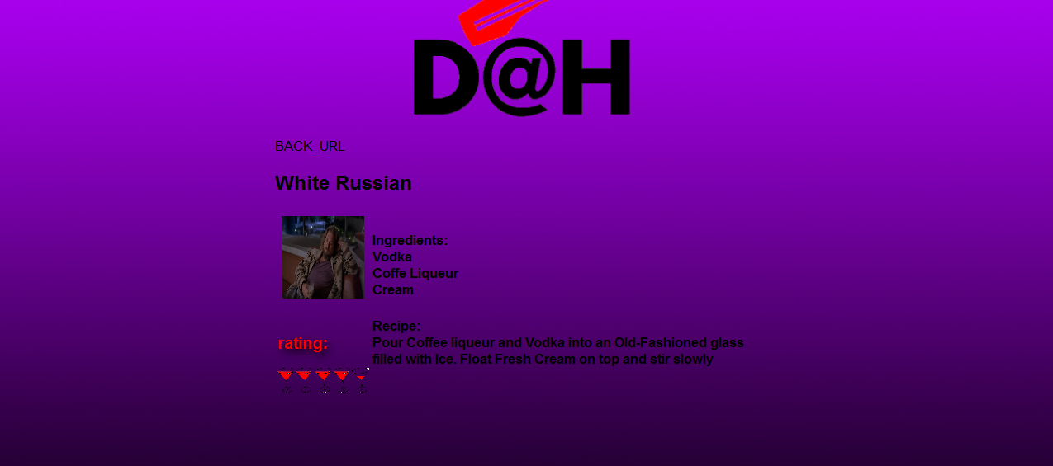
Enjoy!

