Slide 1

Visualization and pattern recognition using a Knowledge graph of API methods
EECS 6414 Team Project
Moshi Wei (presenter)
Nima Shiri harzevili, Isaac Ye

Slide 2
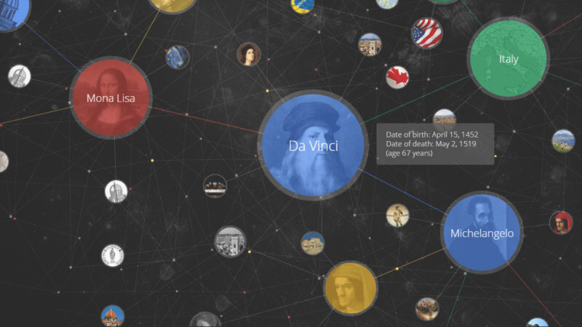

What we propose
Self-explainable and interpretable API recommendation system using Knowledge Graphs that can be applied to API design and architecture design

Slide 3
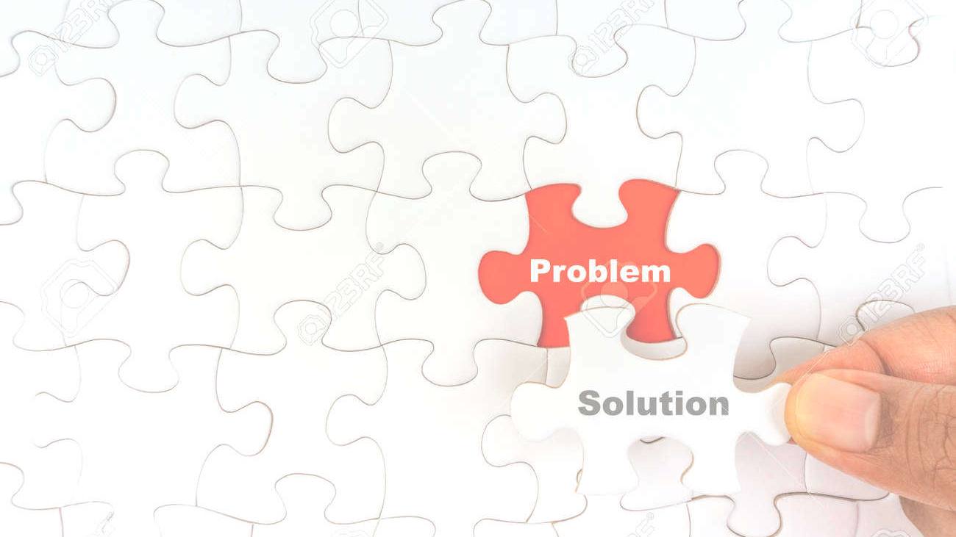
What we solve
What is a systematic way to interpret a KG-based API recommendation system?
What is prediction performance of a KG-based API recommendation system compared to existing ML-based models?
Can we recommend API usage examples beside true APIs using the proposed recommendation engine?

Slide 4
Knowledge Graphs
API
object
['java.util.Optional.ofNullable', 'java.lang.Integer.parseInt']
Q
cast
how do I convert a string to an int in java?
relation
string
Integer
API
convert
['java.lang.Integer.valueOf']
relation
Q
Entity
Entity
how to cast an object to an int

Slide 5
Overall Pipeline
Test data
Data Collection
(JDK website)
Data preprocessing
Data preprocessing
Entity extraction
Relation mapping
KG optimization
Knowledge Graph
API recommendation

Slide 6
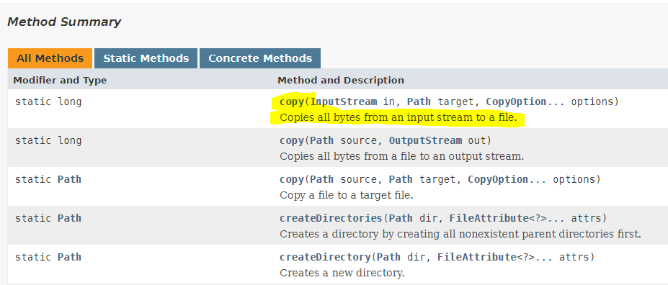
Data set - training
Total number of tokens: 1.39M
Unique tokens: 33K
Entities: 30K
Unique verbs: 1784
Potential verbs: 416

Slide 7
What we answer
What is a systematic way to interpret a KG-based API recommendation system?
What is prediction performance of a KG-based API recommendation system compared to existing ML-based models?
Can we recommend API usage examples beside true APIs using the proposed recommendation engine?
Our system features
• Descriptive statistics • Shortest path among nodes
• Community detection

Slide 8
What we answer
What is a systematic way to interpret a KG-based API recommendation system?
What is prediction performance of a KG-based API recommendation system compared to existing ML-based models?
Can we recommend API usage examples beside true APIs using the proposed recommendation engine?
Our system features
• NLP and similarity ranking

Slide 9
What we answer
What is a systematic way to interpret a KG-based API recommendation system?
What is prediction performance of a KG-based API recommendation system compared to existing ML-based models?
Can we recommend API usage examples beside true APIs using the proposed recommendation engine?
Our system will be extended to suggest
• API’s code snippet in case of developer’s query (future work)

Slide 10
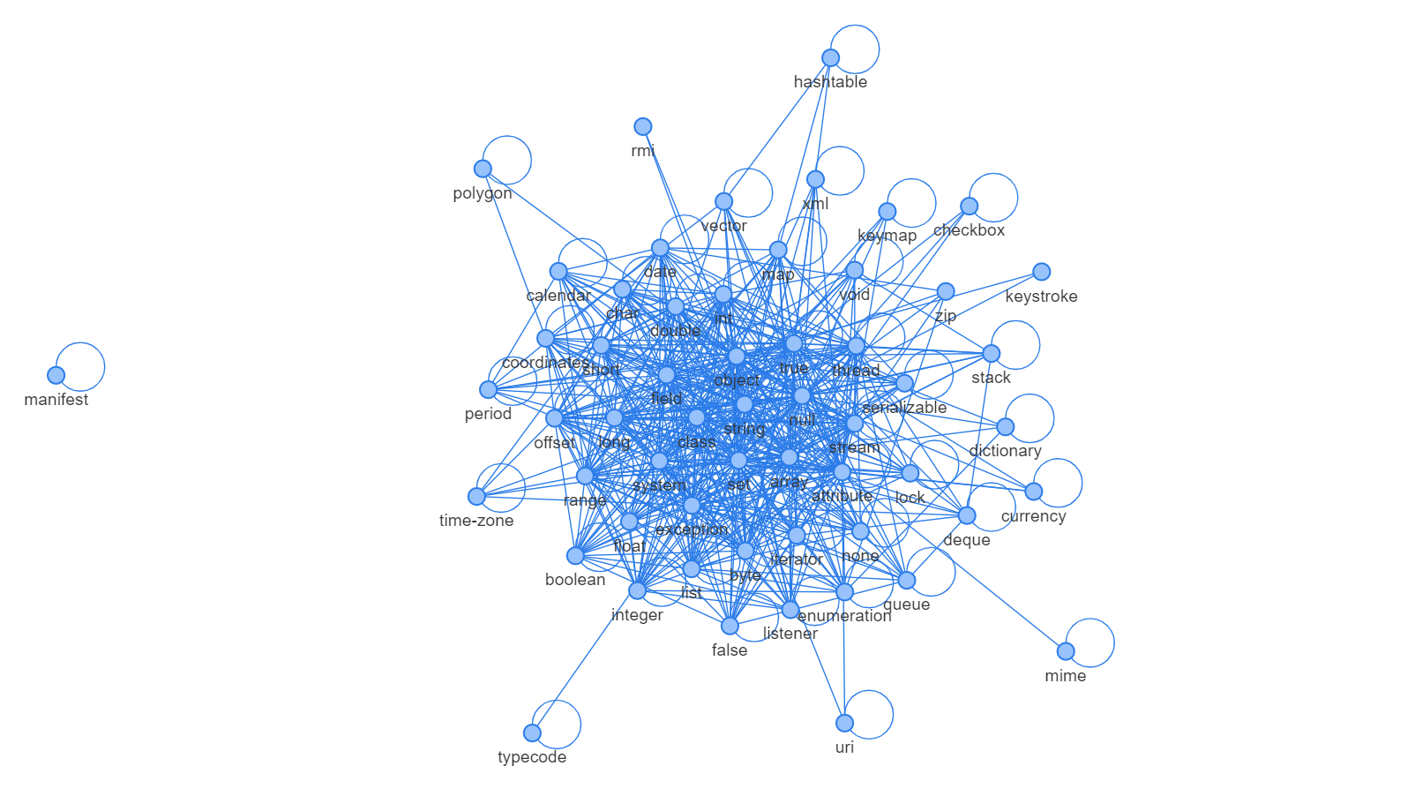
Evaluation and preliminary results 1
Top 10 nodes
Set: 47
True:46
Object: 45
Null: 43
Array: 42
String: 41
System: 38
Exception: 37
Class: 36
Field: 35
58 nodes
571 edges
19.68 avg. degree
Knowledge graph
Constructed Knowledge Graph on top of documents extracted from JAVA docs

Slide 11
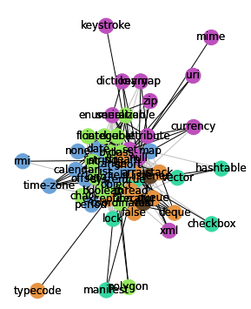
Evaluation and preliminary results 2
Community 0
[’field’, ’period’, ’none’, ’rmi’, ’time-zone’, ’short’, ’calendar’, ’range’, ’string’, ’map’, ’offset’, ’system’, ’list’, ’date’]
Community 1
[’coordinates’, ’object’, ’integer’, ’int’, ’double’, ’float’, ’boolean’, ’polygon’, ’class’, ’long’, ’char’, ’serializable’, ’byte’]
Community 2
[’set’, ’null’, ’zip’, ’xml’, ’keymap’, ’uri’, ’at- tribute’, ’enumeration’, ’mime’, ’currency’, ’keystroke’, ’dic- tionary’]
Community 3
[’stack’,’iterator’,’queue’,’typecode’,’stream’, ’false’, ’deque’, ’exception’, ’thread’, ’array’]
Community 4
[’true’,’lock’,’checkbox’,’manifest’,’hashtable’, ’vector’]
Community detection

Slide 12
Evaluation and preliminary results 3
Community 0
[’field’, ’period’, ’none’, ’rmi’, ’time-zone’, ’short’, ’calendar’, ’range’, ’string’, ’map’, ’offset’, ’system’, ’list’, ’date’]
Community 1
[’coordinates’, ’object’, ’integer’, ’int’, ’double’, ’float’, ’boolean’, ’polygon’, ’class’, ’long’, ’char’, ’serializable’, ’byte’]
Community 2
[’set’, ’null’, ’zip’, ’xml’, ’keymap’, ’uri’, ’at- tribute’, ’enumeration’, ’mime’, ’currency’, ’keystroke’, ’dic- tionary’]
Community 3
[’stack’,’iterator’,’queue’,’typecode’,’stream’, ’false’, ’deque’, ’exception’, ’thread’, ’array’]
Community 4
[’true’,’lock’,’checkbox’,’manifest’,’hashtable’, ’vector’]
Entity | Eigenvector Centrality
Object | 0.228951
Class | 0.203172
Byte | 0.181269
Long | 0.164466
Int | 0.161041
Eigenvector centrality for nodes

Slide 13
Conclusion and future work
A Knowledge graph for API method recommendation using entity extraction and action token extraction
A preliminary network graph with 63 nodes and 400+ edges
Things done
Things to be done
Another source of data such as GitHub to increase generalizability
Inference of KG to address the research questions.

